Slide 1
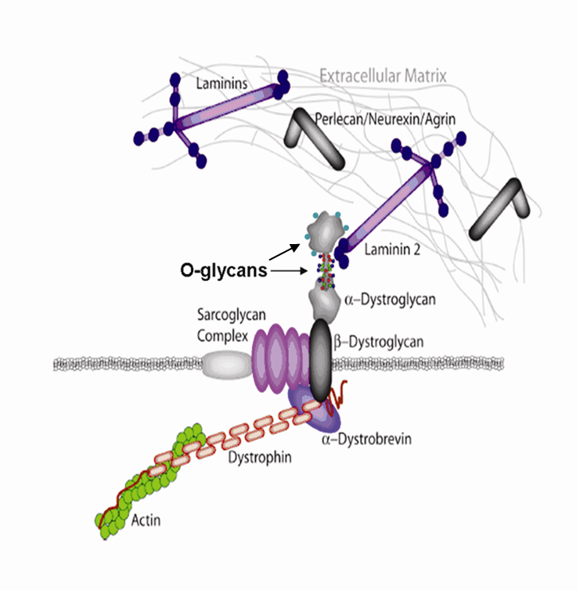
Conformation and Dynamics in Protein O-Glycosylation
Andrew Borgert², Lachele Foley¹, and David Live¹*
¹Complex Carbohydrate Research Center, Athens GA, Department of Medical Research,
²Gundersen Lutheran Medical Foundation, La Crosse, WI
extracellular matrix
Introduction
Post-translational glycosylation of proteins is a prevalent phenomenon (~50% of proteins)
The two major categories are O-linked and N-linked glycosylation. N-linked glycosy-lation occurs on an asparagine residue in a defined sequon (NXS/T), with the protein proximal sugar residues constant, while O-linked, most commonly on modified S and T residues, is more diverse with regard to sequence variation at loci of modification, sometimes exhibiting clustering of these sites. The initiating sugar residue varies among glycans of this type. Thus the variations in O-linked glycosylation can result in differential conformational influences on the underlying protein scaffold.
cell membrane
Since glycosylation is not a template driven process, for a particular glycoprotein there is a degree of intrinsic inhomogeneity in its glycosylation, making studies of naturally occurring challenging, compounded by molecular size. This has been resolved by synthesizing appropriate model glycopeptides derived from an α-DG sequence, PPTTTTKKP, with either O-GalNAc or O-Man modifications, which were used in NMR studies, extended with MD simulations, to study differential conformational influences.
The glycoprotein α-dystroglycan (α-DG) provides a motivation for studying the differential structural and functional effects of O-glycans originating with either N-acetyl-galactosamine (GalNAc) or mannose (Man) residues, since both glycan types have been identified on it. α-DG is a component of the dystrophin glycoprotein complex, where α-DG is the extracellular part of a transmembrane complex that links the cytoskeleton to components of the extracellular matrix (ECM) such as laminin. In muscle it serves as the primary conduit of force transmission to the muscle cells. A subset of the O-Man glycans at the N-terminus of the fully mature glycoprotein carry the glycan epitope which interacts with the ECM. The O-GalNAc glycans are mapped to a region further from the N-terminus. EM images of α-DG suggest two globular ends with a more extended central region. With one possible interpretation being that the extended segment is populated by O-GalNAc glycans. Our goal was to investigate the relationship between glycosylation and structural and functional features of α-DG.
Animation of a
Glycosylated
AA
Slide 1

Slide 2
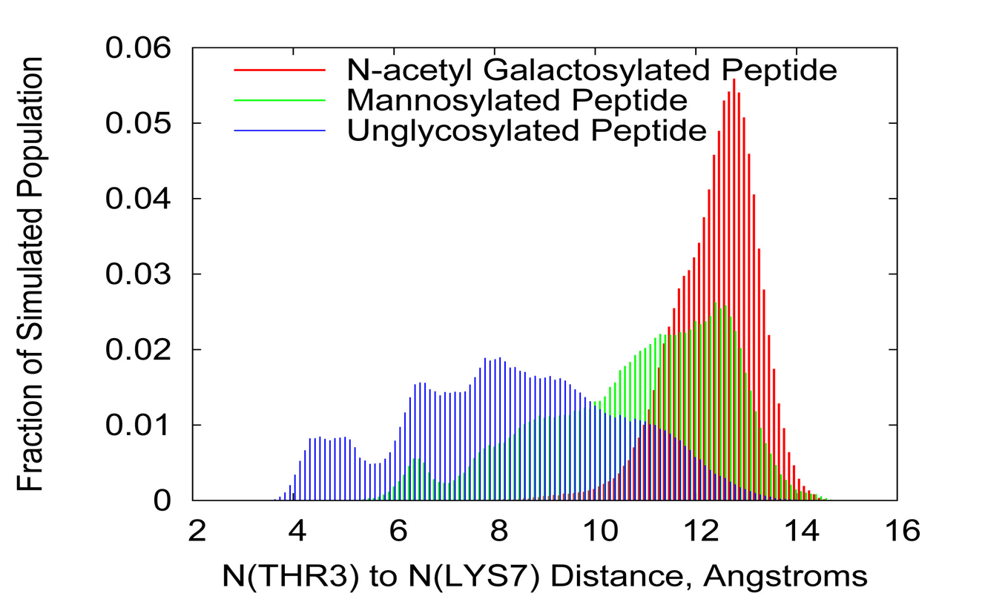
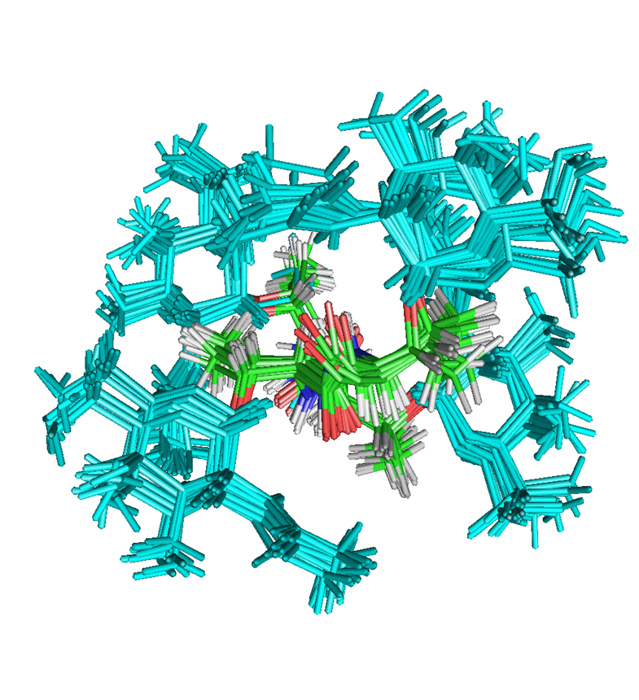
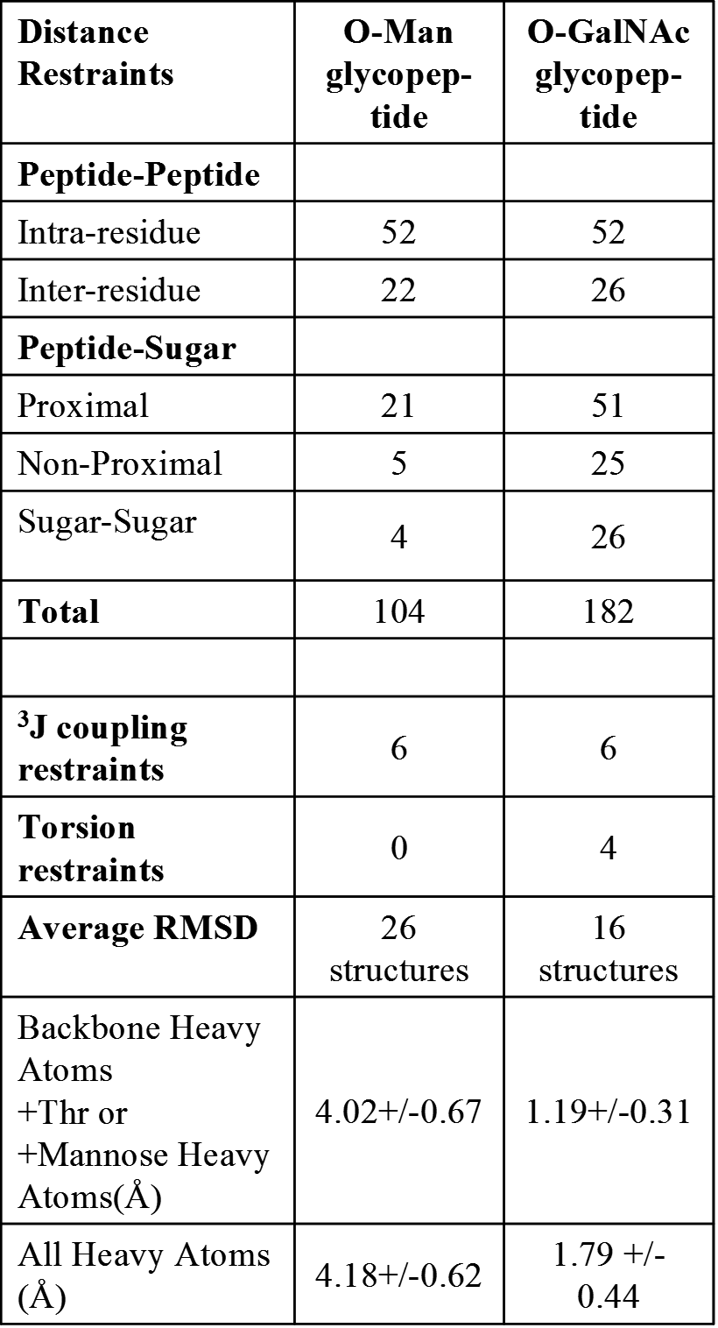
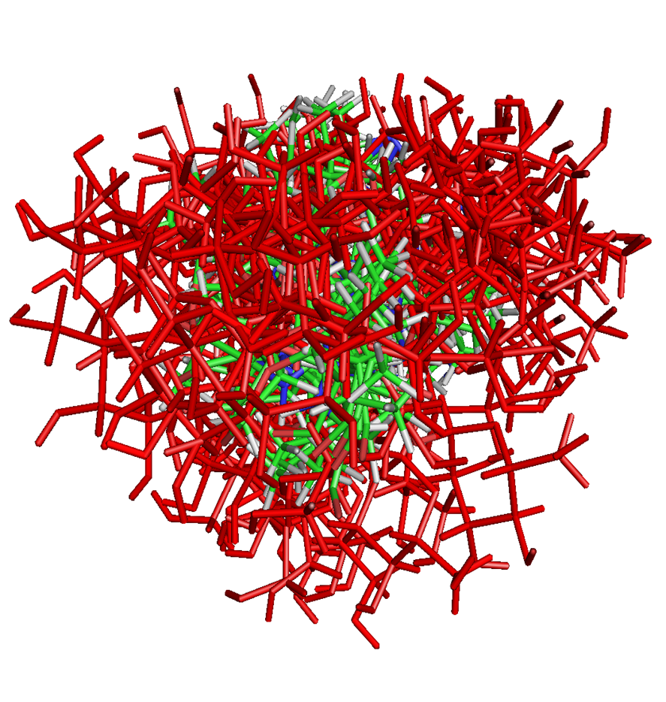
NMR constraint derived structures of the TTTT core region of the 16 best structures of the GalNAc modified (A) and mannose modified (B) constructs (fig 1) were calculated using the constraints. An experimental test of whether the more diffuse O-Man conjugate was due to fewer constraints, were RDCs for both glycopeptides and subsequently adding them to the refinement protocol. In the case of the GalNAc modified glycopeptide, this improved the quality of the structure, where for the O-Man modified it got worse. This supports the interpretation of intrinsically greater disorder for the O-Man modified construct.
To further validate the interpretation we turned to unrestrained molecular dynamics simulations, starting from each of the NMR structures of both constructs and the unmodified peptide.
Insert
Animations of MD
For 2 glycopeptide and peptide
In this space
They may not use the full width
Fig. 1. NMR structures of the
Glycosylated core viewed
Down the peptide backbone
Table 1
A
200 snapshots along one of the 100 ns MD trajectories for each of the constructs are shown in the animation. Differential dynamics among the three structures are evident, with the GalNAc modified glycopeptide being the most well defined. The results of the N-N distance across the glycopeptide core for all trajectories are summarized in the histogram, and, as well, in a plot of the RMS fluctuations along the trajectories from each starting structure. MD simulations were done under water solvated conditions with TIP3P water in cubes with periodic boundary conditions with AMBER ff12SB for the peptide, GLYCAM_06h-1 for the monosaccharides and GLYCAM-06-12SB GLYCAM_06h-12SB amino acid atom types.
B
Slide 2

Slide 3
MD of T-GalNAc
MD of T-Man
T3-GalNAc and water
Length vs angle
Plot for H-bond for T3
The MD additionally allowed further analysis of the hydrogen bonding-like interaction between the N-acetyl NH on the sugar (Ng) and the peptide backbone oxygen (Ob), suggested here and in other GalNAc modified structures we have studied(1,2). Contour plots of the angle and distance between heavy atoms show that most points along the trajectory fall in region 2, that while a bit outside the canonical hydrogen bond parameters, should still contribute to structural stabilization. The water participation appears to be some association between the O from water and the NH protons of both GalNAc and the backbone.
The local dynamics of a GalNAc-T and Man-T residue
Are illustrated …
Conclusions
•The NMR structures show a descending degree of order among the GalNAc and Man glycopeptides and the unmodified peptide.
•Unrestrained molecular dynamics simulations were run starting from the NMR structures that support the conclusion that the GalNAc glycopeptide is more extended and its conformational space the most limited, followed by the O-Man glycopeptide and the unmodified peptide.
•MD also provides further insights into GalNAc glycopeptide intramolecular hydrogen bonding and solvation.
•The comparison of the two glycopeptide constructs results confirm the unique impact of the α-GalNAc modification on glycoprotein structure.
•With regard to alpha-DG, the results are consistent with the current thinking that the O-Man glycans are associated with the globular segment at the N-terminus and the O-GalNAc glycans play a role in the more extended following section of alpha-DG.
Refs (1) Coltart, DM et al., J. Amer. Chem. Soc., 124:9833 (2002), (2) Borgert.A et. al. ACS Chem. Biol., 7:1031 (2012) Supportred by NIGMS RO1-111939, P41-103490
Slide 3

