Slide 1
Loan Repayment Predictive Model -
Project 4 Group 3 L.Potter M.Chapman M.Siad P.Bhardwaj

Slide 2
Contents
Project Objective
How to Install and Run Project
Implementation of Predictive Model
Model Notebook
Tableau Data Visualizations
Model Results and Recommendations

Slide 3
Project Objective

Slide 4





How to Install and Run Project
To run this code, you need to have the following libraries installed:
```bash
pip install pandas - numpy - matplotlib - seaborn - scikit-learn
- **pandas**: Data manipulation and analysis
- **numpy**: Numerical computing.-
- **matplotlib**: Plotting and data visualization.
- **seaborn**: Statistical data visualization.
- **scikit-learn**: Machine learning and data preprocessing

Slide 5
Implementation of Predictive Model

Slide 6
Model

Slide 7
Understanding factors
https://www.kaggle.com/datasets/nurudeenabdulsalaam/prosper-loan-dataset
https://docs.google.com/spreadsheets/d/1gDyi_L4UvIrLTEC6Wri5nbaMmkGmLQBk-Yx3z0XDEtI/edit#gid=0
'Term',
'ProsperRating (numeric)',
'Average Credit Score',
'EmploymentStatus’,
'IsBorrowerHomeowner',
'IncomeRange',
'StatedMonthlyIncome',
'BorrowerRate',
'EmploymentStatusDuration',
'LoanMonthsSinceOrigination',
'LoanOriginalAmount',
'TotalProsperPaymentsBilled',
'OnTimeProsperPayments',
'LP_CustomerPayments',
'MonthlyLoanPayment',
'RevolvingCreditBalance',
'CurrentDelinquencies',
'Recommendations',
'Investors',
'ProsperPrincipalBorrowed',
'ProsperPrincipalOutstanding'.

Slide 8
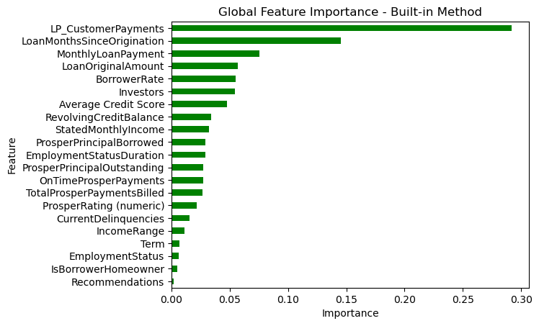
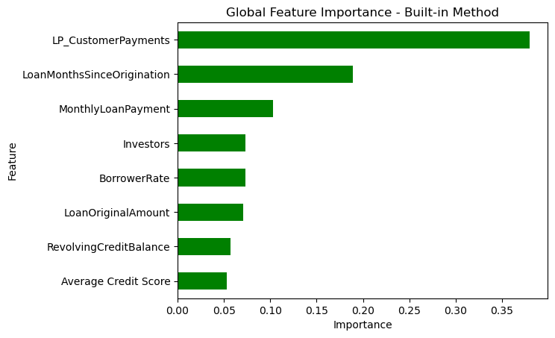
Global Feature Importance

Slide 9

Key ideas of the code
Based on the analysis and visualizations of the dataset, here are the conclusions:

Slide 10
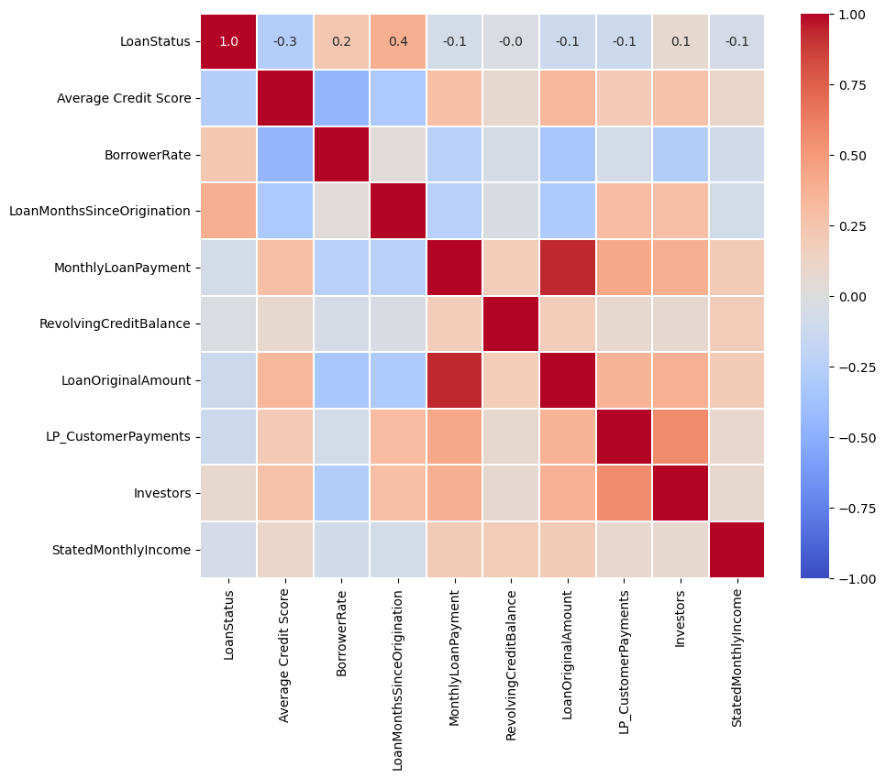
Correlation Heatmap Analysis This correlation heatmap visualizes the relationships between different features in the dataset, highlighting how they are interrelated.
Strong Negative Correlation:
Average Credit Score and BorrowerRate (-0.3): A low credit score is associated with a lower likelihood of a problematic loan status, indicating that credit score is a significant factor in borrower rate performance.
Strong Positive Correlation:
Loan Original Amount and Monthly Loan Payment (0.9): Higher income ranges are moderately associated with stable employment status, suggesting that individuals with higher incomes are more likely to have stable employment.
Notable Relationships:
Investors and LP_CustomerPayments Individuals with a relation score of (0.75)

Slide 11
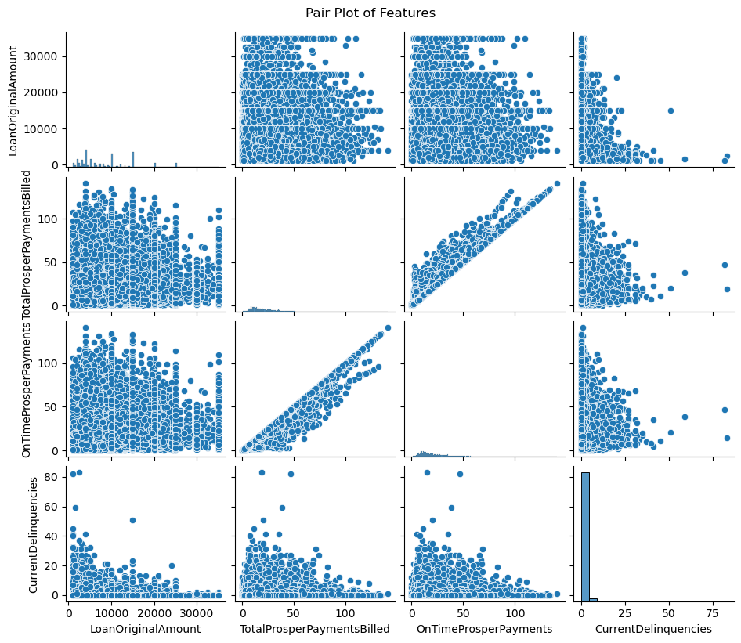
Pair Plot Analysis
Loan Original Amount:
The LoanOriginalAmount shows a dispersed pattern with TotalProsperPaymentsBilled, indicating a variety of loan amounts relative to payments billed.There's a similar dispersed pattern between LoanOriginalAmount and OnTimeProsperPayments.
Prosper Payments:
A strong linear relationship is visible between TotalProsperPaymentsBilled and OnTimeProsperPayments, indicating that most billed payments are on time.These features also show some clustering, indicating certain standard loan practices or amounts.
Current Delinquencies:
CurrentDelinquencies shows a concentration of lower values across all features, suggesting fewer delinquencies overall.There's a visible scatter with LoanOriginalAmount and Prosper Payments, indicating variance in borrower behavior.

Slide 12
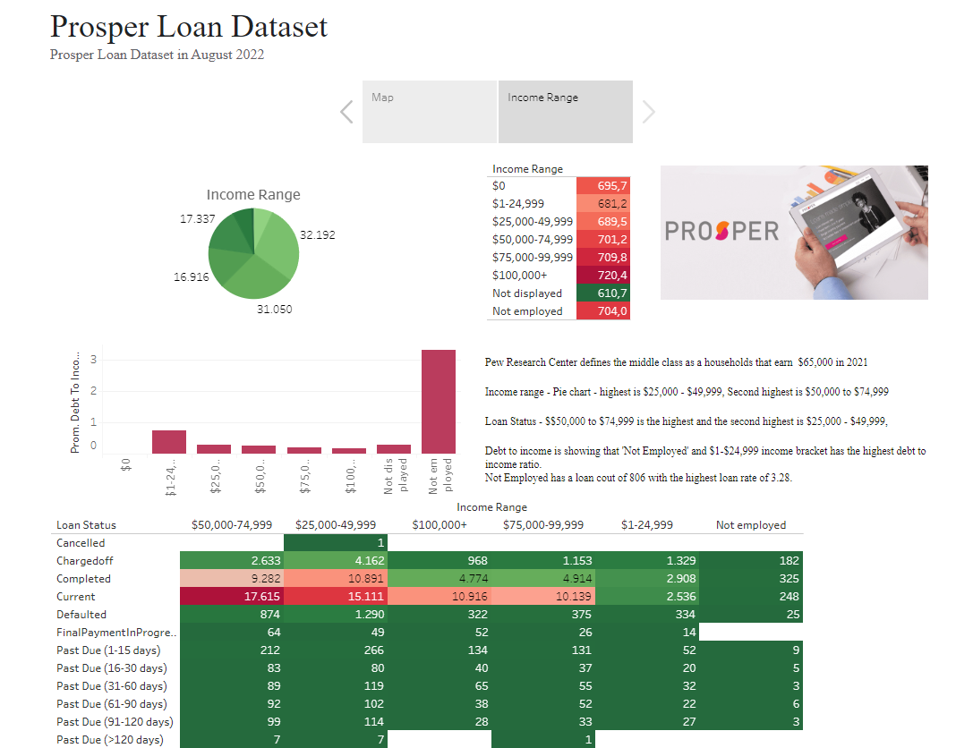
Tableau Data Visualizations
https://public.tableau.com/app/profile/madeleine.chapman/viz/project4_17174152559490/Story1?publish=yes

Slide 13
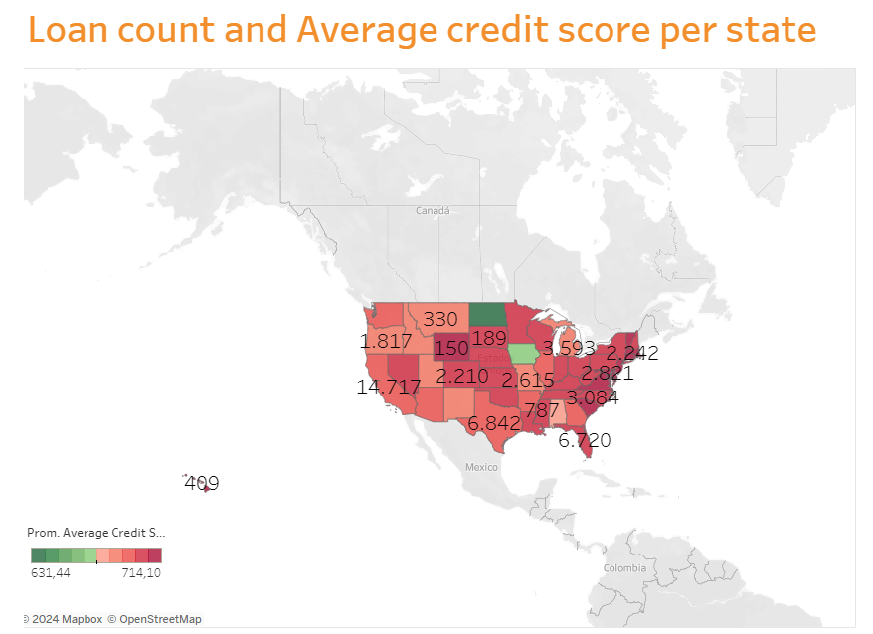
Tableau
Worked out which data was best for Tableau
Found that the State codes were an issue as it wasn’t apart of Tableau mapping.
Fixed the state codes to no longer be abrivations and now actually state names.
Made Borrow state into Latatuide and Longatuide
Created a map that shows Loan count for each state and Average credit rating to give an visual idea on the type of data we were working on
Worked with Tableau graphing to get data relating back to income range, average credit score, Delinquencies, occupation until I was able to create a story base on my graphs.
Create a dashboard for the story using the map and income data.
Analysed the data

Slide 14
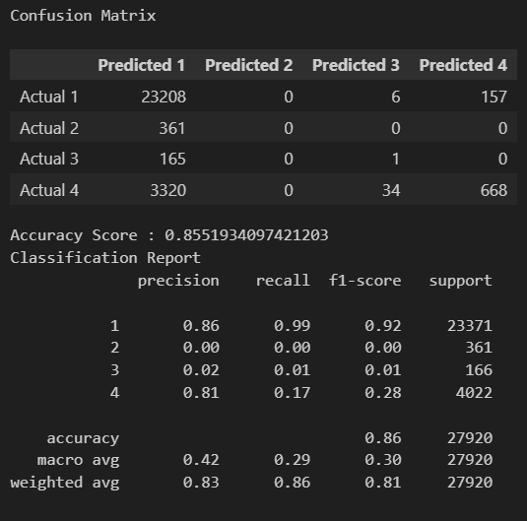
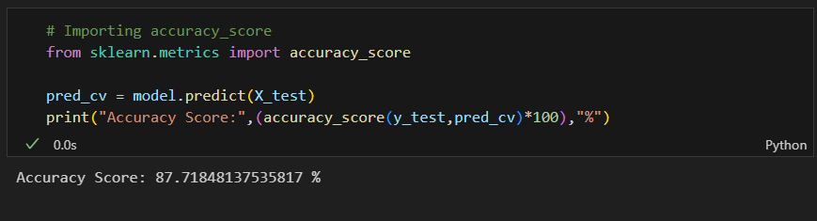
Model Results and Recommendations

Slide 15
THANK YOU!!!

