Slide 1
Loan Repayment Predictive Model -
Project 4 Group 3 L.Potter M.Chapman M.Siad P.Bhardwaj

Slide 2
Contents
Project Objective
How to Install and Run Project
Implementation of Predictive Model
Model Notebook
Tableau Data Visualizations
Model Results and Recommendations

Slide 3
Project Objective
Objective of this project is to predict probability of loan repayment among different customer segments.

Slide 4
Prosper Loan Dataset / Data cleaning
https://www.kaggle.com/datasets/nurudeenabdulsalaam/prosper-loan-dataset
https://docs.google.com/spreadsheets/d/1gDyi_L4UvIrLTEC6Wri5nbaMmkGmLQBk-Yx3z0XDEtI/edit#gid=0

Slide 5





How to Install and Run Project
To run this code, you need to have the following libraries installed:
```bash
pip install pandas - numpy - matplotlib - seaborn - scikit-learn
- **pandas**: Data manipulation and analysis
- **numpy**: Numerical computing.-
- **matplotlib**: Plotting and data visualization.
- **seaborn**: Statistical data visualization.
- **scikit-learn**: Machine learning and data preprocessing

Slide 6
Dataset/Data Model/Steps
Dataset/Data Model/Steps
Find Data/Data Source - Quality, quantity and integrity of Data and Data source.
Data Cleaning - Cleansing and preparing data.
Data Converting – Converting categorical features to numerical values, for scaling
Best fit Algorithm - Find best fit algorithm/Model.
Model Development - Selection of right parameters for analysis.
Model Optimization - Improve the model performance by making adjustments to the parameters.
Model Evaluation - Testing the model on sample for accuracy.
* The project is founded on Prosper Loan Dataset by Nurudeen Abdulsalaam, sourced via Kaggle

Slide 7
Models/Algorithms
Models/Algorithms/Functions used in Exploratory Data Analysis
Logistic Regression:- Logistic Regression naturally outperforms Linear Regression in predicting the probability of loan default since its outcome contains a continuous range of grades between 0 and 1, which represents the likelihood of an event occurring.
Train_test_split:- This function is used to split dataset into two subsets, training set testing set.
RandomForestClassifier :- Random forest classifier is a set of decision trees of random subset of training set. It aggregates the votes from decision trees to decide the final class of the test object.
Random Forest :- Stochastic gradient descent model is an algorithm often used in machine learning to find the model parameters that correspond to the best fit between predicted and actual outputs.
Linear SVM :- Support vector machine (SVM) is a type of supervised learning algorithm used in machine learning to solve classification and regression tasks.

Slide 8
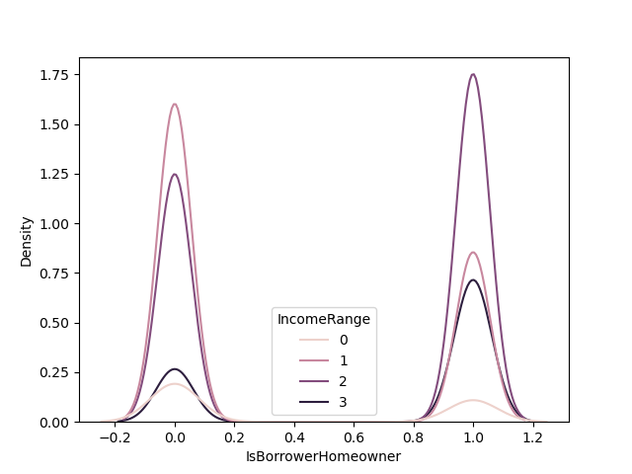
Visualization
Income Distribution:
The graph indicates that a significant portion of non-homeowners fall within the $25,000-$49,999 income range, as shown by the high blue bar on the left side. In contrast, homeowners have a more evenly distributed income range with a notable increase in higher income categories.
Higher Income Range:
Homeowners have a higher proportion of individuals earning $100,000+ (represented by the red bar) compared to non-homeowners. This suggests that higher income is positively correlated with homeownership.
Low and No Income Categories:
Both homeowners and non-homeowners have smaller segments in the low-income ($1-$24,999, represented by pink bars) and no-income (gray bars) categories. However, the proportion is slightly higher among non-homeowners, indicating that lower income levels are more prevalent in this group.

Slide 9
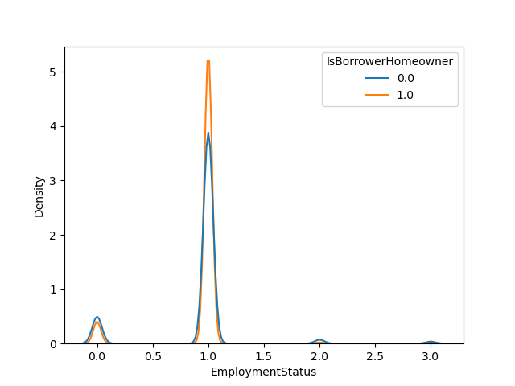
Visualization
Dominance of Employment Status:
The majority of both homeowners and non-homeowners are employed full-time, indicating that full-time employment is prevalent among both groups. This suggests a potential correlation between stable, full-time employment and the ability to own a home.
Distribution of Employment Types:
There is a noticeable difference in the distribution of employment types between homeowners and non-homeowners. For instance, there are more non-homeowners who are employed part-time or not employed compared to homeowners, highlighting how employment status may influence homeownership.

Slide 10
Model

Slide 11
Loan Status
'Completed': "1",
'Current': "1",
'FinalPaymentInProgress': "1",
'Past Due (1-15 days)': "2",
'Past Due (16-30 days)': "2",
'Past Due (31-60 days)': "2",
'Past Due (61-90 days)': "3",
'Past Due (91-120 days)': "3",
'Past Due (>120 days)': "3",
'Chargedoff': "4",
'Defaulted': "4",
'Cancelled': "4",.

Slide 12
Understanding factors
‘Loan Status’
'Term',
'ProsperRating (numeric)',
'Average Credit Score',
'EmploymentStatus’,
'IsBorrowerHomeowner',
'IncomeRange',
'StatedMonthlyIncome',
'BorrowerRate',
'EmploymentStatusDuration',
'LoanMonthsSinceOrigination',
'LoanOriginalAmount',
'TotalProsperPaymentsBilled',
'OnTimeProsperPayments',
'LP_CustomerPayments',
'MonthlyLoanPayment',
'RevolvingCreditBalance',
'CurrentDelinquencies',
'Recommendations',
'Investors',
'ProsperPrincipalBorrowed',
'ProsperPrincipalOutstanding'.

Slide 13
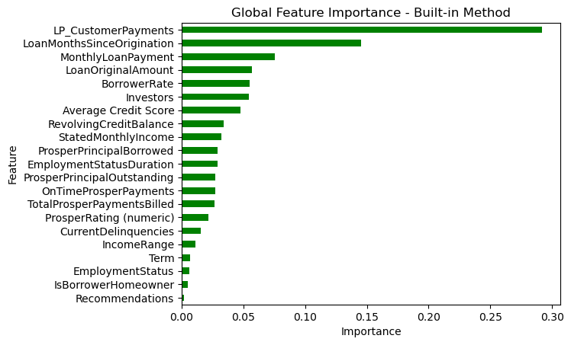
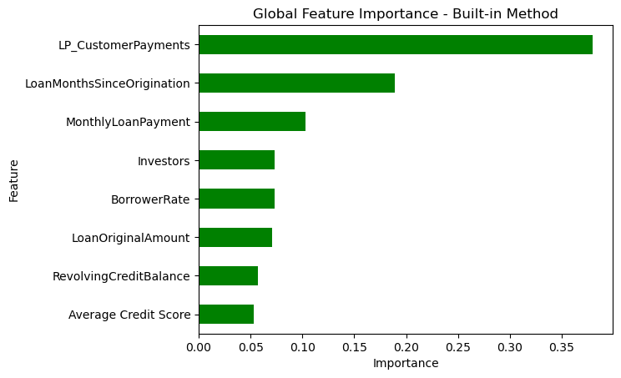
Global Feature Importance

Slide 14
Understanding factors
Several factors can impact whether a loan is paid off or not. These factors include both personal financial circumstances and broader economic conditions. Here are some key elements:
- Personal Financial Circumstances
- Loan-Specific Factors
- Economic Conditions
- External Factors

Slide 15

Personal Financial Circumstances
Income Stability and Level
Debt-to-Income Ratio
Credit History and Score
Savings and Emergency Funds
Financial Literacy

Slide 16
Loan-Specific Factors
Interest Rates
Loan Term and Repayment Schedule
Type of Loan
Fees and Penalties

Slide 17

Economic Conditions
Employment Rates
Inflation
Interest Rate Environment
Housing Market Conditions
Government Policies

Slide 18
External Factors
Global Economic Trends
Natural Disasters and Pandemics

Slide 19

Key ideas of the code
Based on the analysis and visualizations of the dataset, here are the conclusions:

Slide 20
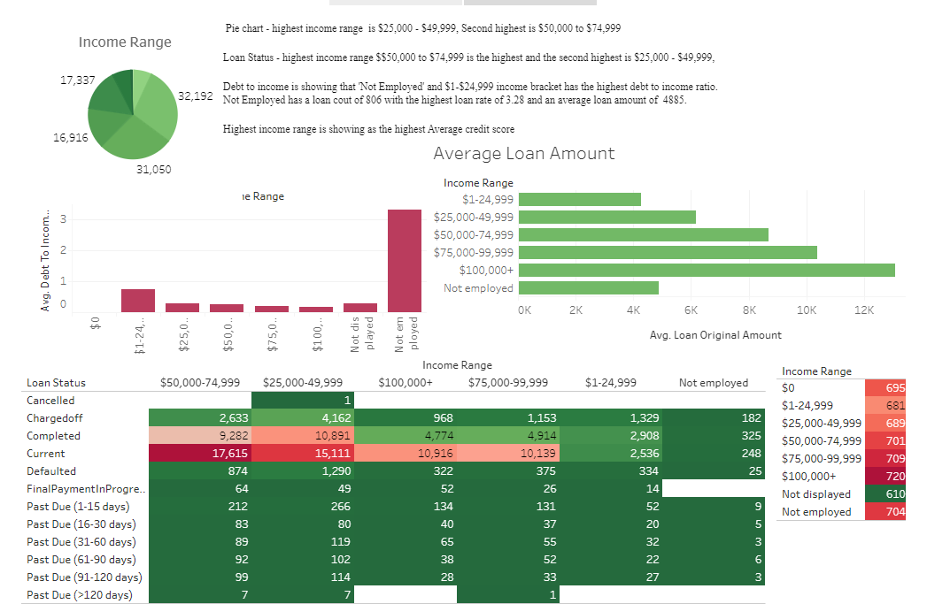
Tableau Data Visualizations
https://public.tableau.com/app/profile/madeleine.chapman/viz/project4_17174152559490/Story1?publish=yes

Slide 21
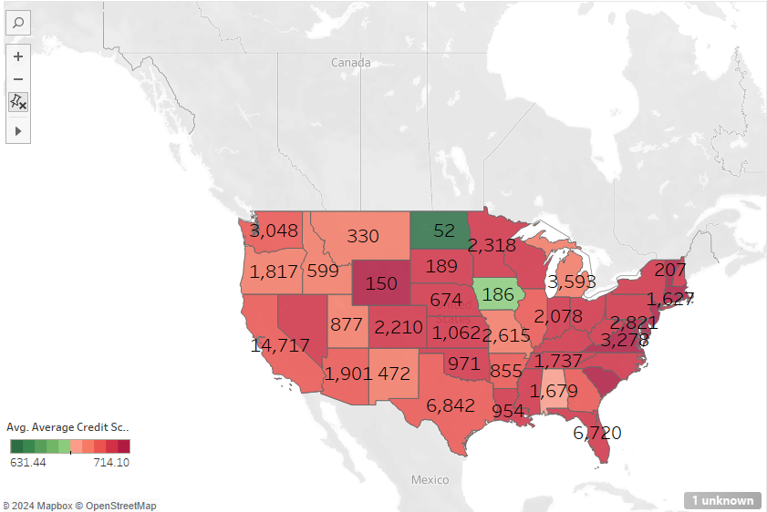
Tableau
Worked out which data was best for Tableau
Found that the State codes were an issue as it wasn’t apart of Tableau mapping.
Fixed the state codes to no longer be abrivations and now actually state names.
Made Borrow state into Latatuide and Longatuide
Created a map that shows Loan count for each state and Average credit rating to give an visual idea on the type of data we were working on
Worked with Tableau graphing to get data relating back to income range, average credit score, Delinquencies, occupation until I was able to create a story base on my graphs.
Create a dashboard for the story using the map and income data.
Analysed the data

Slide 22
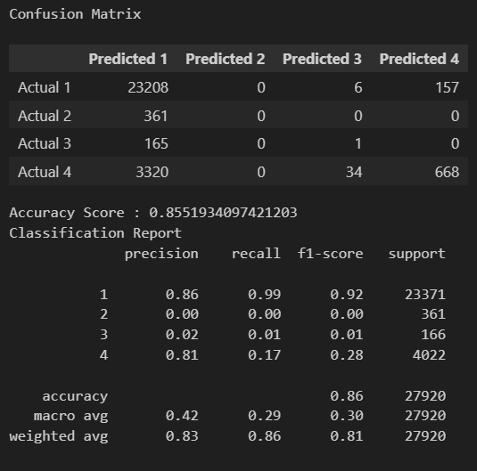
Model Results and Recommendations
Rf_model = Accuracy Score: 87.71 %
LogisticRegression = Accuracy Score: 83.74 %
SGDClassifier = Accuracy Score: 85.54 %
confusion_matrix = Accuracy Score : 85.51 %

Slide 23
THANK YOU!!!

