Slide 1
CORS ADVISOR
GROUP SAM
Jonathan & Lacie

Slide 2
The Features Promised
To organize and display all the past year bidding records in a table
To show the past year bidding records as a trend graph
To offer advice on the amount of bidding points to place to the user.

Slide 3
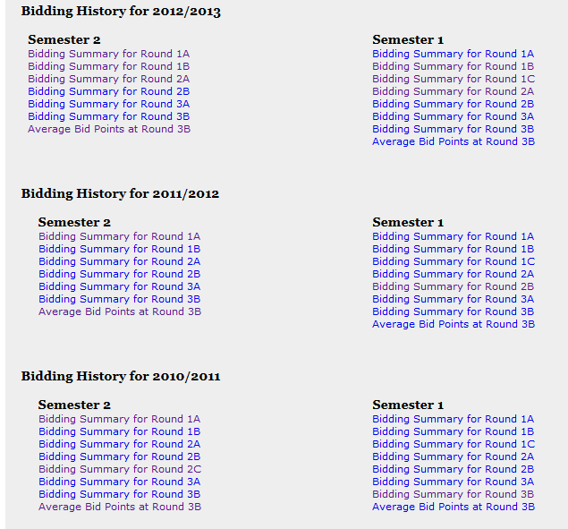
Extracting Data from CORS
Build a Python Webcrawler
BeautifulSoup

Slide 4
Storing Data from CORS
Use of ReferenceProperty
One Module object and several BidInfo object
Module
BidInfo1
BidInfo2
BidInfo3

Slide 5

Storing Data from CORS
Objects stored into local server
Deploy the application
Upload data into google app engine

