Slide 1

Phishing
Nicholas D'Urso, 4Cinf

Slide 2

1 - what's phishing?
2 - how phishing really works?
3 - how do criminals use phishing?
4 - example of a phishing attack
5 - how to get scammers away from you

Slide 3

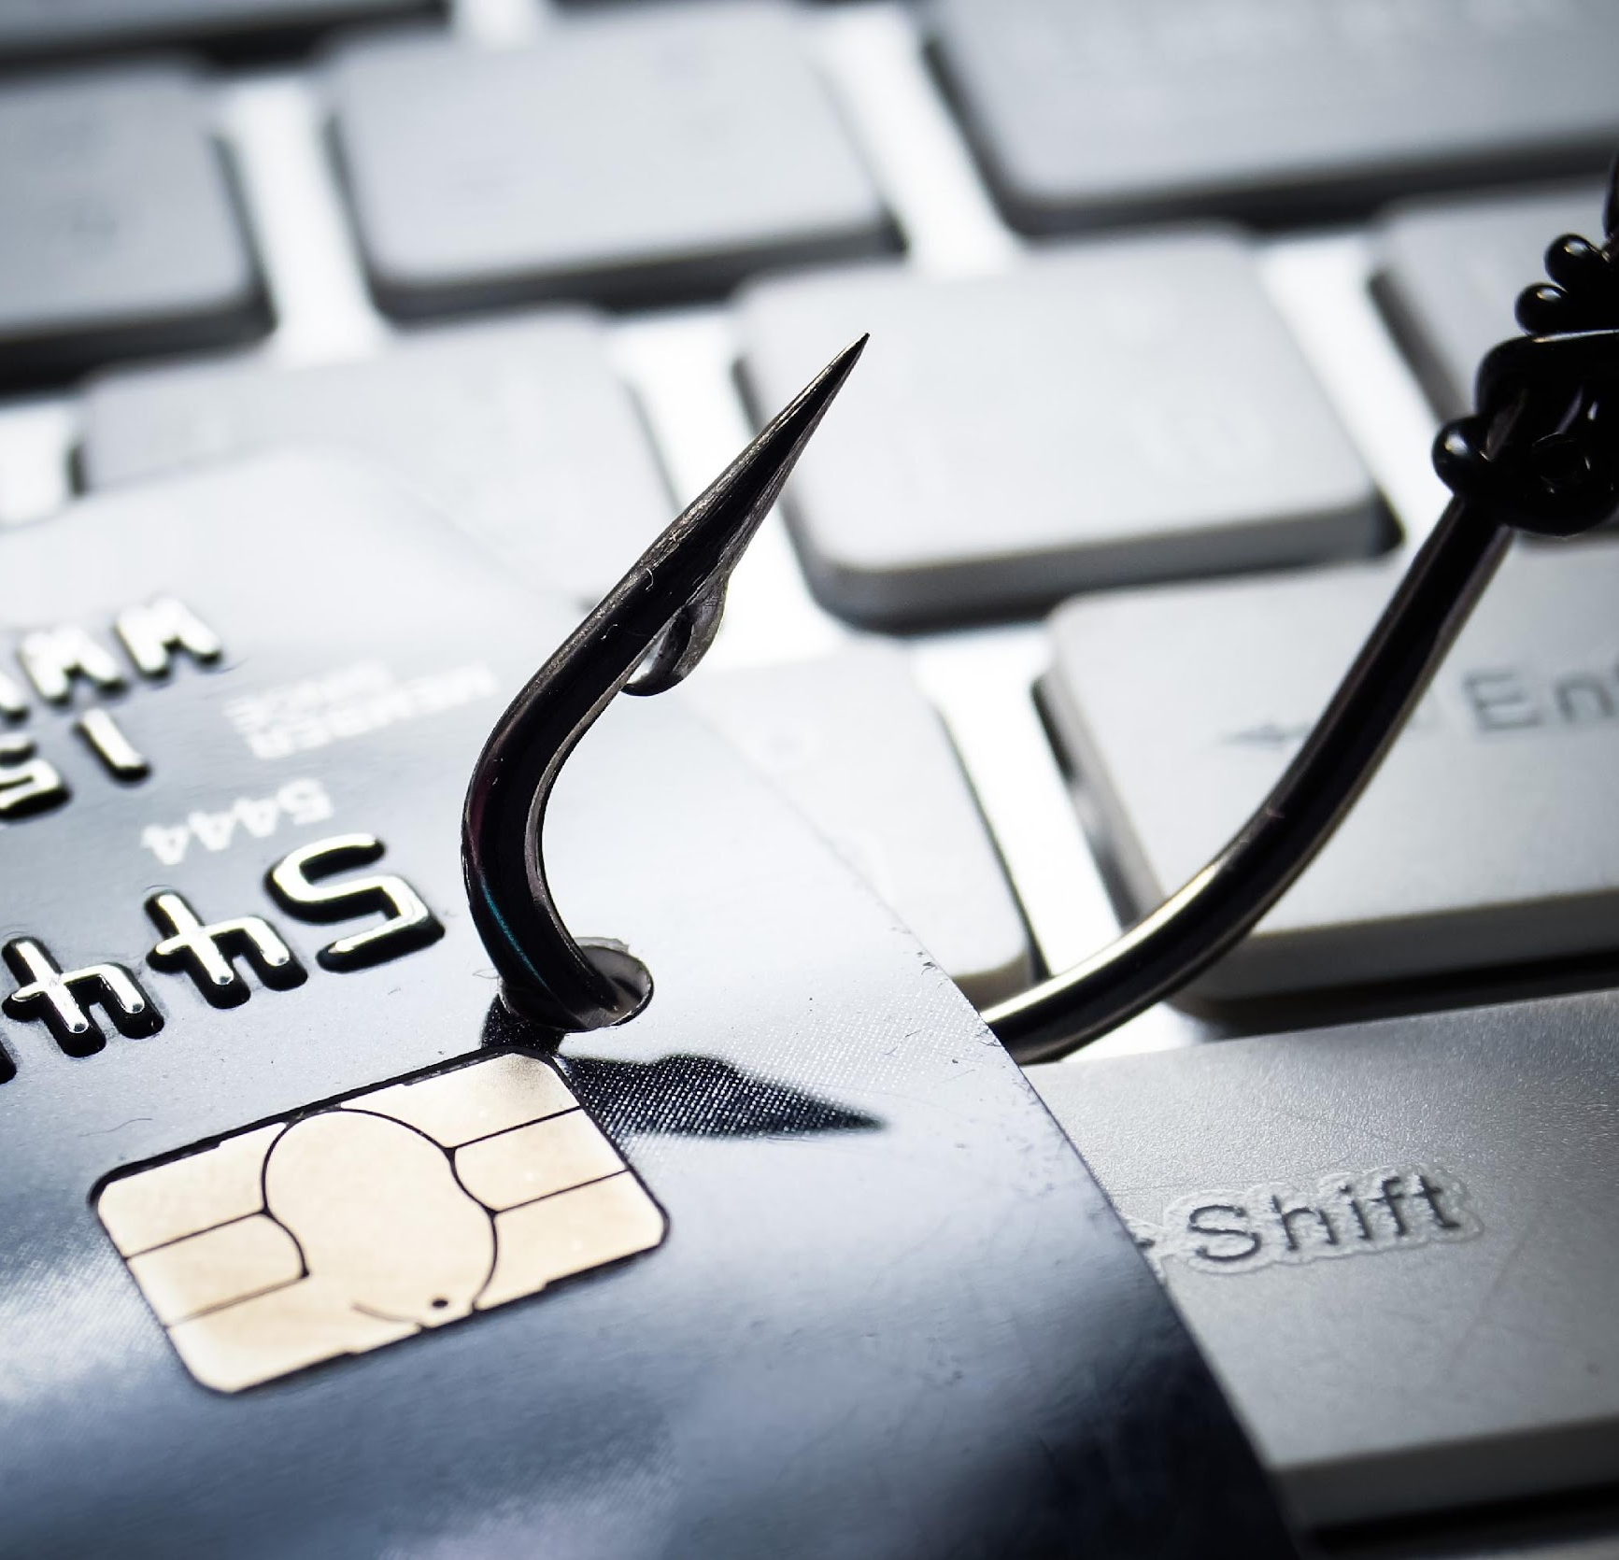
1 - what's phishing?
"Phishing is a type of internet scam in which an attacker tries to trick the victim into providing personal information, financial data, or access codes by pretending to be a trusted entity in a digital communication."

Slide 4
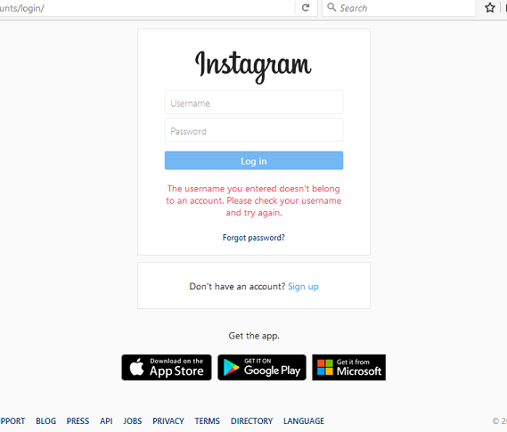
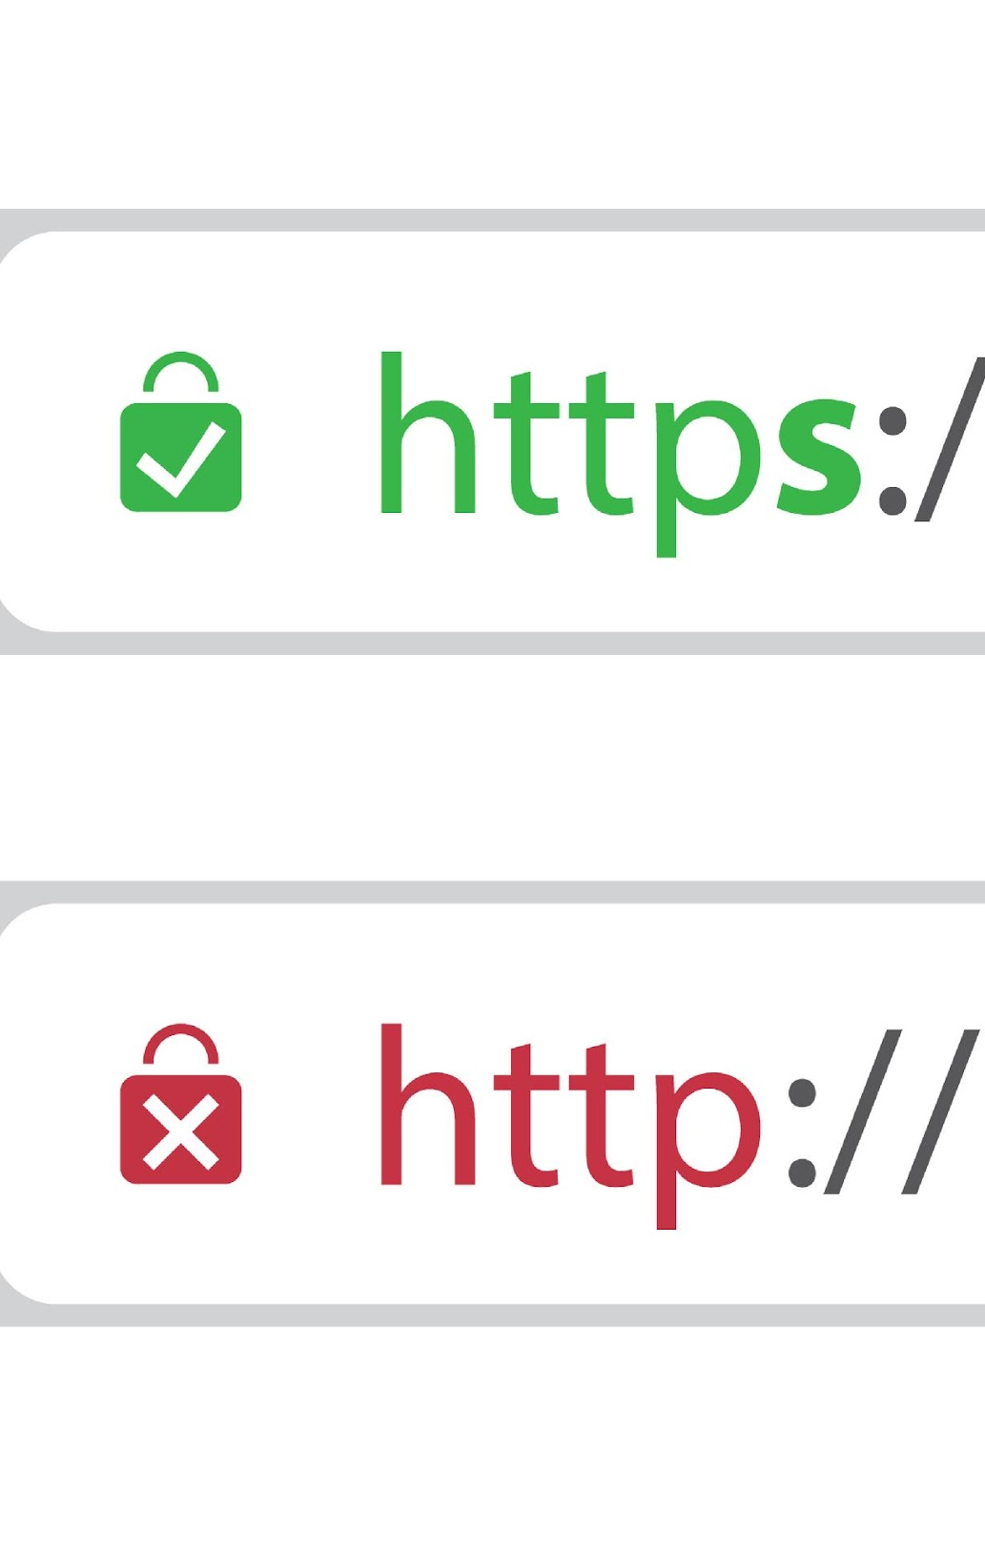
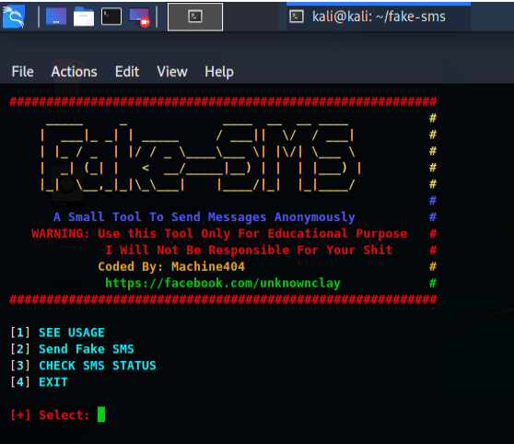
2 - How phishing really works?
Copy a website form login
Server-side languages
Buy a Trusted Domain
Buy email addresses / phone numbers
Sms spoofing
Good social skills

Slide 5
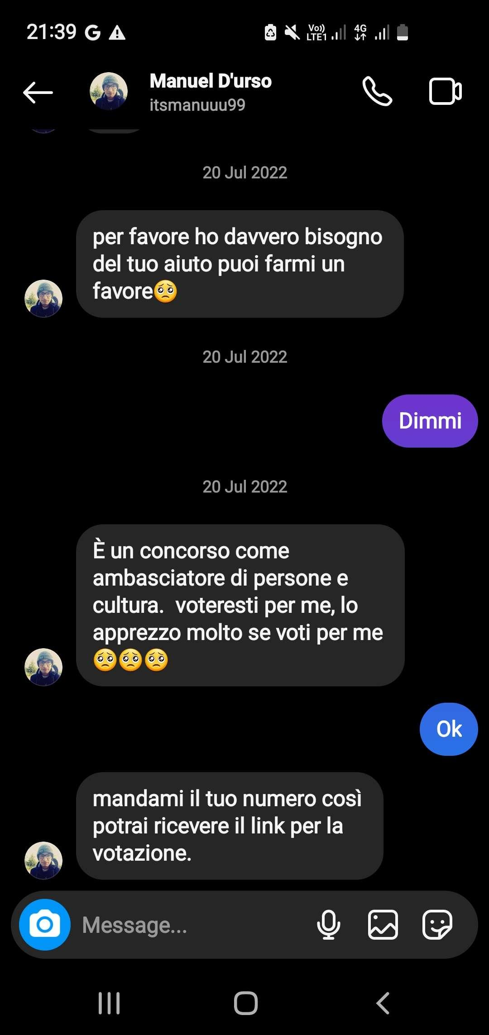
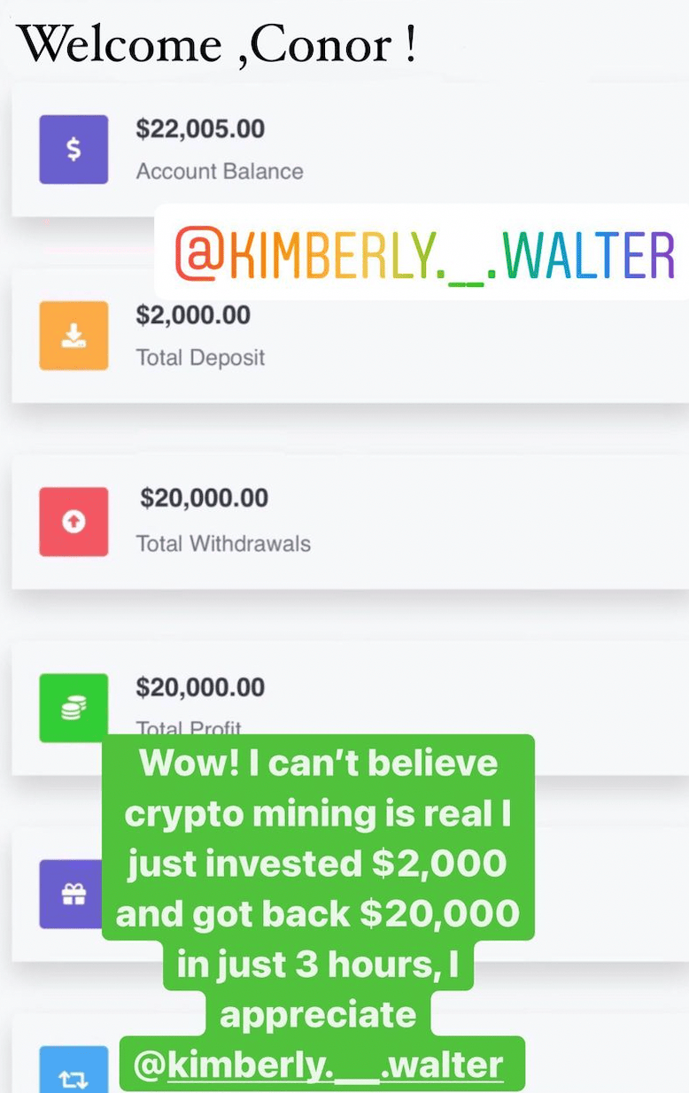

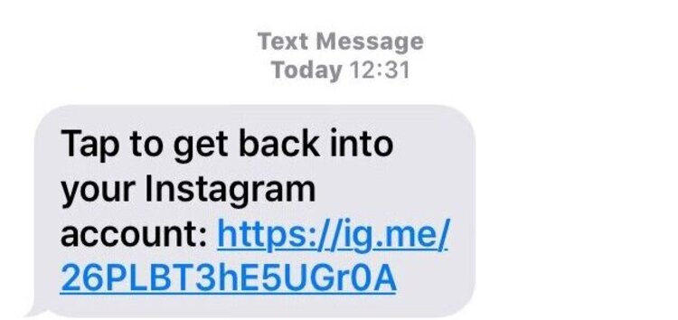
3 - What do scammers gain by phishing?
Sell accounts
Just fun
Steal bank / credit card details
Blackmail
Promote other scams

Slide 6
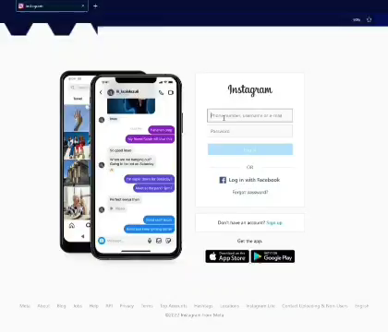
4 – phishing attack example

Slide 7
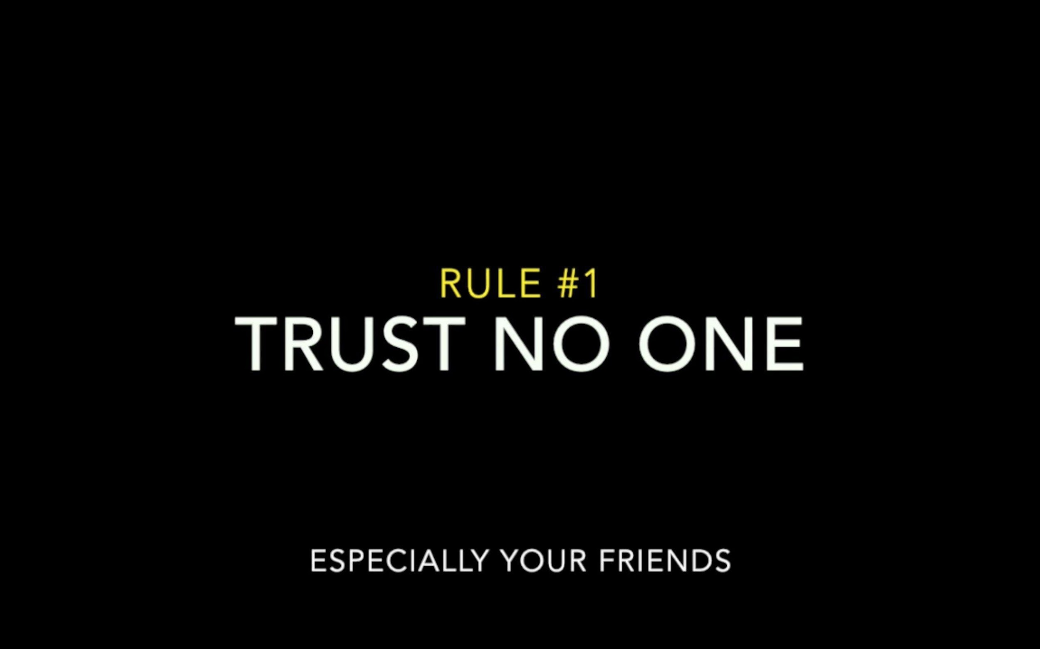

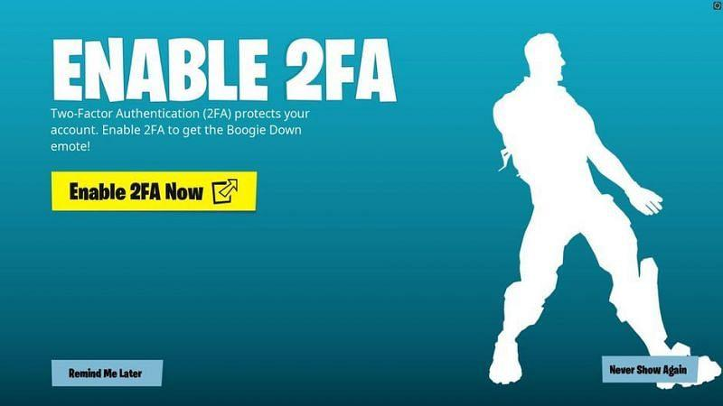
5 - Am I in danger?
Avoid scammers in few steps:
1 - Antivirus
2 - Don't trust anyone
3 - Be more careful
4 - Vpn
5 - 2FA (2-Factor Authentication)
"Something you know, something you have or something you are?"

Slide 8


