Slide 1

Generating automated executable code using UML Models. (CoDraw).
K. J. SOMAIYA INSTITUTE OF ENGINEERING AND INFORMATION TECHNOLOGY SION, MUMBAI-22
B.E. Project Topic

Slide 2
Project Group Members:-
Jignesh Lad
Purvisha Khunt
Dhruv Tank
Project Guide:- Prof. Reena Lokare

Slide 3
Objectives of the project:-
The main objective is to provide overview of one of the Model Driven Engineering Tool i.e. Transformation Tool.
Model Driven engineering tool is used to develop, interprete, compare, align, measure, verify, transform, etc.
UML based approach provides abstraction to deal with the complex generalized applications and when combined with Model-driven Engineering can also provide automation through automatic code generation.

Slide 4
Problem Statement:-
The proposed system is an approach for generation of executable Java code from UML models(Class Diagram , Activity Diagram & Sequence Diagram).
To validate this, a system will be developed which captures UML models composed of Class Diagram , Activity Diagram & Sequence Diagram which will generate executable Java code from it.

Slide 5
Proposed System
User interface
Uml diagram parser
Save UML diagram as image (.jpeg and .png)
Code file creator
Code generator

Slide 6
System Flow Diagram:-
Generates executable code
User draws the UML models on the canvas
On Submit
Automatic Code Generation algorithms are applied
Generating executable Java code is obtained.

Slide 7
Comparative Study of existing systems
Tools | Implementation | Features | Limitation
Ujector | Java | Provides easy GUI, input as an XML file. | No Drag and Drop
Code Cooker | Javascript | Easy GUI, Drag and Drop, Structural Code. | Do not provide behavioural diagram, exporting pdf format.
GenMy Model | HTML5, JavaScript | Supports exporting to pdf format, Structural diagram. | Requires internet, No user friendly GUI.
Code Maestro | C# | User friendly UI, supports structural diagram and image. | Does not provide behavioural diagram, generates only partial code.

Slide 8
Scope of the project:-
This system can further be extended by adding different UML models like sequence diagrams, state diagrams etc.
The resulting code that will be generated only in Java for now can further be made available in various other languages like python, C++,C# etc.
This tool will prove to be very handy and useful for various corporate organizations as well as startups for making the base of the software and making small executable modules of the larger project.

Slide 9
Modules
User Interface
UML Diagram Parser.
Code Generation Algorithm
Modules Integration.
Testing.

Slide 10
Technology that will be used:-
Hardware Requirements
Processor- Dual core
System Ram- 4GB minimum
Hard Drive 512 GB.
Software Requirements
Language C#
Microsoft Visual Studio 2013 or later
Operating System – Windows 7 or later

Slide 11
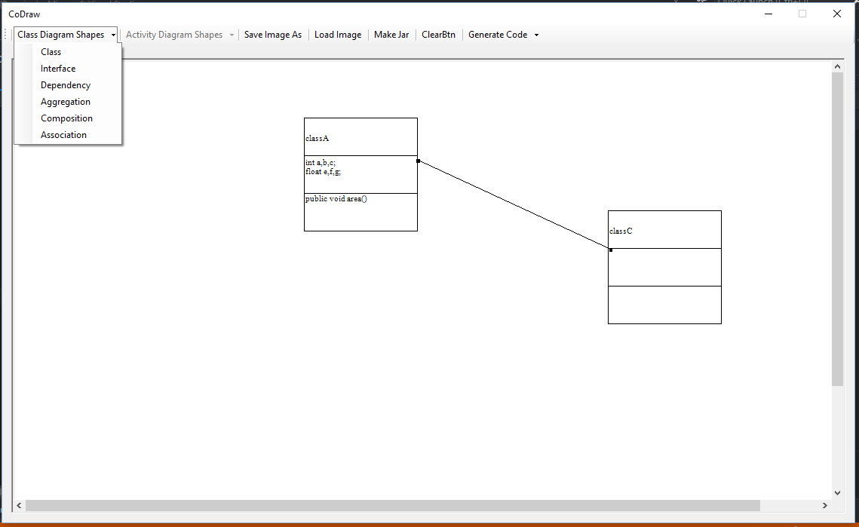
Screen Shots:-

Slide 12
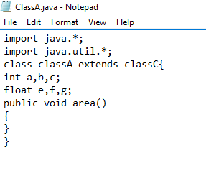
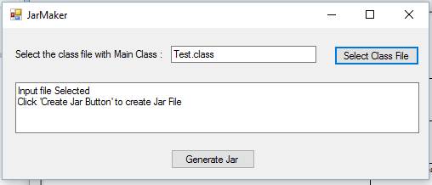

Slide 13
References:-
Wikipedia
www.smartdraw.com/uml-diagram
https://www.researchgate.net/publication/228644052_Automatic_generation_of_Java_code_from_UML_diagrams_using_UJECTOR

Slide 14
Thank You

