Slide 1

Lua for TerraME:
A Short Introduction
Pedro Ribeiro de Andrade
Münster, 2013

Slide 2
What is Lua?
Yet another scripting language
Simple and flexible
  “Simple things simple, complex things possible”
Small, Efficient, Portable
  Whole library written in ANSI C, compiles the same source code in all platforms
  The tarball for Lua 5.1.4 takes 860K uncompressed. The source contains around 17000 lines of C. Under Linux, the interpreter takes 153K and the library, 203K.
  Several benchmarks show Lua as the fastest language in the realm of interpreted scripting languages.
Free and distributed under MIT license

Slide 3


Where is Lua?
Inside Brazil
  Petrobras, the Brazilian Oil Company
  Embratel (the main telecommunication company in Brazil)
  many other companies
Outside Brazil
  Lua is used in hundreds of projects, both commercial and academic
  CGILua still in restricted use
    until recently all documentation was in Portuguese
Lua is the language of choice for computer games
        Lua and the Web
source: the Lua team
[Ierusalimschy et al, 1996]
Notes:
Ierusalimschy, R., L. H. Figueiredo, et al. (1996). "Lua-an extensible extension language." Software: Practice & Experience 26(6): 635-652.

Slide 4
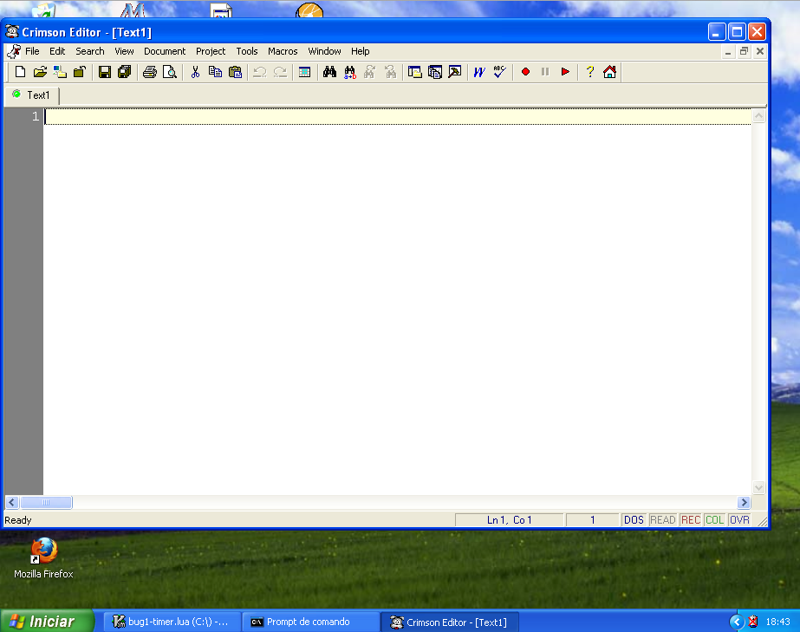

Slide 5
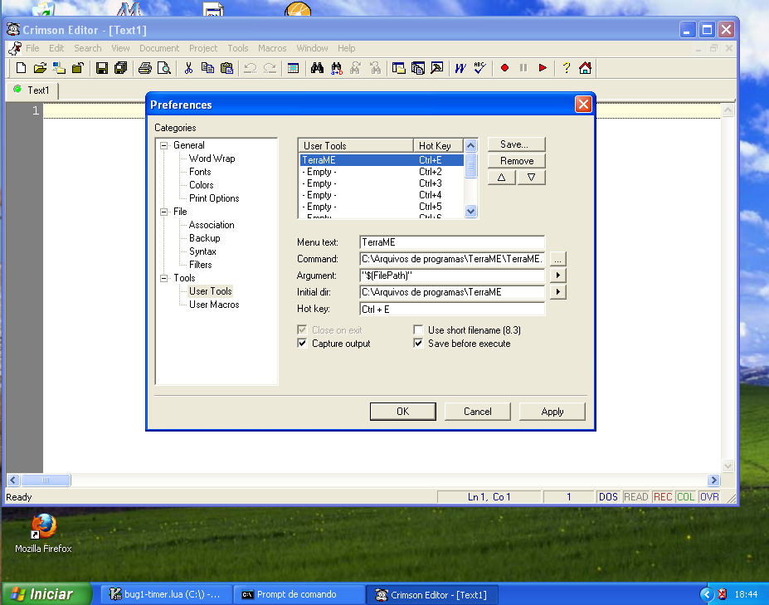

Slide 6
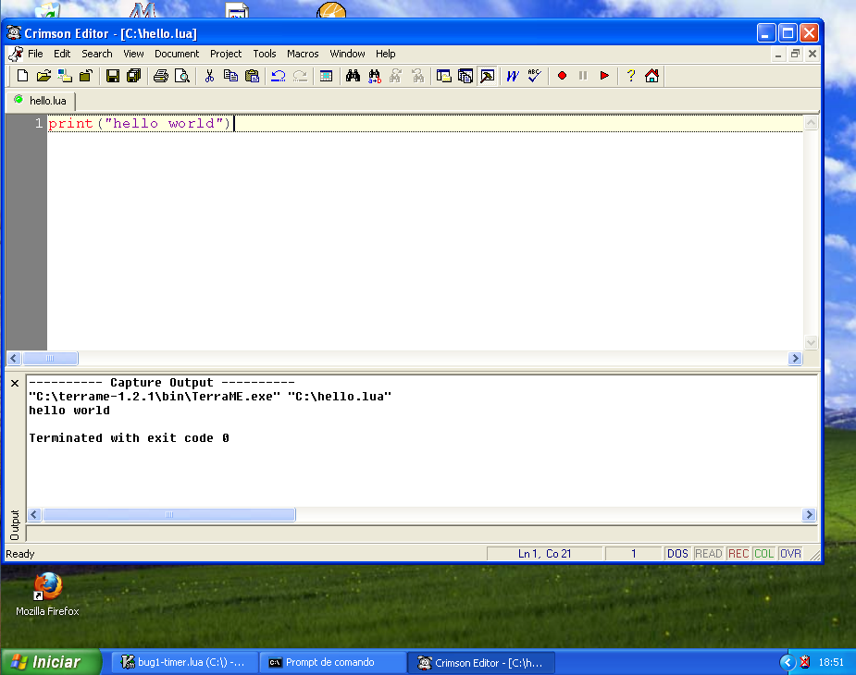

Slide 7
Variables and Values
Case sensitive
semicolon may optionally follow any statement
a = 1
b = a*2
print(a)
print(b)

Slide 8
Comments
double hyphen (--) until the end of the line.
block comments start with --[[ and run until ]]
print("hello") -- my comment
-- print("hello")
--[[
print(10) -- no action (comment)
--]]

Slide 9
Types
nil
boolean
number
string
table
function
print(type(3))

Slide 10
nil
Everything that does not exist
print(c)
c = 10
print(type(c))
c = nil
print(type(c))
print(type("a string!!"))
print(type(print))

Slide 11
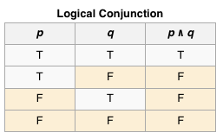
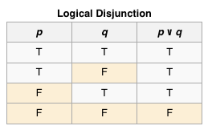
boolean
false/true
nil and false are false, everything else is true
zero and the empty string are true
operators and, or, and not
      (and) (or)
print(true)
print(true and false)
print(true and (false or true))
print(false or (true and false) or (true and true))

Slide 12
number
the only type for numeric values
double-precision floating-point number
arithmetic operators: +, –, *, /
exponent (^) and modulus (%)
boolean operators (<, >, <=, >=, ~=, and ==)
A = 6 + 2.2 * 4e+3
a = A ^ 2
b = A % 7
print(a)
print(b)
print(a > b)
print(b ~= 2)

Slide 13
Parentheses
Always optional (except in the case of function call)
When in doubt, use parentheses
a+-i < b/2+1 <--> (a+(-i)) < ((b/2)+1)
5+x^2*8 <--> 5+((x^2)*8)
a < y and y <= z <--> (a < y) and (y <= z)
–x^y^z <--> –(x^(y^z))

Slide 14
string
single or double quotes
operator ..
print("hello")
print('hello')
x = 2
print ("x = "..x)

Slide 15
if statement
An if statement tests condition and executes its then-part or its else-part (optional) accordingly
a = 6; b = 5
if a < 0 then
print("a < 0")
end
if a < b then print("a < b") else print("a >= b") end
if a < b then
print("a < b")
elseif a < b + 5 then
print("b <= a < b+5")
else
print("a > b+5")
end

Slide 16
for statement
A statement to repeat other statements, with the following syntax:
for var = exp1, exp2, exp3 do
something
end
That loop will execute something for each value of var from exp1 to exp2, using exp3 as the step to increment var. This third expression is optional (default is 1).
for i = 1, 10 do
print(i)
end
for i = 1, 10, 2 do
print(i)
end

Slide 17
table
The only structured data type
Can implement arrays
x = {7, 3, 2, 6, 4, 3, 9}
print(x[1])
x[1] = x[2] + x[3]
print(x[1])
print(#x)
for i = 1, #x do
print(i.." "..x[i])
end
Notes:
hash sign

Slide 18
table
Tables can be indexed not only with numbers, but also with strings or any other value of the language, except nil
loc = {
cover = "forest",
distRoad = 0.3,
distUrban = 2
}
print(loc["cover"])
print(loc.cover)
loc.distRoad = loc.distRoad^2
loc.distTotal = loc.distRoad + loc.distUrban
print(loc.distTotal)
loc.deforestationPot = 1/loc.distTotal
print(loc.deforestationPot)

Slide 19
Tables within tables
loc = {
cover = "forest",
dist = {road = 0.3, urban = 2}
}
print(loc.dist.road)
loc.dist.total = loc.dist.road + loc.dist.urban
print(loc.dist.total)

Slide 20
function
A function can carry out a specific task (commonly called procedure) or compute and return values.
A function is a first-class value in Lua.
Functions can be stored in variables and in tables, can be passed as arguments, and can be returned by other functions, giving great flexibility to the language.
myprint = print
print = nil
myprint(2)
print = myprint

Slide 21
Standard libraries
Basic (print, type, tostring, tonumber, …)
String (string.find, string.gsub, string.format, …)
Table (table.insert, table.remove, table.sort, …)
Math (math.random, math.sin, math.exp, …)
IO (io.open, io.read, io.close, …)
OS (os.clock, os.execute, …)
Debug (debug.getinfo, debug.getlocal, …)
﻿print(8*9, 9/8)
a = math.sin(3) + math.cos(10)
print(a)
print(os.time())
print(string.find("pattern", "tt"))

Slide 22
Definition of a function
function add(a, b)
return a + b
end
print(add(2, 3))
add = function(a, b)
return a + b
end
print(add(2, 3))

Slide 23
Parameters of a function
function f(a, b)
return a and b
end
CALL PARAMETERS
f(3) a = 3, b = nil
f(3, 4) a = 3, b = 4
f(3, 4, 5) a = 3, b = 4 (5 is discarded)

Slide 24
High-order Functions
Functions can also be parameters to other functions. This kind of function is what we call a higher-order function.
﻿﻿function foreach(tab, func)
for position, value in pairs(tab) do
func(value, position)
end
end
x = {7, 3, 2, 6, 4}
foreach(x, function(element)
print(element)
end)
foreach(x, function(value, position)
print(position, value)
end)

Slide 25
Tables with functions
Table may have their own functions.
loc = {
cover = "forest",
distRoad = 0.3,
distUrban = 2,
deforestPot = function(myloc)
return 1/(myloc.distRoad + myloc.distUrban)
end
}
print(loc.deforestPot(loc))
print(loc:deforestPot())

Slide 26
Tables with functions
We can declare a “class” in Lua by creating a function that takes a table constructor as argument.
function MyLocation(locdata)
locdata.covertype = "forest"
locdata.deforPot = function(self)
return 1/(self.distRoad + self.distUrban)
end
return locdata
end
loc = MyLocation({distRoad = 0.3, distUrban = 2})
loc = MyLocation{distRoad = 0.3, distUrban = 2}
print(loc.covertype)
print(loc:deforPot())

