Slide 1
Feedbacks
Pedro Ribeiro de Andrade
Münster, 2013

Slide 2
Last week
Inflow
Stock
Outflow
Two ways to increase stocks
Stocks act as delays or buffers
Stocks allow inflows and outflows to be decoupled

Slide 3
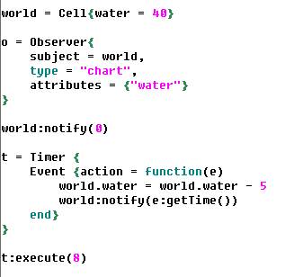
Implementing the model
Stocks
Observation
Flows
Simulation

Slide 4
Feedbacks
Feedback is how the system affect itself
Inflow
System
Outflow
Feedback

Slide 5
Population growth
Mortality
Births
Population
Deaths
Fertility

Slide 6
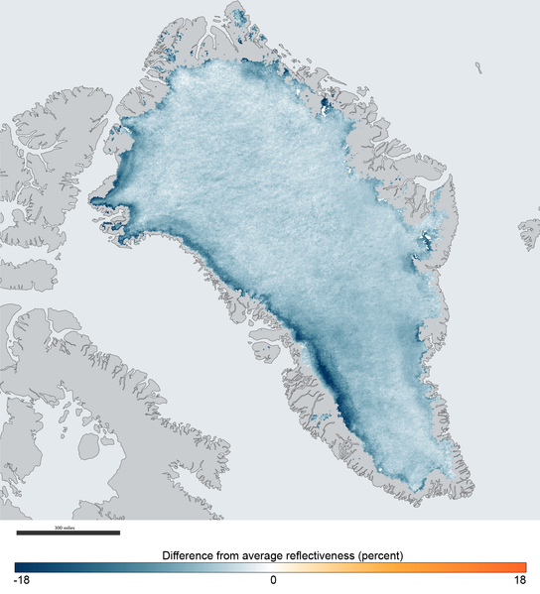
Albedo
Energy
Ice
Deice
Reflected energy

Slide 7
Water in the dam
Rain
Dam
Generate Energy
Consumption
City
Growth
The information delivered by a feedback can only affect future behavior

Slide 8
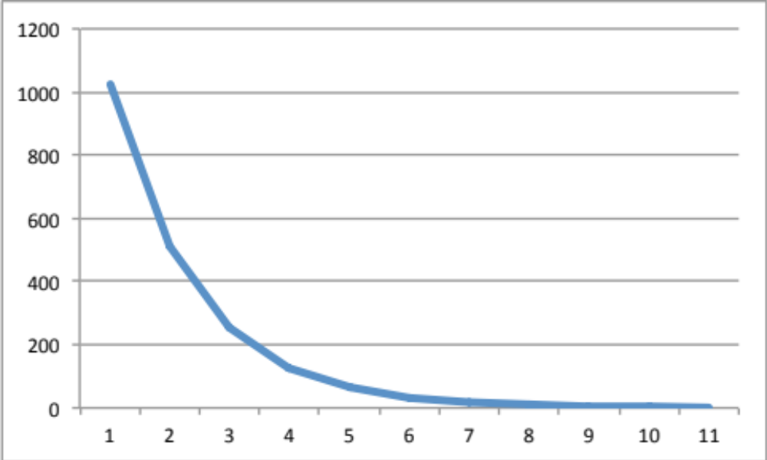
Balancing feedback
(Also negative, self-correcting, discrepancy-reducing, regenerative)
Equilibrating or goal-seeking structures

Slide 9
Coffee Cups Cooling or Warming
Stock: coffee temperature(t) = coffee temperature(t – dt) – flow x dt
Initial stock: coffee temperature = 80ºC, 20ºC, 5ºC
t = minutes
dt = 1 minute
Run time = 20 minutes
Flow: discrepancy x 10%
Discrepancy: coffee temperature – room temperature
Room temperature: 20ºC

Slide 10
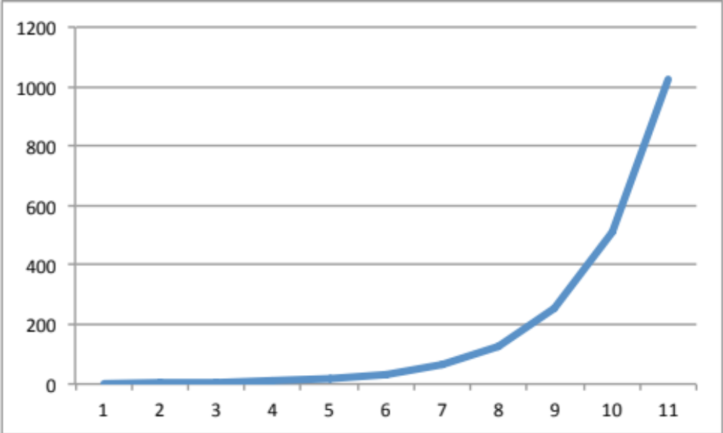
Reinforcing feedback
(Also positive, self-reinforcing, discrepancy-enhancing, degenerative)
Self-enhancing behavior that leads to growth or even collapses

Slide 11
Populations Growth
Stock: population(t) = population(t – dt) + growth x dt
Initial stocks: population = 60, 20
t = years
dt = 1 year
Run time = 7 years
Inflow: growth = population x 50%, population x 90%

Slide 12
Feedbacks
Feedbacks have limits!

Slide 13
Populations Growth
Stock: population(t) = population(t – dt) + growth x dt
Initial stocks: population = 60, 20
t = years
dt = 1 year
Run time = 7 years
Inflow: growth = population x 50%, population x 90%
What would happen if growth rates decrease 20% each year and we simulate until time 30?

