Slide 1

Slides under a magnifying glass
MODERN METHODS AND ALGORITHMS OF GENERATIVE AI · COURSE PROJECT
забыл упомянуть, выступление будет на английском
A vision-language model with crop and zoom
Vladislav Voronin, Pavel Vasilevykh
AIFT’27
Notes:
A small VLM answers questions about presentation slides that need small details: a label, a value on a chart, how blocks connect. We give it a crop and zoom tool and let it choose the regions. The talk covers what we built, how we measured it, and the result: on the slides we tested, zoom helps less than a bigger single view.

Slide 2
Research questions
Small vision-language models read slides at low resolution and miss small labels. A crop tool can give them the pixels back, if the model asks for the right region.
RQ1
RQ2
RQ3
When does zoom help?
Where does the model look?
What errors remain?
Compare the zoom agent with the same slide at a larger budget and with fixed tiles.
Check whether the boxes it picks sit on the evidence, and whether it zooms when it should.
Sort the wrong answers into causes: no zoom, wrong region, misread text, format, reasoning.
Model: Qwen3-VL-4B-Instruct, 4-bit.
Voronin, Vasilevykh · Slides under a magnifying glass
2 / 17
Notes:
Three questions drive the project. First, when does zoom help compared with simply giving the model a bigger picture. Second, how good the model is at choosing regions. Third, which errors remain once it can zoom.

Slide 3

The zoom agent
1
2
3
4
Overview
Model reply
Crop
Decide
Slide downscaled to 256 visual tokens
One JSON object: zoom or answer
Box cut from the original, upsampled to 1280 px
Answer, or request another region
REPLY FORMAT
LOOP GUARDS
{"action": "zoom", "box": [x1, y1, x2, y2]}
At most 3 zooms per question, then demands answer
Checking for JSON parsing error: one retry, then an empty answer
{"action": "answer", "answer": "..."}
Voronin, Vasilevykh · Slides under a magnifying glass
3 / 17
Notes:
The protocol is JSON inside the prompt, not native tool calling, because small models break chat-template parsers. The model sees a low-budget overview and either answers or names a box. The box is cut from the original image, so the crop has real pixels, then upsampled to 1280 px. Three guards keep the loop finite: a zoom cap, a repeat-box check by IoU, and a single retry after a format error.

Slide 4
Viewing modes
Mode | What the model sees | Role
A | Whole slide, 256 visual tokens, no zoom | Baseline
B | Whole slide, 1500 tokens, no zoom | Is a bigger view enough?
C | Overview plus 4 tiles (2×2, 10% overlap) from the original, in one query | Fixed-crop baseline
D | Overview, then up to 3 crops chosen by the model | Zoom agent
E | As D, but exactly one box is forced before the answer | Ablation of D
F | Same view as A, answer requested as JSON | Control for answer format
Two extra runs use a 768-token overview: A at 768 tokens and D at 768 tokens.
Voronin, Vasilevykh · Slides under a magnifying glass
4 / 17
Notes:
B tells us whether zoom is needed at all or a larger picture is enough. C is the fixed-crop baseline. E tests whether letting the model choose when to zoom matters. F separates the effect of the JSON answer format from the effect of zoom.

Slide 5
Data
400
SlideVQA test questions, one evidence slide each: 284 text and 116 numeric answers
SIZE CHECK
1024 px
30 + 120
dev and test split, ids fixed once, balanced between text and numeric answers
Median longest side of SlideVQA slides. The 10th and 90th percentiles are also 1024 px.
The original has no more pixels than a 768-token view, so zoom can add little on this dataset.
40
own questions on 2560 px slides: 20 on course slides, 20 on dense slides with small print
Voronin, Vasilevykh · Slides under a magnifying glass
5 / 17
Notes:
The pool comes from the SlideVQA test split: single-hop questions, one evidence page, answers of at most five words. Because SlideVQA slides are only 1024 px on the long side, we added 40 questions of our own on 2560 px slides, where zoom can recover real detail. The dense slides were chosen for small print, which favours any method that reads small print; we say so in the limitations.

Slide 6
Metrics and statistics
SCORING
STATISTICS
EM = 1 if norm(pred) = norm(gold) for any accepted gold answer
95% intervals: bootstrap over questions, 2000 resamples
Paired difference: bootstrap on per-question score differences
Exact McNemar test on EM, using only questions where two modes disagree
Threshold p < 0.006 for 8 comparisons
F1 = max over gold of 2PR / (P + R), with P and R from shared words
norm: lowercase, no thousands commas, punctuation to spaces, articles dropped. An empty or invalid answer scores 0 and stays in the denominator.
Voronin, Vasilevykh · Slides under a magnifying glass
6 / 17
Notes:
Exact match is strict, so we also report F1 and count format mismatches separately in the error analysis. The paired tests look at the same questions under two modes. With eight pairwise comparisons the Bonferroni-style threshold is about 0.006, and only two comparisons clear it: A to B and B to D.

Slide 7
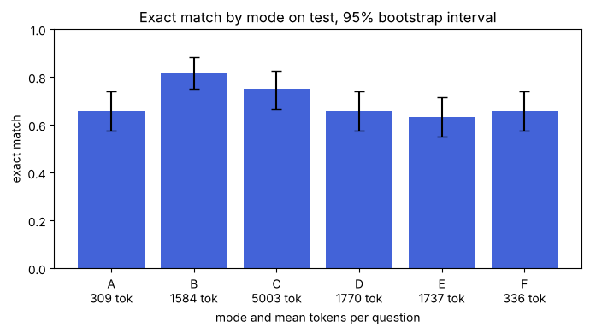
Accuracy by mode on SlideVQA
0.82
B, whole slide at 1500 tokens, against 0.66 for A
0.66
D, zoom agent: 1770 tokens and 12.8 s per question, A takes 309 and 1.6 s
0.75
C, overview plus 4 tiles, at 5003 tokens
Voronin, Vasilevykh · Slides under a magnifying glass
7 / 17
Notes:
Test set, 120 questions. B, the whole slide at 1500 tokens, is the most accurate of the six modes. The zoom agent D equals A and F at 0.66 but costs about six times more tokens. E, the forced single box, scores 0.63. D asks for a zoom on 84% of the questions, E by design on 99%. No JSON format errors occurred on test.

Slide 8
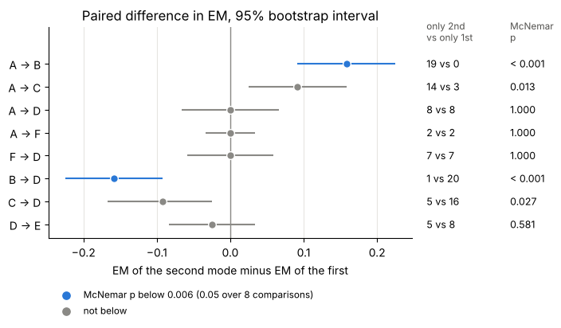
Paired comparisons
A to B: +16 points
19 questions gained, 0 lost, p < 0.001
A to D: no effect of zoom
8 against 8; F to D is 7 against 7 at the same answer format
A to F: format does not matter
2 against 2, so JSON answers cost no accuracy
B to D: −16 points
1 gained, 20 lost, p < 0.001
Voronin, Vasilevykh · Slides under a magnifying glass
8 / 17
Notes:
Each row compares two modes on the same 120 questions. The marker is the difference in exact match, the bar its 95% bootstrap interval. The two columns on the right give the number of questions only the second and only the first mode answers correctly, and the exact McNemar p value. With a strict threshold of about 0.006 only A to B and B to D count. D against A or F is zero with an interval of about plus or minus 6 points.

Slide 9
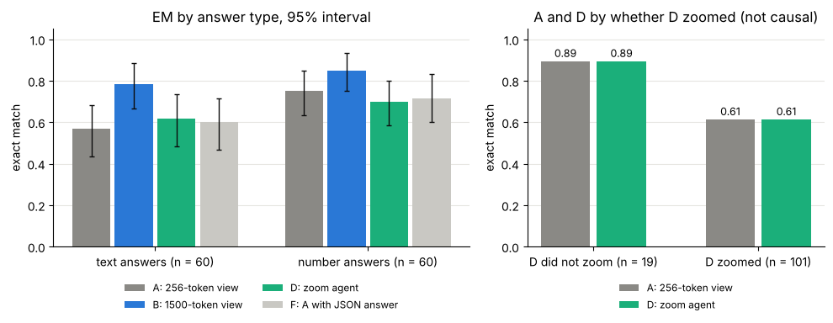
Answer type and zoom usage
Text answers gain most from a bigger view (B 0.78, A 0.57); numbers gain less (0.85 against 0.75). D skips zoom on 19 of 120 questions, mostly easy ones: A and D both score 0.89 there and 0.61 on the 101 zoomed ones.
Voronin, Vasilevykh · Slides under a magnifying glass
9 / 17
Notes:
Each answer-type group has 60 questions, so intervals are about plus or minus 12 points. The right panel is not a causal estimate: the model chooses when to zoom, so the questions differ between the two groups.

Slide 10
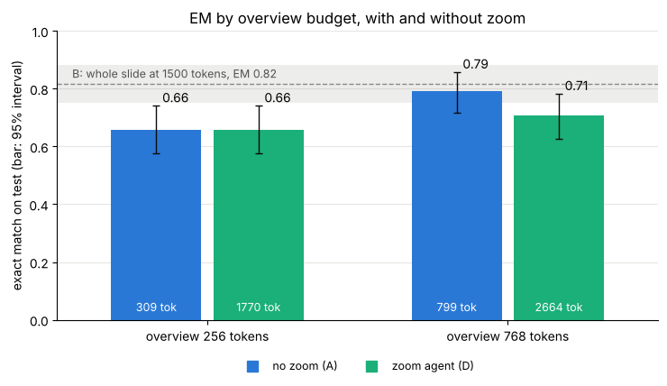
Overview budget: 256 against 768 tokens
A: 0.66 to 0.79
13 points for 256 –> 768
D at 768: 0.71
8 points under A at 768 (12 questions against 2, p = 0.013)
Nothing left to recover
A 1024×768 slide costs exactly 768 tokens at native resolution, so zoom only adds cost
Voronin, Vasilevykh · Slides under a magnifying glass
10 / 17
Notes:
The question: does a better first look let the agent catch up with B? We ran D with a 768-token overview and, to separate the effect of zoom from the effect of a bigger overview, A with the same overview and no zoom. A at 768 tokens lands within 3 points of B at about half the cost. D at 768 is below it.

Slide 11
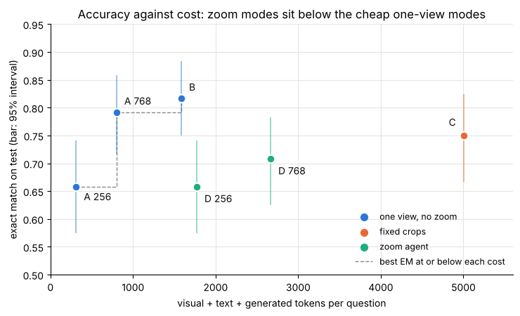
Accuracy against cost
On the frontier
A at 256 tokens, A at 768 tokens and B
Below it
Both agent runs, and C at 5003 tokens for EM 0.75
768 to 1500 tokens
+2.5 points for about 780 more tokens, inside the noise (p = 0.375)
Voronin, Vasilevykh · Slides under a magnifying glass
11 / 17
Notes:
Each point is one mode on the 120 test questions. The horizontal axis is tokens per question including image, text and generated tokens. The dashed line joins the modes that no other mode beats at equal or lower cost. The intervals overlap for most pairs, so the order inside the group A 768, B, C and D 768 is not established. The clear results are A at 256 below A at 768 and B, and D at 768 below A at 768.

Slide 12
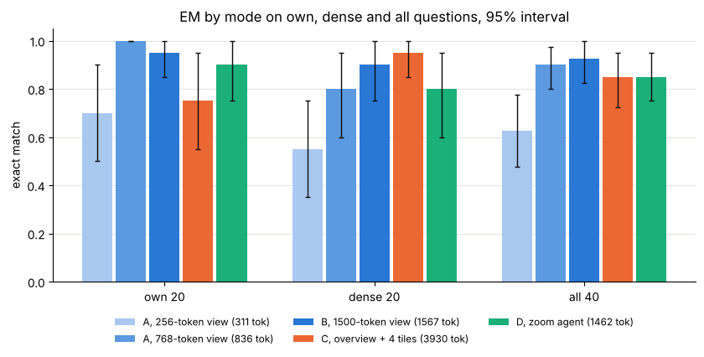
Own and dense slides, @ 2560 px
D 0.85 against A 0.62
+22.5 points on all 40 (13 against 4, p = 0.049)
A at 768 and B match D
0.90 and 0.93, within noise of D
Dense slides favour tiles
C scores 0.95 on the 20 dense questions; small text rises from 0.60 (A) to 0.93 (B and C)
Voronin, Vasilevykh · Slides under a magnifying glass
12 / 17
Notes:
Here zoom has real pixels to find: the slides are 2560 px wide. D clearly beats A at 256 tokens, but a bigger first look closes the gap without zoom: A at 768 tokens beats A at 256 by 27.5 points (13 against 2, p = 0.007), the clearest effect in this section. With 20 to 40 questions an interval is about plus or minus 15 to 20 points, so only large gaps count.

Slide 13
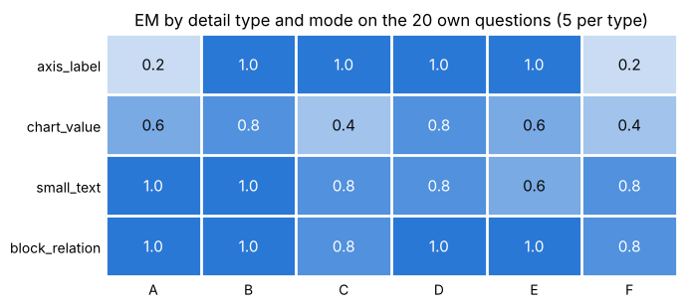
Heatmap by detail type on 20 own questions
Axis labels
A and F score 0.2; B, C, D and E read them (1.0)
Chart values
The weakest type for every mode, 0.4 to 0.8
Blocks and small text
Easy at this slide size, 0.6 to 1.0
Five questions per cell: one question moves a cell by 0.2.
Voronin, Vasilevykh · Slides under a magnifying glass
13 / 17
Notes:
The 20 own questions are split into five per detail type: axis label, value on a chart, small text, relation between blocks. They were written from the slides before any model run. Axis labels are the clearest case where reading small print decides the answer: the 256-token view fails, and every mode that sees more pixels reads them.

Slide 14
Error analysis on SlideVQA test
A, 256 tokens
D, zoom agent
30 sampled errors each, count per category
no_zoom
12
1
0
Zoom removes no_zoom errors
wrong_region
1 left against 12 for A
10
8
but adds wrong boxes
format
10 against 0, so A and D both make 41 errors
10
misread
3
2
A third of D’s errors are format
5
Right in meaning, wrong on exact match
reasoning
6
bad_gold
2
1
Voronin, Vasilevykh · Slides under a magnifying glass
14 / 17
Notes:
Each mode makes 41 errors on the 120 test questions; we sampled 30 per mode with a fixed seed and sorted them by cause from a montage of the slide, the boxes and the crops. no_zoom: the needed text was too small at the overview size. wrong_region: the box misses the evidence or cuts it. format: right in meaning, fails exact match. Scaled to all 41 errors, D has about 14 wrong boxes and 14 format mismatches. Categories were assigned in one pass by an AI assistant and checked by one of the authors; shares come from samples of 30, so each count is uncertain by several errors.

Slide 15
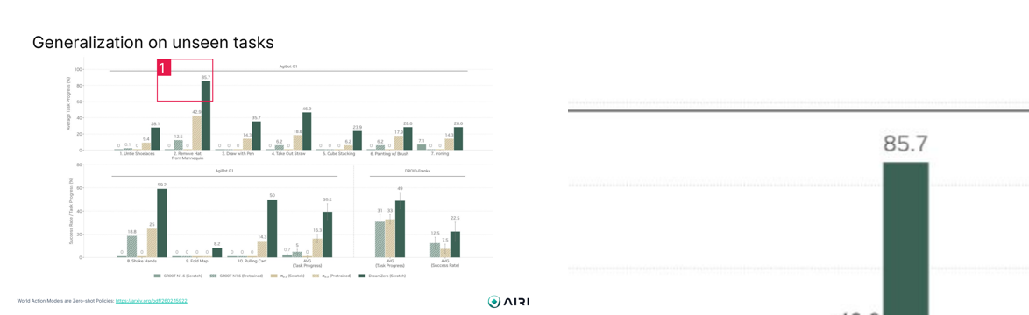
Two cases
ZOOM WORKS
RIGHT ANSWER, WRONG REGION
dense_12: asked for the value of DreamZero (Scratch) on task 2, D boxes the tallest bar and reads 85.7 in the crop. Gold: 85.7.
Will demonstrate in the demo.
Voronin, Vasilevykh · Slides under a magnifying glass
15 / 17
Notes:
The picture is a replay record from the demo: left the slide with the numbered box the model chose, right the crop it received. The second case comes from the live run in the demo. The answer is right, but the box does not contain the number, so a correct answer does not prove that the model looked in the right place. This is why the error analysis checks boxes and not only answers.

Slide 16
Limitations
SlideVQA slides are 1024 px wide, so zoom has no extra pixels there: its gain comes from more tokens per region and from upsampling.
Small VLM model, Qwen3-VL-4B in 4-bit; larger models were not tested.
Modes A to C use a text answer prompt, D and E use JSON.
Exact match penalises right answers in another format (“12.5 bn” and “12.5”), about a third of D’s errors.
The 40 own and dense questions are ours, on 17 slides, and the dense slides add biad with agents which work better with small text.
Voronin, Vasilevykh · Slides under a magnifying glass
16 / 17
Notes:
The first limitation matters most: on SlideVQA the original image has no more detail than a 768-token view, so the test is unfavourable to zoom by construction. That is why we added the 2560 px slides.

Slide 17
Conclusions
1
On 1024 px SlideVQA slides a bigger single view is the cheapest gain: 768 tokens give EM 0.79 and 1500 tokens 0.82, while the zoom agent scores 0.66 to 0.71 at 1770 to 2664 tokens.
2
On 2560 px slides zoom lifts D from 0.62 (A) to 0.85, but A at 768 tokens (0.90) and B (0.93) are within noise range. Fixed tiles score highest on dense small print (0.95).
3
Zoom fixes text that is too small to read (1 such error left against 12) and adds wrong-box errors (10 against 0). A third of D’s errors are format mismatches, so exact match understates both modes.
Voronin, Vasilevykh · Slides under a magnifying glass
17 / 17
Notes:
Short version: the model can read boxes in the right coordinate space and a crop does give it detail, but choosing the region is the weak step. When the first look is already large enough, zoom adds cost and loses accuracy.

