Slide 1

STUDENT FINAL GRADE PERFOMANCE
Team Savvy

Slide 2
SUSTAINABLE DEVELOPMENT GOAL
The mission of SDG is to call the end of poverty , protect environment and bring peace all of which can be attained through Quality Education.

Slide 3
Problem Statement Approach
Dataset contains socio-economic factors that affects the performance of the child from that educators and policy makers need to implement ideas to increase the student’s performance.

Slide 4
Methodology
START
EDA
PREPROCESSING
HANDLING OUTLIERS
LABEL ENCODING
TESTING WITH DIFFERENT MODELS
BEST ACCURACY WITH DIFFERENT RANDOM STATEMENTS
BY AVERAGE ACCURACY BEST 5 MODELS
END

Slide 5
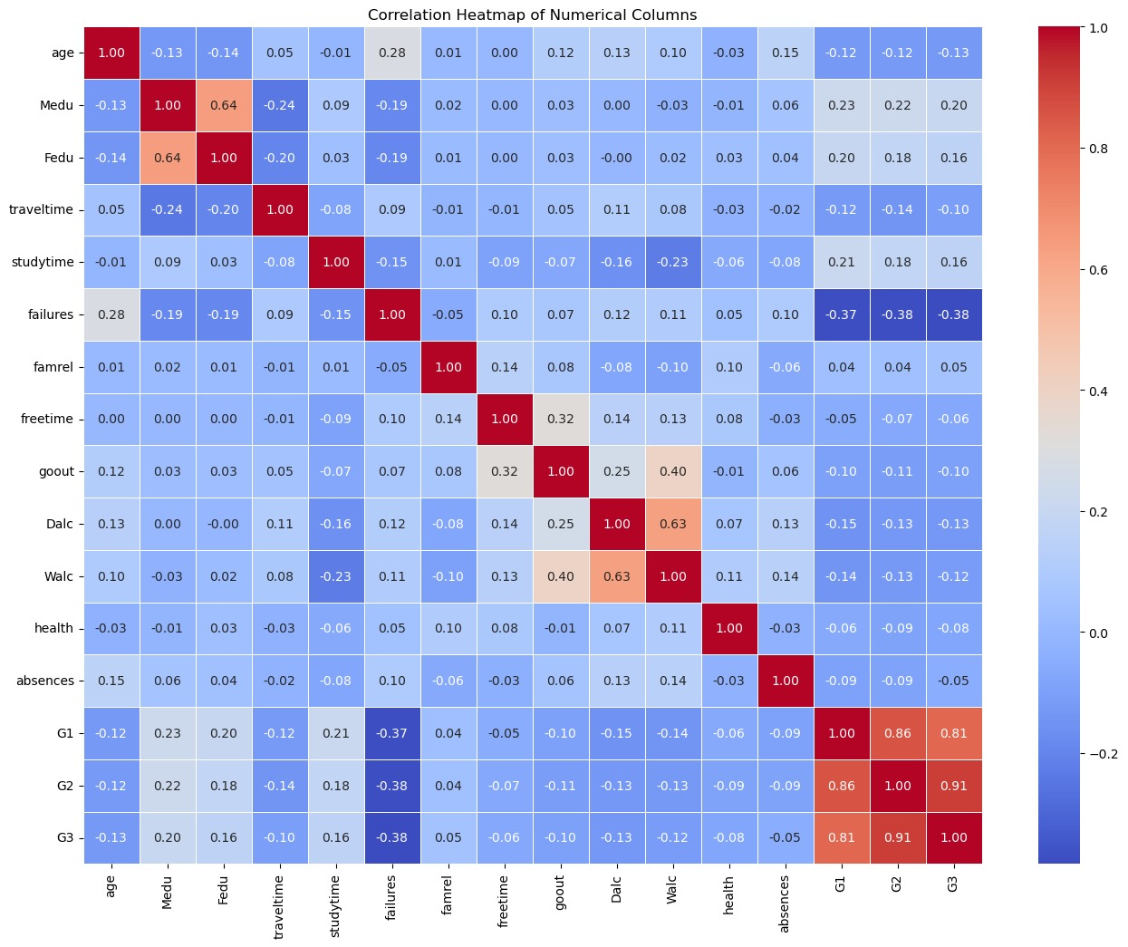
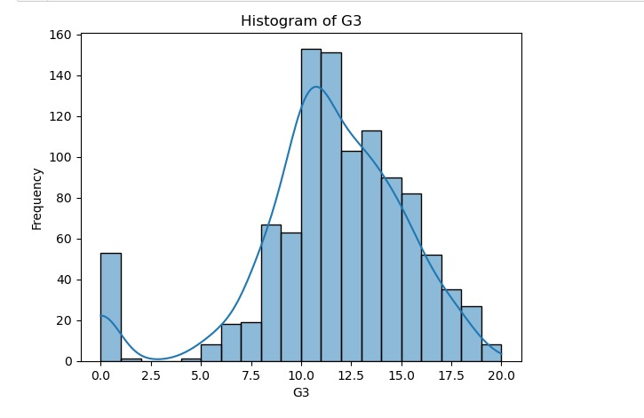
VISUALIZATION

Slide 6
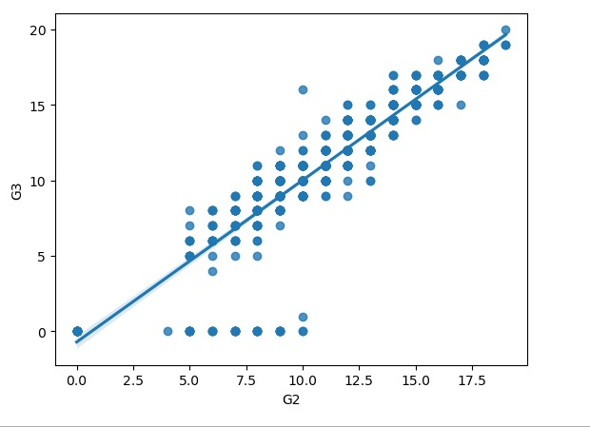
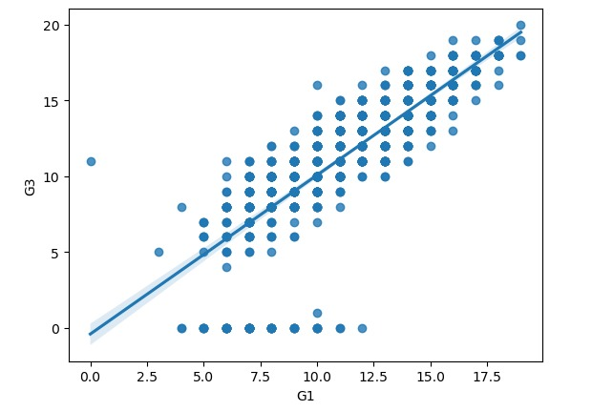
VISUALIZATION

Slide 7
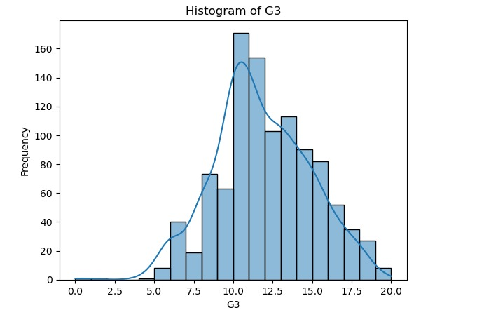
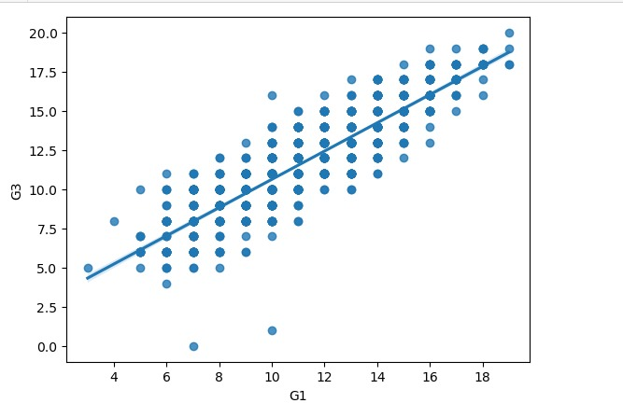
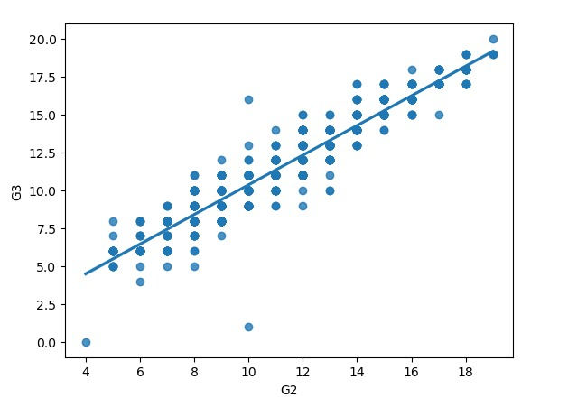
VISUALIZATION

Slide 8
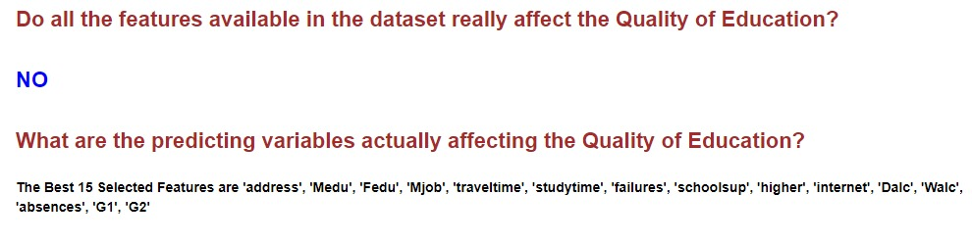
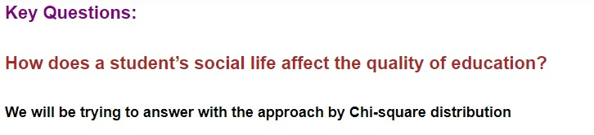
ADDRESS KEY QUESTIONS

Slide 9
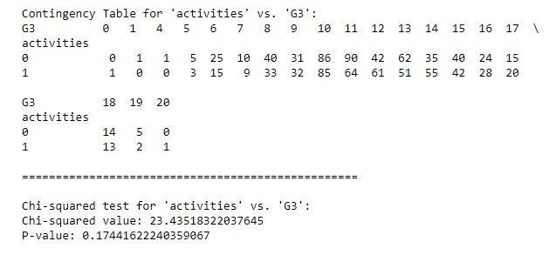
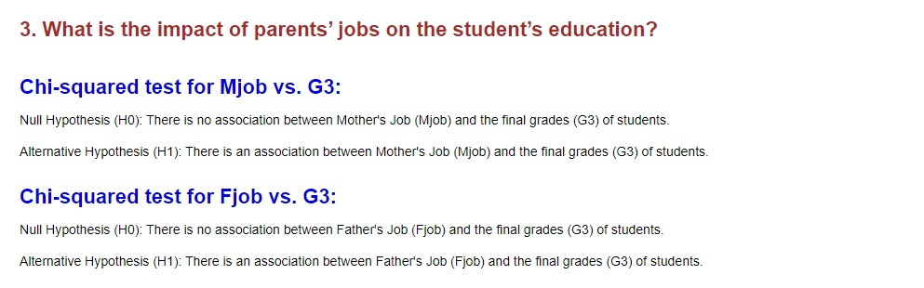
ADDRESS KEY QUESTIONS

Slide 10
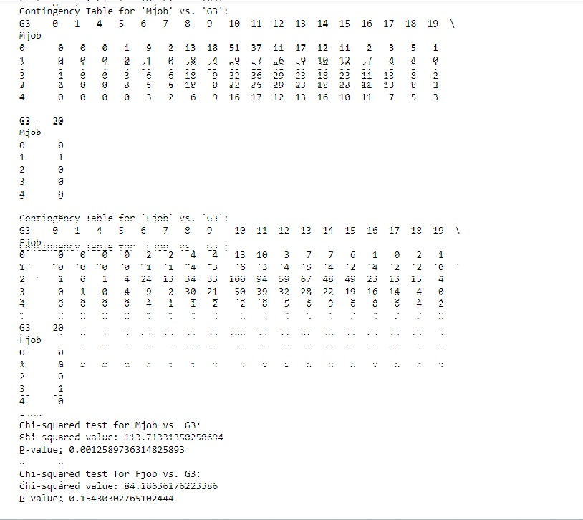

Slide 11
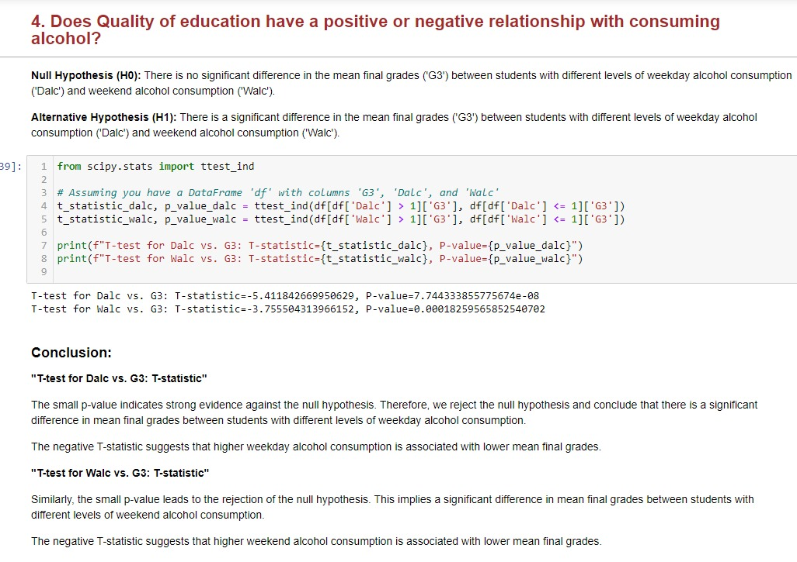

Slide 12
CONCLUSION
We have developed the predictive model for the Final Grade of the Students, Also we are recommending features for better Education Growth. Utilizing a Graphical User Interface (GUI) for data analysis enhances accessibility and comprehension.

Slide 13
Thank you

