Slide 1
Spotify Playlist Enhancer
Jevegnij Ivanov 20748055 Fiachra Monnelly 20397701 Fabian jaskiewicz 20443346
Development progress presentation

Slide 2
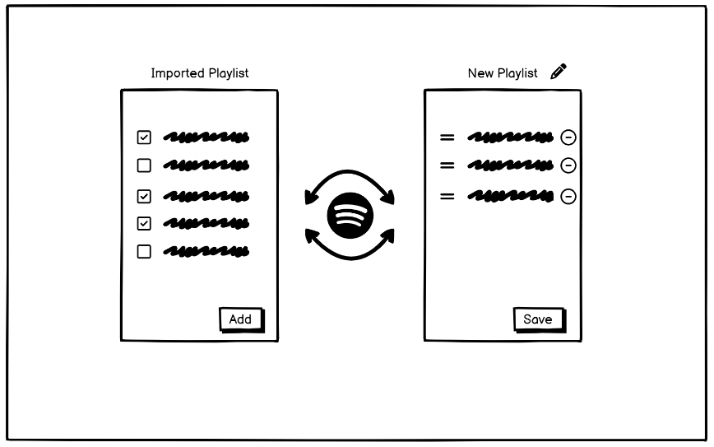
UI Mock-up
1. We have imported Playlist from Spotify that we like.
2. We select favourite songs from the playlist and click add.
3. You can add to an existing playlist or create a new one.
4. You can then edit the order and layout of your playlist.

Slide 3
Technologies for implementation
Our team decided that the main technology used in development will be React.js, which is a popular open source library for front-end and back-end development.
React can be used to develop single-page, mobile, or server-rendered applications with frameworks like, and that is why it fits well for our idea.
The plan is to start developing UI front-end first, and then enable functionality through back-end.

Slide 4
Teamwork allocation and testing
Currently, the plan is to put Jevgenij and Fabian on React.js development.
Fiachra is responsible for UI design, mock-ups and visual appeal.
Later in development, we will decide the work load for audio implementations.
During the development, we will cross collaborate to help each other out and learn as a group.

Slide 5
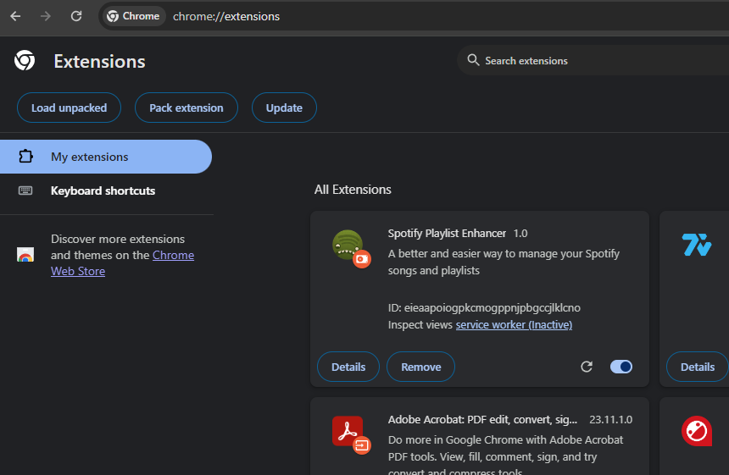
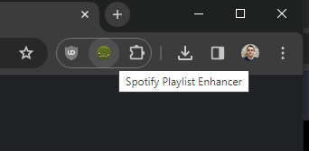
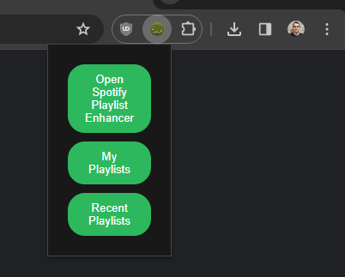
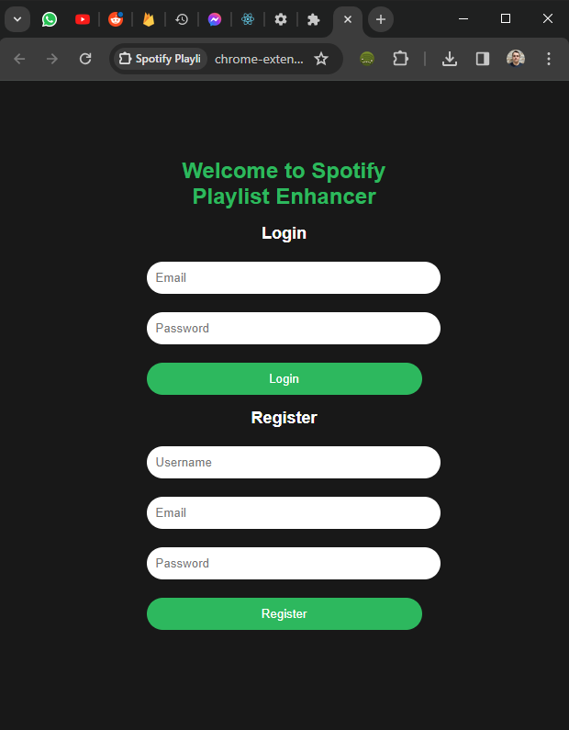
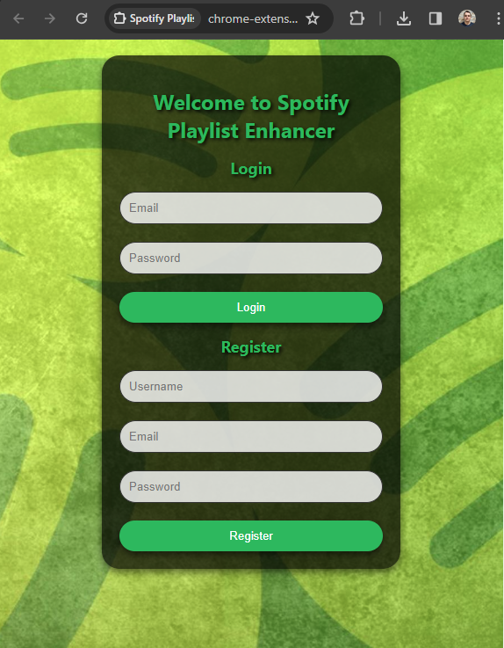
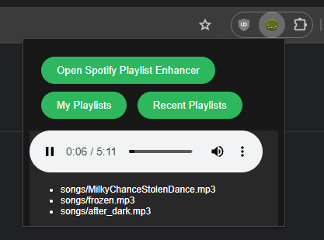
Jevgenij’s contributions
Created a Google Chrome extension.
Ensured the extension loads into your Chrome browser correctly.
The extension has a unique Spotify icon and Spotify themed buttons. Can also be pinned into Chrome panel.
The first button opens a new tab in your Chrome browser. For now it’s a Login and Registration page.
Created a Login/Registration page
The chrome extension button now redirects the user to the Login/Registration page.
The Login/Registration page has Spotify themed style applied through a .css script for buttons and text.
Next objectives/goals
Firebase Data Storage
Collaborate with Fabian. Connect Firebase to store login/registration and song/playlist data.
Help with React UI design
Collaborate with Fiachra to help him make a design for our web API to manage playlists.
Add functionality to buttons in Web API

Slide 6
Future plans and goals for development
Spotify API – Establish connection
Personal Spotify account authorization, for access to account playlist, songs and more
Learn how to use Spotify API to export and manipulate songs and podcasts, and then implement the functionality with our extension
Firebase integration
Add Firebase for various use of data features, such as storing account information and music/podcast data
Learn how to correctly implement Firebase tools and features for our project, experiment and test available functionality
Continue to work and improve Web API UI
Continue to improve the front-end for all our project features, such as Playlist management UI (React API) and the Chrome extension UI.

