Slide 1
Spotify Playlist Enhancer
Jevegnij Ivanov 20748055 Fiachra Monnelly 20397701 Fabian jaskiewicz 20443346

Slide 2
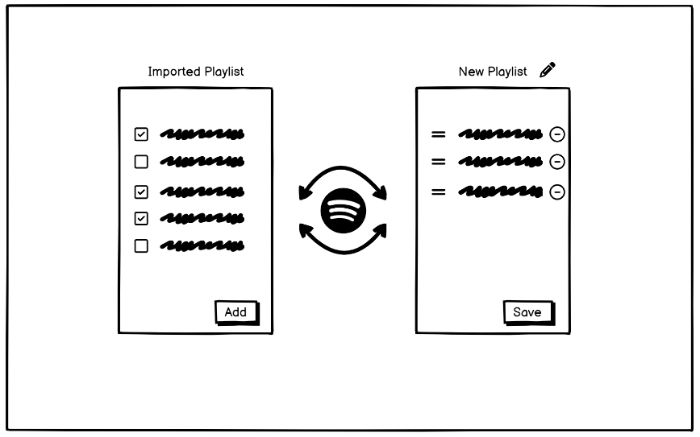
UI Mock-up
1. We have imported Playlist from Spotify that we like.
2. We select favourite songs from the playlist and click add.
3. You can add to an existing playlist or create a new one.
4. You can then edit the order and layout of your playlist.

Slide 3
Technologies for implementation
Our team decided that the main technology used in development will be React.js, which is a popular open source library for front-end and back-end development.
React can be used to develop single-page, mobile, or server-rendered applications with frameworks like, and that is why it fits well for our idea.
The plan is to start developing UI front-end first, and then enable functionality through back-end.

Slide 4
Teamwork allocation and testing
Currently, the plan is to put Jevgenij and Fabian on React.js development.
Fiachra is responsible for UI design, mock-ups and visual appeal.
Later in development, we will decide the work load for audio implementations.
During the development, we will cross collaborate to help each other out and learn as a group.

Slide 5
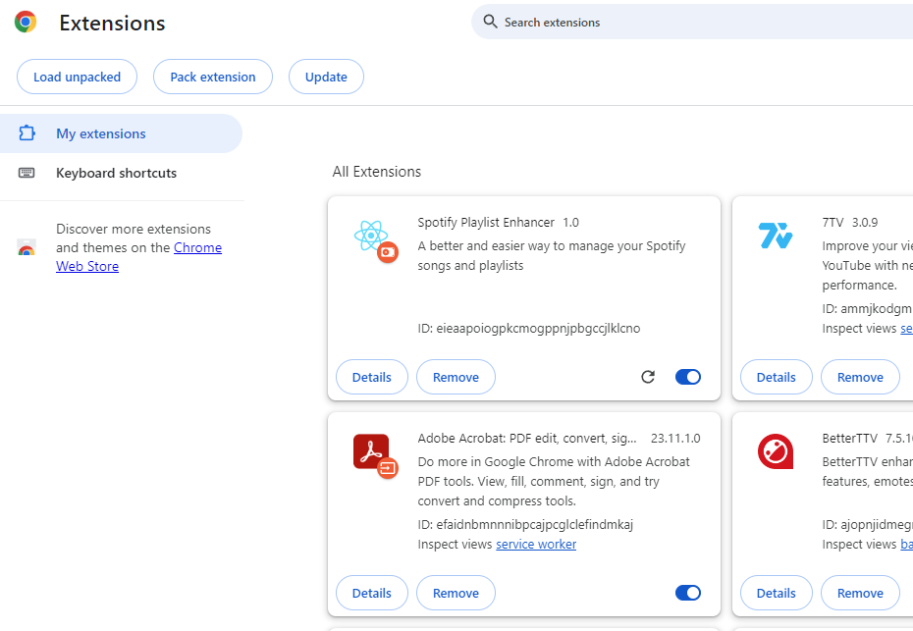
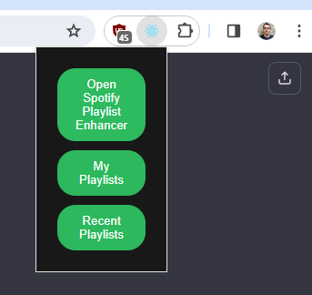
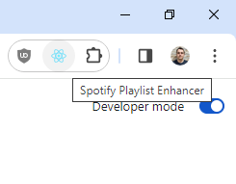
Jevgenij’s work
Created Google Chrome extension compatibility with React App. The app now appears in the list of Chrome Extensions
-
-
-

