Slide 1



INTRODUCTION
Asset Classes
Trade Selection
AI Assistance
Webull: options on stocks (NVDA, AAPL, MSFT, AMZN, PG, JPM) and ETFs (SPY, VOO, IWM). CFI: CFDs on indices, gold, silver, oil, forex and an ETF
Fundamentals first (sector news, growth vs defensive stocks), then technicals (trend and price vs strike) before picking a call or a put
[Fill in: did you use AI? If yes, which tool and how. If no, say the analysis was your own]
Webull: −$17,466 (−1.75%) | CFI: +$18,409.92 (+18.4%)

Slide 2
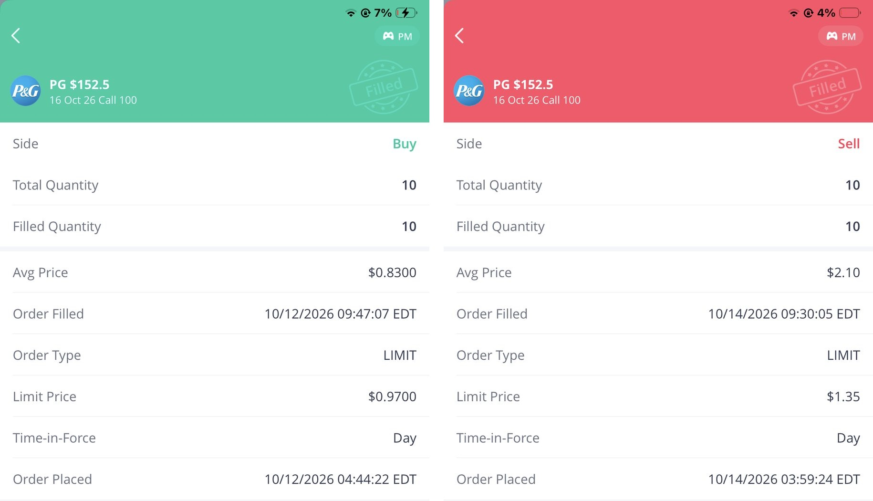
WINNING
TRADE: PG
Trade: Bought 10 PG $152.5 calls at $0.83 (12 Oct)
Result: Sold 10 at $2.10 (14 Oct), net +$1,270 (+153%)
Why it worked: PG rose above the strike; defensive staples were bought ahead of mid-October earnings
Technical: Price sat just under the strike; with days to expiry, delta and gamma were high so a small move paid a lot
Figure: Webull buy and sell orders for the PG $152.5 call, net +$1,270.
WEBULL

Slide 3
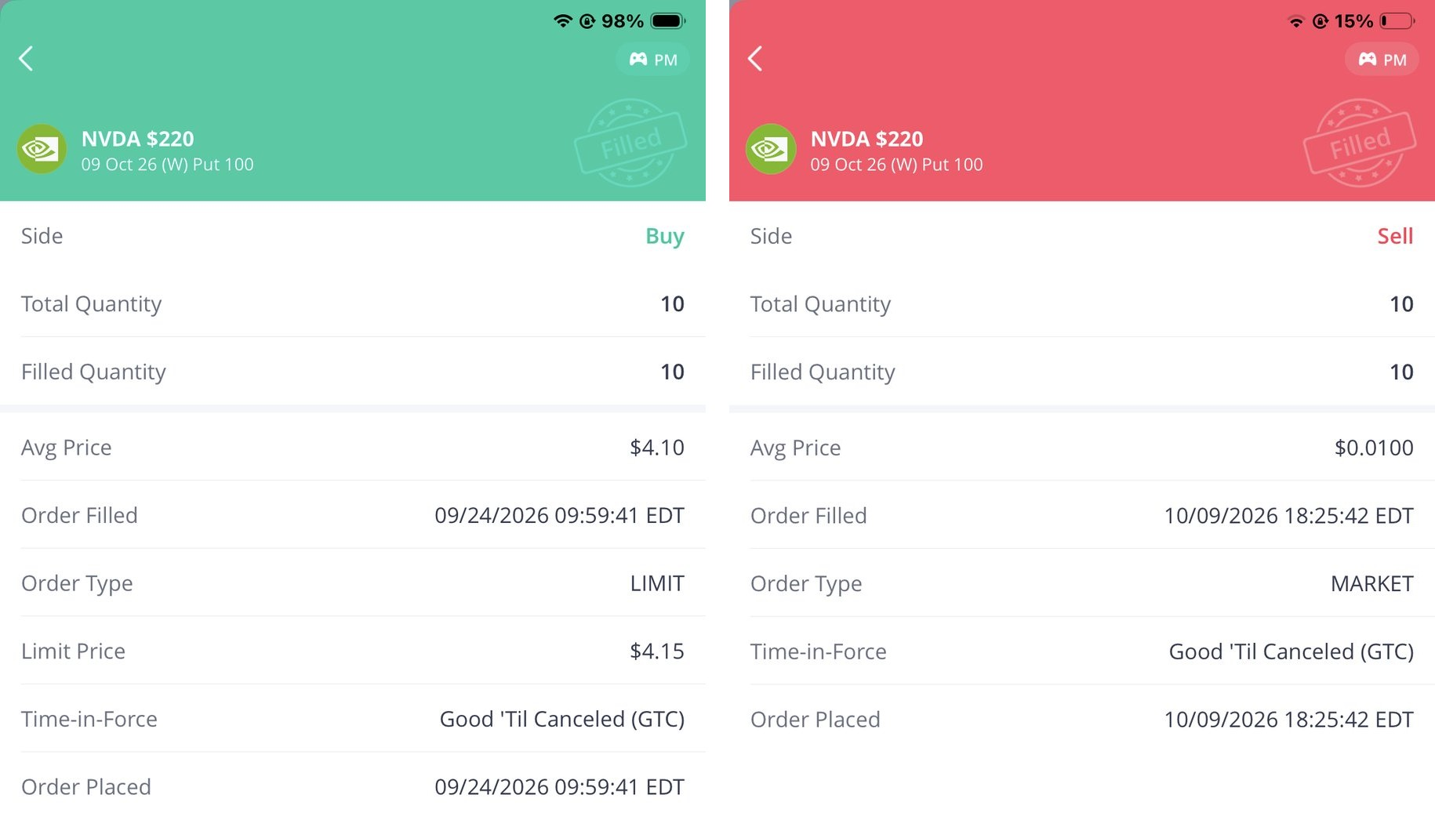
LOSING
TRADE: NVDA
Trade: Bought 10 NVDA $220 puts at $4.10 (24 Sep)
Result: Sold at $0.01 on expiry (9 Oct), net −$4,090
Why it failed: NVDA stayed above $220, so the put expired worthless and time decay took the premium
Mistake: I bought the put to 'balance' my NVDA call, against the uptrend and with no bearish news
Lesson: Trade with a thesis and exit at −50% instead of holding to expiry
Figure: Webull buy and sell orders for the NVDA $220 put, net −$4,090.
WEBULL

Slide 4
Webull Options
Matched my risk appetite: total premium was $32,852 (3.3% of the account) and no trade was over 0.6%. But I used no stops, and short-dated options lost 53% of the premium.
RISK
MANAGEMENT
CFI CFDs
Did not match: 14 of 15 trades had no stop-loss and 8 lots of gold was about $3.3M of exposure. Silver and the Nikkei lost $40,884. Options risk the premium; CFDs risk leverage.
Hedging NVDA
Protective put: caps the loss but costs the premium. Covered call: earns income but caps gains. My speculative NVDA put lost 99.8% of its premium; owning shares with a put would only have cost insurance.

Slide 5
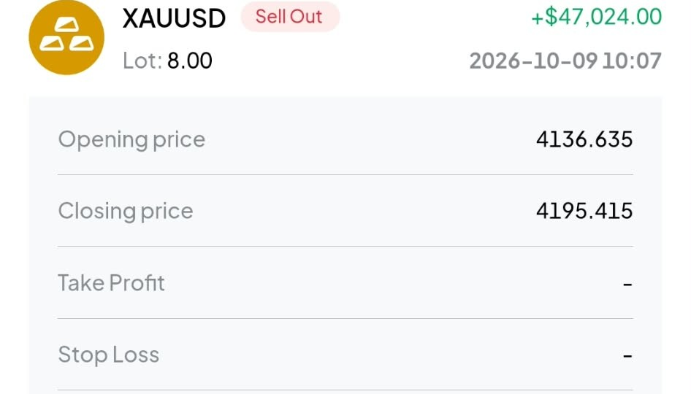
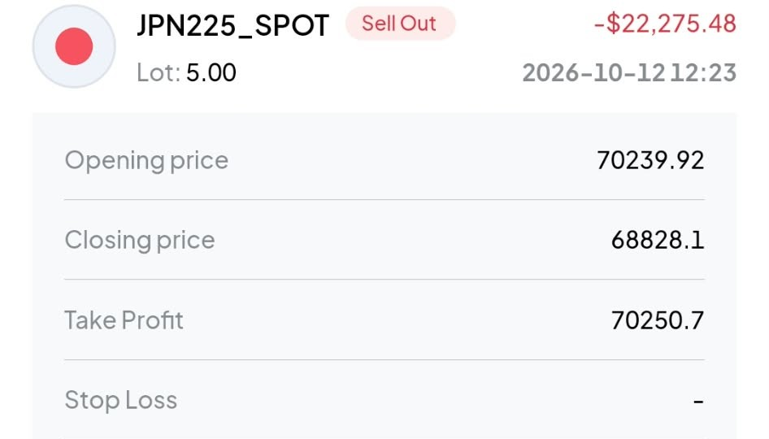
CFDS ON CFI
Start: $100,000
End: $118,409.92
Winning Trade: XAUUSD +$47,024 (4136.635 > 4195.415)
Losing Trade: JPN225 −$22,275.48 (70239.92 > 68828.1)
15 Trades:
Vs Options on Webull
Balance grew +$18,409.92 (+18.4%). 10 wins, 4 losses, 1 still open. Gold alone made +$52,326.
No expiry or time decay; leverage is the risk. No stops, so one Nikkei trade lost $22,275.
CFDs let traders profit from price moves without owning the asset.

Slide 6
REFLECTION
What Needs Learning
Risk Tolerance
Option Greeks (theta and delta), choosing 30–45 day expiries, position sizing and MT5 stop-loss tools.
Lower than I thought. A fixed premium loss felt fine; one silver CFD losing $18,608 in two days did not.
Biggest Lesson
Emotions
Plan the exit before the entry. A stop-loss on the Nikkei and silver trades would have saved most of the $40,884.
Early option losses made me cautious. The +$47,024 gold win made me overconfident, so I opened six CFDs at once.

Slide 7
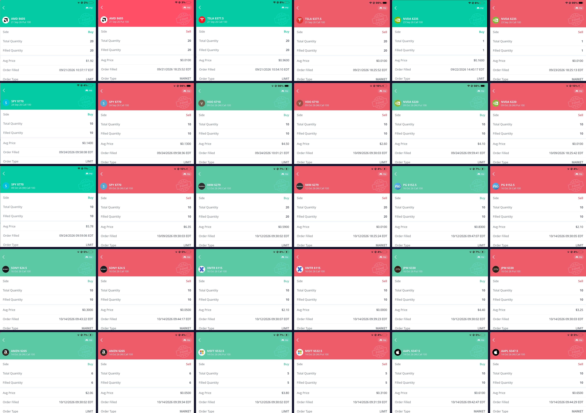
APPENDIX
WEBULL - SALMAN
Figure: Webull buy and sell orders for all 15 options trades (21 Sep to 14 Oct 2026).

Slide 8
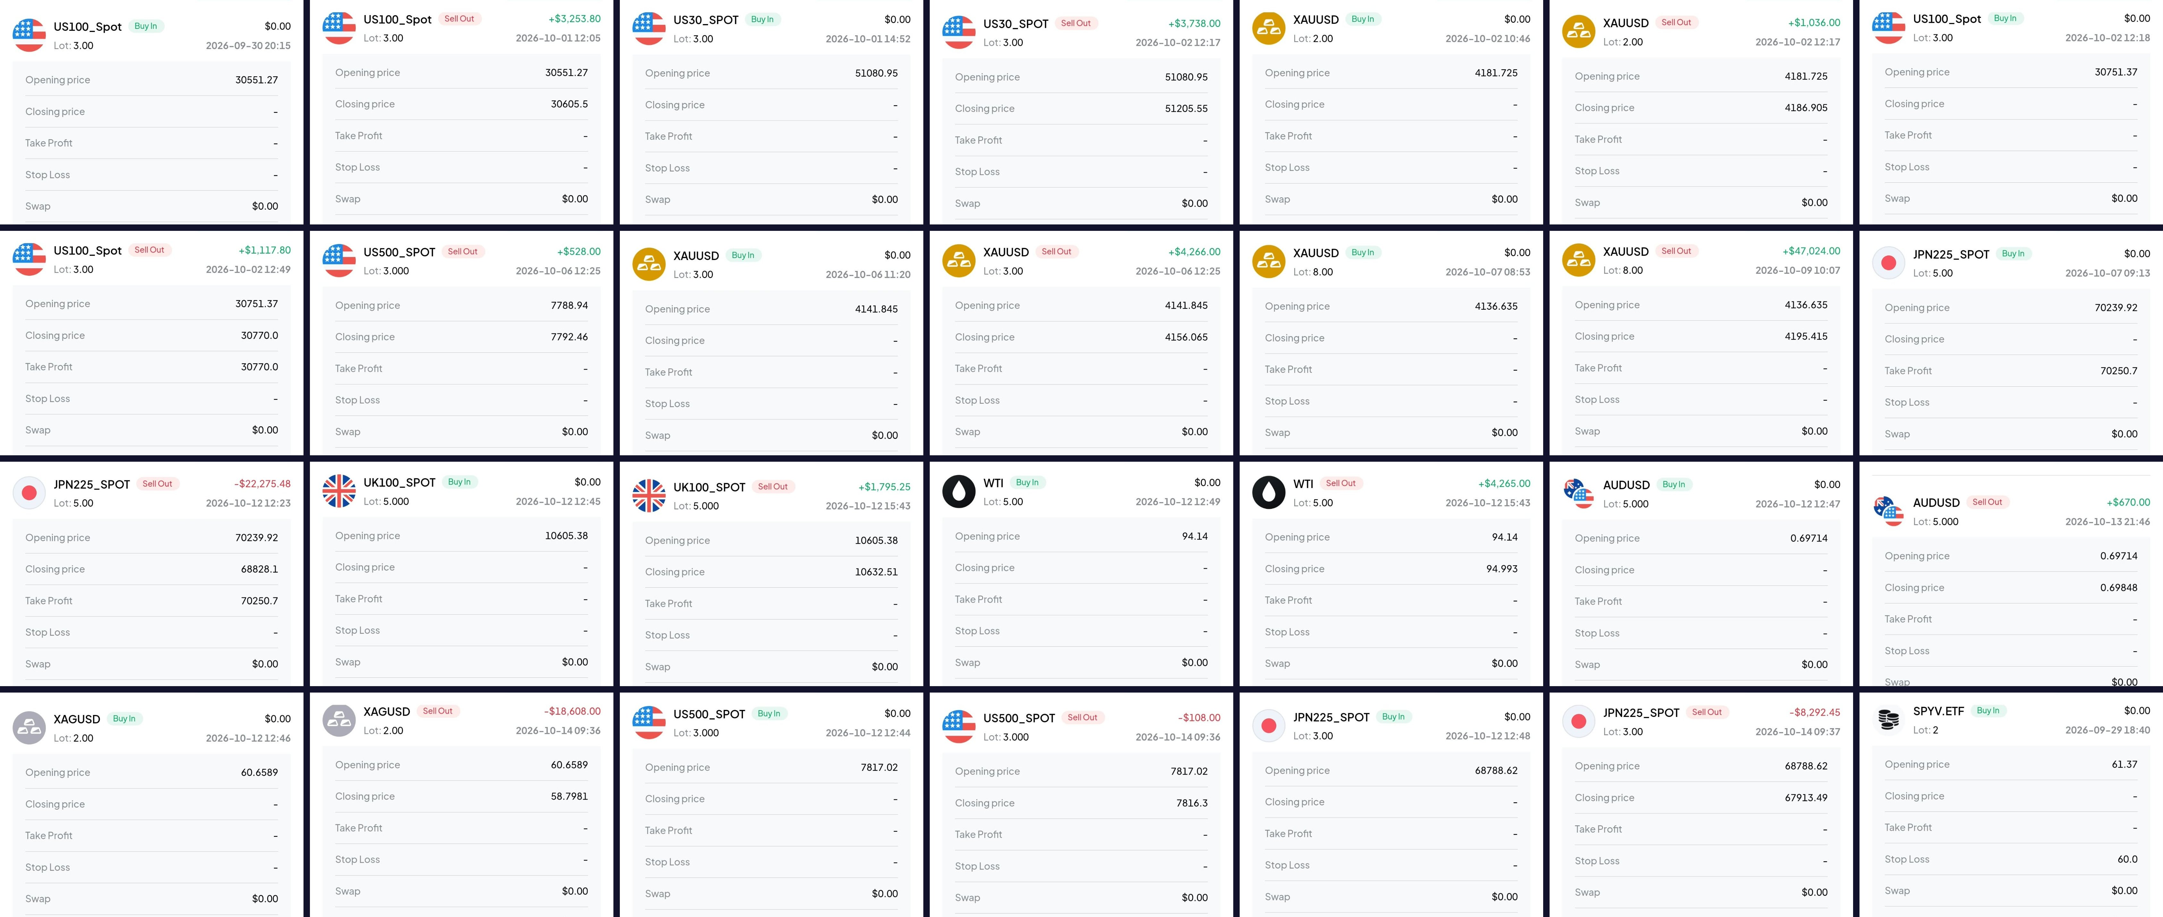
APPENDIX
CFI - SALMAN
Figure: CFI trade history for all 15 CFD trades (29 Sep to 14 Oct 2026).

