Slide 1
BU 8301 · GROUP ASSESSMENT
Options vs CFDs: What Four Weeks of Trading Taught Us
Webull paper trading (options) · CFI demo account (CFDs) · 13 Sep – 14 Oct 2026
−$17,466
+$18,410
30
Webull options P/L
15 trades · −1.75% of $1M
CFI CFD P/L
15 trades · +18.4% of $100k
Trades across stocks, ETFs,
indices, commodities & forex
Presented by: [Group member names & IDs]
Notes:
Edit the presenter names in Canva before submitting.

Slide 2
Five Asset Classes, Two Platforms, Opposite Results
SLIDE 1 · INTRODUCTION
Why these asset classes (fundamental view)
Did the accounts grow?
Stocks
NVDA, AAPL, MSFT, AMZN, TSLA, AMD: AI-driven earnings growth and very liquid options. PG, JPM, SONY, XMTR added sector diversification (staples, banks, electronics).
−1.75%
+18.4%
Webull: $1,000,000 → $982,534
CFI: $100,000 → $118,410
ETFs
SPY, VOO, IWM, SPYV: a view on the whole US market (large and small caps) without single-stock risk.
Indices
US100, US30, US500, UK100, JPN225 CFDs: trading the global equity trend.
Options: 3 of 15 winners. Short-dated, out-of-the-money contracts lost value to time decay.
CFDs: 10 of 14 closed trades won. One gold trade (+$47,024) drove most of the profit.
Commodities
Gold and silver as safe-haven hedges in an uncertain rate environment; WTI oil for supply-driven moves.
Forex
AUD/USD: a risk-on currency linked to commodity demand.
Use of AI: [Edit: state Yes/No. If yes, name the tool (e.g. ChatGPT, CFI AI) and how it shaped trades. If no, say the analysis came from Webull and MT5 charts and market news.]
Notes:
Talking point: stocks/ETFs on Webull through options; indices, commodities, forex and an ETF on CFI through CFDs. Fill in the AI statement honestly: the rubric gives full marks either way as long as it is clear.

Slide 3
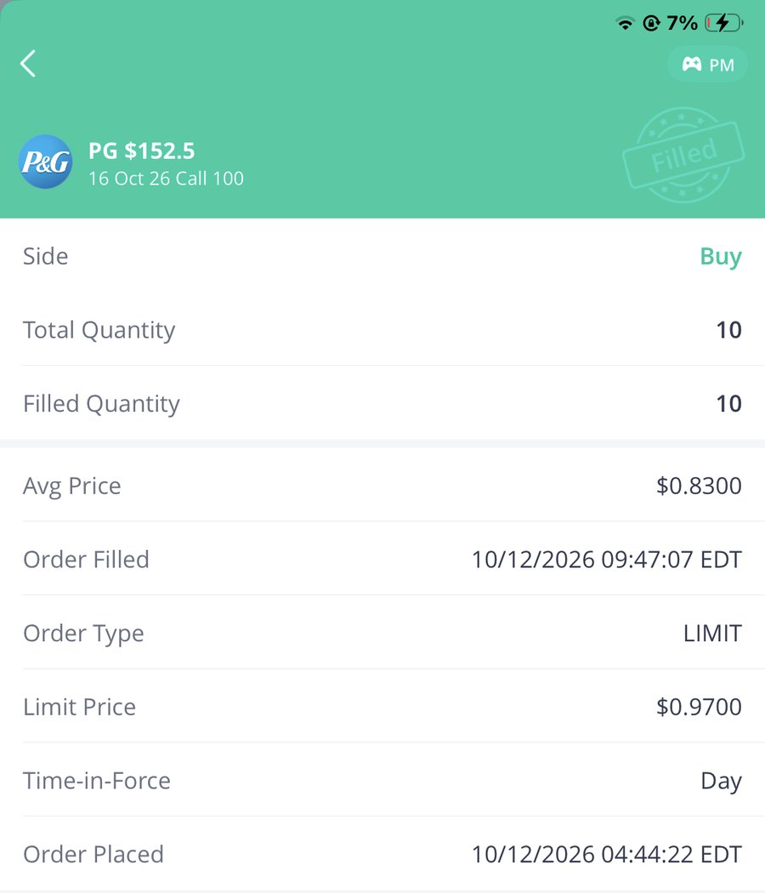
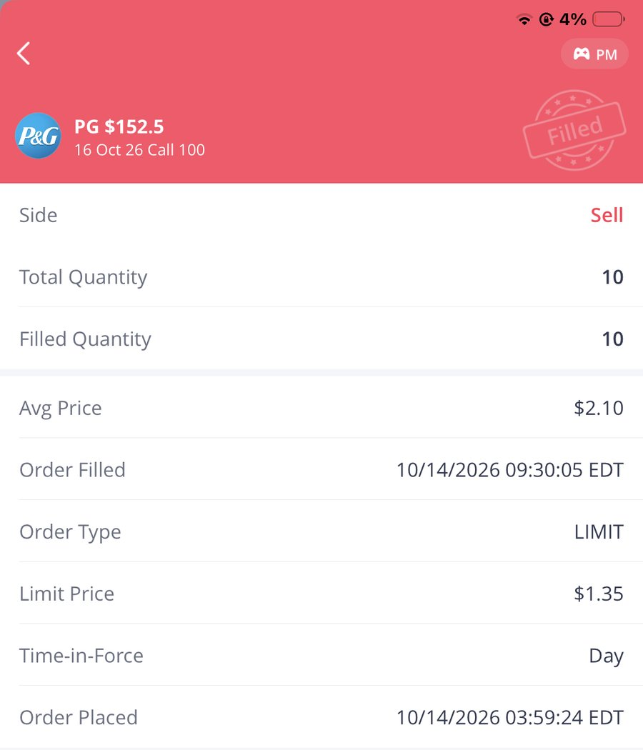
PG $152.5 Call: +$1,270 (+153%) in Two Days
SLIDE 2 · ONE WINNING TRADE (WEBULL)
Why it moved
CONTRACT
PG $152.5 Call · exp 16 Oct
PG rose above the $152.5 strike, so the call gained intrinsic value: a $2.10 price two days before expiry means PG was trading around $154 or higher.
With only days to expiry the option had high delta and gamma, so a small move in PG gave a large % move in the premium.
We sold at the open instead of waiting, which locked in the gain before time decay could take it back.
BOUGHT · 12 OCT
10 × $0.83 = $830
SOLD · 14 OCT
10 × $2.10 = $2,100
ORDER TYPE
Limit (sell limit $1.35, filled $2.10)
Buy · filled 12 Oct
Sell · filled 14 Oct
PROFIT
+$1,270
Fundamental: PG is a defensive consumer-staples company with steady earnings and dividends, a stable stock to add next to our tech trades. Its quarterly results are due mid-October.
Technical: price was just below the strike, so a small breakout above $152.5 would put the call in the money.
Our biggest options win
Also positive: SPY $770 call +$570 and AAPL $347.5 call +$40.
RETURN ON PREMIUM
+153%
MAX RISK
$830 (premium only)
Notes:
Confirm the fundamental/technical reasons match what the group actually saw when placing the trade.

Slide 4
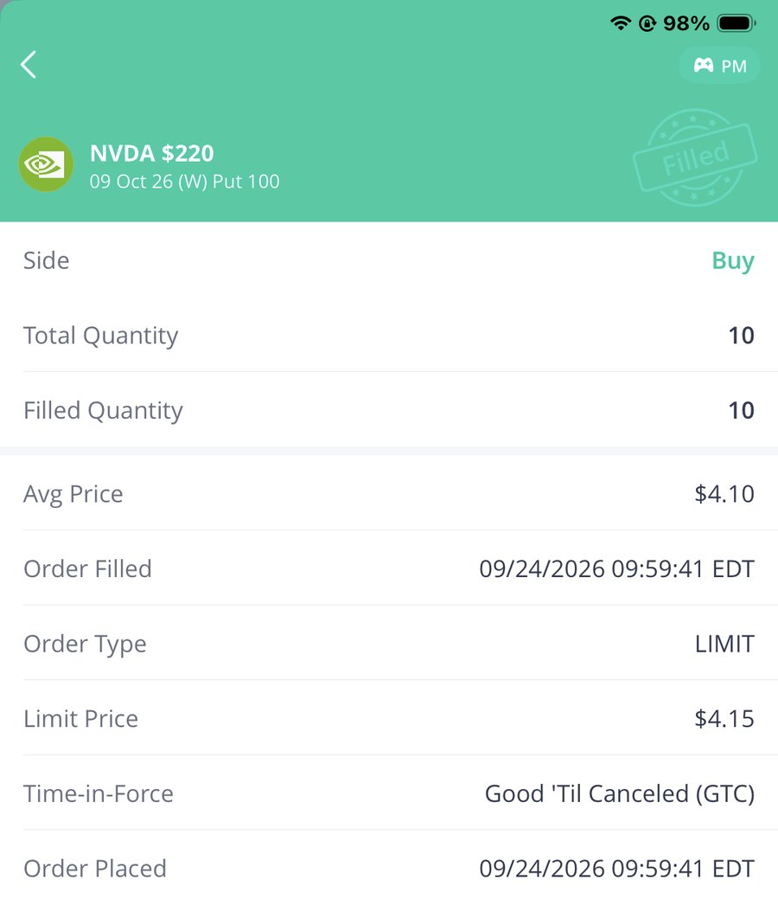
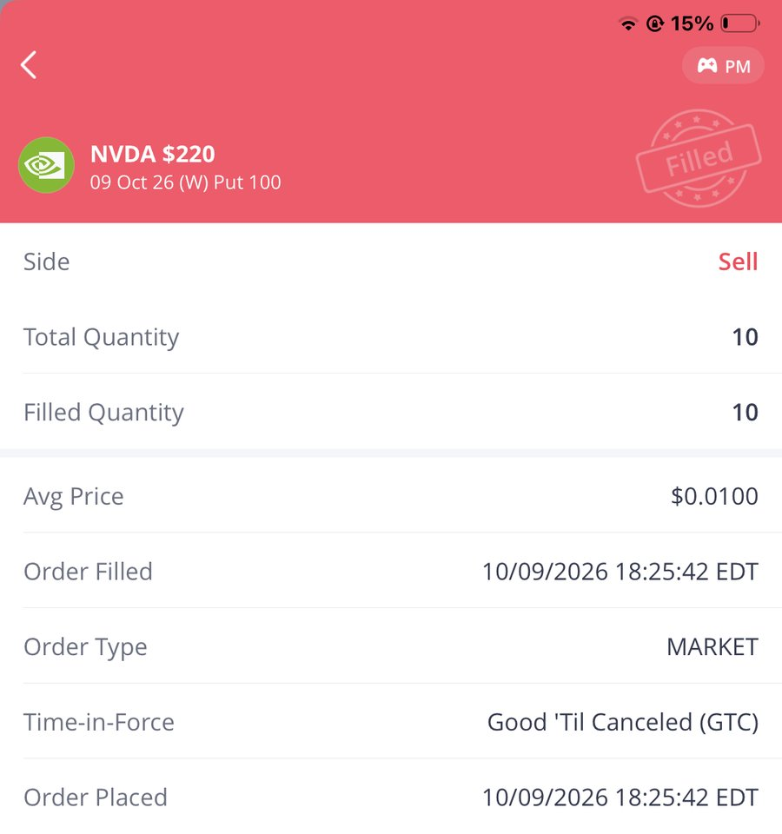
NVDA $220 Put: −$4,090, Our Largest Loss
SLIDE 3 · ONE LOSING TRADE (WEBULL)
Why it moved
CONTRACT
NVDA $220 Put · exp 9 Oct
NVDA stayed above $220 until expiry, so the put finished out of the money and worthless.
Time decay (theta) ate the $4.10 premium every day NVDA failed to fall.
The put was bought to 'balance' our NVDA call, not because we expected a fall: a bet against the trend without a catalyst.
BOUGHT · 24 SEP
10 × $4.10 = $4,100
SOLD · 9 OCT (EXPIRY)
10 × $0.01 = $10
ORDER TYPE
Limit buy · market sell
Buy · filled 24 Sep
Sell · 9 Oct expiry
LOSS
−$4,090
Lessons learned
Trade with a thesis, not to 'balance' a position.
Set an exit, e.g. sell at −50% of premium.
Don't hold to expiry and let it go to $0.
RETURN ON PREMIUM
Technical: the NVDA chart was trending up (the same reason we bought the $235 call), so the put went against the trend.
Fundamental: AI chip demand kept supporting NVDA; we had no bearish news to justify a put.
−99.8%
BREAKEVEN NEEDED
NVDA below $215.90

Slide 5
Small Option Bets, Big CFD Leverage
SLIDE 4 · RISK MANAGEMENT (1/2)
Webull options
CFI CFDs
 | Options (Webull) | CFDs (CFI)
Max loss | Premium paid | Can exceed margin
Leverage | Built in, capped | High, margin-based
Time decay | Yes, works against buyers | None (swap only)
Payoff | Non-linear | Linear 1:1 with price
Our result | −$17,466 | +$18,410
$32,852
≈33×
total premium paid = 3.3% of $1M
gold 8 lots ≈ $3.3M exposure on a $100k account
0.6%
14 of 15
largest position ($5,780 SPY call)
trades opened with no stop-loss
Matched a low risk appetite: the most we could ever lose was the premium. But 53% of that premium was lost because we chose short-dated, out-of-the-money contracts.
Above our risk appetite: a 3% fall in silver cost $18,608 and a 2% fall in the Nikkei cost $22,275. We handled losses by closing them manually, often too late.
Options risk is known up front; CFD risk grows with position size, so stops and sizing matter more.

Slide 6
Hedging vs Speculation on NVDA
SLIDE 4 · RISK MANAGEMENT (2/2)
What we did: bought 10 NVDA $220 puts for $4,100 as a pure bet on a fall, with no shares to protect. When NVDA stayed above $220, we lost 99.8% of the premium.
Speculation (what we did)
Protective put (hedge)
Covered call (hedge)
Long 10 × $220 puts, no shares
Own 1,000 NVDA shares + buy 10 × $220 puts
Own 1,000 NVDA shares + sell 10 × $235 calls
Cost: $4,100
Max loss: $4,100 (100%)
Max gain: large only if NVDA falls below $215.90
Result: −$4,090
Cost: $4,100 insurance
Max loss: (entry − $220) × 1,000 + $4,100
Max gain: unlimited upside, less $4,100
NVDA stayed up: shares gain, put expires as paid insurance
Income: call premium received up front
Downside: cushioned only by that premium
Max gain: capped at $235 + premium
Suits a flat-to-slightly-up view
Takeaway: a hedge accepts a small, known cost to protect a position we already own; speculation risks the whole premium on direction. A protective put caps loss and keeps upside; a covered call adds income but caps upside.

Slide 7
CFDs: +$18,410 (+18.4%), With Big Swings
SLIDE 5 · CFDS ON CFI
What is a CFD?
A Contract for Difference: an agreement with the broker to exchange the change in an asset's price. You never own the asset, can go long or short, and trade on margin (leverage).
$100,000
starting balance (demo 35224)
10 wins / 4 losses (71%); SPYV still open
Avg win $6,769 vs avg loss −$12,321
Gold +$52,326 · indices −$20,243 · silver −$18,608
How it differed from options
No premium, expiry or time decay
Profit/loss moves 1:1 with price × lot size
Losses are not capped by a premium
$118,409.92
ending balance (app screenshot)
Notes:
Ending balance and P&L match the CFI app and the Excel log: 14 closed trades. SPYV.ETF is still open (+$2.50 unrealised, not counted).

Slide 8
Size by Risk, Not by Confidence
SLIDE 6 · REFLECTION
1
Emotions
2
Risk tolerance now
Losing $5,720 on our first two trades made us cautious (next trade: 1 contract). The +$47,024 gold win made us overconfident: on 12 Oct we opened six CFDs at once, and silver and the Nikkei then lost $26,900.
Lower than we thought. Losing a fixed premium felt manageable; watching a leveraged CFD fall 18% of the account in two days did not. We now prefer defined-risk trades.
3
Biggest lesson
4
What we still need
Decide the exit before the entry. Set a stop-loss and take-profit on every CFD and a loss limit on every option, and keep each trade to 1–2% of capital at risk.
Option Greeks (theta, delta), choosing 30–45-day expiries, position-sizing rules, an economic calendar, and the CFI Academy courses on MT5 risk tools.
Notes:
These are drafts based on the trade record. Each member should adapt them to how they actually felt; every presenter will be asked individually.

Slide 9
Webull Options Trade Log (15 Trades)
APPENDIX A · WEBULL
# | Opened | Ticker | Type | Strike | Premium | Contracts | Closed | Exit | P/L
2 | 21 Sep | AMD | Put | $605 | $1.92 | 20 | 21 Sep | $0.01 | −$3,820
3 | 21 Sep | TSLA | Call | $377.5 | $0.96 | 20 | 21 Sep | $0.01 | −$1,900
4 | 22 Sep | NVDA | Call | $235 | $0.16 | 1 | 23 Sep | $0.01 | −$15
5 | 24 Sep | SPY | Call | $770 | $0.14 | 10 | 24 Sep | $0.13 | −$10
6 | 24 Sep | VOO | Call | $710 | $4.50 | 10 | 9 Oct | $2.60 | −$1,900
7 | 24 Sep | NVDA | Put | $220 | $4.10 | 10 | 9 Oct | $0.01 | −$4,090
8 | 24 Sep | SPY | Call | $770 | $5.78 | 10 | 9 Oct | $6.35 | +$570
9 | 12 Oct | IWM | Call | $279 | $0.59 | 20 | 12 Oct | $0.01 | −$1,160
10 | 12 Oct | PG | Call | $152.5 | $0.83 | 10 | 14 Oct | $2.10 | +$1,270
11 | 14 Oct | SONY | Call | $24.5 | $0.30 | 10 | 14 Oct | $0.05 | −$250
12 | 12 Oct | XMTR | Call | $115 | $2.10 | 10 | 14 Oct | $0.00 | −$2,100
13 | 12 Oct | JPM | Put | $330 | $4.40 | 10 | 14 Oct | $3.25 | −$1,150
14 | 12 Oct | AMZN | Call | $265 | $2.06 | 6 | 14 Oct | $0.05 | −$1,206
15 | 12 Oct | MSFT | Put | $532.5 | $3.80 | 5 | 14 Oct | $0.31 | −$1,745
16 | 14 Oct | AAPL | Call | $347.5 | $0.61 | 10 | 14 Oct | $0.65 | +$40
Total realised P/L (all Buy-to-open) |  |  |  |  |  |  |  |  | −$17,466

Slide 10
CFI CFD Trade Log (All Long)
APPENDIX B · CFI
# | Instrument | Class | Lots | Opened | Closed | P&L
1 | US100 | Index | 3 | 30 Sep | 1 Oct | +$3,253.80
2 | US30 | Index | 3 | 1 Oct | 2 Oct | +$3,738
3 | XAUUSD | Gold | 2 | 2 Oct | 2 Oct | +$1,036
4 | US100 | Index | 3 | 2 Oct | 2 Oct | +$1,117.80
5 | US500 | Index | 3 | n/a | 6 Oct | +$528
6 | XAUUSD | Gold | 3 | 6 Oct | 6 Oct | +$4,266
7 | XAUUSD | Gold | 8 | 7 Oct | 9 Oct | +$47,024
8 | JPN225 | Index | 5 | 7 Oct | 12 Oct | −$22,275.48
9 | UK100 | Index | 5 | 12 Oct | 12 Oct | +$1,795.25
10 | WTI | Oil | 5 | 12 Oct | 12 Oct | +$4,265
11 | AUDUSD | Forex | 5 | 12 Oct | 13 Oct | +$670
12 | XAGUSD | Silver | 2 | 12 Oct | 14 Oct | −$18,608
13 | US500 | Index | 3 | 12 Oct | 14 Oct | −$108
14 | JPN225 | Index | 3 | 12 Oct | 14 Oct | −$8,292.45
15 | SPYV.ETF | ETF | 2 | 29 Sep | open | Open (+$2.50 unrealised)
Net P&L on 14 closed trades ($100,000 → $118,409.92) |  |  |  |  |  | +$18,409.92

Slide 11
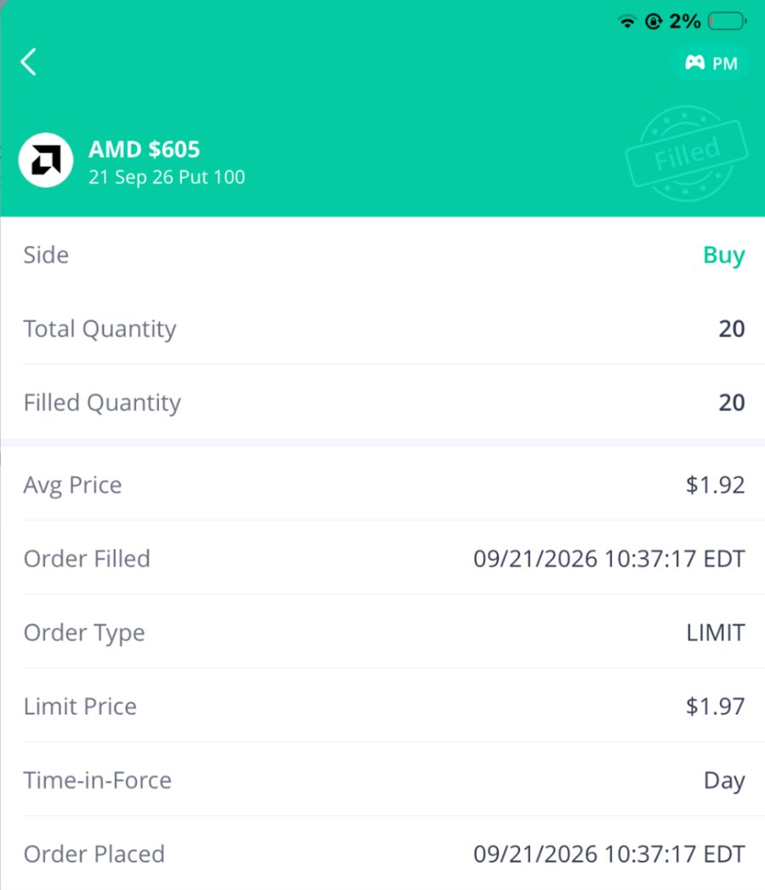
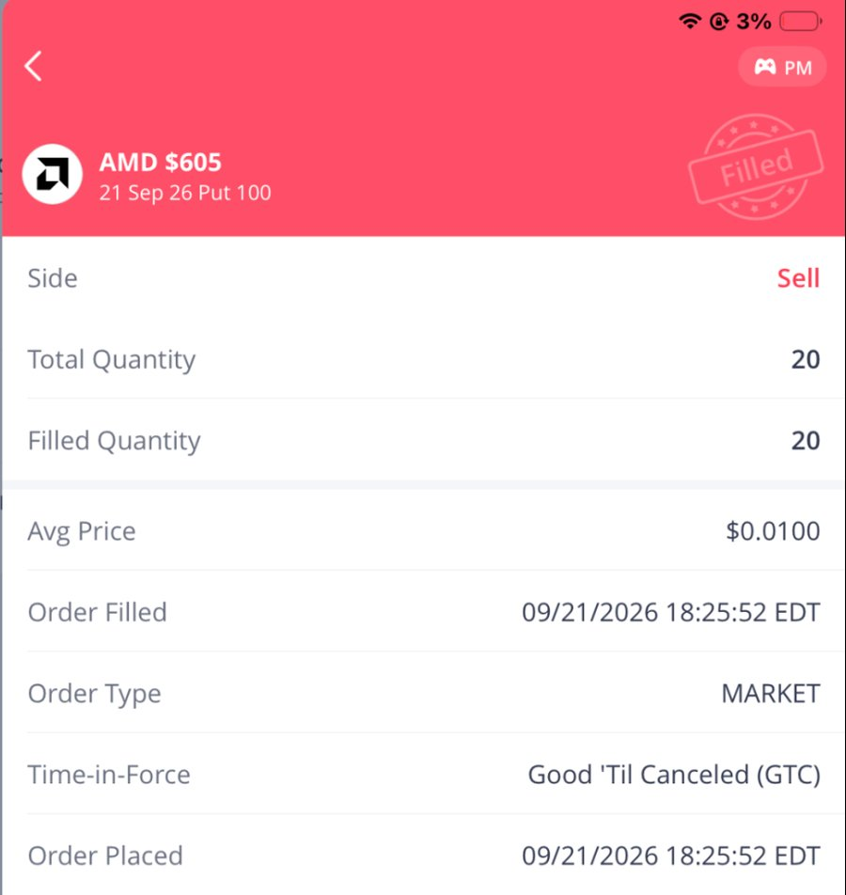
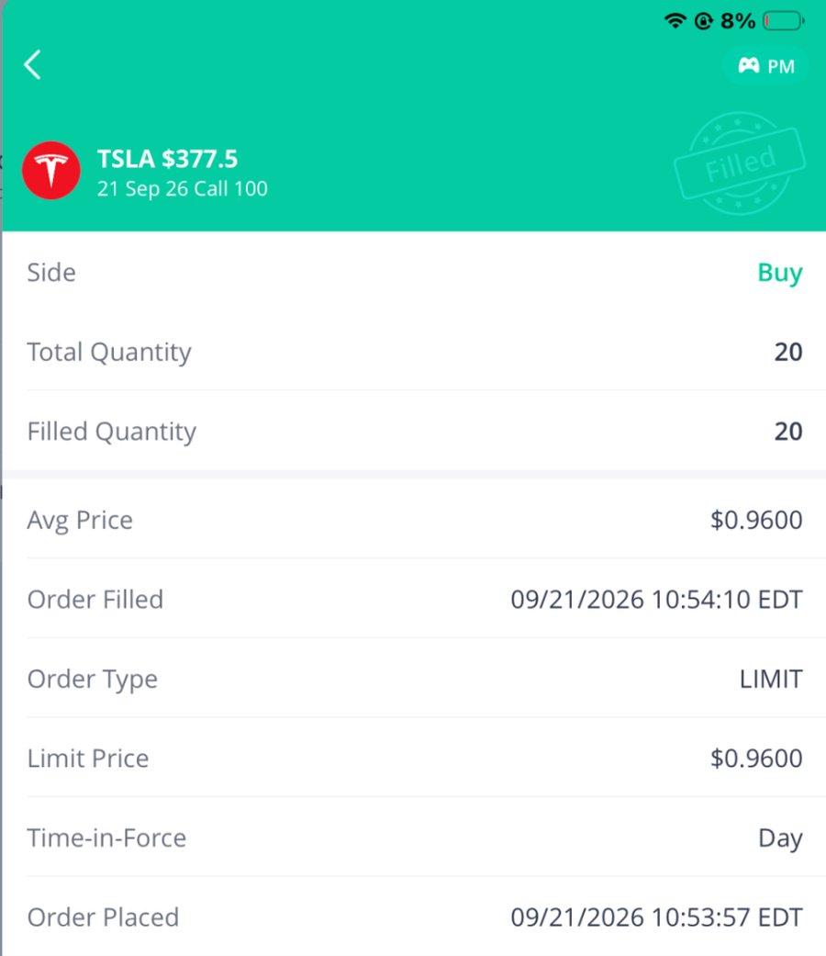
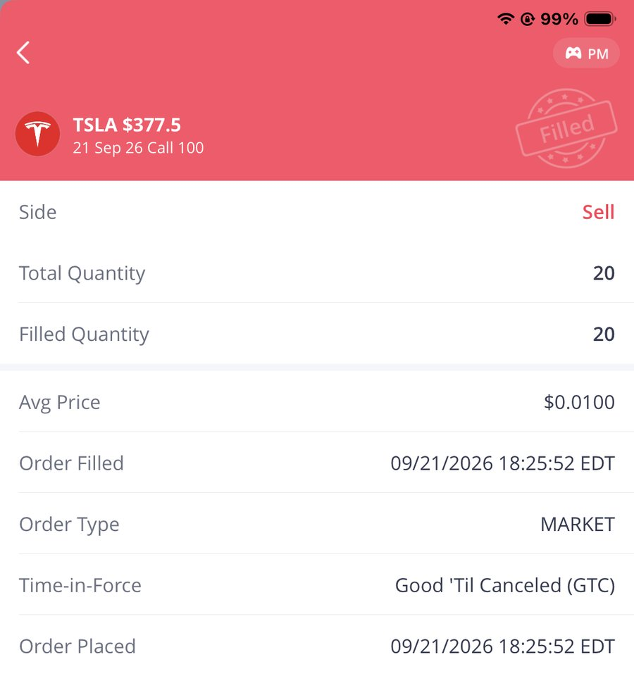
Trades #2 & #3: Buy and Sell Orders
APPENDIX C · WEBULL SCREENSHOTS
#2 AMD $605 Put −$3,820
#3 TSLA $377.5 Call −$1,900

Slide 12
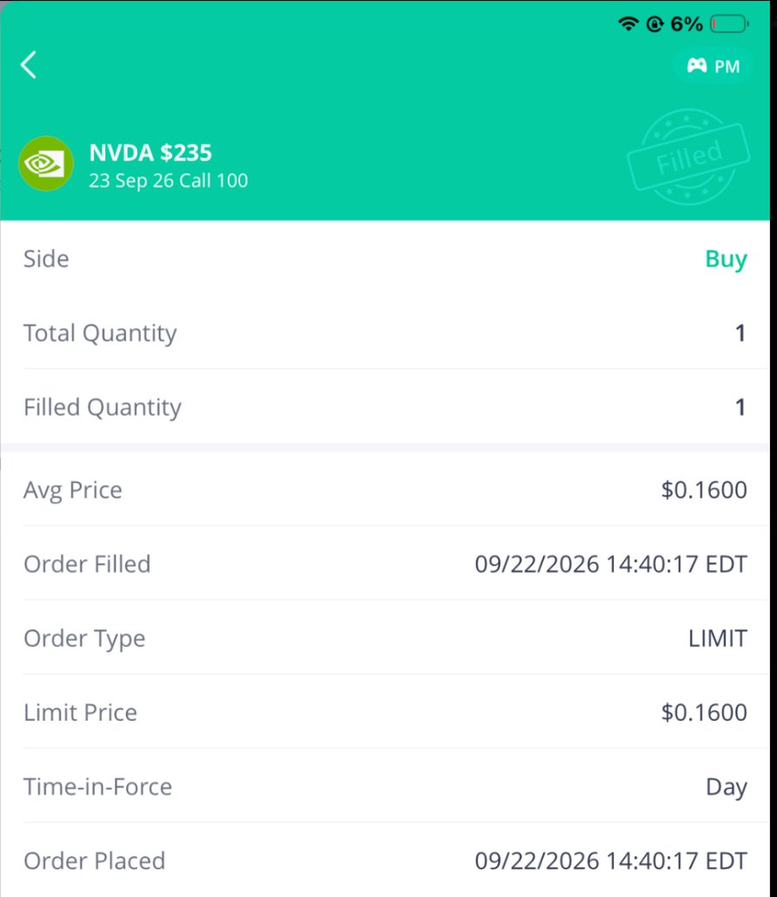
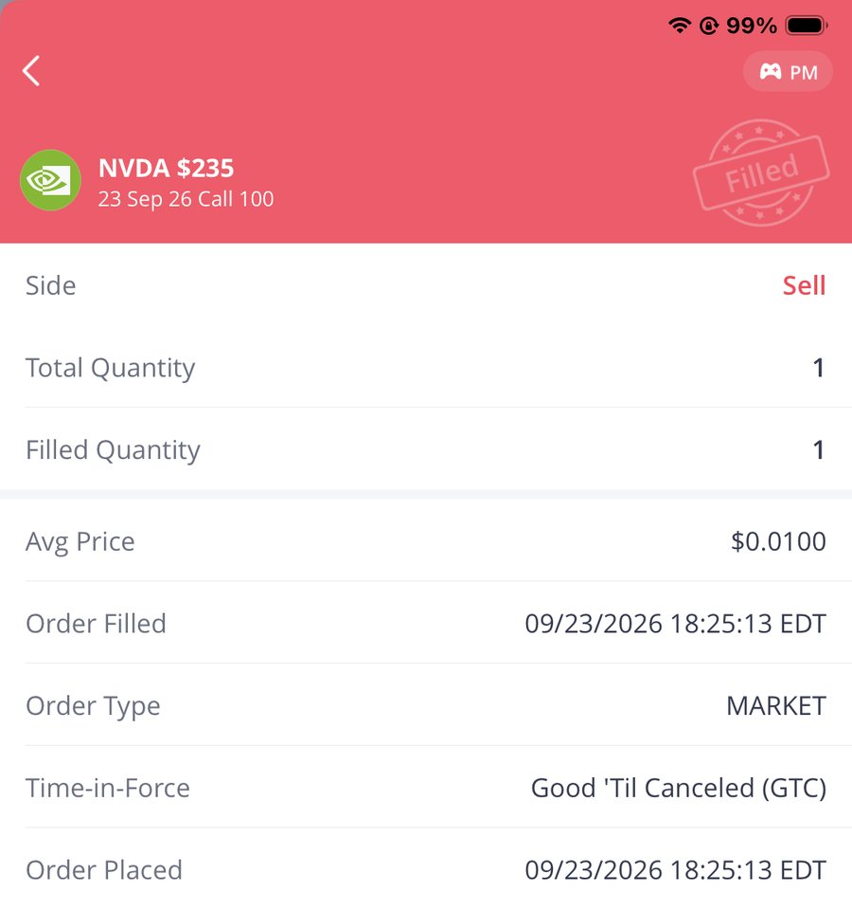
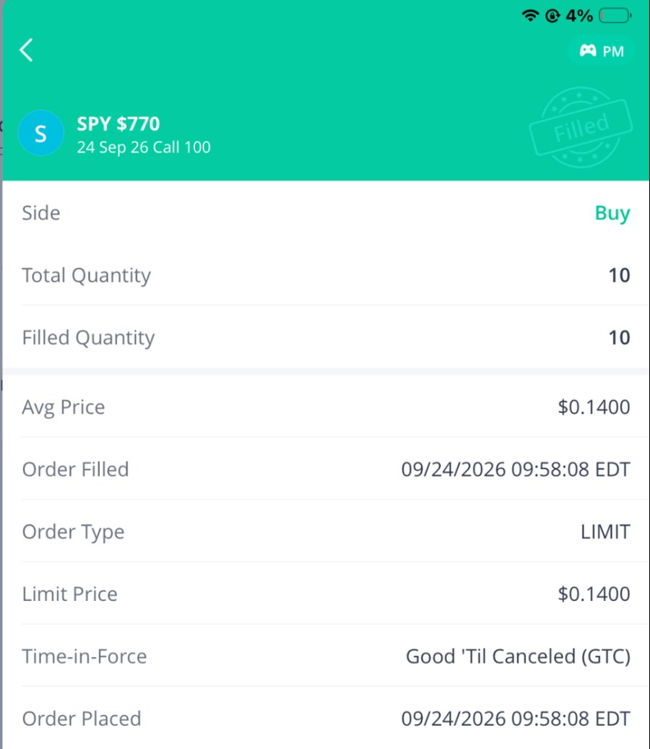
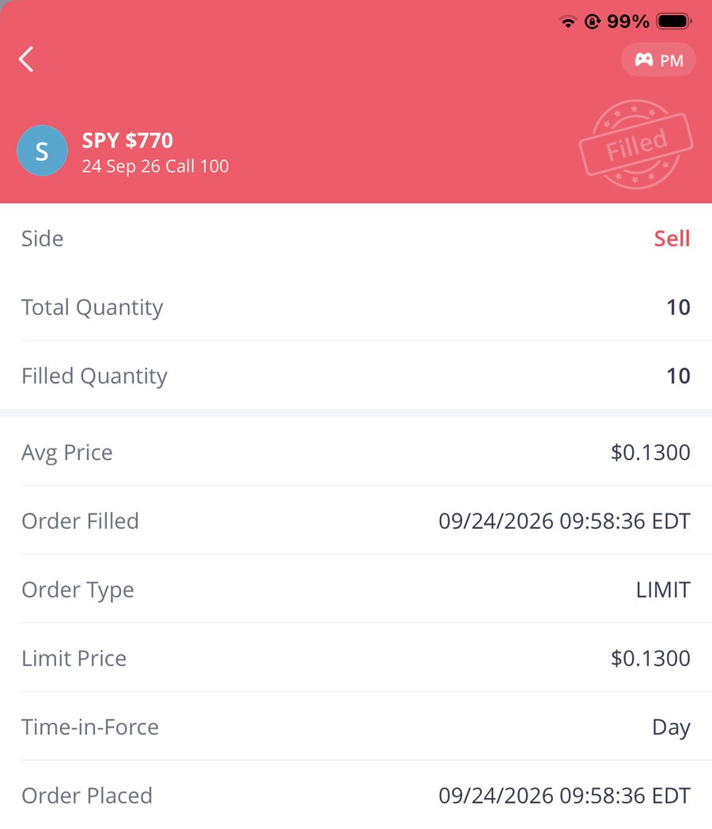
Trades #4 & #5: Buy and Sell Orders
APPENDIX C · WEBULL SCREENSHOTS
#4 NVDA $235 Call −$15
#5 SPY $770 Call −$10

Slide 13
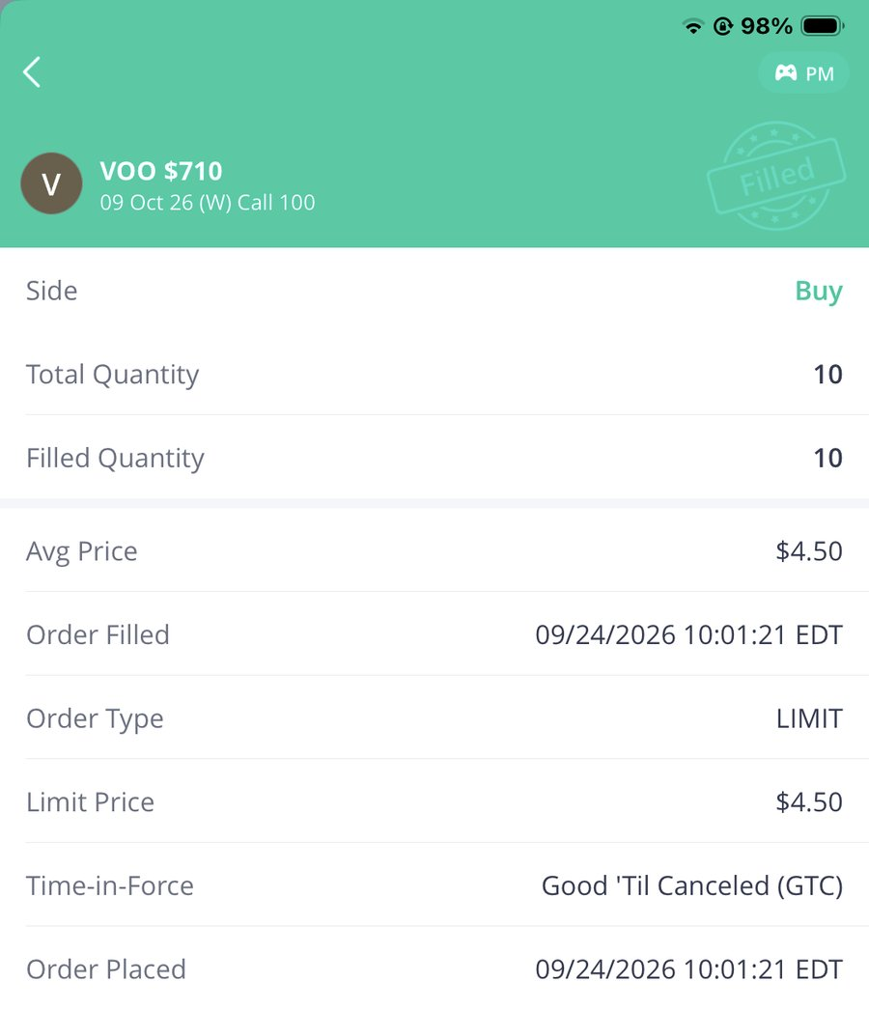
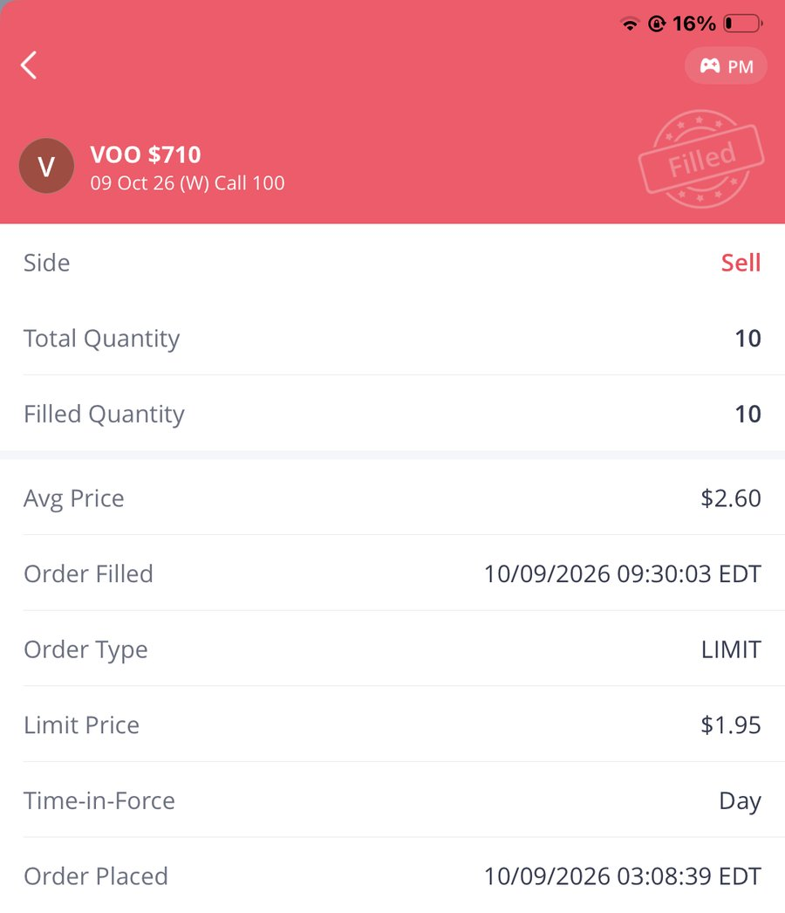
Trades #6 & #7: Buy and Sell Orders
APPENDIX C · WEBULL SCREENSHOTS
#6 VOO $710 Call −$1,900
#7 NVDA $220 Put −$4,090

Slide 14
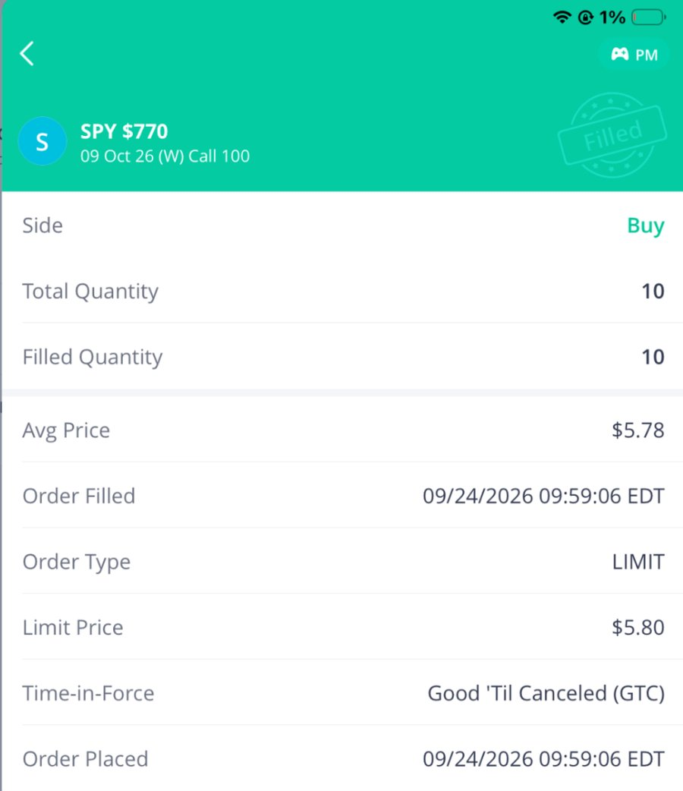
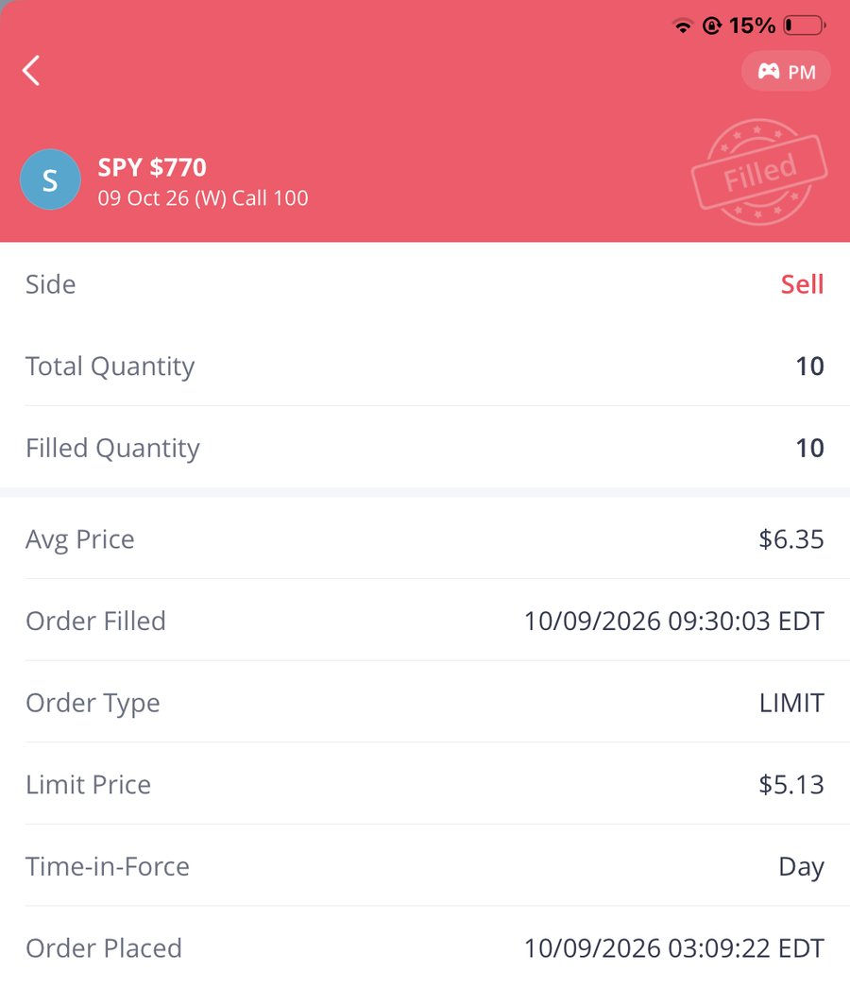
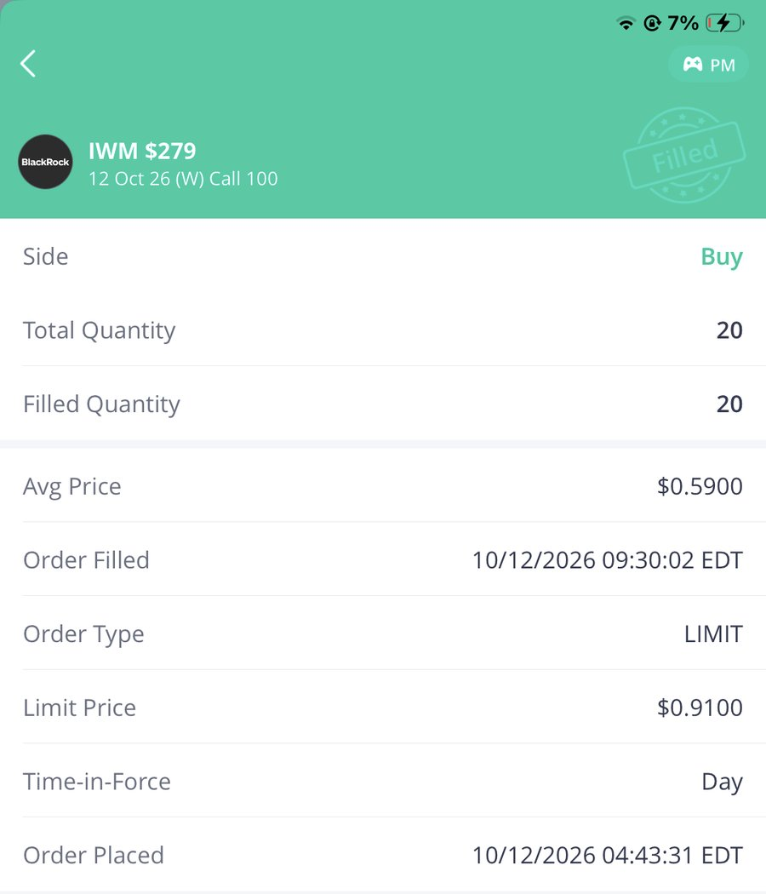
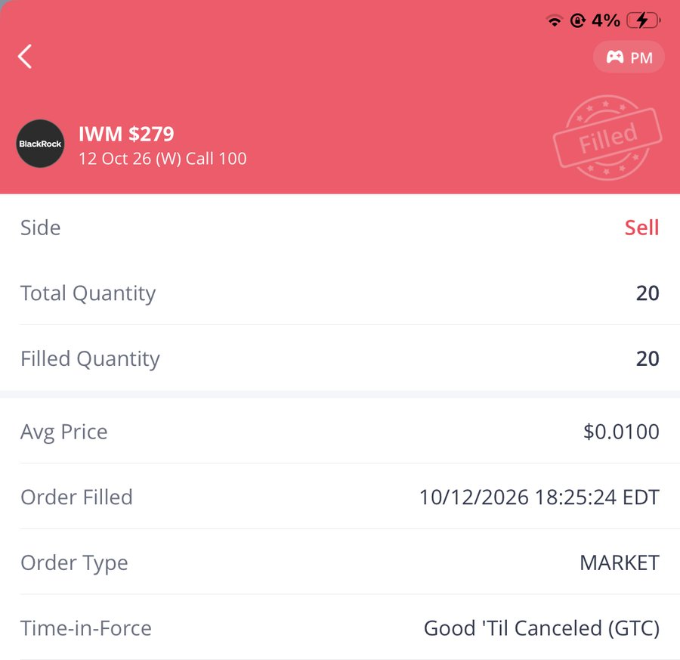
Trades #8 & #9: Buy and Sell Orders
APPENDIX C · WEBULL SCREENSHOTS
#8 SPY $770 Call +$570
#9 IWM $279 Call −$1,160

Slide 15
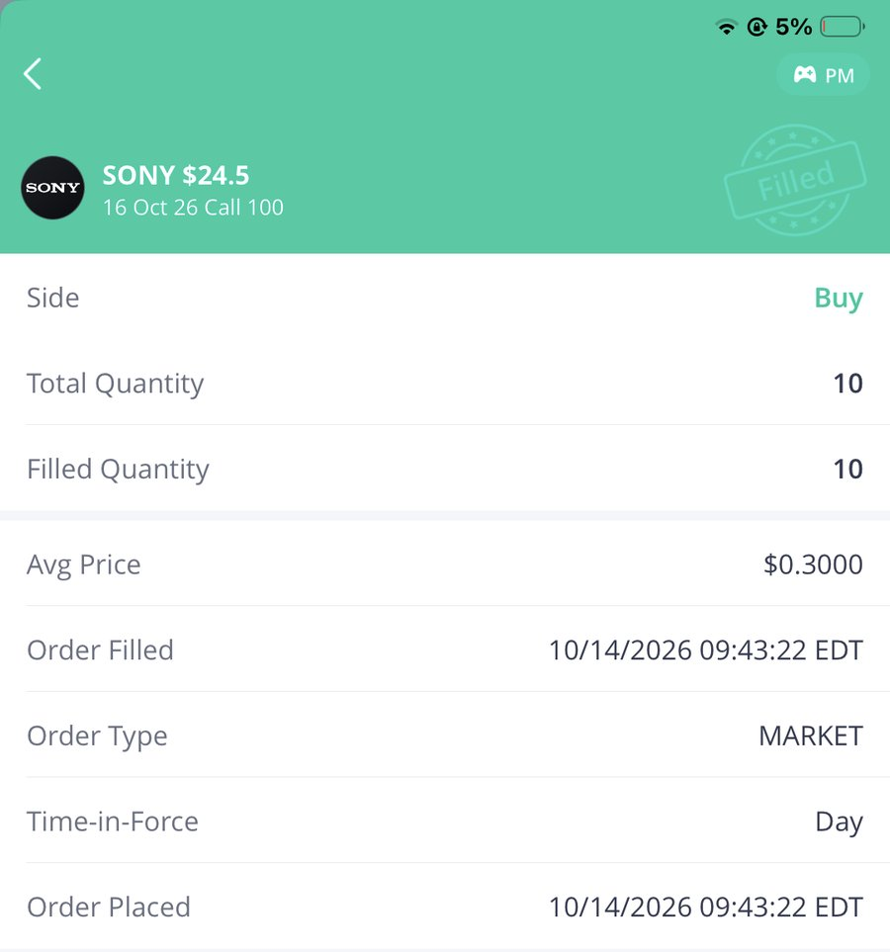
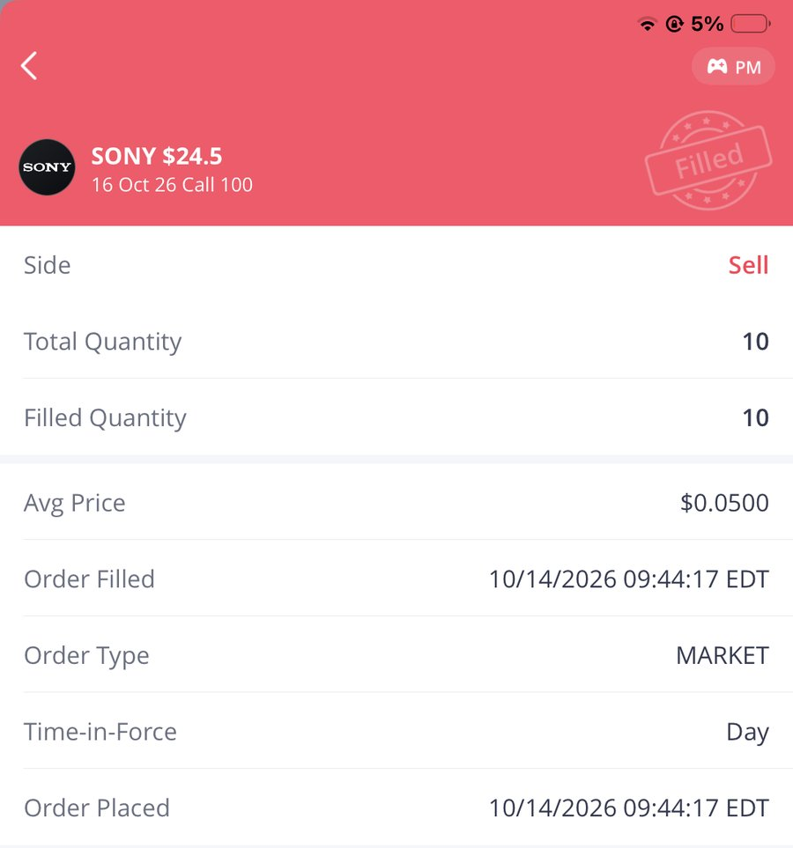
Trades #10 & #11: Buy and Sell Orders
APPENDIX C · WEBULL SCREENSHOTS
#10 PG $152.5 Call +$1,270
#11 SONY $24.5 Call −$250

Slide 16
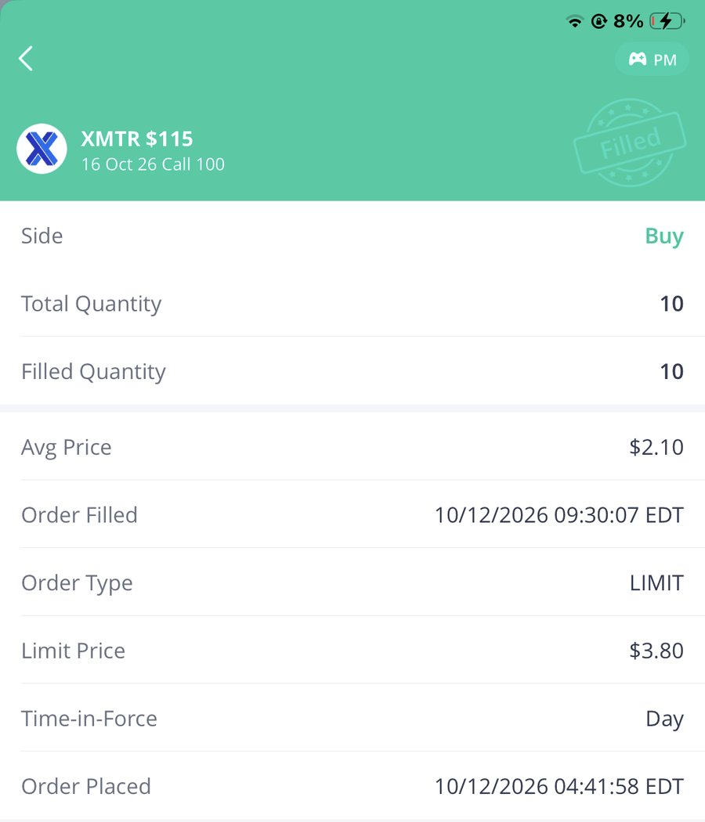
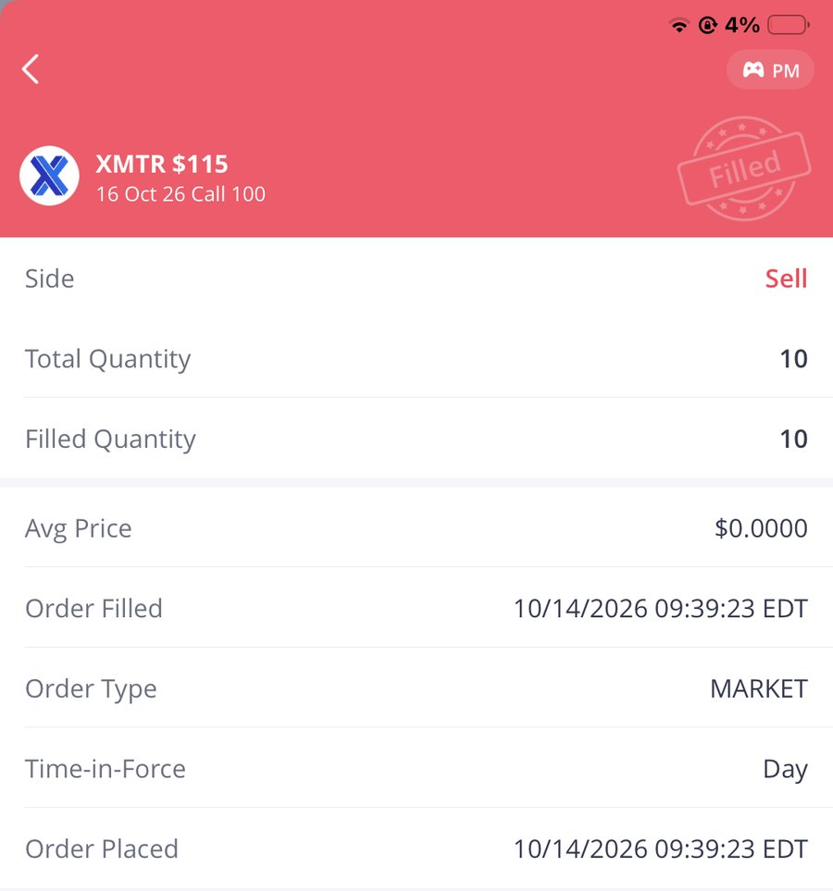
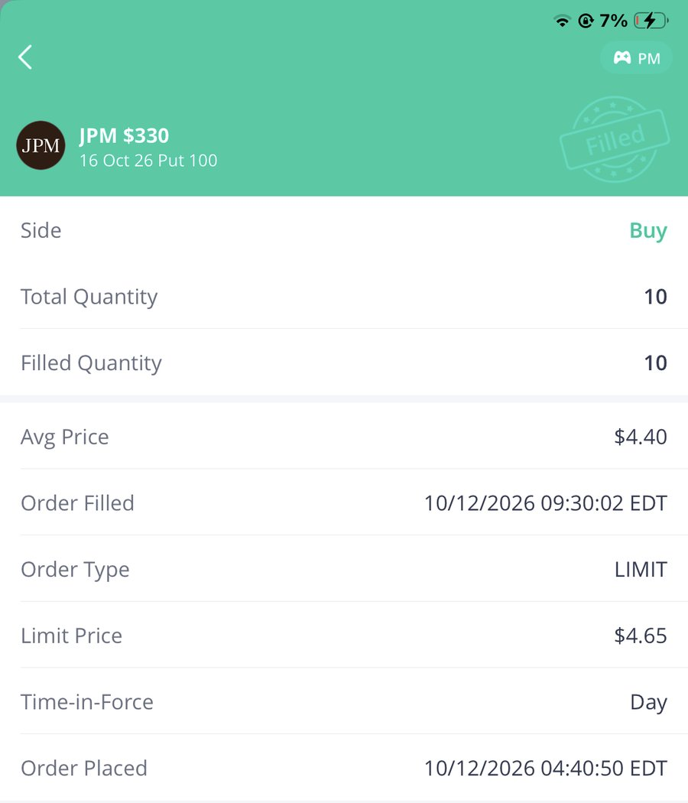
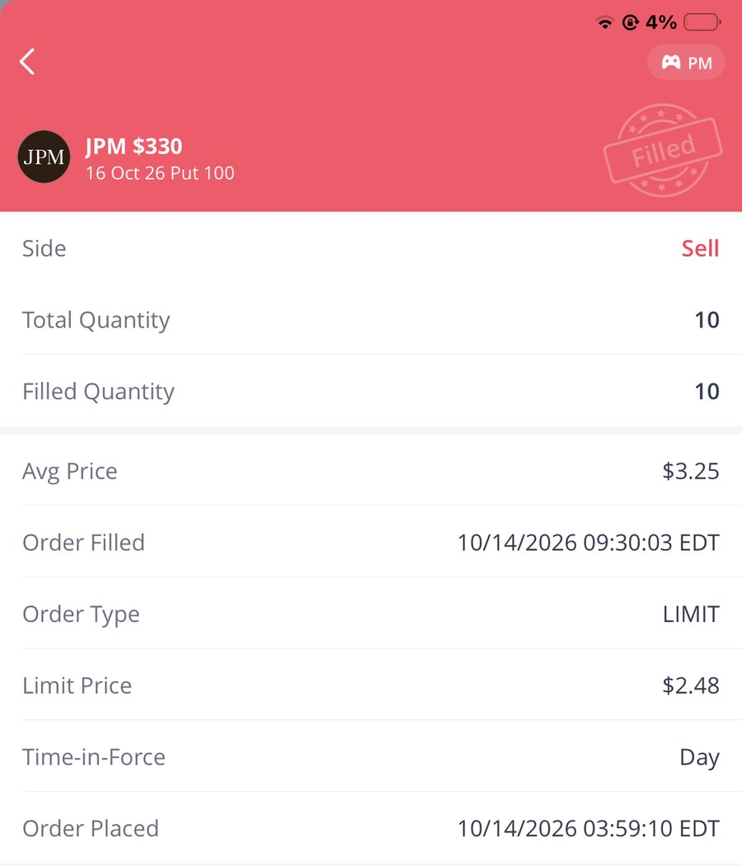
Trades #12 & #13: Buy and Sell Orders
APPENDIX C · WEBULL SCREENSHOTS
#12 XMTR $115 Call −$2,100
#13 JPM $330 Put −$1,150

Slide 17
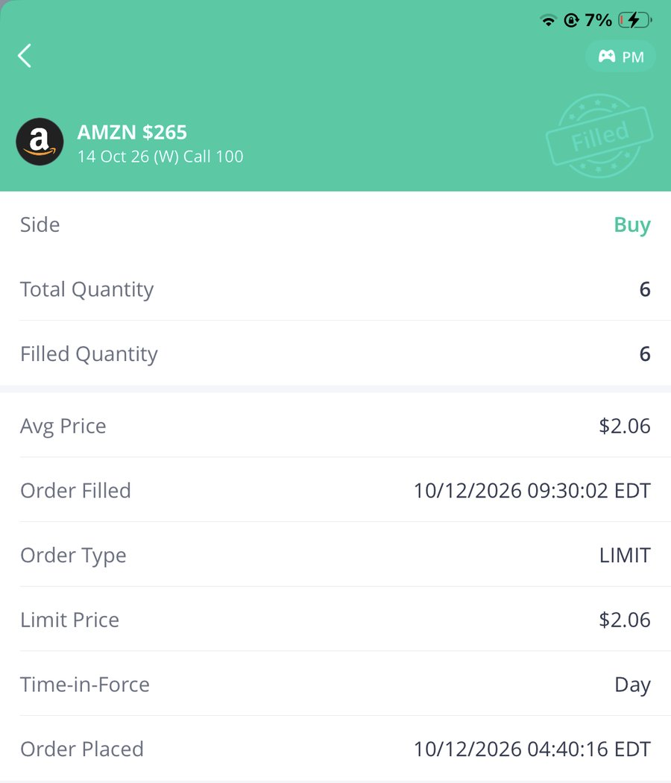
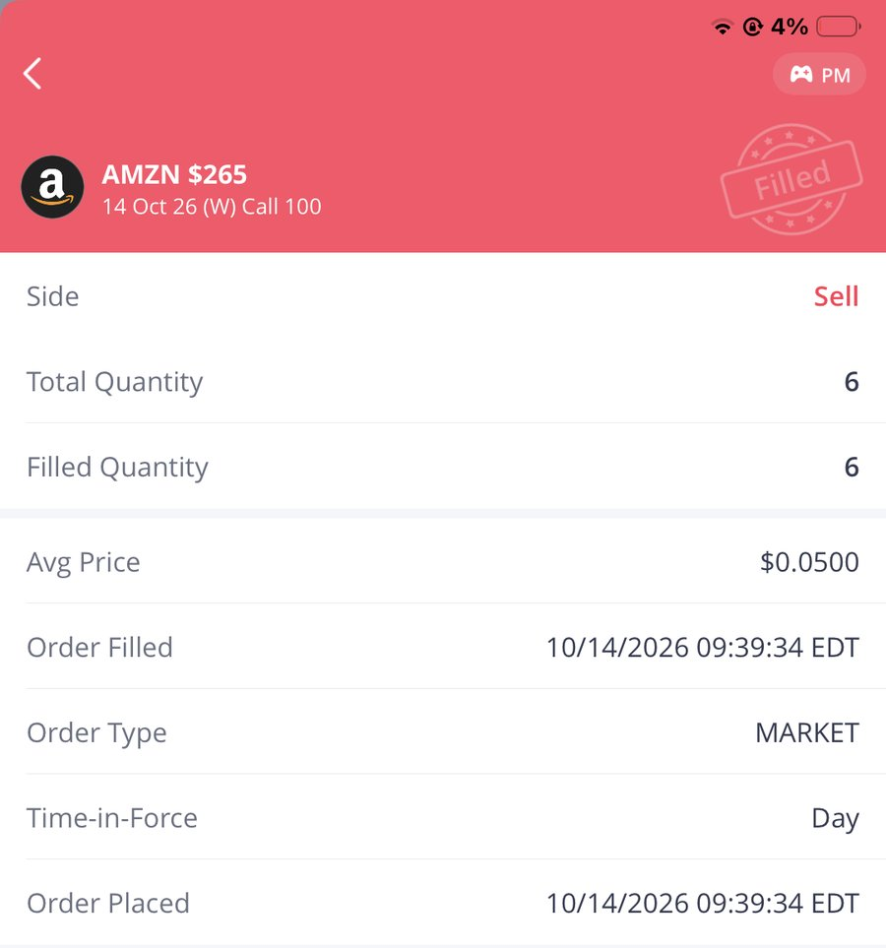
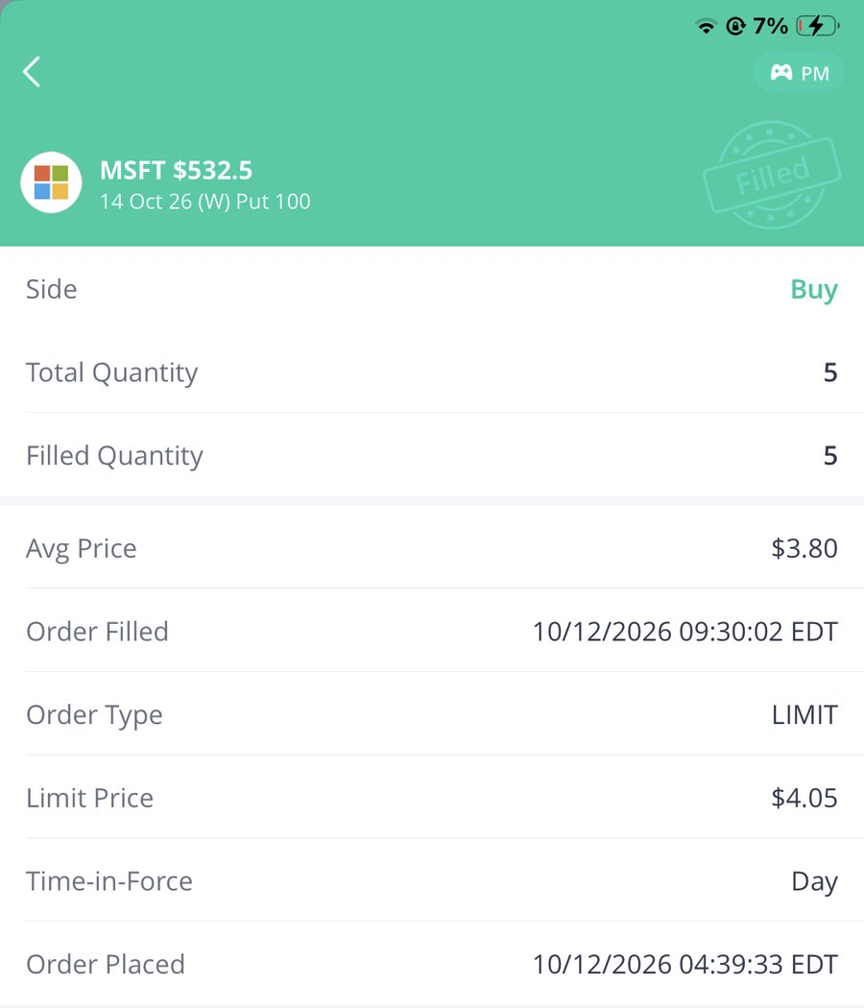
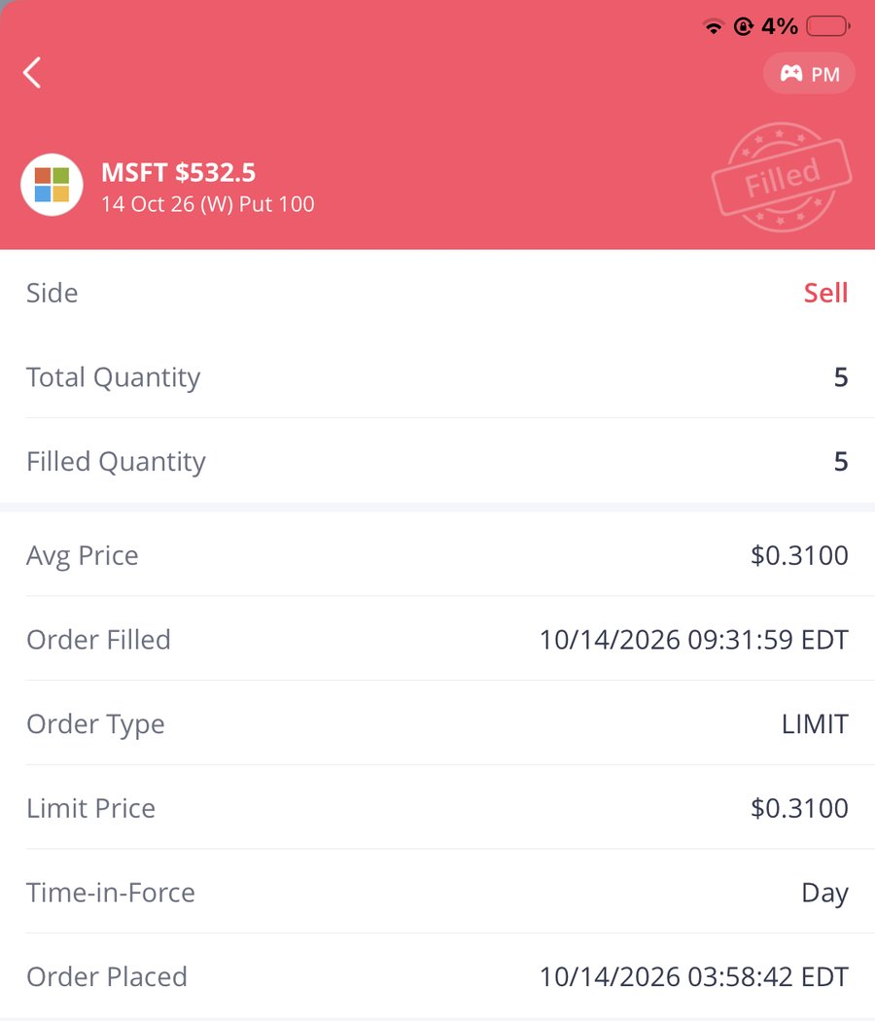
Trades #14 & #15: Buy and Sell Orders
APPENDIX C · WEBULL SCREENSHOTS
#14 AMZN $265 Call −$1,206
#15 MSFT $532.5 Put −$1,745

Slide 18
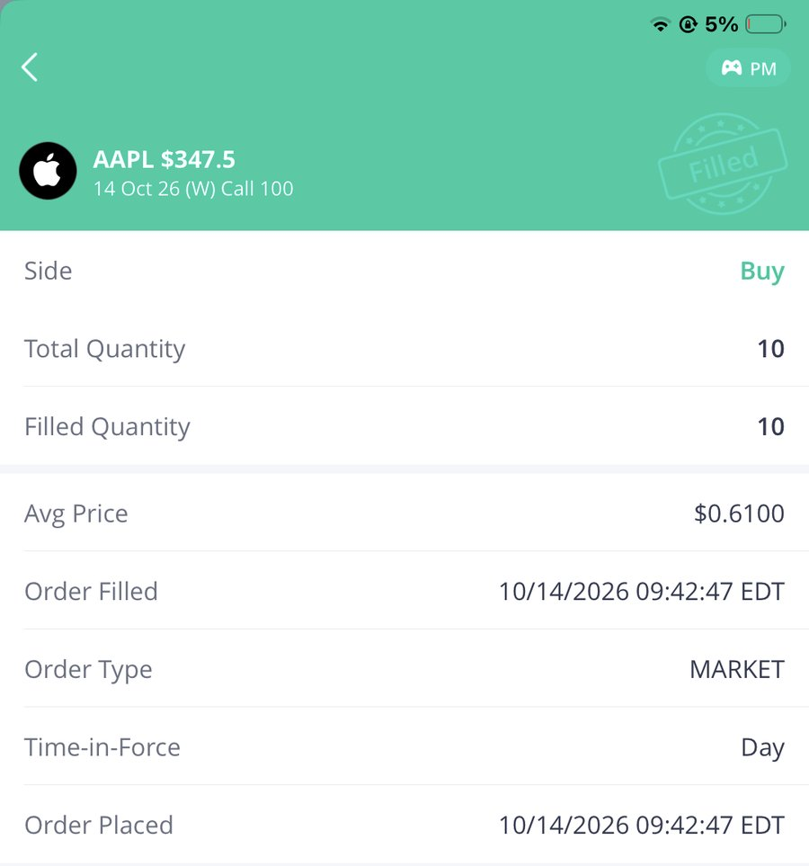

Trade #16: Buy and Sell Orders
APPENDIX C · WEBULL SCREENSHOTS
#16 AAPL $347.5 Call +$40

Slide 19
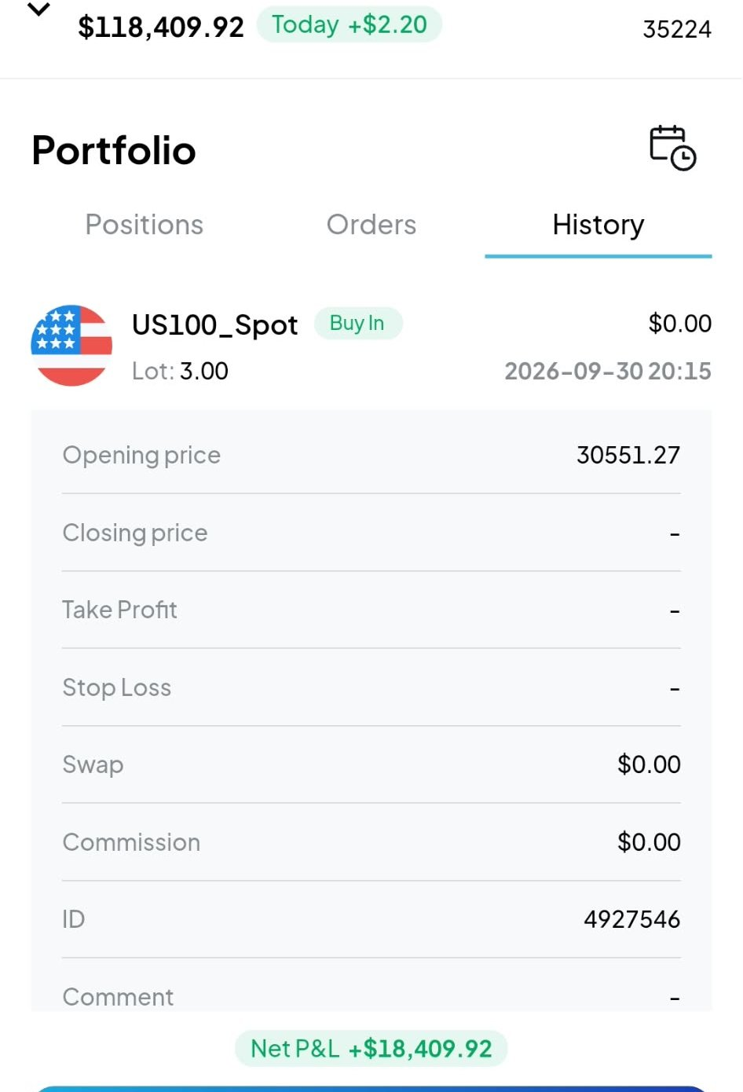
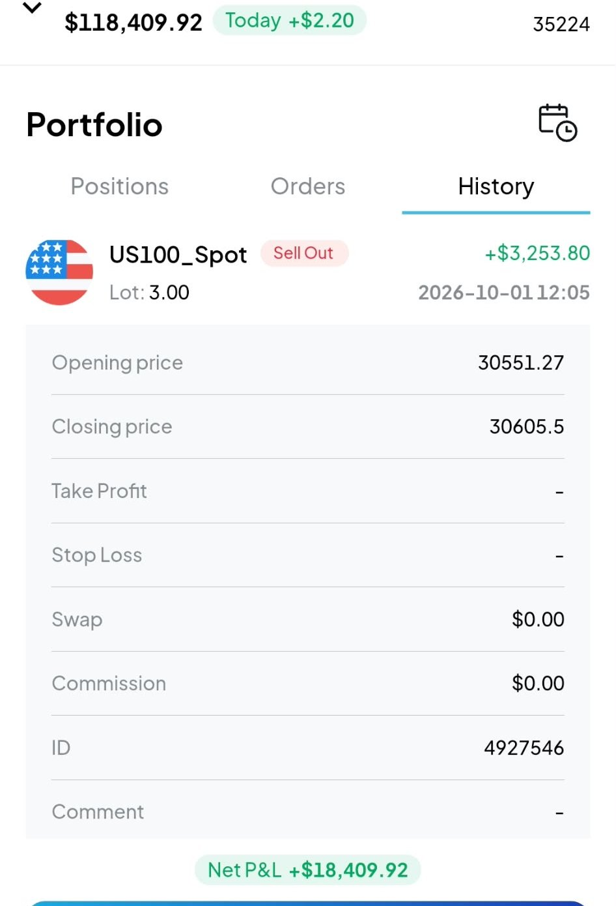
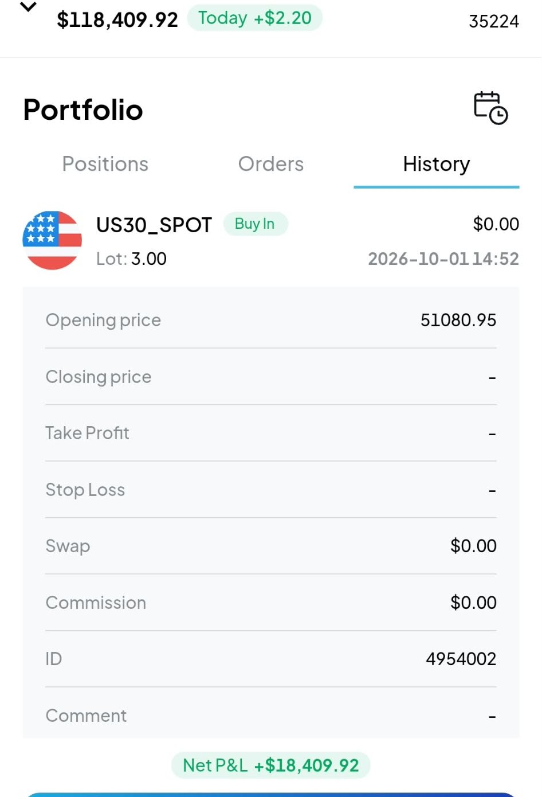
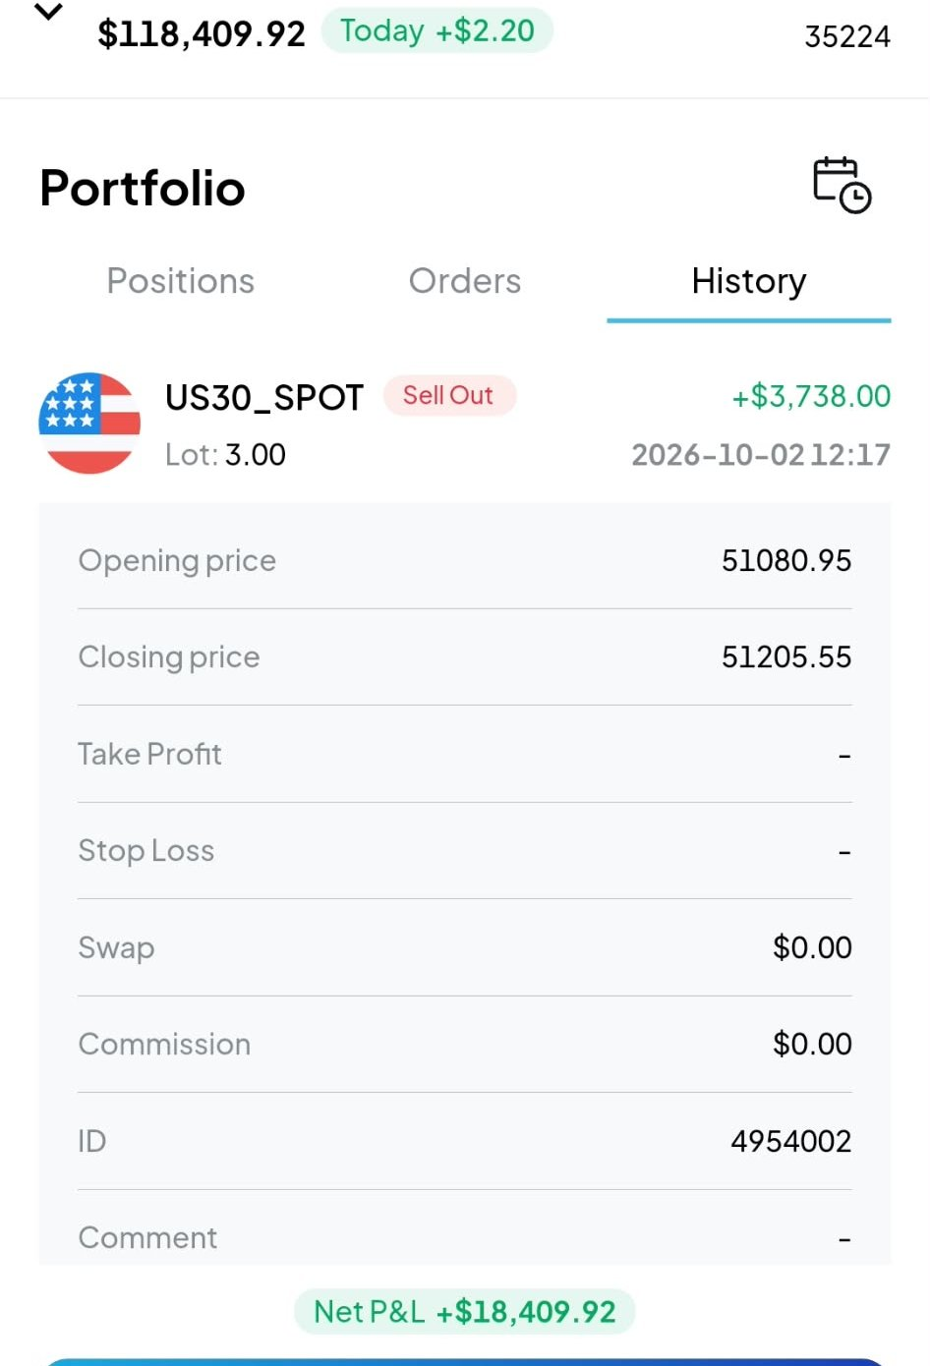
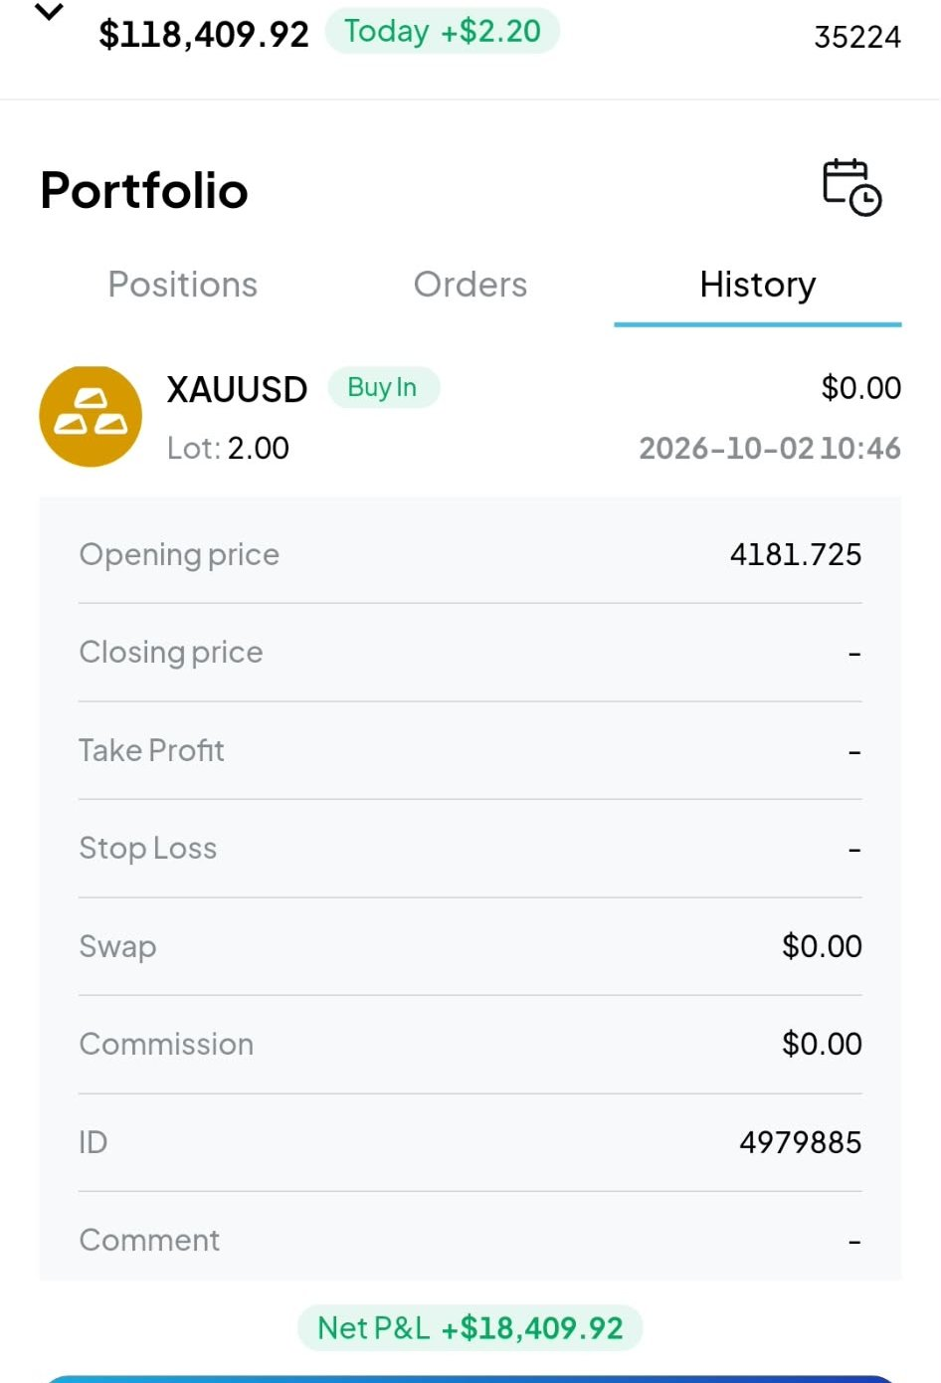
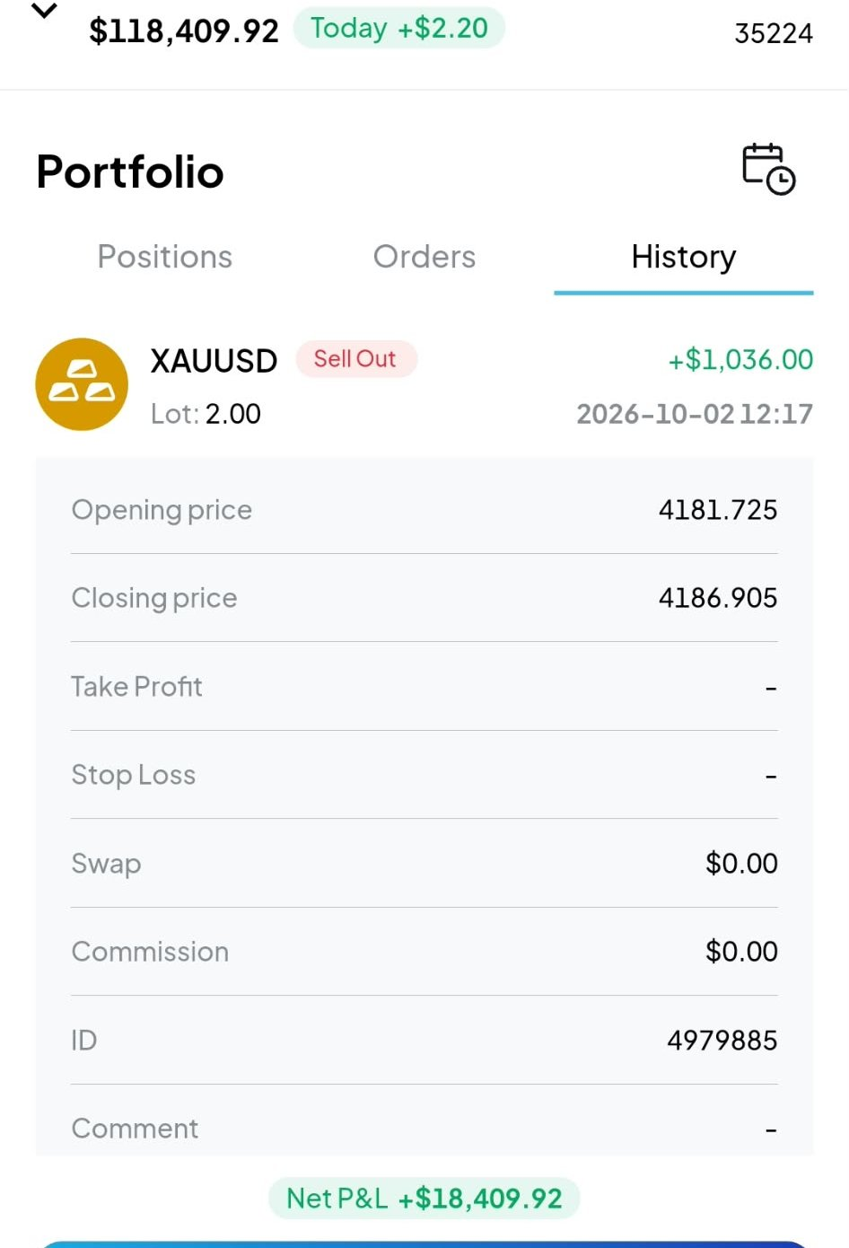

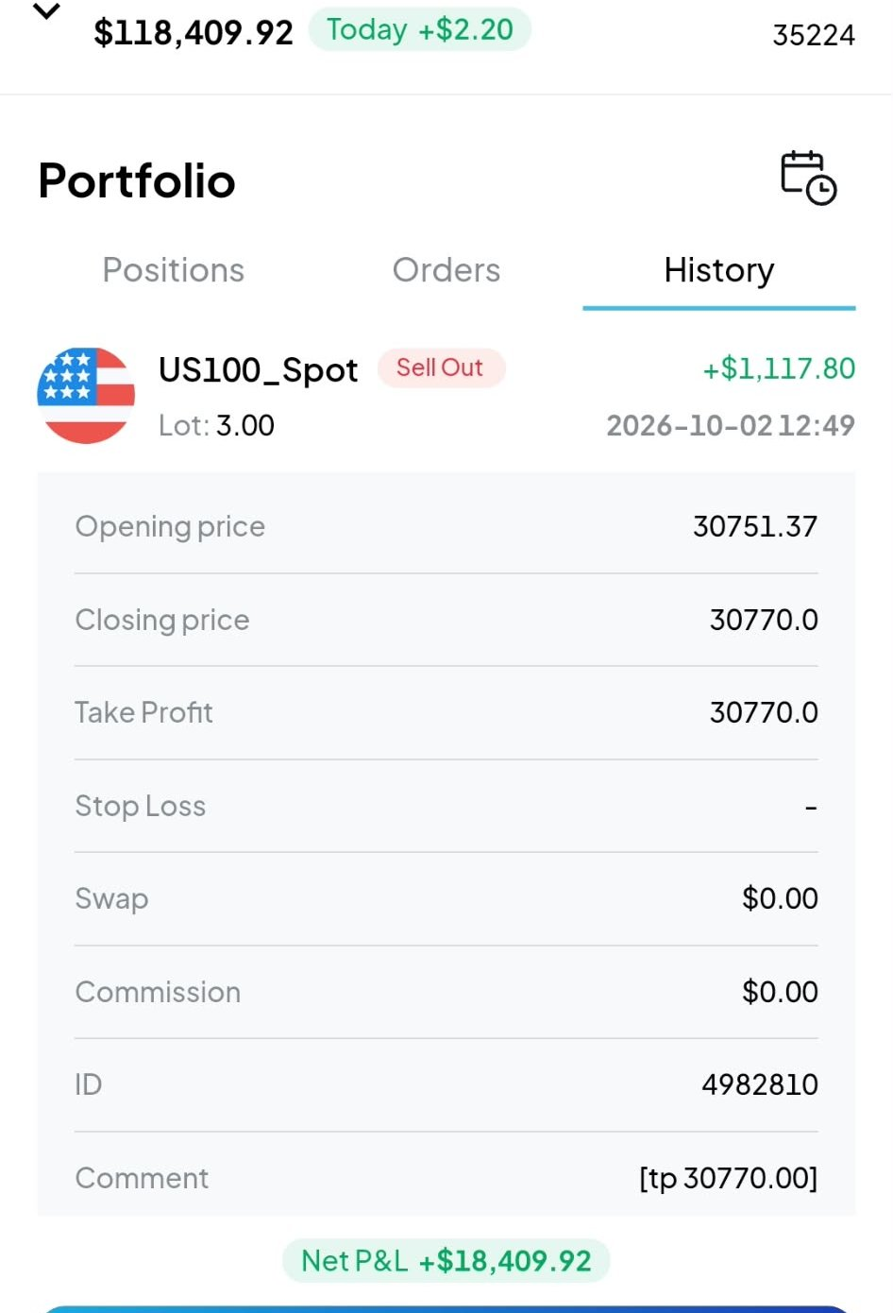
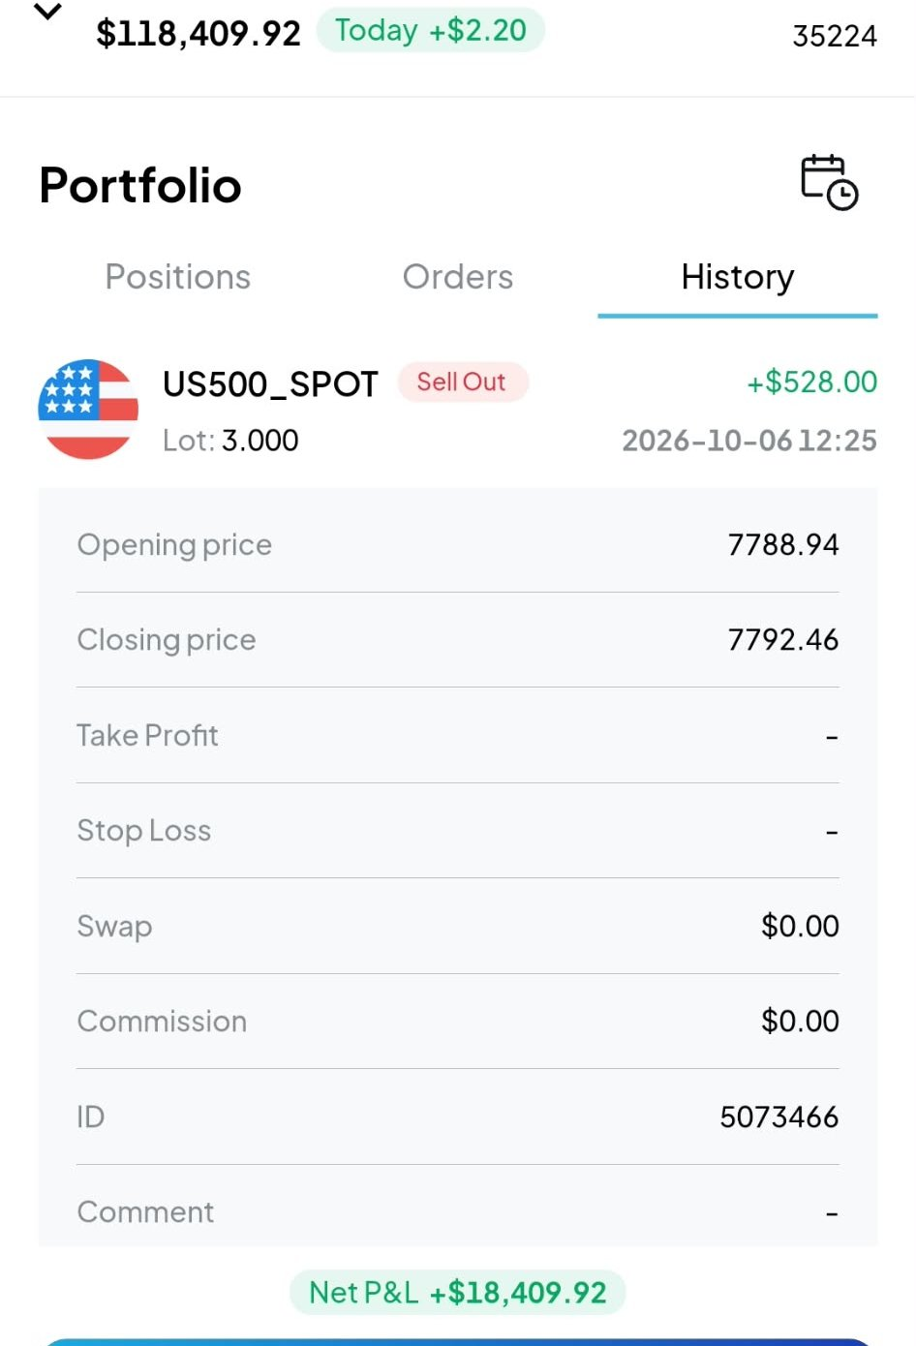
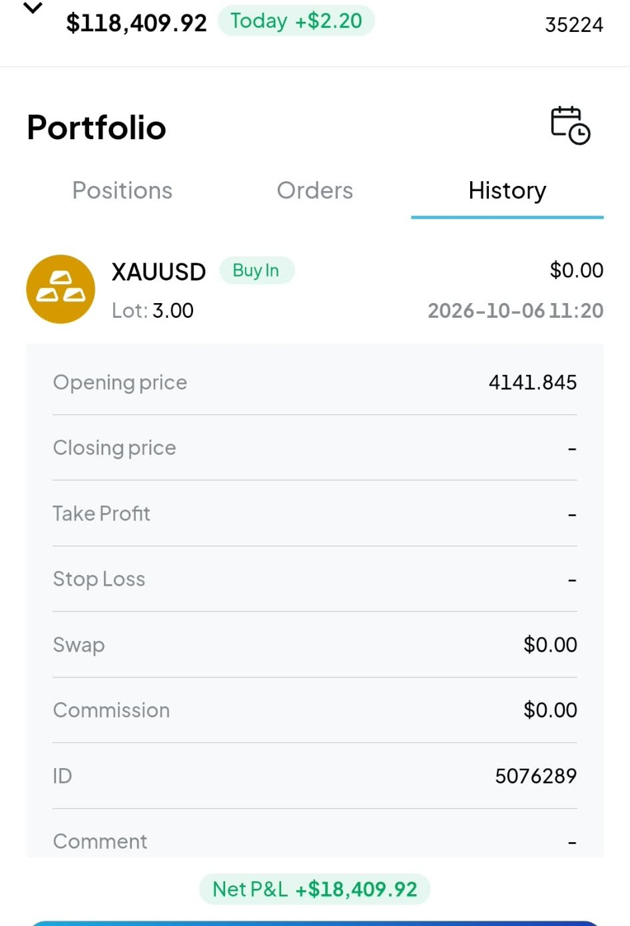
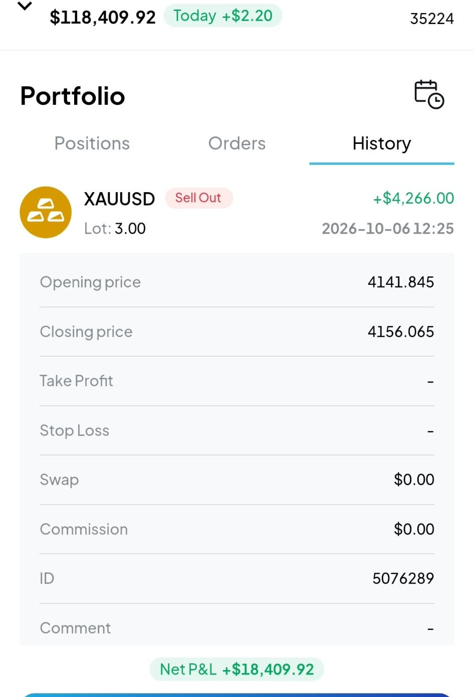

CFI History Screenshots (1 of 3)
APPENDIX D · CFI SCREENSHOTS
#1 · Buy
#1 · Sell
#2 · Buy
#2 · Sell
#3 · Buy
#3 · Sell
#4 · Buy
#4 · Sell
#5 · Sell
#6 · Buy
#6 · Sell
#7 · Buy

Slide 20
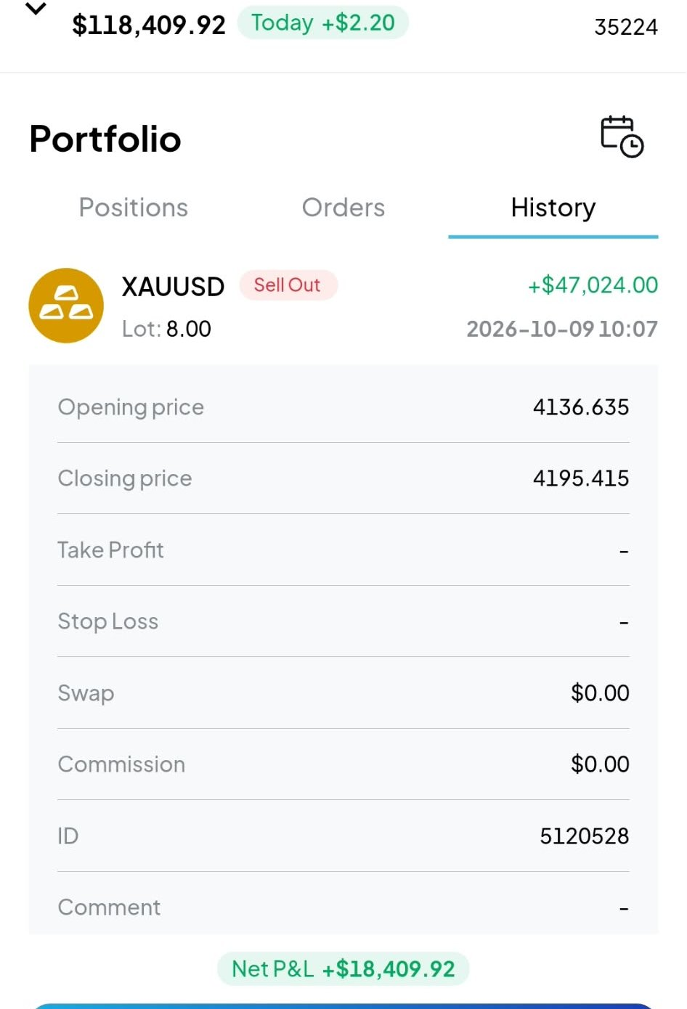
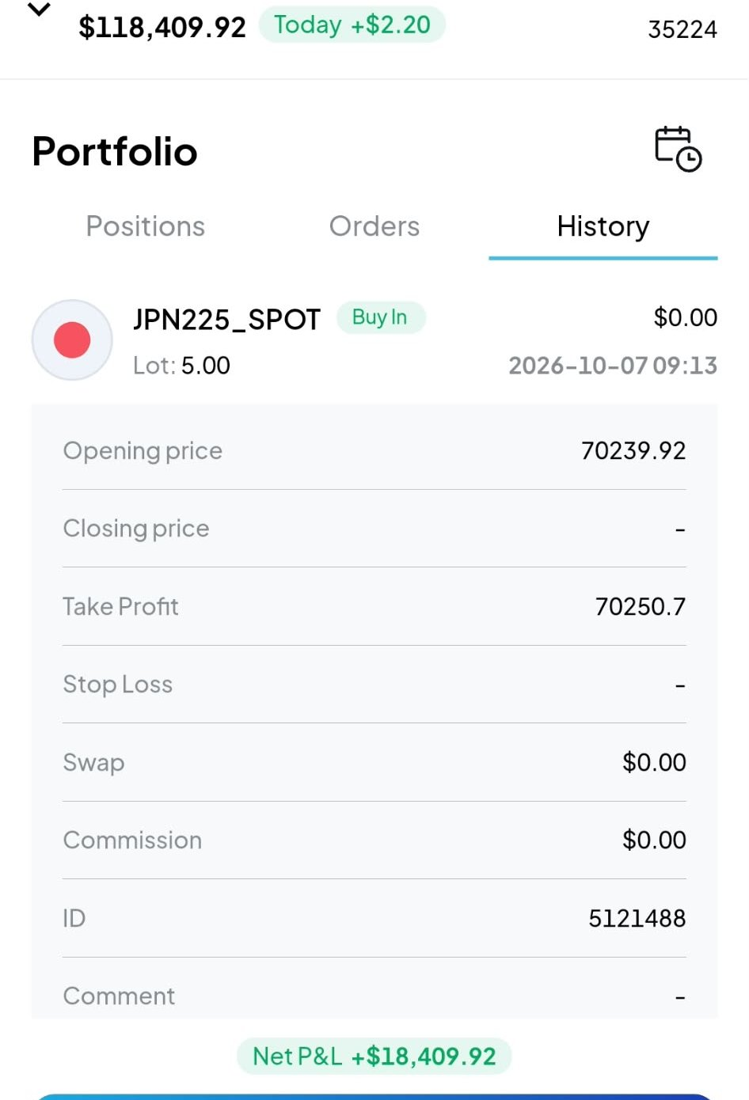
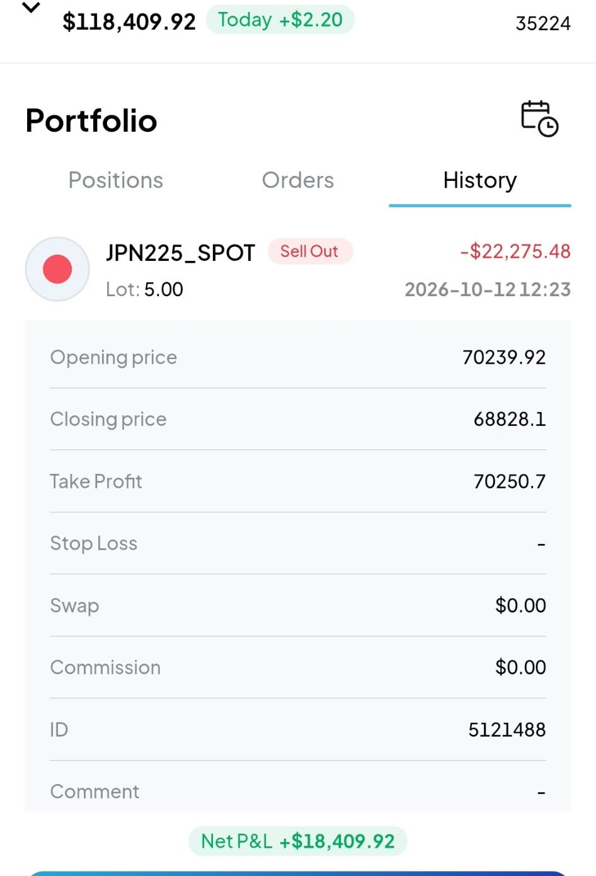
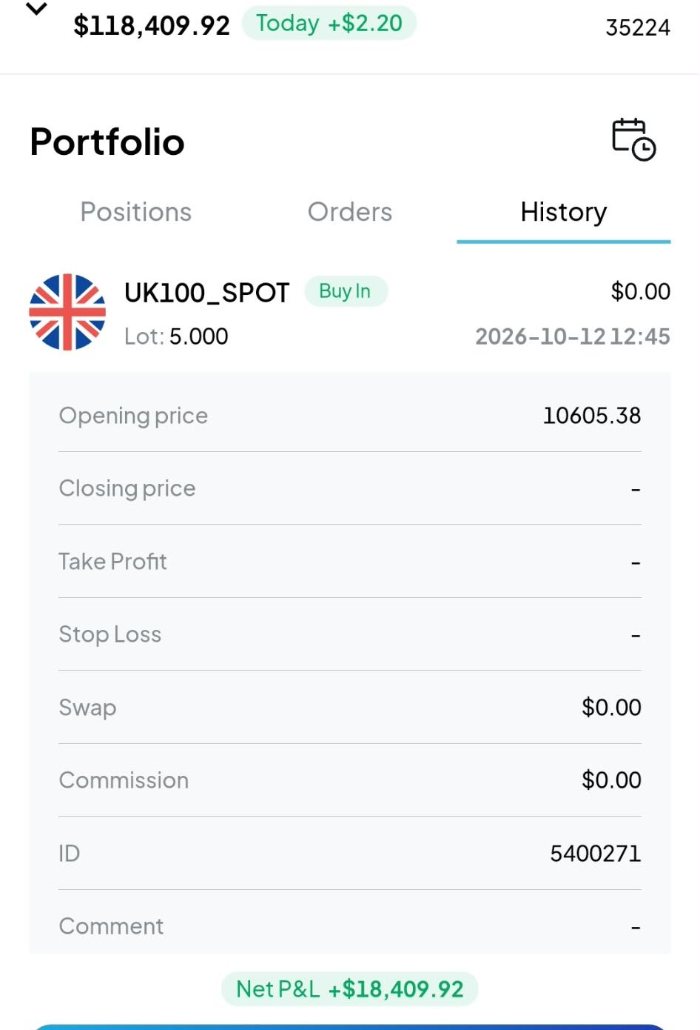
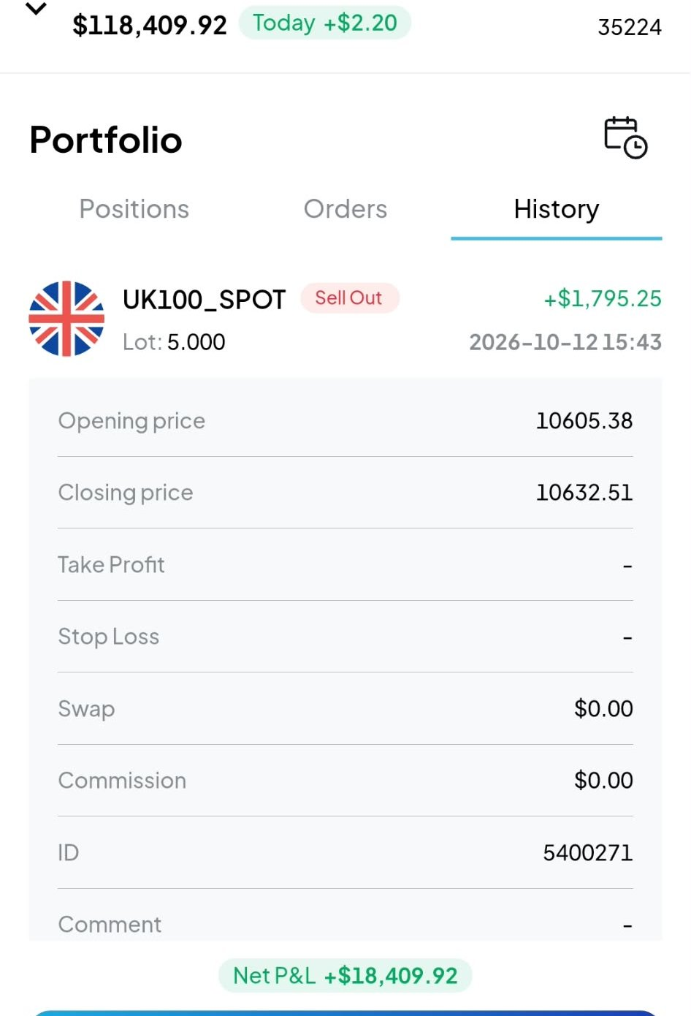
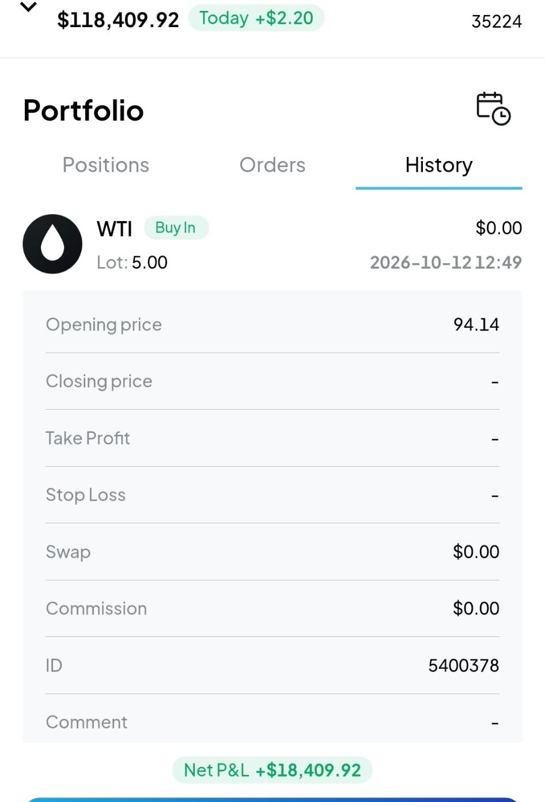
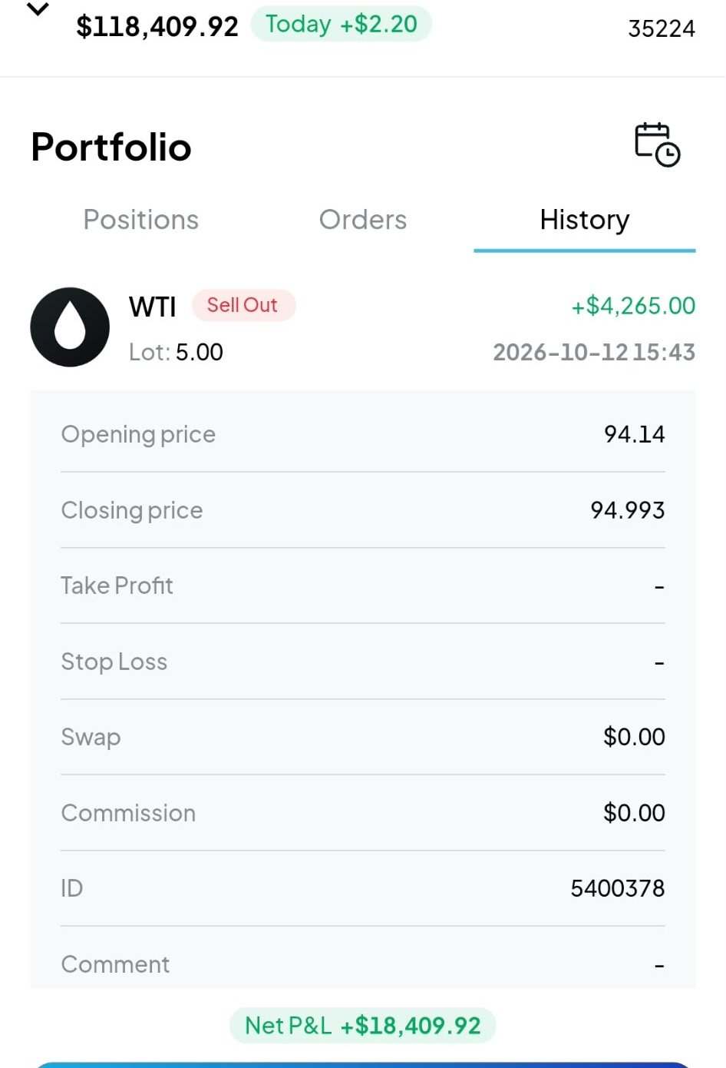
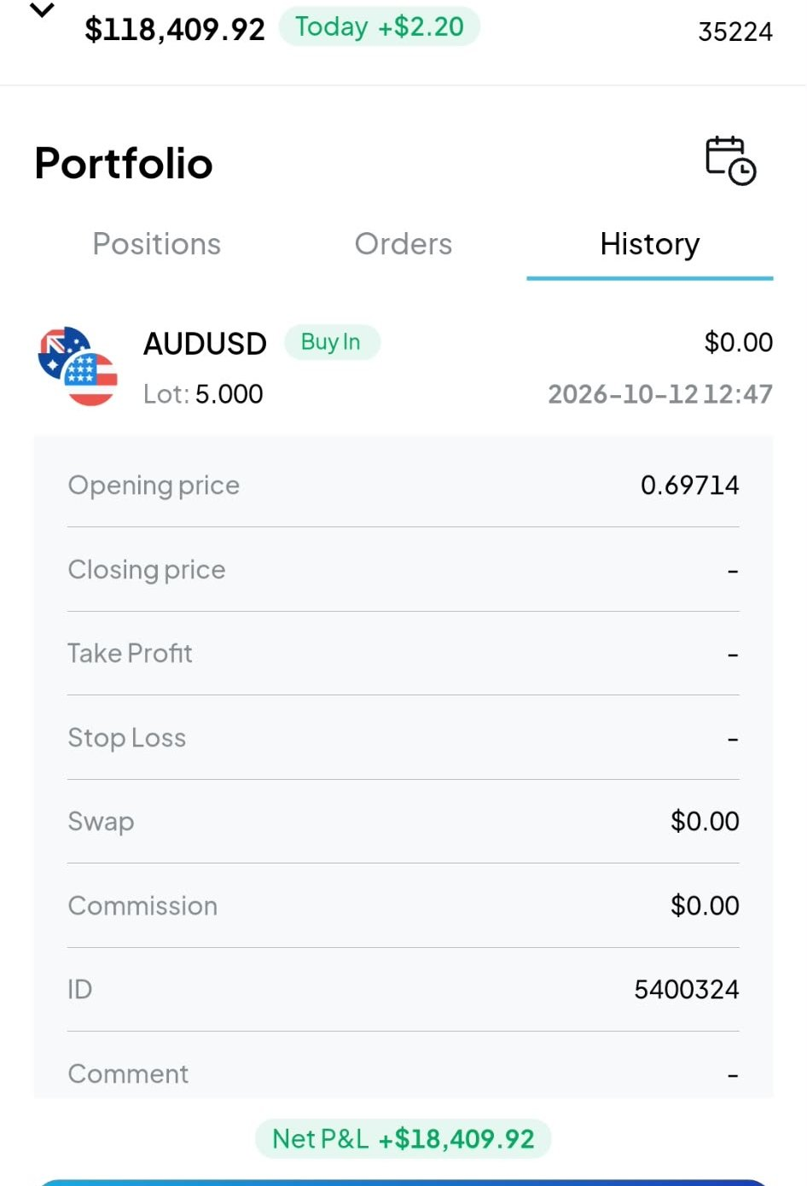
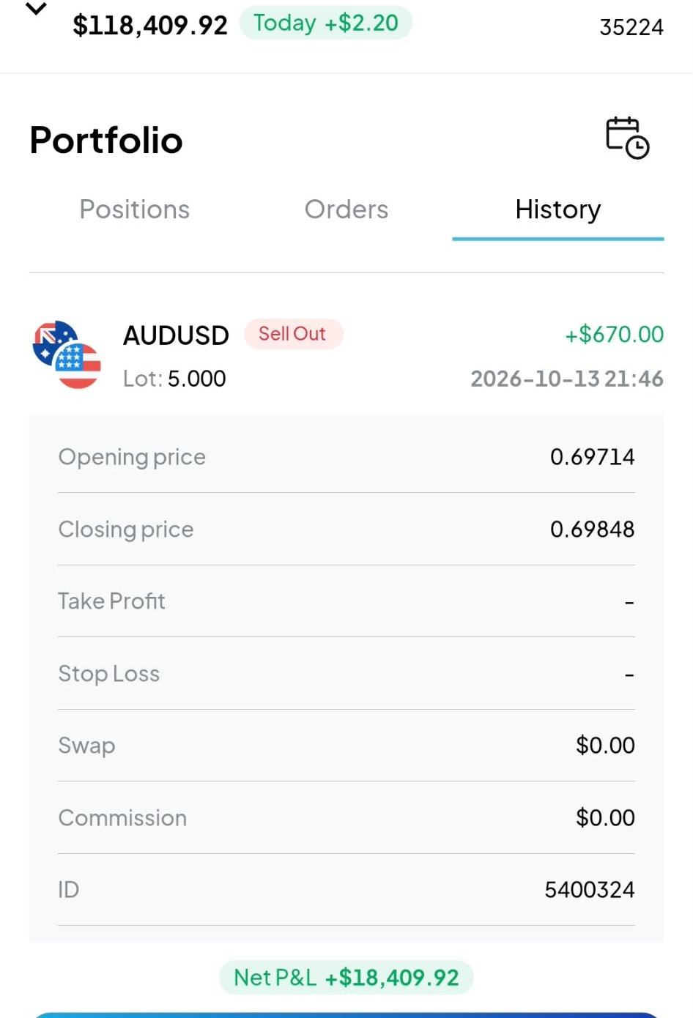
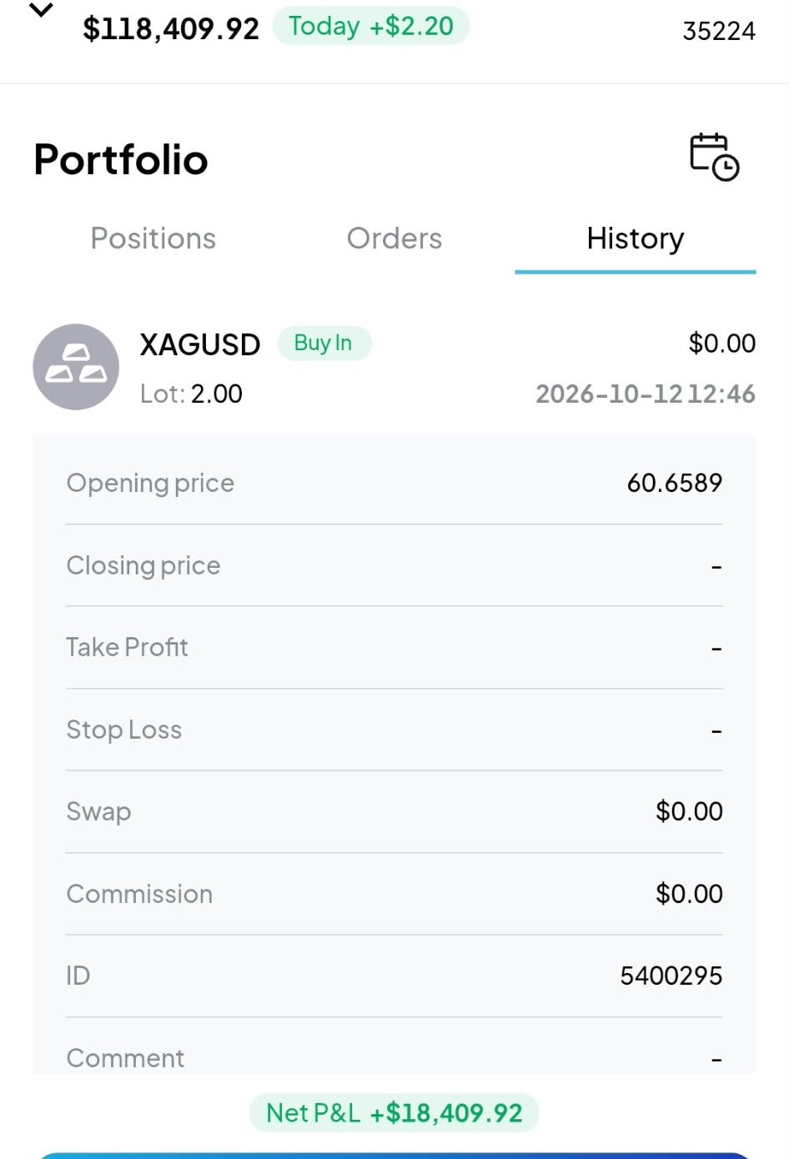
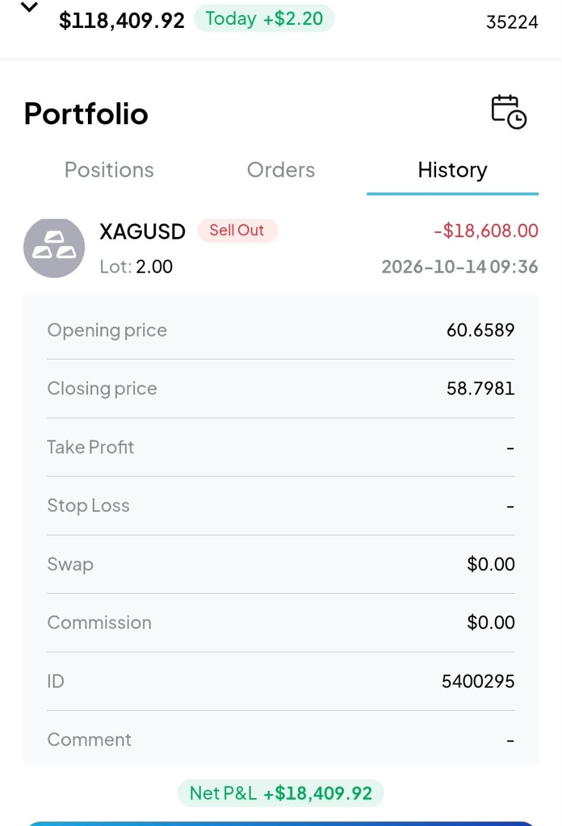

CFI History Screenshots (2 of 3)
APPENDIX D · CFI SCREENSHOTS
#7 · Sell
#8 · Buy
#8 · Sell
#9 · Buy
#9 · Sell
#10 · Buy
#10 · Sell
#11 · Buy
#11 · Sell
#12 · Buy
#12 · Sell
#13 · Buy

Slide 21




CFI History Screenshots (3 of 3)
APPENDIX D · CFI SCREENSHOTS
#13 · Sell
#14 · Buy
#14 · Sell
#15 · Buy (open)

