Slide 1

Internship BIRA-IASB ALTIUS
Benoit Ladrange

Slide 2

Task description
Testing of solutions for the RF generator integrated in the RF chain of the ALTIUS project.
Two solutions considered : one using a DDS and the other employing a PLL.
Task : implement a user interface on a computer allowing a user to set the parameters of the DDS and PLL chips.
The interface linking the computer to the electronic devices should also be programmed.
Notes:
One of the ALTIUS project’s main aspect is the use of an AOTF to select specific wavelengths that will be presented at the input of a 2D detector.
The wavelength selected by the AOTF depends directly on the frequency of an external RF signal.
Need for a tunable frequency synthesizer to steer the AOTF.

Slide 3
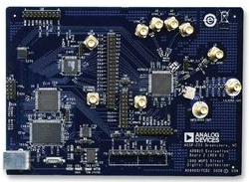
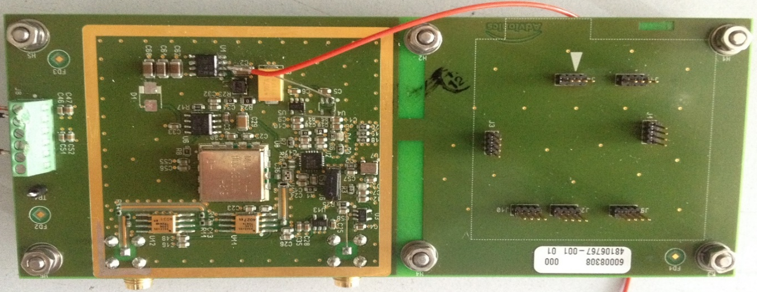
Hardware
DDS : AD9910 evaluation board from Analog Devices.
PLL : home-made PCB from BIRA-IASB forming a complete PLL with an ADF4108 from Analog Devices.
Notes:
PLL’s PCB : Reference frequency + PLL + Loop filter + VCO.

Slide 4
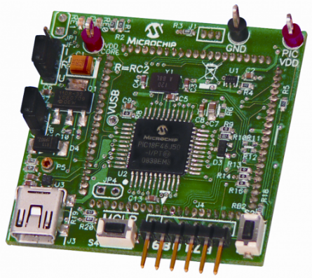
Hardware
Interface linking the computer and the electronic component : USB device PIC18F46J50 FS USB PIM DEMO BOARD from Microchip.

Slide 5
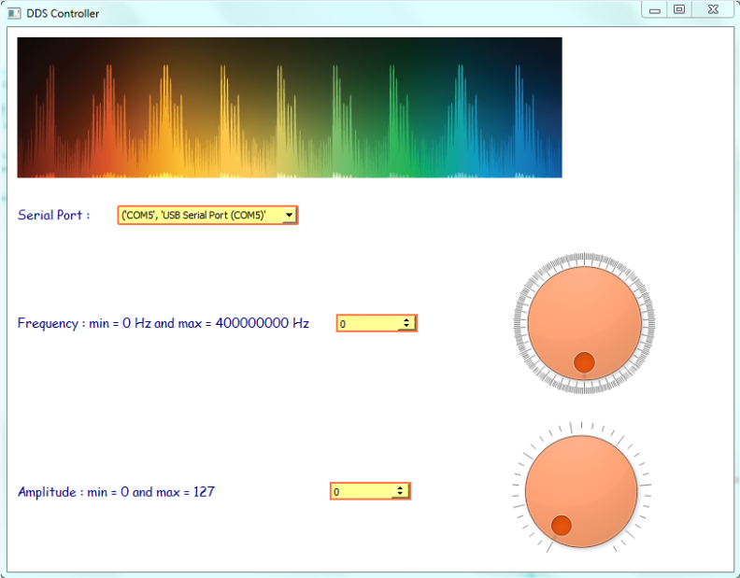
Undertaken tasks
DDS evaluation board
Implementation of the Graphical User Interface with Python.
Notes:
The dial buttons and the spinboxes are linked together.

Slide 6
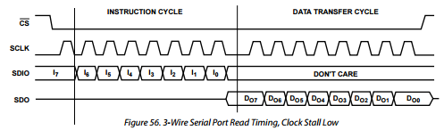
Undertaken tasks
DDS evaluation board
Programming the USB device on MPLABX IDE so that it receives data from a computer and sends it to the chip via an SPI communication. Acts as a « USB-SPI » translater.
Notes:
SPI chronogramme found in the AD9910’s datasheet.
MSB sent first, clock’s active state is a high state.
A bit is sent on a clock transition from active to IDLE state.
Data sent 8 bits at a time.
All these parameters allows us to determine the SPI mode to use.

Slide 7
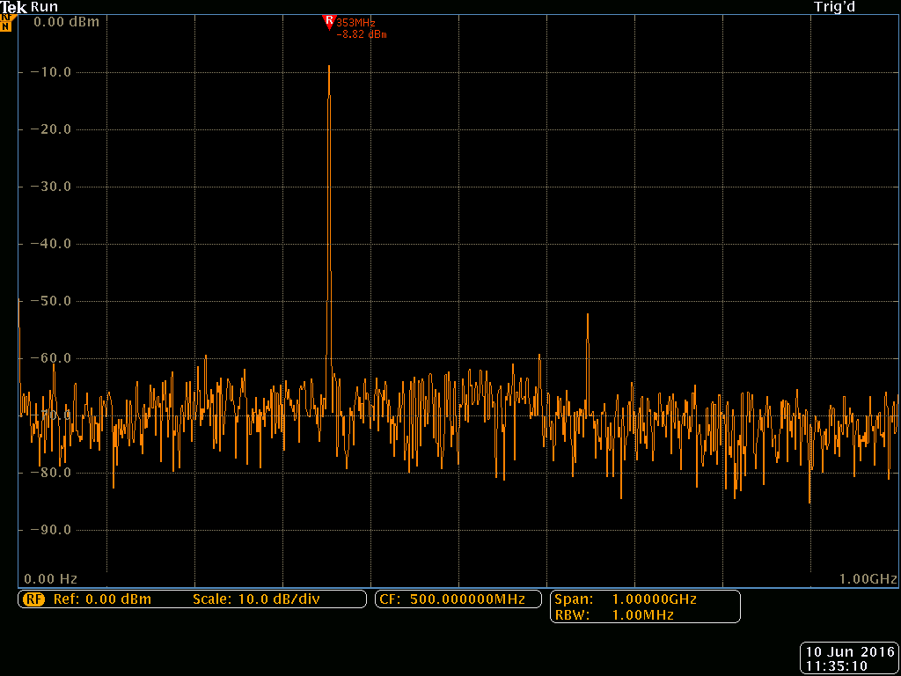
Undertaken tasks
DDS evaluation board
Test of the software with the evaluation board by looking at the output signal on a spectrum analyzer.
Notes:
Connect the USB demo board to the computer, turn on the power of the DDS evaluation board and see the changing of frequency and amplitude dynamically.

Slide 8
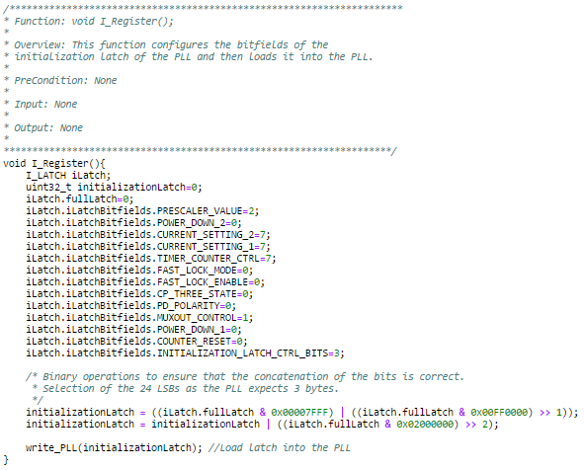
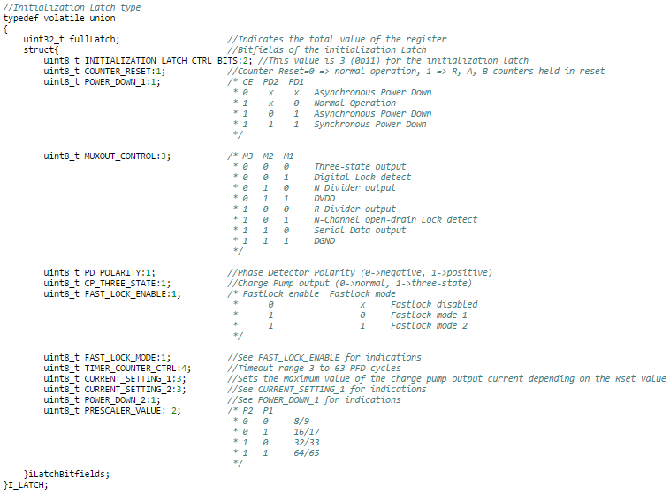
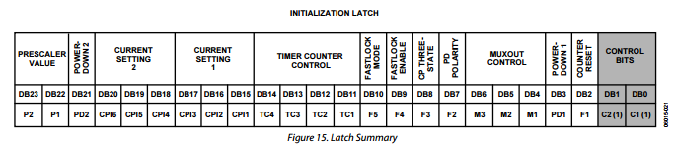
Undertaken tasks
PLL’s PCB
Programming the USB device so that it directly sends instructions to the ADF4108 without using a user interface.
Example of one of the PLL’s internal registers :
Notes:
Didn’t know if I had the time to implement the user interface so did a complete MPLAB code to build and send instructions to the PLL chip.
A register can be seen as a structure of bitfields.
Programming a loop which sweeps through a given frequency range with a specified step.

Slide 9
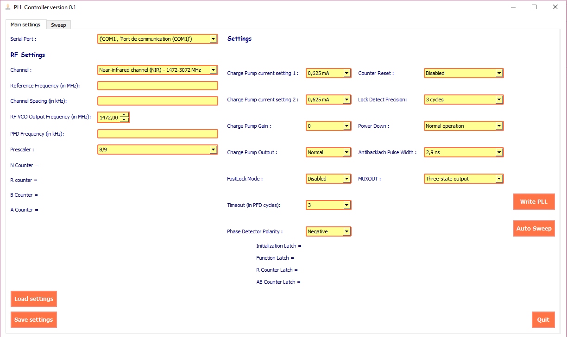
Undertaken tasks
PLL’s PCB
Implementation of the Graphical User Interface using Python.
Notes:
Many operations can be initiated using this interface.

Slide 10
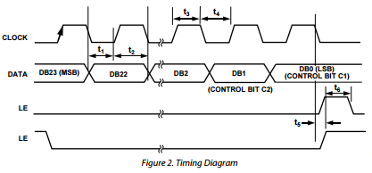
Undertaken tasks
PLL’s PCB
Programming the USB on MPLABX IDE so that it receives the registers’ values and transfers them to the ADF4108 via SPI.
Notes:
Again, the SPI mode must be known in order to correctly parameter the communication between the USB device and the PLL chip.
The LE signal is set high to indicate the end of the transfer of one register to transfer the data from the input buffer to the active register.
1 register = (3 x 8) bits = 24 bits.

Slide 11
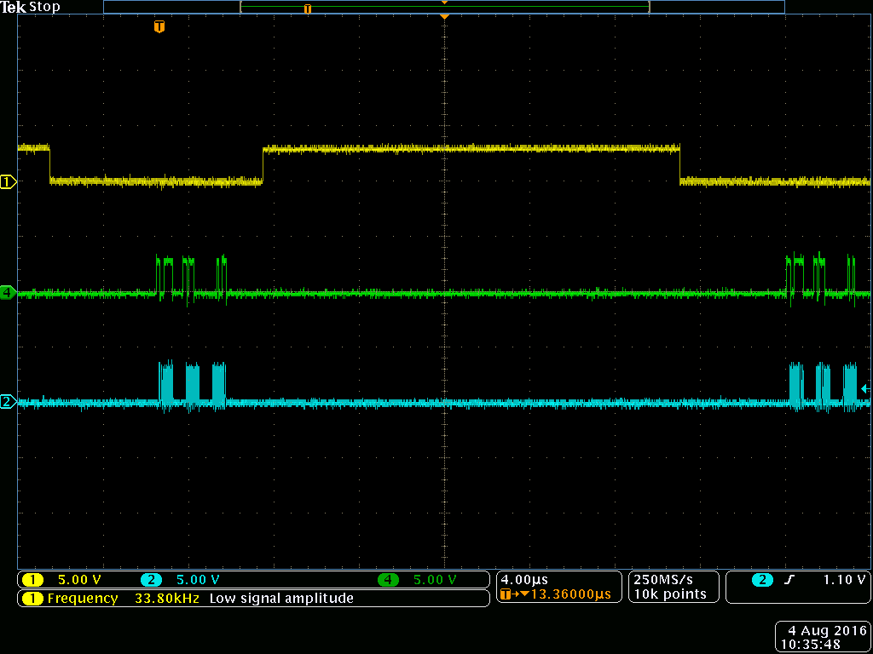
Undertaken tasks
PLL’s PCB
Test of the user interface with the USB device by analysing the SPI bitstreams on an oscilloscope.
Notes:
These acquisition was then compared to the previous chronogramme and the timing characteristics were measured to make sure these signals would be suitable to program the PLL.
Finally : real test directly on the PCB was a succes thanks to a lot of determination and ingenuity from the Engineering team.

Slide 12
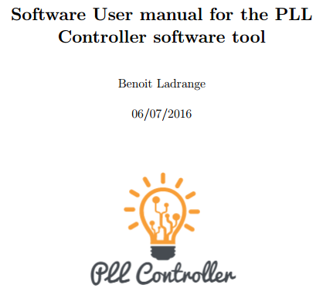
Undertaken tasks
Software user manual using LaTeX (document preparation system).
Goal : present the application and detail precisely what can be achieved with it and how.
Notes:
Every element displayed in the application is explained.
All the different operations are also detailed.
Also tips on how to get the application running and so on.

Slide 13
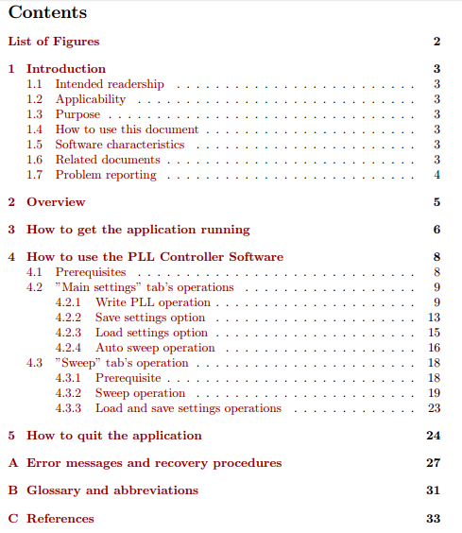

Slide 14
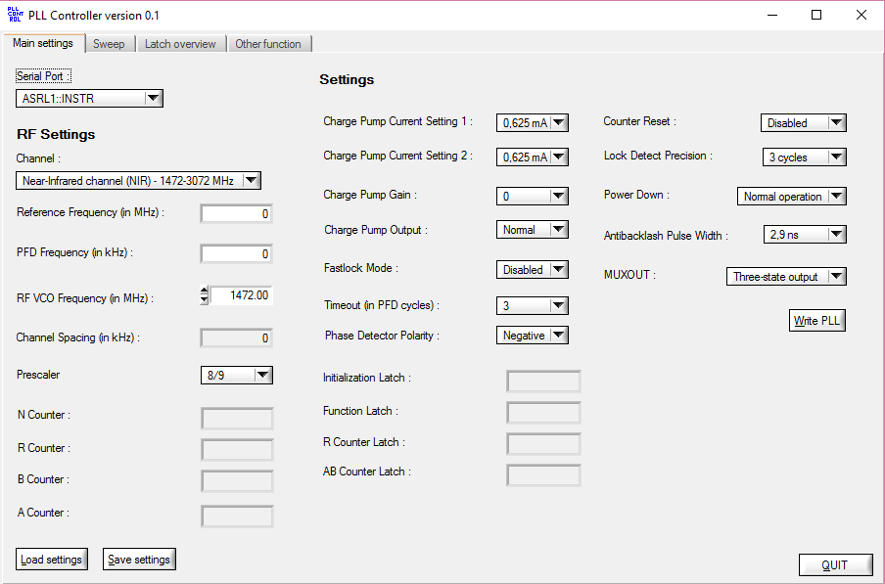
Undertaken tasks
Graphical User Interface using LabWindows/CVI
Notes:
This application was made because I couldn’t test the Python program on the PCB due to delays so I decided to make another one to have some kind of insurance and to propose several softwares.
It also allowed me to develop new functionnalities that can be interesting.
The basic concept is still the same though.

