Slide 1
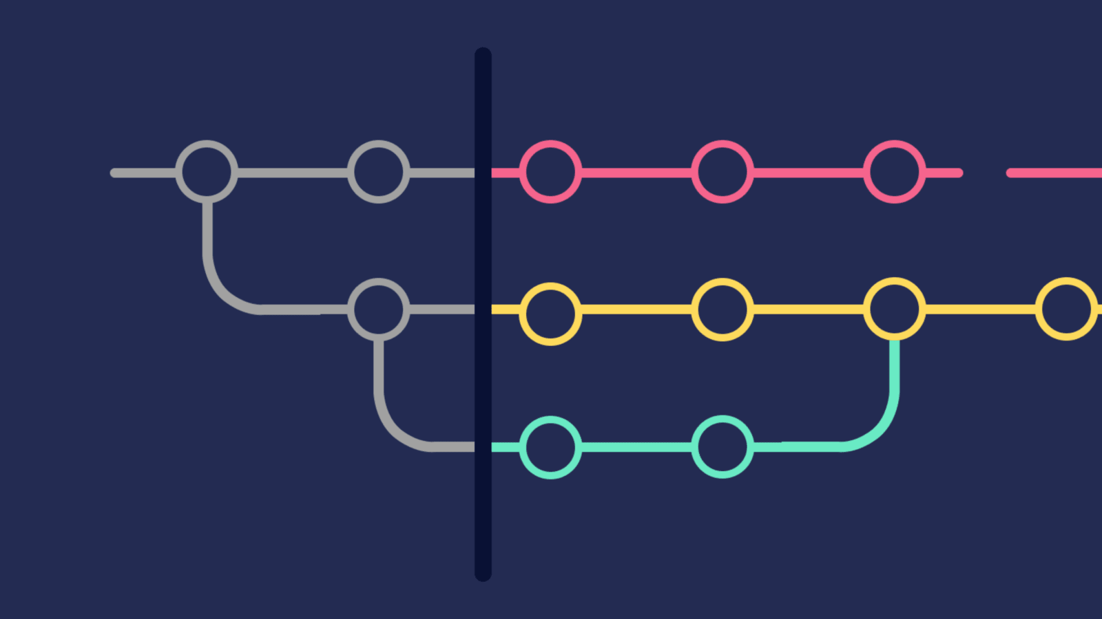

Version Control, Git and GitHub
October 2024

Slide 2
Contents
1 | What is version control?
2 | What is Git?
3 | What is GitHub?
4 | How are we going to use Git and GitHub on this project?

Slide 3
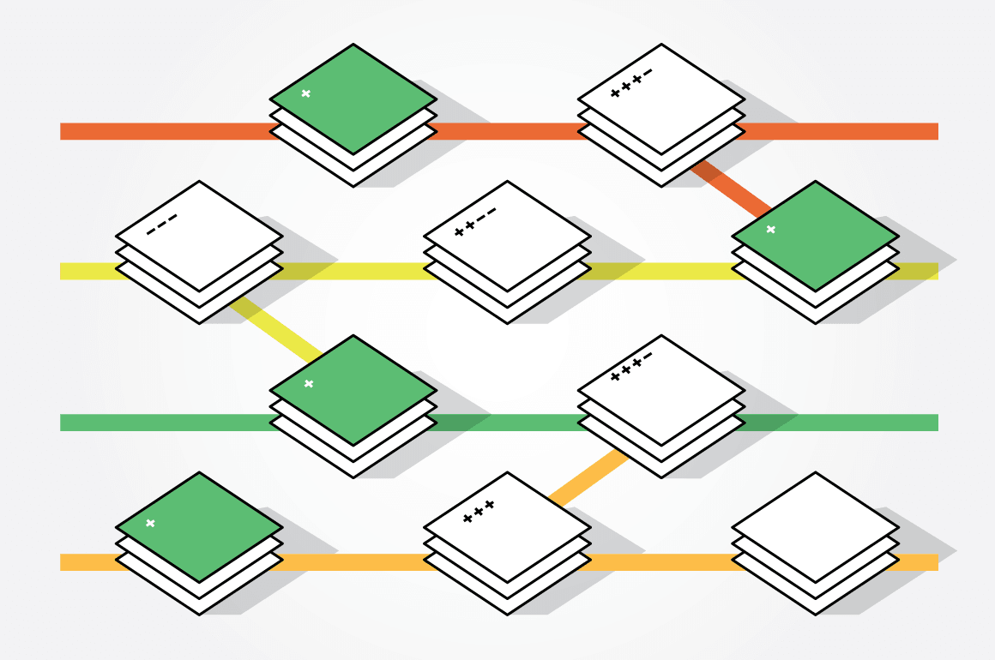
What is Version
Control?

Slide 4
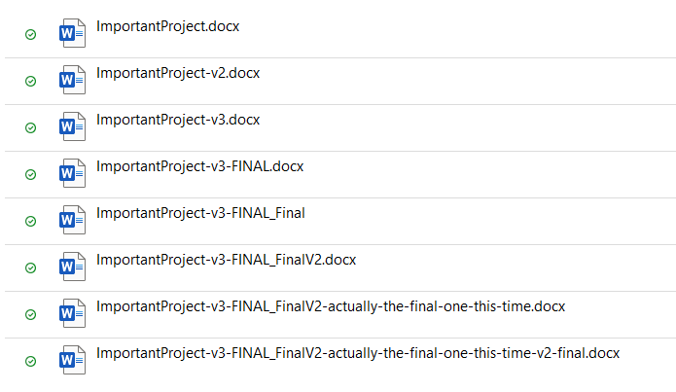
Have you ever done this?
This is a version control system (but a TERRIBLE one!)

Slide 5
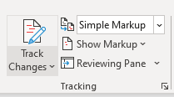
Have you ever used this?
This is also a version control system, but it’s much better!
We can:
Inspect the history of changes
Revert the document back to a previous state if we make a mistake
Comment on differences between different versions
Lots more!

Slide 6
How does this apply to writing code?
There are several useful version control tools that are available for keeping track of changes across an entire folder/directory of documents. As well as the useful features of the Track Changes button in Word, these allow people to:
Work on files separately, and then combine their changes together
Split all of the code into different “branches” and manage these separately
For example, you might want to have different code running to your customers to the code that you are currently testing internally
Keep track of who has changed what
Maintain a central source for the code, and allow people to work on their own versions without affecting the central source’s code
Many more useful things!

Slide 7
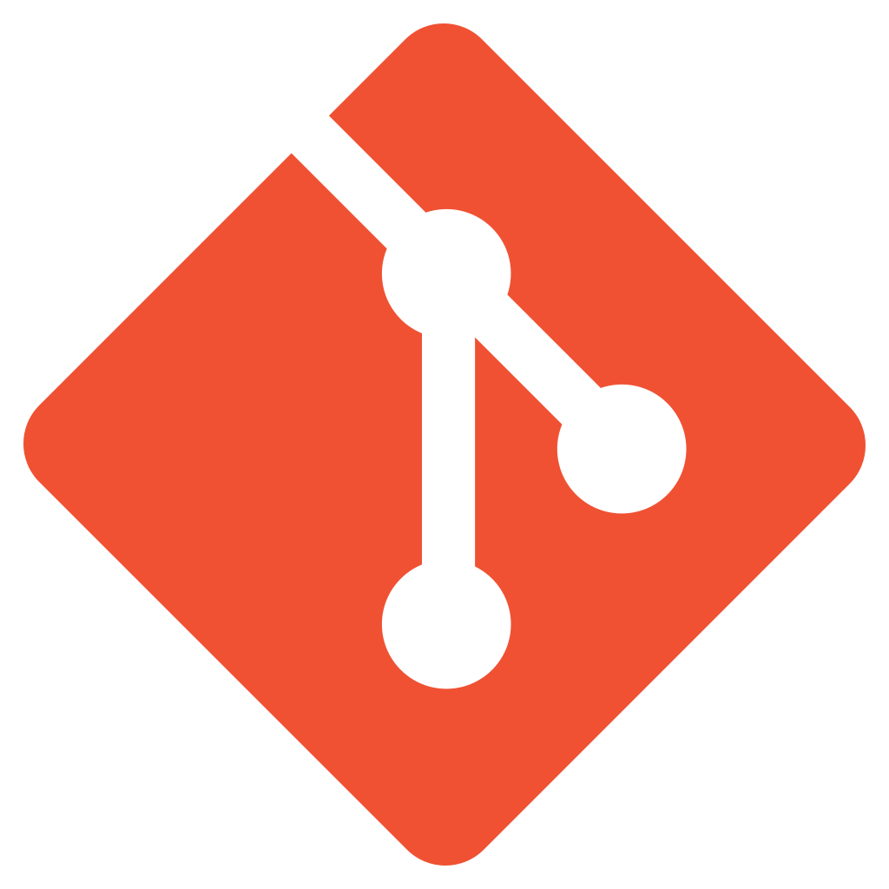
What is Git?

Slide 8
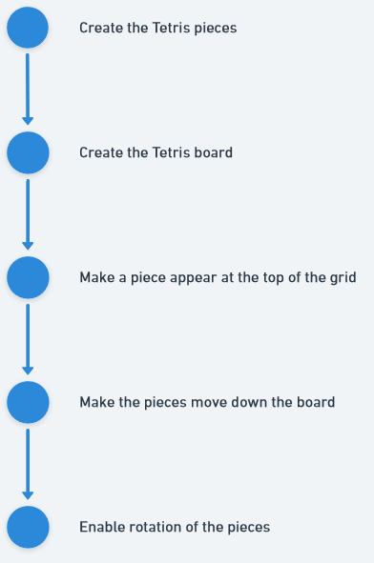
What is Git?
Git is the most commonly used version control system for software projects
It allows you to add changes in chunks called “commits” so that you end up with a linear history of changes with helpful descriptions
It also allows you to make “branches” so that you can work on your own changes without affecting the main code that is being used by others

Slide 9
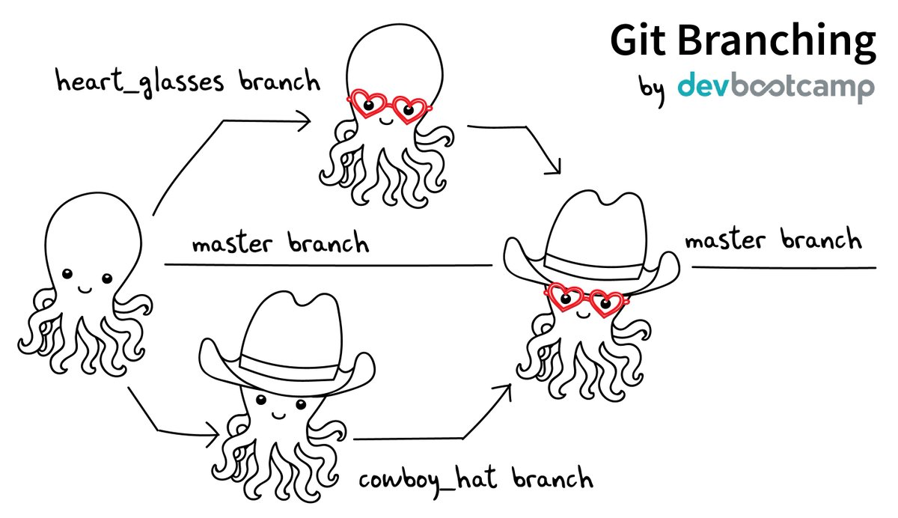
How do branches work?

Slide 10
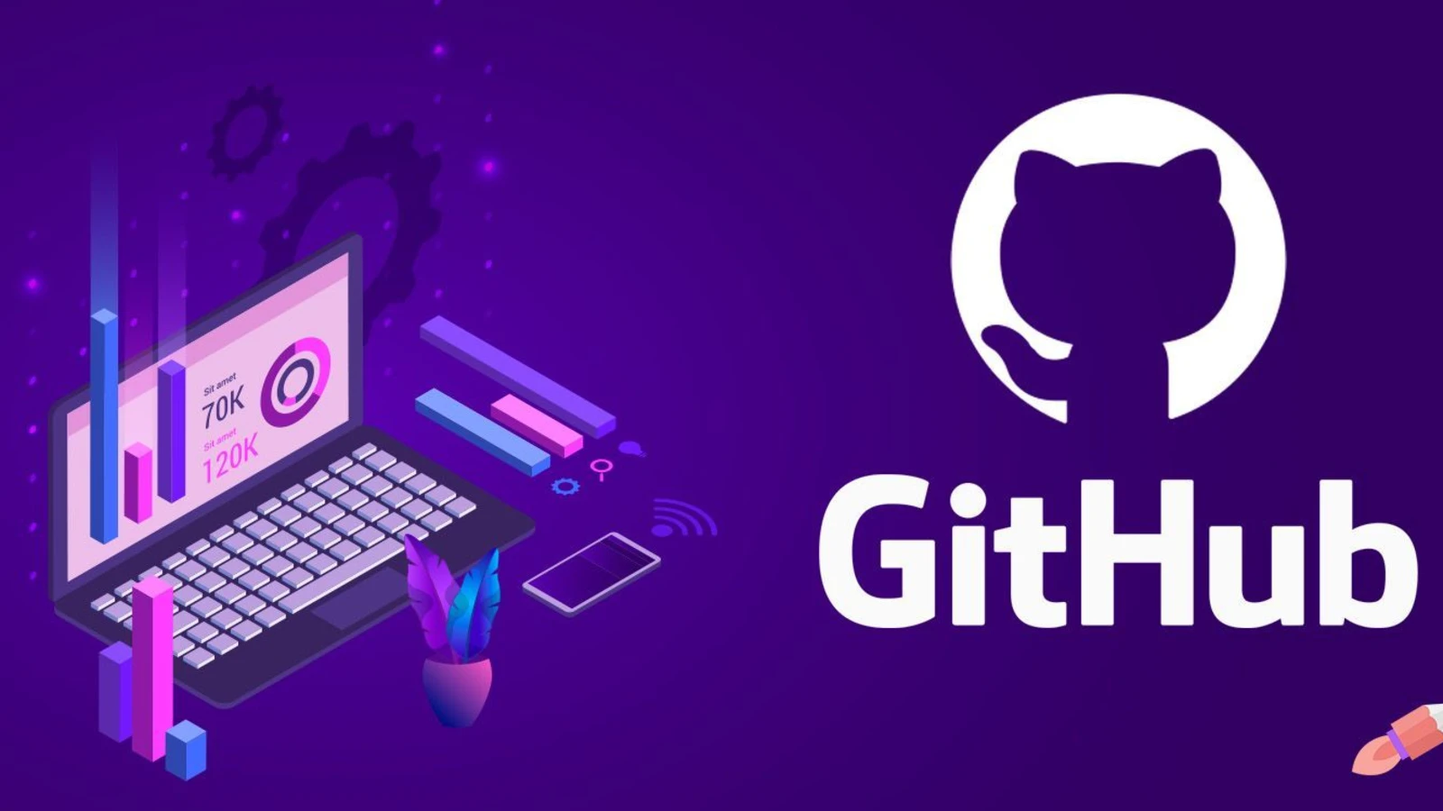
What is GitHub?

Slide 11
What is GitHub?
GitHub provides a cloud-based Git repository. There are lots of services that do this, and they’re all quite similar in principle. We will be using GitHub for this project.
GitHub is a central source for all of our branches that can be accessed over the internet. It allows us to:
Clone (download) the code from GitHub repository
Push (upload) our branches and changes to the GitHub repository
View the current state of all of the branches
Enforce some rules about what users can do
Lots more!

Slide 12
What is a Pull Request?
It is possible to just work on the main branch of a project when working in Git. You can clone the code, make changes on the main branch and then push those changes up to GitHub to update the main branch.
This can be a good idea for hobby projects where you are the only person working on the code, but for larger projects is usually not a good idea.
Instead, developers work on their own branch and push this branch up to GitHub. They can then raise a “Pull Request” – a request to merge the changes on their branch into the main branch on GitHub.
We will be making Pull Requests for all changes on this project, so that:
I can review the changes you’ve made before they go into main and affect other people’s work
We handle “merge conflicts” carefully and don’t break the website on the main branch

Slide 13
Feature development with GitHub
git push
GitHub
Your Computer
Merge (using button in GitHub)
GitHub
git clone
or
git pull

Slide 14

How are we going to
use Git and GitHub
on this Project?

Slide 15
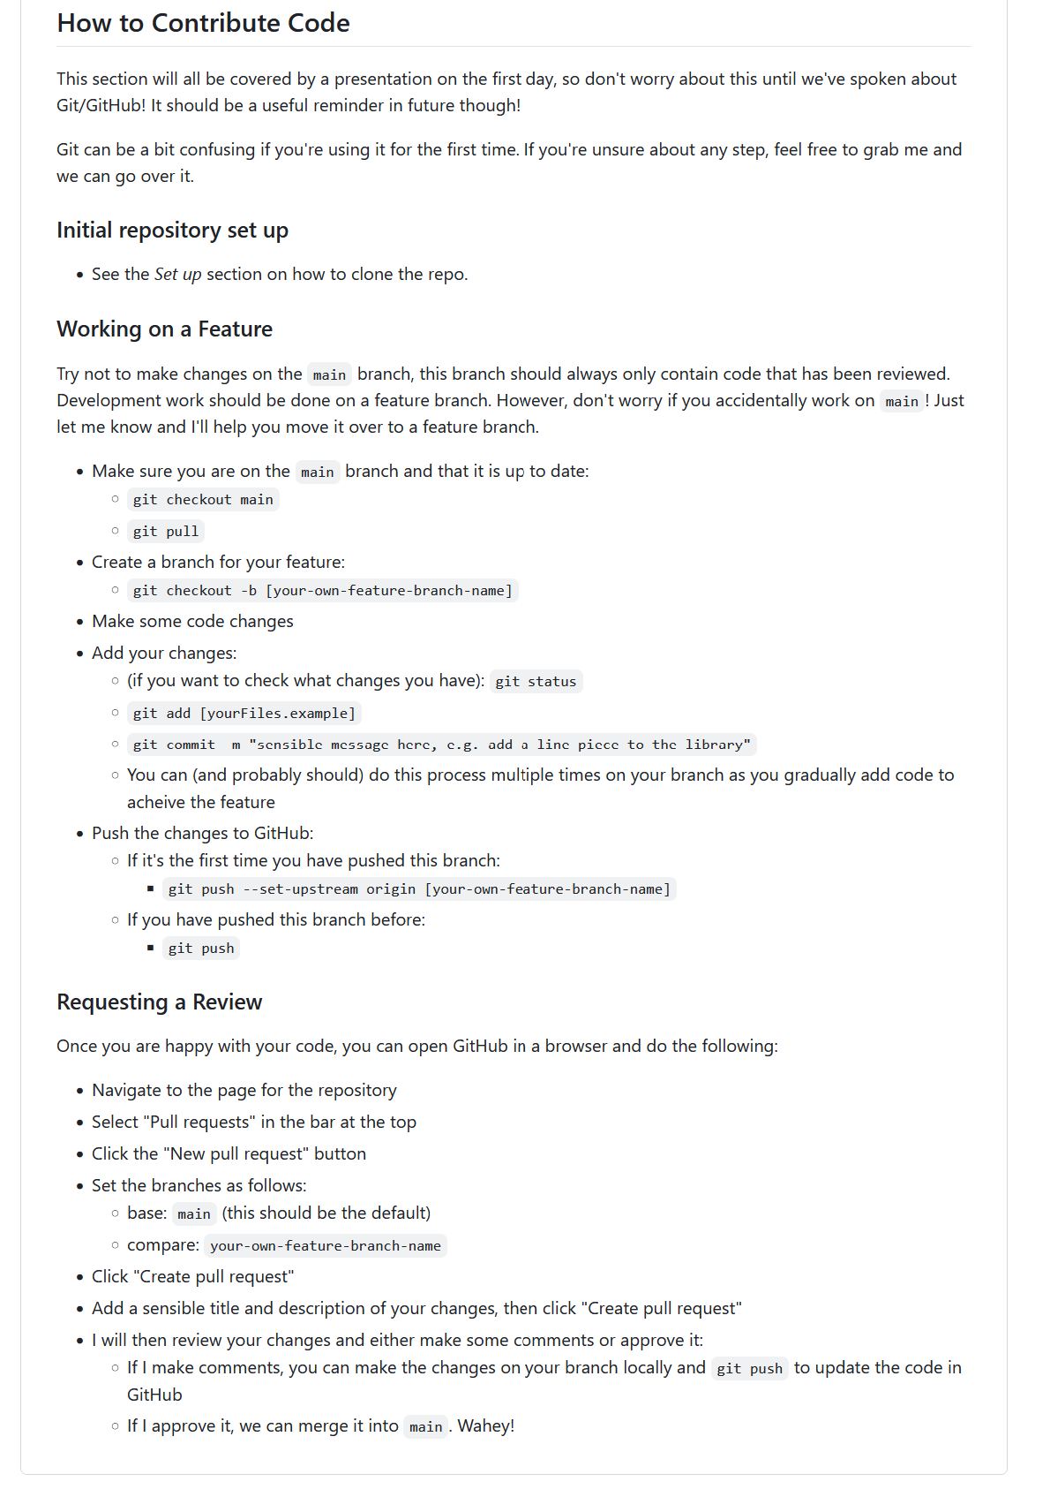
How are we going to use Git and GitHub on this project?
Git has many complicated features; we’re going to deliberately avoid using most of them and focus on doing the basics well.
There is a step by step guide in the README of the Tetris repository that should contain all of the commands that you need to know.
I will now demonstrate the entire process of:
Clone
Pull
Branch
Develop
Add
Commit
Push
Raise a Pull Request

Slide 16
Ladun Omideyi
Delivery Lead
Ladun.Omideyi@softwire.com
Floor 2, Hilton House,
16-28 Hilton St,
Manchester
M1 2EH
Copyright © Softwire 2021
All rights reserved

