Slide 1
Presentation on
TwiTone
Tone and Relationship insight using IBM Watson services
Guided by
Dr. NIRMALA C R M. Tech (C.E), Ph.D., M.I.S.T.E
Associate. Professor,
Department of CS&E,
B.I.E.T., Davanagere
Project By
Aditya Ladwa

Slide 2
Introduction
This is the era of Single Page Web Applications
Pages are rendered in real time which makes them interactive and performant e.g. Facebook Chat
With added difficulty in developing these web application
Programming Enthusiasts started abstracting common features that every Web Application requires and Open-sourced them so its available for everyone to develop applications easily.
The common patterns were MVC , MVVM , MVW
React was one of them introduced by Facebook
Many people choose to think of React as the V in MVC

Slide 3
Introduction
What makes React different from other Frameworks?
Simple: Simply express how your app should look at any given point in time, and React will automatically manage all UI updates when your underlying data changes.
Declarative: When the data changes, React conceptually hits the "refresh" button, and knows to only update the changed parts.
Build Composable Components: React is all about building reusable components. In fact, with React the only thing you do is build components. Since they're so encapsulated, components make code reuse, testing, and separation of concerns easy.
Architecture Beyond HTML: The basic architecture of React applies beyond rendering HTML in the browser. For example, Facebook has dynamic charts that render to <canvas> tags.
Isomorphic JavaScript: React enabled us to build JavaScript UI code that can be executed in both server (e.g. Node.js) and client contexts.

Slide 4
Features of React
React Components
Prop and State
JSX
Virtual DOM

Slide 5
React Components
Object-oriented widgets definition i.e. using the java scripts OOP concepts
Nested widgets support i.e. multiple components can be nested and a more complex UI widget can be created
HTML-Like Widget DOM definition (Virtual DOM)
Optimized rendering to the real DOM tree

Slide 6
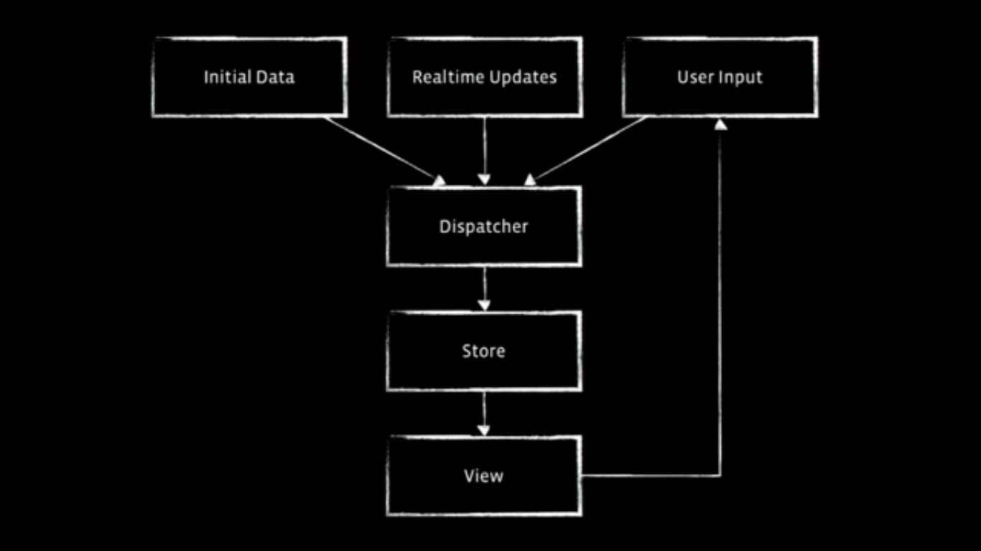
React Components
Our main focus is on the view

Slide 7
Prop and State
Prop
State
passed in from parent
<MyComp foo="bar" />
this.props read-only within
can be defaulted & validated
created within component
getInitialState()
this.state to read
this.setState() to update

Slide 8
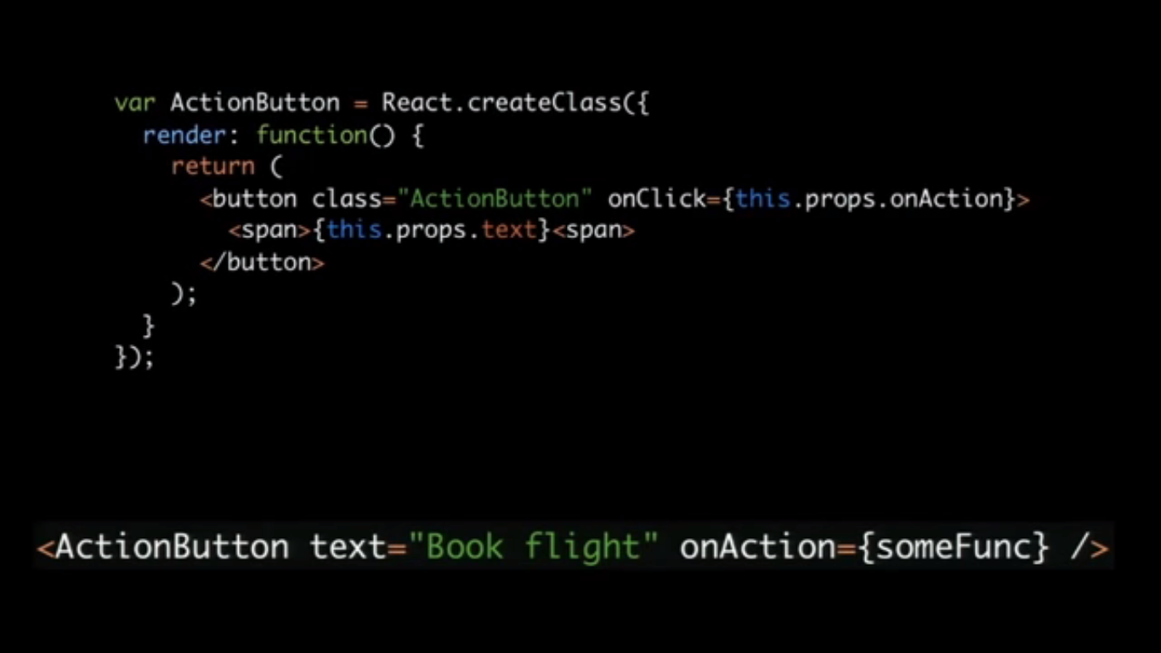
Prop and State
How to access properties?

Slide 9
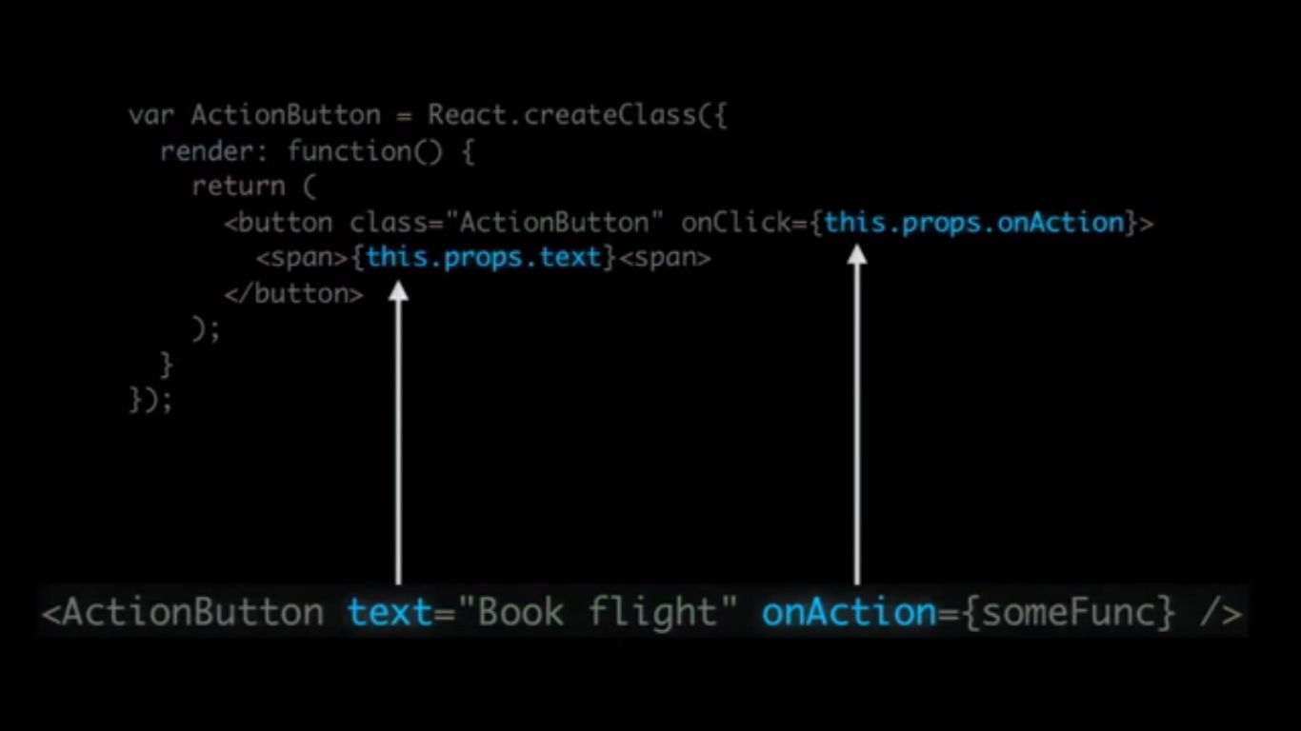
Prop and State
How to access properties?

Slide 10
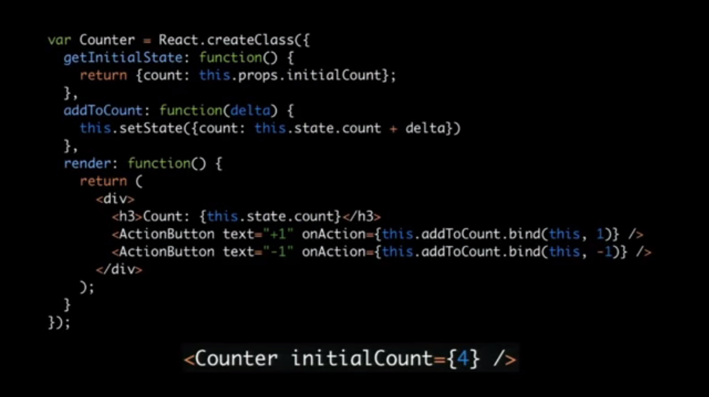
Prop and State
How states are initialized and accessed?

Slide 11
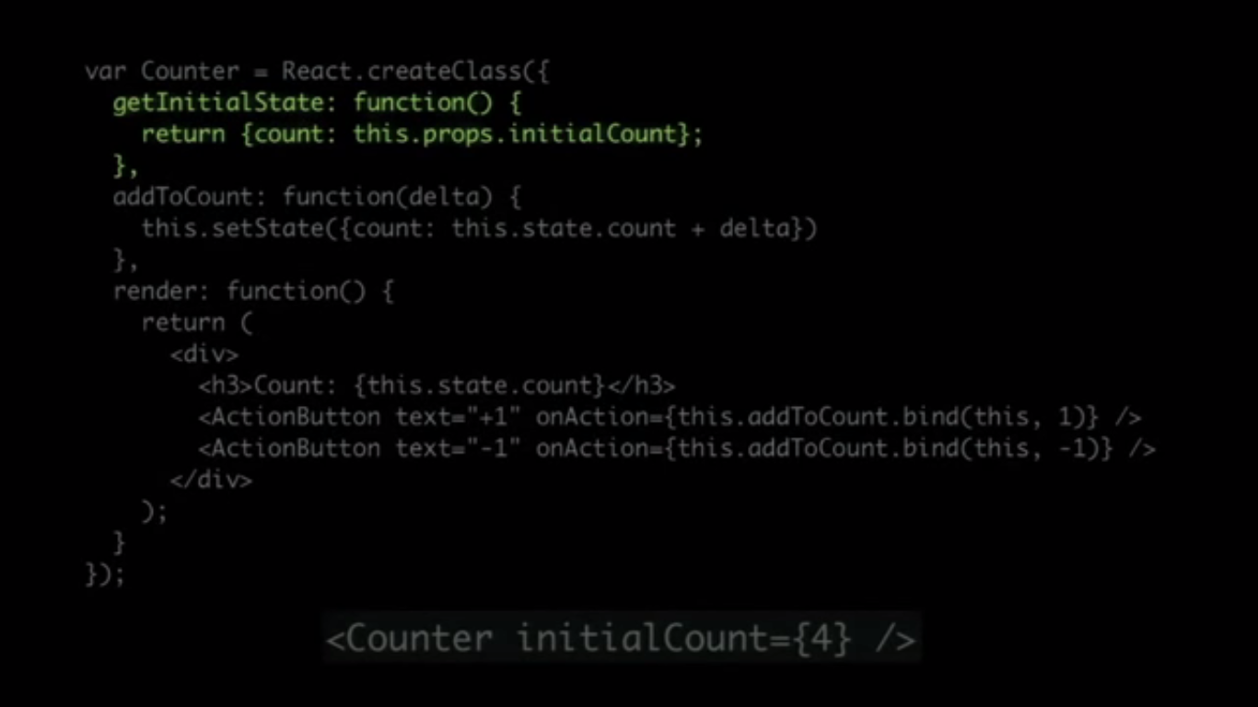
Prop and State
How states are initialized?

Slide 12
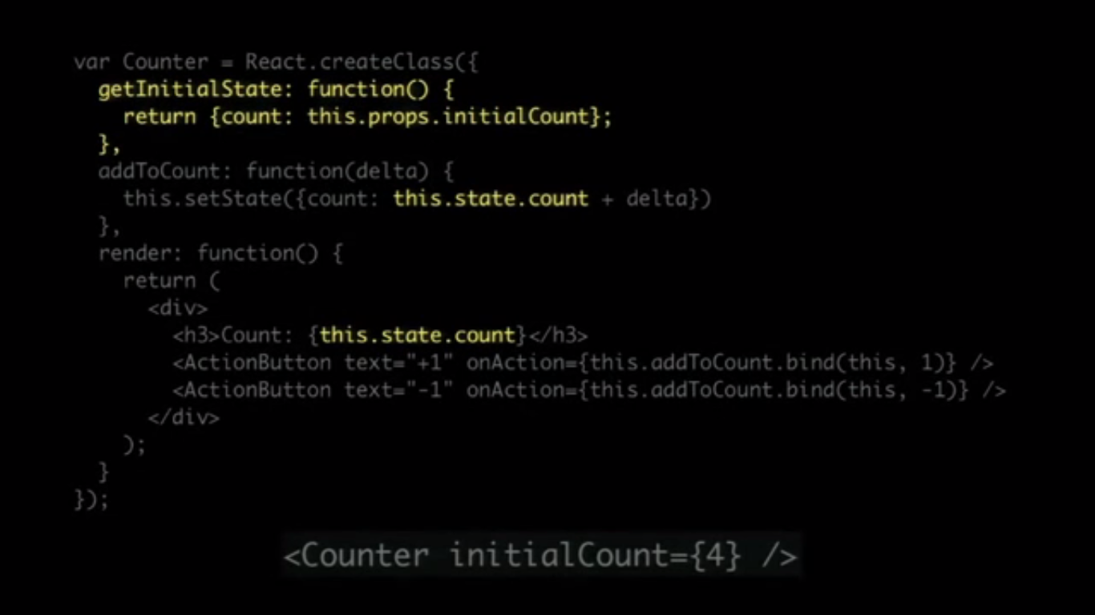
Prop and State
How states are accessed?

Slide 13
JSX
To simplify Virtual DOM definition Facebook added html subset language called JSX (JavaScript extension syntax)
JSX allow to define Widget DOM piece directly within your JavaScript file
JSX converter is used for production into raw JavaScript with preprocessor (browserify or babel )

Slide 14
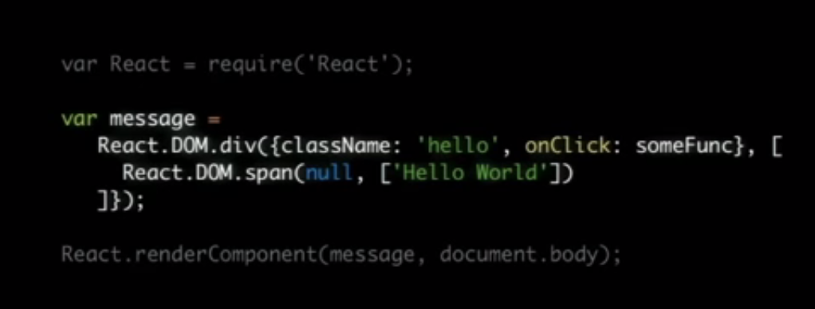
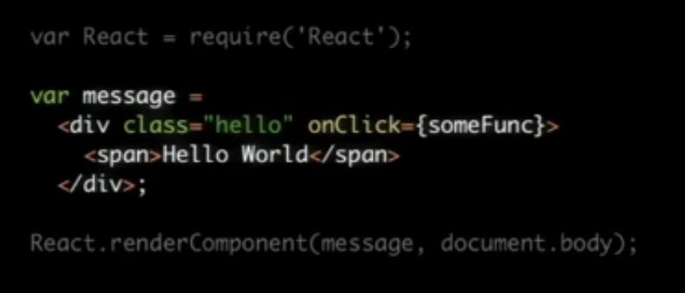
JavaScript v/s JSX

Slide 15
Virtual DOM
Modification within real DOM tree is very slow and expensive
To speed up things Facebook created Virtual DOM which consist from lightweight JavaScript objects which represent Widgets DOM tree
It’s a pure JavaScript representation of the DOM
Render() is called whenever state of a component changes
When state changed Virtual and real DOM trees are compared and real DOM modified only where it’s required

Slide 16
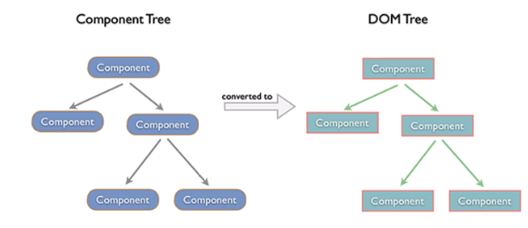
Virtual DOM
Complexity to compare two trees is O(n^3) complexity
React managed to turn O(n^3) problem into linear O(n)
So it’s really fast.

Slide 17
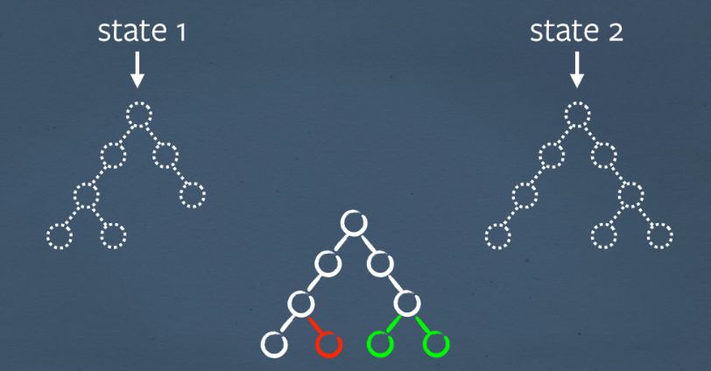
Virtual DOM Mutation

Slide 18
Implementation
Software:
Google Chrome or Mozilla FireFox
A text editor (Atom, Sublime Text 3)
Reactjs, jquery, bootstrap
Windows 7 or above operating system
Hardware:
PENTIUM III processor
DDR RAM of 1GB
Standard qwerty serial or PS/2 keyboard
Standard serial or PS/2 mouse.
Cache memory 256 KB.

Slide 19
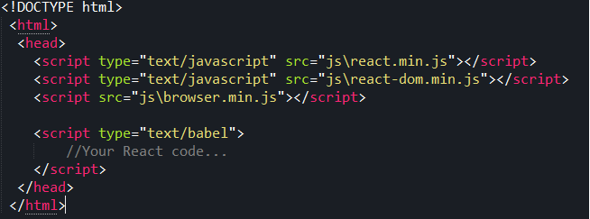
Implementation
Basic setup of a HTML document to declare a component

Slide 20
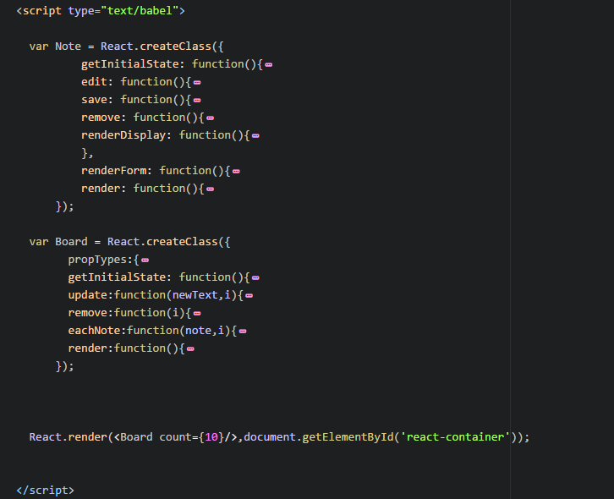
Implementation
Object definition overview

Slide 21
Conclusion
We have attempted to design and implement a simple Single Page Application using React and its built in JSX support.
found that the creation of a UI component is fairly fast and efficient and the rendering of UI is optimized by the Virtual DOM that React supports
Also we can use a single UI component can be used at multiple instances
Code is available on https://github.com/LadwaAditya/ReactJSNoteApp

Slide 22
BIBILOGRAPHY
https://facebook.github.io/react/
https://github.com/facebook/react
https://en.wikipedia.org/wiki/React_(JavaScript_library)
https://github.com/facebook/react/wiki/Examples

Slide 23

Thank You

