Slide 1
Presentation on
TwiTone
Tone and Relationship insight using IBM Watson services
Guided by
Dr. NIRMALA C R M. Tech (C.E), Ph.D., M.I.S.T.E
Professor and HOD,
Department of CS&E,
B.I.E.T., Davanagere
Project By
Aditya Ladwa

Slide 2
Introduction
TwiTone is a WebApp that provides tone analysis of tweets and Relationship insights
The WebApp is built using modern web Technologies
MEAN stack
MongoDB
Express.js
Angular.js
Node.js
IBM Watson Tone Analyzer and Relationship insight services are used from bluemix
Canvas.js for plotting various graphs
Twitter Bootstrap for providing CSS

Slide 3
Features of TwiTone
Display tweets of a user
Analyze Tone of Tweets using IBM Watson Tone Analyzer
Provide Emotional Summery such as Sadness, joy, Fear, Disgust, Anger in a Tweet.
Provide Social Summery such as Emotional Range, Agreeableness, Extraversion, Consciousness, Openness in a tweet.
Provide Language Style Summery such as Analytical, Confident, Tentative.
Provide Relationship Insight of various linguistic components of a Tweet such as nouns, verbs, pronouns, adjectives

Slide 4
Implementation
Create a Node.js Web App from Bluemix console
Get Twitter API key and Access token from apps.twitter.com
Use node package manager to download these node modules
cfenv ( Provided by default from Bluemix)
Express (For routing requests)
Twitter (To communicate to Twitter API)
Watson-developer-cloud (To communicate and use IBM Watson services )
Create Tone Analyzer and Relationship insight services from Bluemix console and bind the services to our Node App
Create credentials for Tone Analyzer and Relationship Insight in Bluemix console for authentication between Watson services and our application

Slide 5
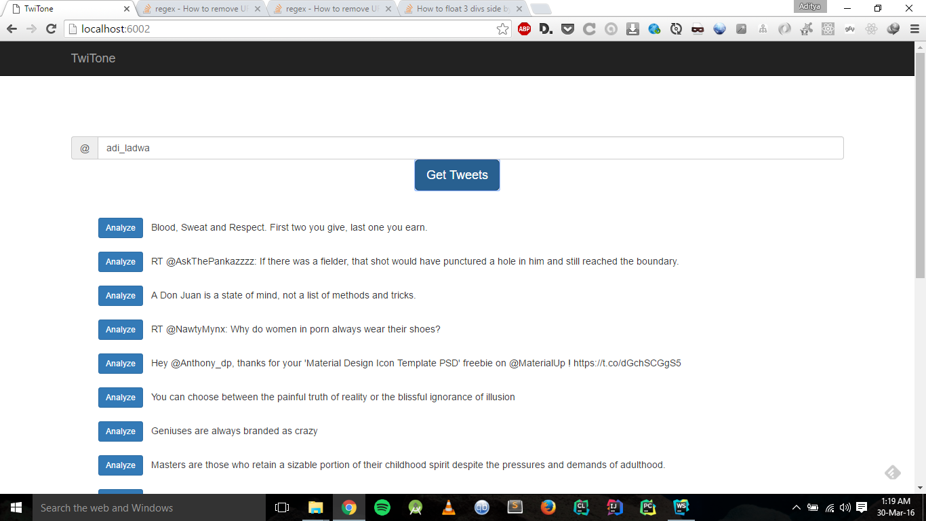
Implementation
Displaying of Tweets

Slide 6
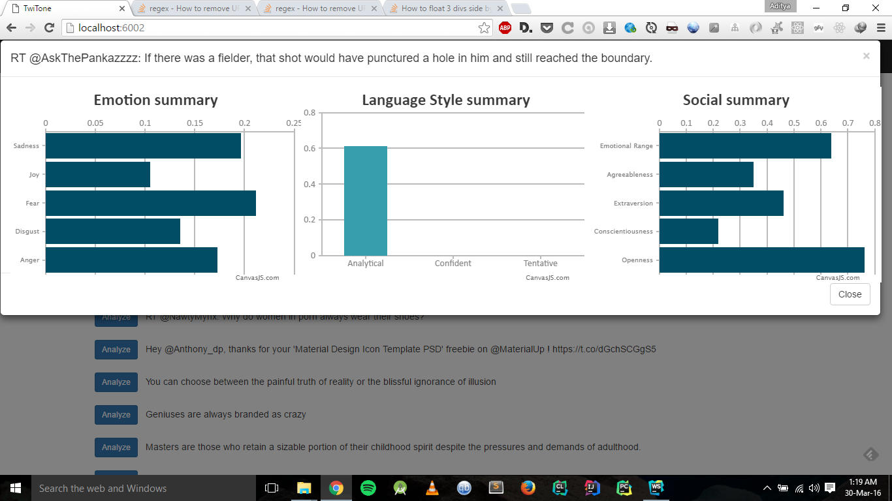
Implementation
Summery of Tone in a Tweet

Slide 7
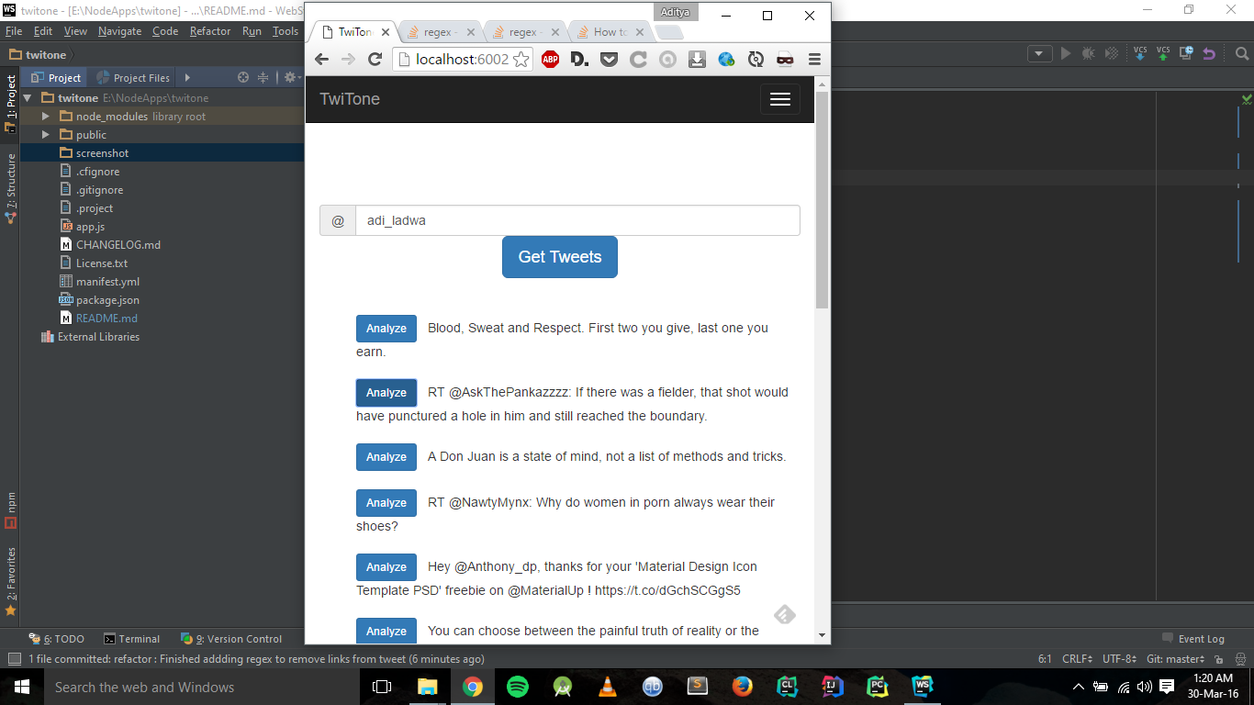
Implementation
Mobile display of App

Slide 8
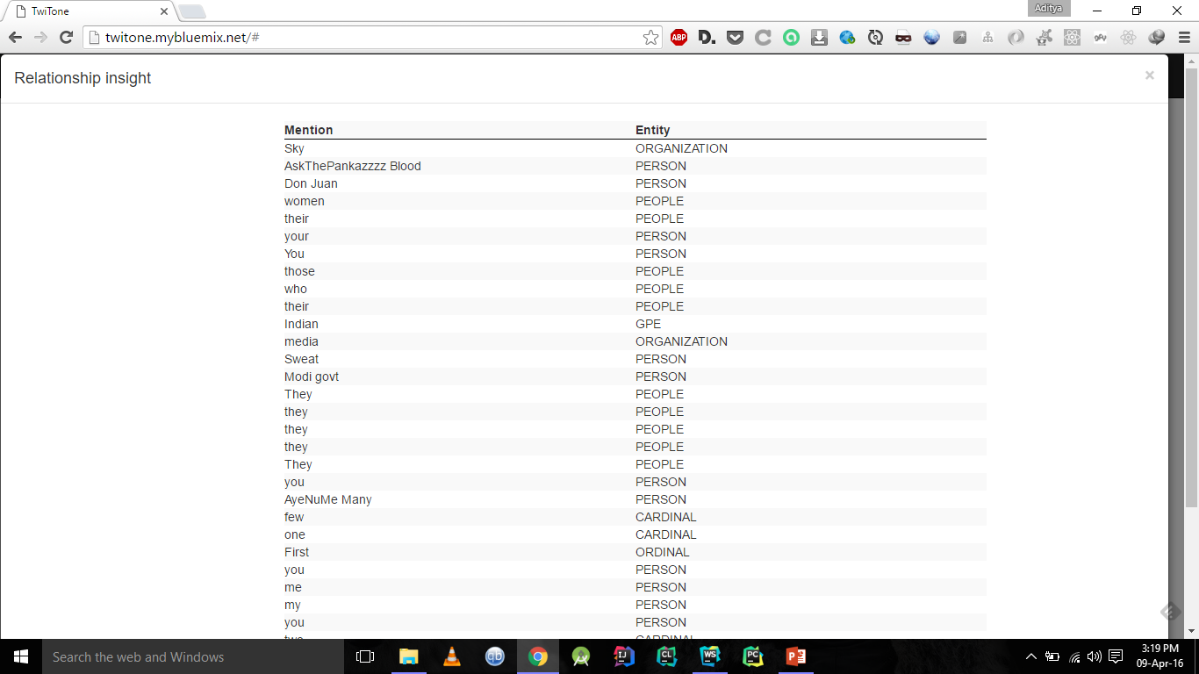
Implementation
Relationship insight

Slide 9
Conclusion
We have attempted to create an application by leveraging Modern Web Technology (MEAN stack), Twitter API and IBM Watson services
WebApp is hosted at this URL http://twitone.mybluemix.net
Code is Open-Sourced at this URL https://github.com/LadwaAditya/TwiTone

Slide 10
BIBILOGRAPHY
https://apps.twitter.com/
https://github.com/watson-developer-cloud/node-sdk
https://console.ng.bluemix.net/

Slide 11
Thank You

