Slide 1
Presentation on
TwiTone
Tone and Relationship insight using IBM Watson services
Guided by
Dr. NIRMALA C R M. Tech (C.E), Ph.D., M.I.S.T.E
Associate. Professor,
Department of CS&E,
B.I.E.T., Davanagere
Project By
Aditya Ladwa

Slide 2
Introduction
TwiTone is a WebApp that provides tone analysis of tweets and Relationship insights
The WebApp is built using modern web Technologies
MEAN stack
MongoDB
Express.js
Angular.js
Node.js
IBM Watson Tone Analyzer and Relationship insight services are used from bluemix

Slide 3
Features of TwiTone
Display tweets of a user
Analyze Tone of Tweets using IBM Watson Tone Analyzer

Slide 4
Implementation
Software:
Google Chrome or Mozilla FireFox
A text editor (Atom, Sublime Text 3)
Reactjs, jquery, bootstrap
Windows 7 or above operating system
Hardware:
PENTIUM III processor
DDR RAM of 1GB
Standard qwerty serial or PS/2 keyboard
Standard serial or PS/2 mouse.
Cache memory 256 KB.

Slide 5
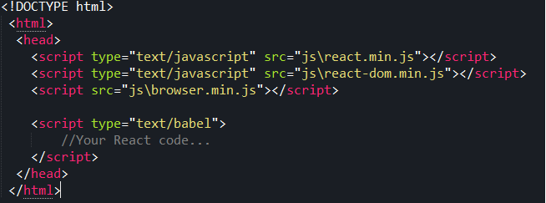
Implementation
Basic setup of a HTML document to declare a component

Slide 6
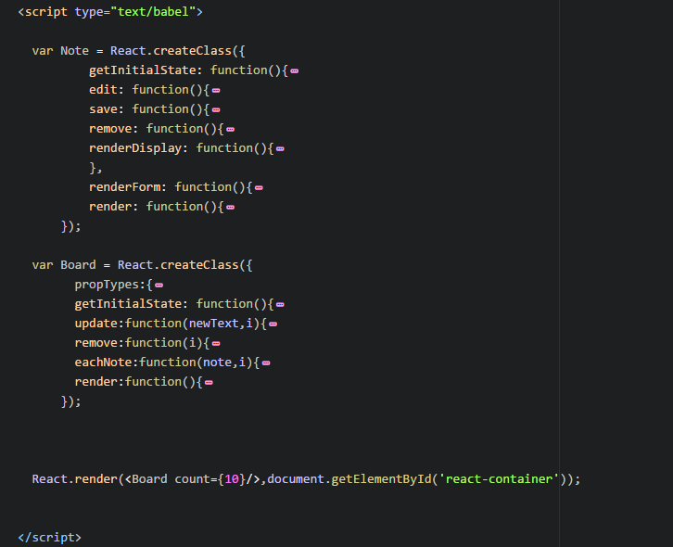
Implementation
Object definition overview

Slide 7
Conclusion
We have attempted to design and implement a simple Single Page Application using React and its built in JSX support.
found that the creation of a UI component is fairly fast and efficient and the rendering of UI is optimized by the Virtual DOM that React supports
Also we can use a single UI component can be used at multiple instances
Code is available on https://github.com/LadwaAditya/ReactJSNoteApp

Slide 8
BIBILOGRAPHY
https://facebook.github.io/react/
https://github.com/facebook/react
https://en.wikipedia.org/wiki/React_(JavaScript_library)
https://github.com/facebook/react/wiki/Examples

Slide 9
Thank You

