Slide 1

Student Classroom Allocation System
G11 Team Members – Tanisha saggar, anchal bedi, hammad abdullah , syed umer , ansh srivastava , Yaoshan Zhong

Slide 2
ACKNOWLEDGMENT
The site visit enables us to recognize how Wurundjeri country interacts with historical backgrounds while understanding the spiritual nature emanating from them. Future operations must demonstrate careful handling of challenges to give honor to the ancestral spiritual leaders who maintain their positions at these locations. Our organization shows the highest admiration toward Aboriginal or Torres Strait Islander people both in our workplace and throughout their interactions with students and alumni graduates and business associates and visitors.
The executive team of our organization decided to respect Traditional Landowners of Australia by recognizing their spiritual connection to their ancestors alongside their cultural power alongside their traditional customs and ancestral heritage. The complete political authority of every Aboriginal and Torres Strait Islander nation remains valid based on multiple established statements.

Slide 3
Project Overview
Built an intelligent classroom allocation system
Balanced academic performance, wellbeing, and bullying risk
Final model: Hybrid of Genetic Algorithm (GA) + CP-SAT
Integrated with a full-stack admin dashboard using Flask, HTML, CSS, and JavaScript
Notes:
overview

Slide 4
PROJECT BACKGROUND
Traditional school allocation lacks adaptive and fairness-aware mechanisms
Academic imbalance across classrooms
Social isolation and mental health concerns
Clustering of high-risk bullying behaviour
Need for intelligent automation to optimize and control group formation
KEY ISSUES ---->>>
Notes:
background

Slide 5




PROJECT SCOPE & OBJECTIVES
Allocate large datasets efficiently across multiple classrooms.
1
Develop a dashboard for admin control and model testing
3
Enforce constraints: Max 25 students per class. Limit bullying concentration (max 2 bullies/class). Balance academic and wellbeing scores across groups
2
Notes:
3 things to do

Slide 6
Deliverables
Hybrid Model (GA + CP-SAT) Powered Classroom Allocation System
Machine learning models used to optimize multi objective classroom allocation
Interactive data visualization and editing
Final documentation, testing, and demonstration
Admin dashboard with manual override option for dynamic adjustments

Slide 7
Initial Model Choice – What We Started with ?
Reinforcement Learning (RL)
Graph Neural Network (GNN)
Genetic Algorithm (GA)
Constraint Programming (CP)

Slide 8
Drawbacks of using standalone models
Too slow and unstable for large-scale classroom allocation
Struggles with generating initial feasible solutions for large datasets
optimizes grouping; CP-SAT enforces rules - together they address performance, constraint satisfaction, and scalability.
Models like GNN- good at predicting but not assignment

Slide 9
Why Hybrid?
Combines strengths of multiple approaches
Reduces invalid or infeasible outputs
Supports customization and improves solution quality

Slide 10
What We Experimented With
Reinforcement Learning + CP-SAT
Too slow and difficult to optimize
Unstable reward metrics
GNN + CP-SAT
Showed potential for handling a relational data
Limited by sparse graph connections
Genetic Algorithm (GA) Alone
Outperformed ML in group diversity
Lacked hard constraint enforcement
GA + CP-SAT ✅ (Selected Approach) Synergized advantages:
Provides evolutionary optimization
CP-SAT guarantees constraint compliance

Slide 11
Why We Chose GA + CP-SAT
GA helps explore optimal grouping quickly using a fitness function
CP-SAT then ensures: No constraint is violated. Every student is placed within school rules
Hybrid approach gave us the best results in: Accuracy, Runtime performance, Rule compliance

Slide 12

LOGICAL BREAKDOWN OF ALGORITHM
START
INPUT DATASET(CSV)
GENERATE INITIAL POPULATION (GA)
EVALUATE FITNESS( Academic, Wellbeing, Bullying)
Select Top Solutions
Passed best algo ( CP-SAT + GA)
Apply Constraints (CP-SAT)
FINAL VALID GROUPING

Slide 13
Genetic Algorithm Logic
Randomly groups students into initial class batches
Evaluates each population on:
* Academic std deviation
* Wellbeing balance
* Bully limit violations
Passes best groupings to CP-SAT for final adjustment

Slide 14
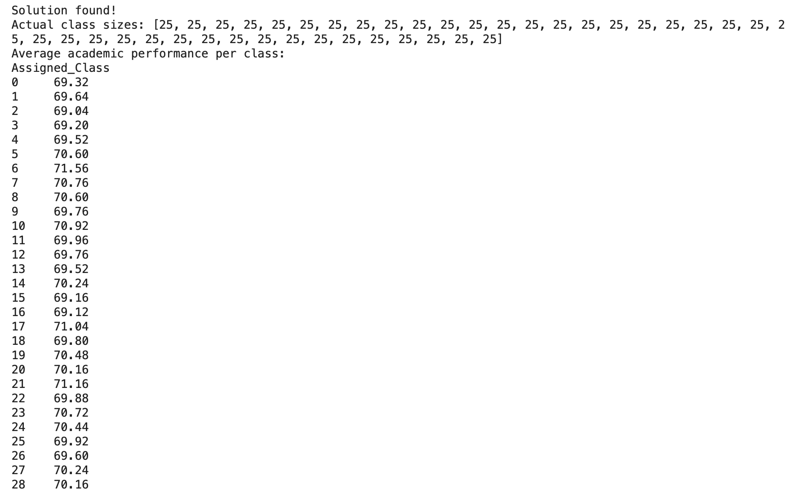

Constraint Programming (CP-SAT) Logic
Original CP-SAT rules:
max_allowed_difference = 10
max_allowed_wellbeing_diff = 1
max_bullies_per_class = 1
Updated CP-SAT rules:
MAX_ALLOWED_DIFFERENCE = 15 # Relaxed from 10 to 15
MAX_ALLOWED_WELLBEING_DIFF = 2 # Relaxed from 1 to 2
MAX_BULLIES_PER_CLASS = 2 # Relaxed from 1 to 2

Slide 15
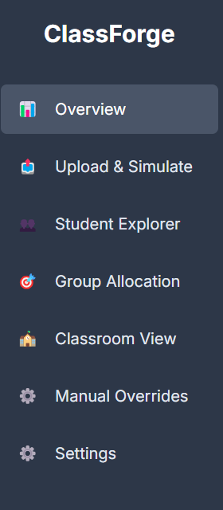
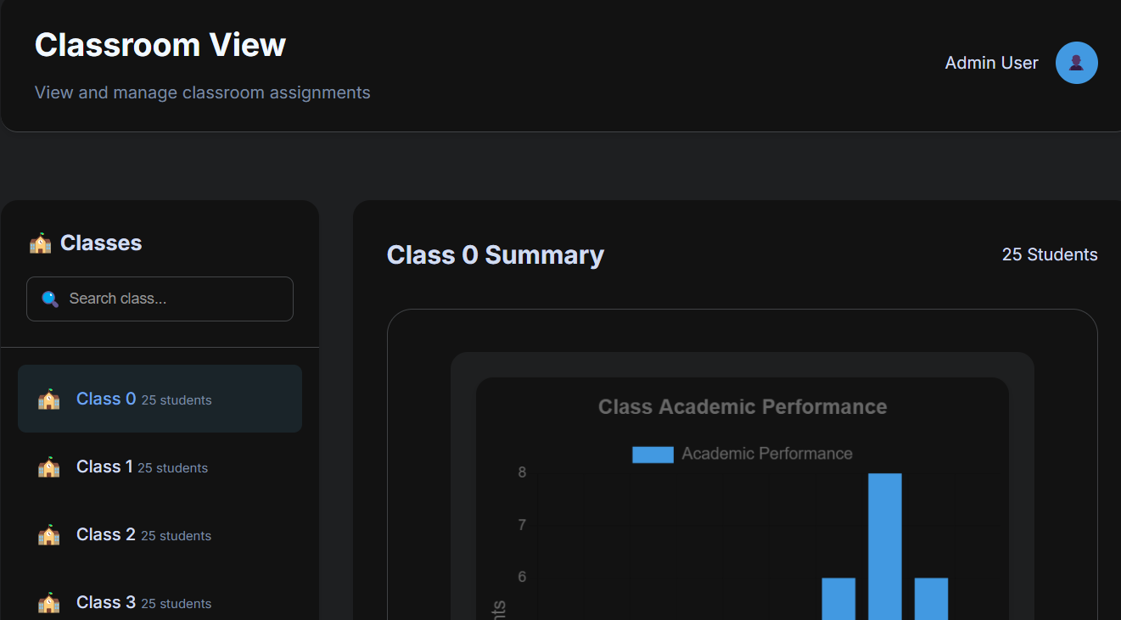
Dashboard and Interface
Built with Flask, HTML, CSS, JavaScript

Slide 16
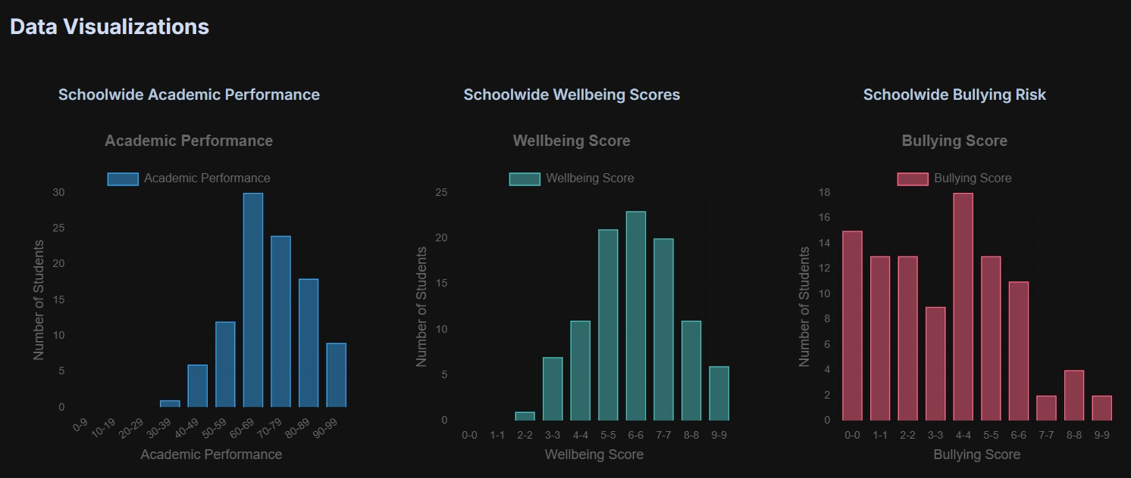
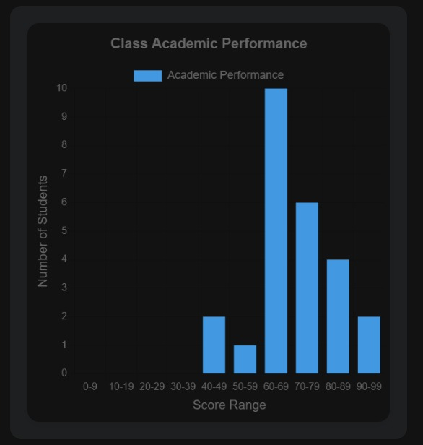
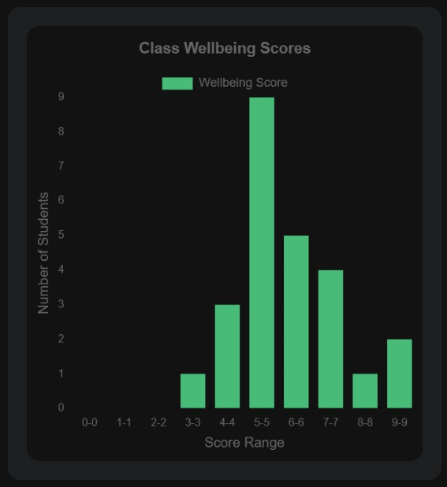
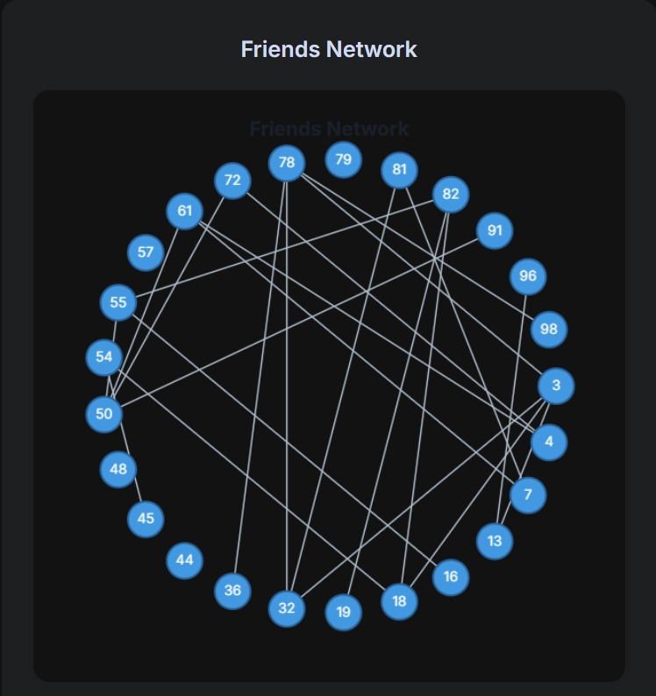
Testing Results
School wide data visualization:
Bell graph: perfect
Bullying Risk – non bell graph: depends on mental health students, mental wellbeing
Class base data visualizattion:
Try to get bell graph, limit deviation
Friends in class, keep friends in the same class

Slide 17
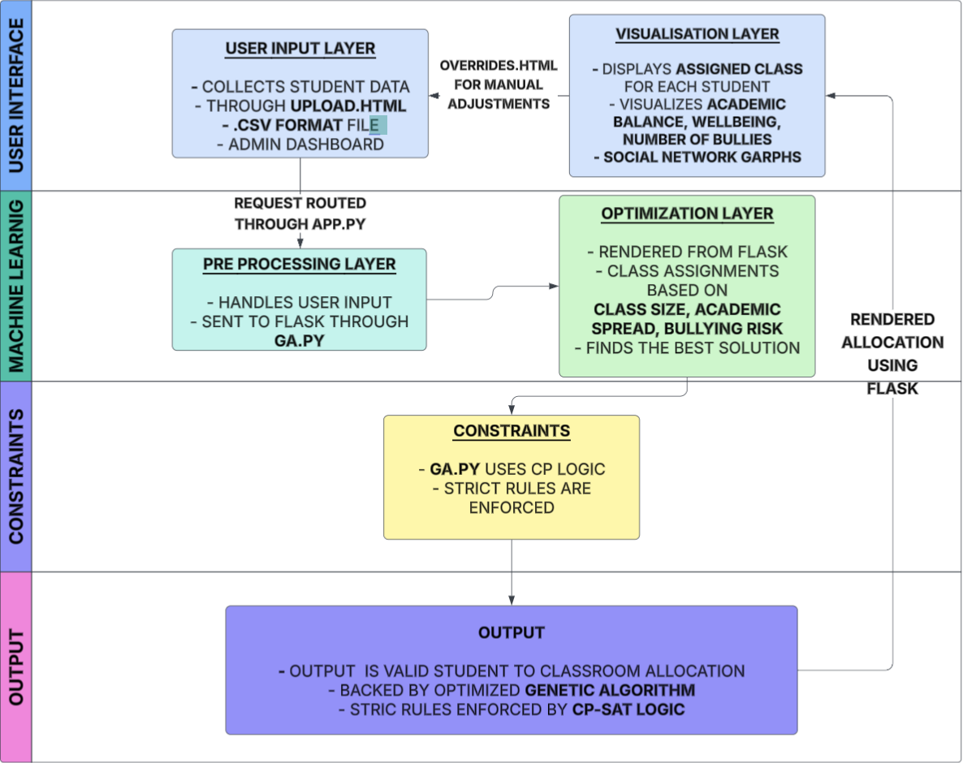
Architecture Diagram

Slide 18
Lessons Learned
ML is useful but needs reinforcement with constraint logic
Dashboards help communicate fairness to users
Social metrics matter as much as academic data But Learning Style Compatibility,Behavioural Incidents History can also be used
Testing multiple models ensures optimal selection.

Slide 19
FUTURE WORK
Optimal Feature Finder
Auto-feedback loop from teachers post-allocation
Expand constraint library for policy-based rules.

Slide 20
THANK YOU

