Slide 1
BookMe Database System
Introduction of BookMe Database System
ER Model of BookMe Database System
What tables it has
The business query it uses

Slide 2
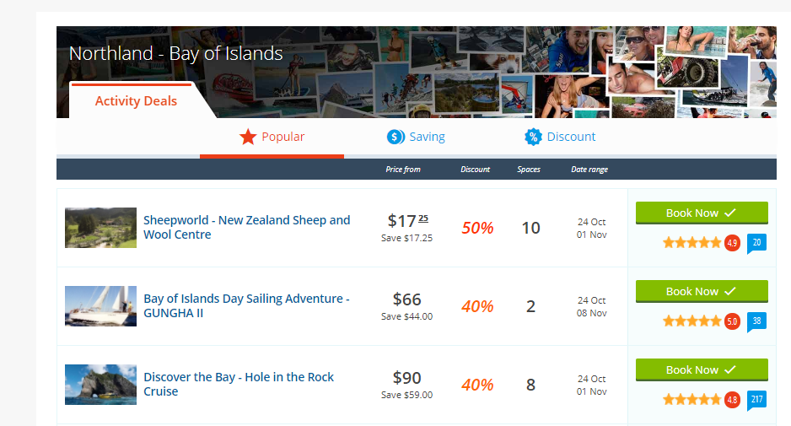
Introduction of BookMe Database System

Slide 3
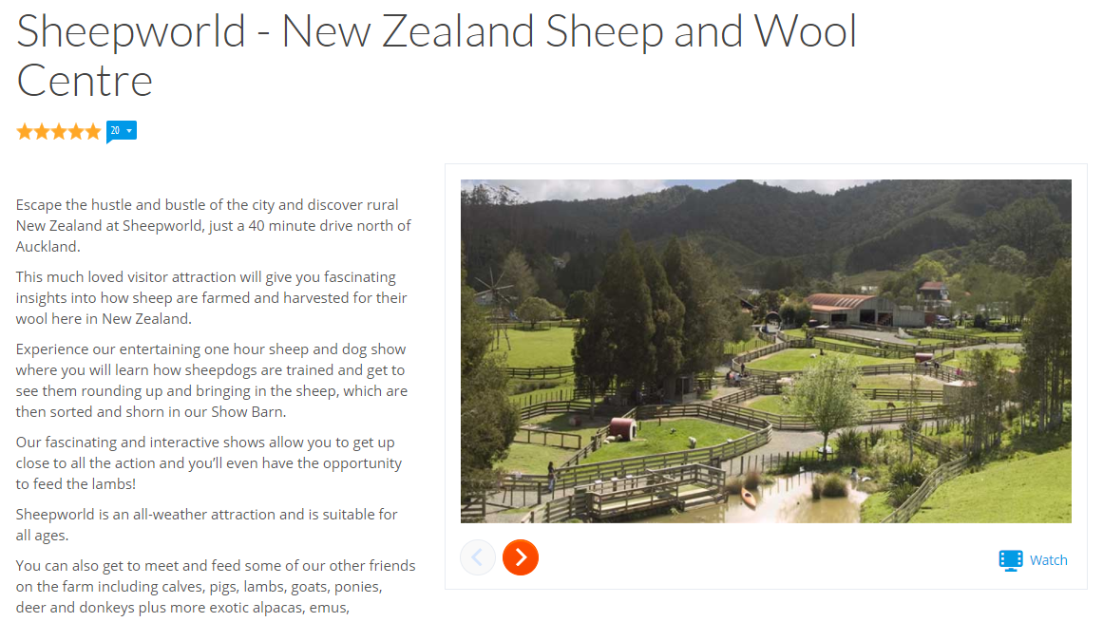
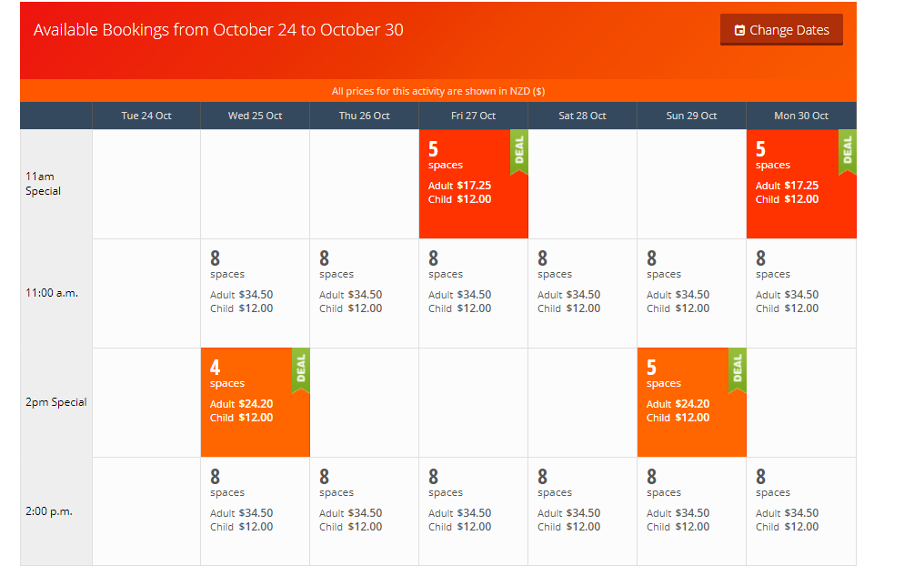
Introduction of BookMe Database System
Product schedule
Product Detail

Slide 4
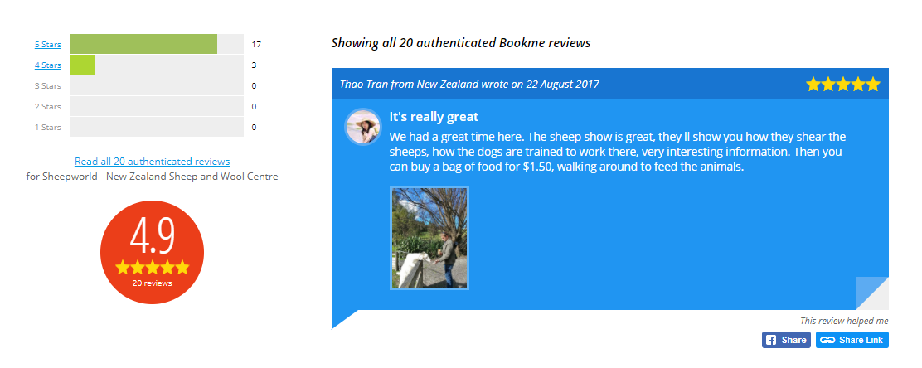
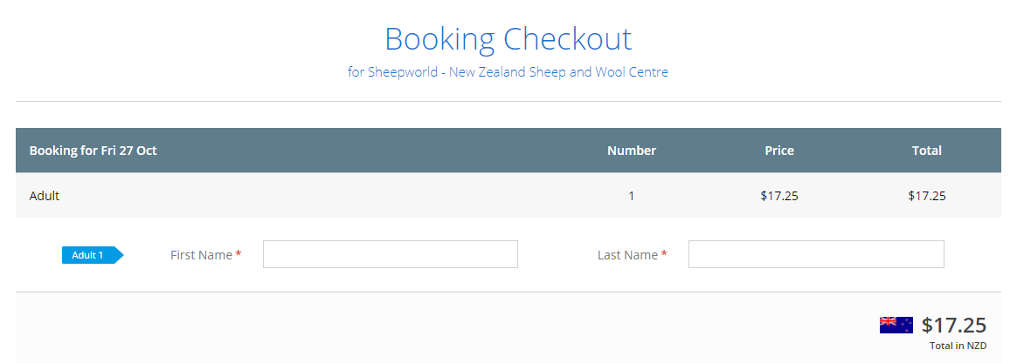
Introduction of BookMe Database System
Reviews
Payment Details

Slide 5
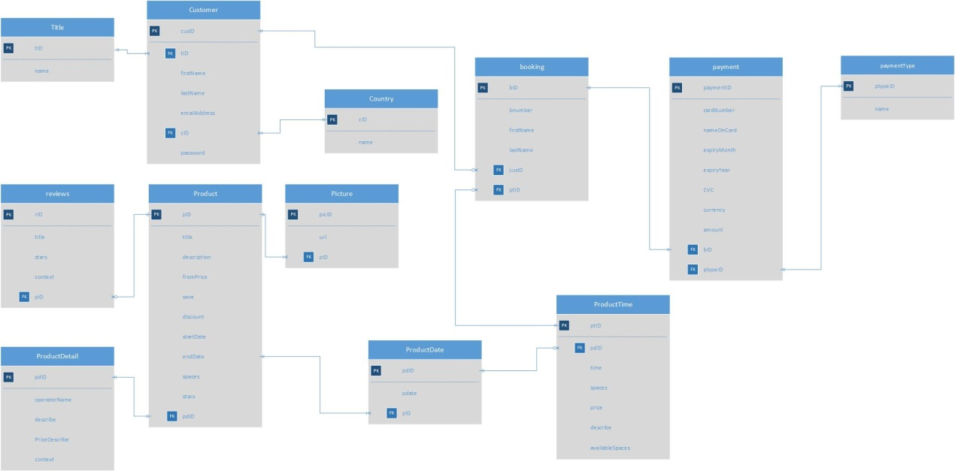
ER Model of BookMe

Slide 6
What tables Bookme Has
Customer
Product
Product Detail
Product Time
Reviews
Booking
Payments

Slide 7
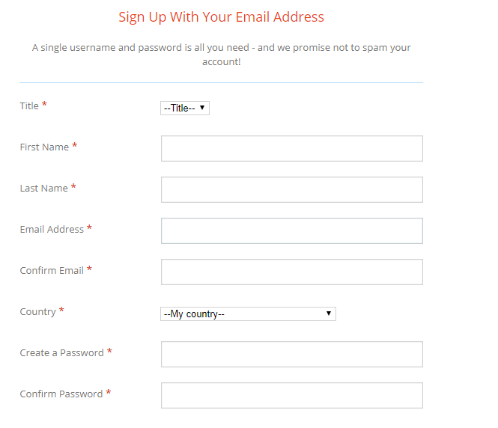
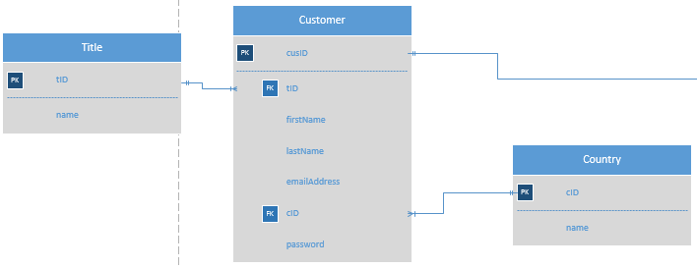
What tables Bookme Has
Customer

Slide 8
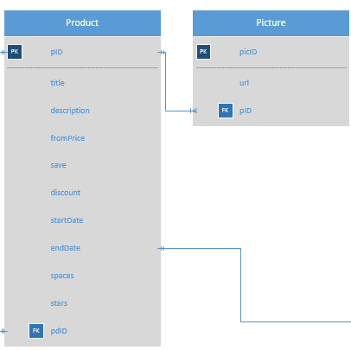
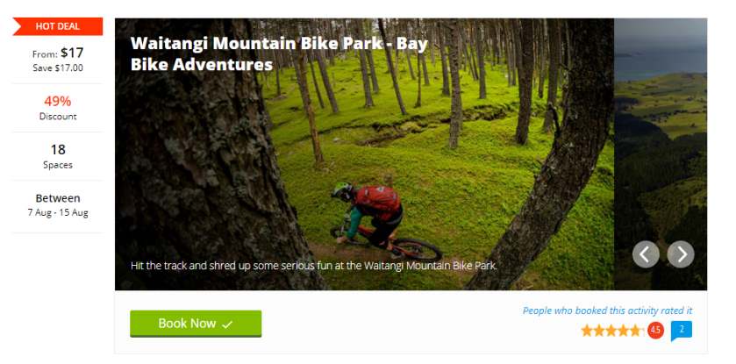
What tables Bookme Has
Product

Slide 9
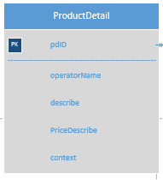
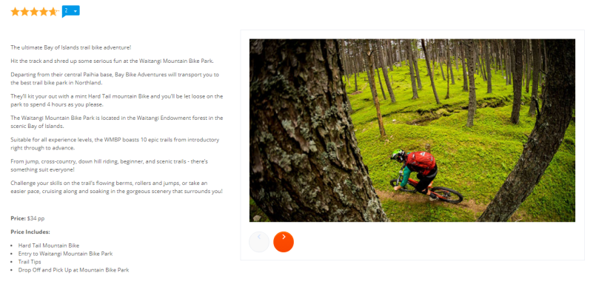
What tables Bookme Has
Product Detail

Slide 10
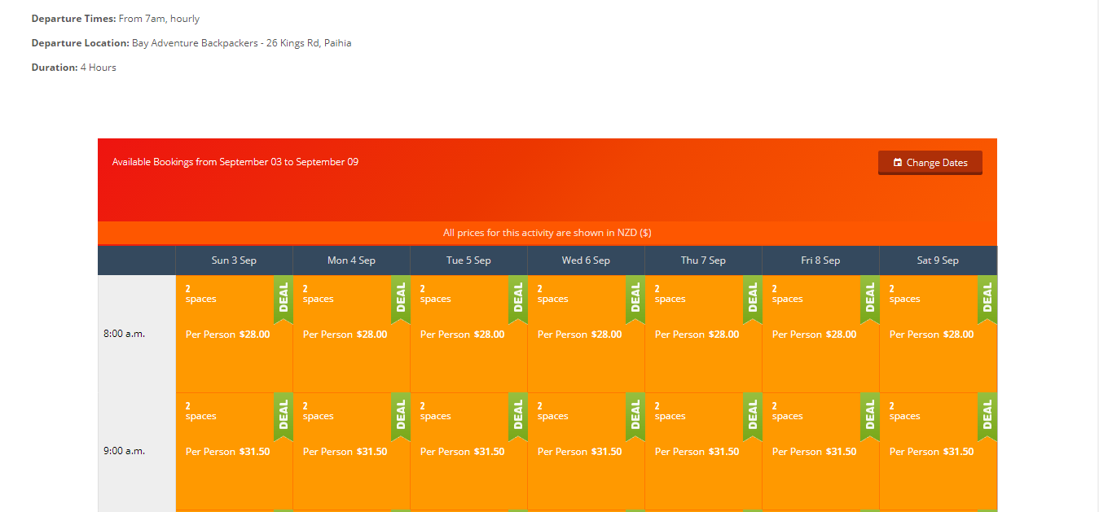
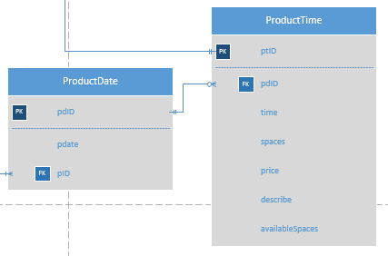
What tables Bookme Has
Product Time

Slide 11
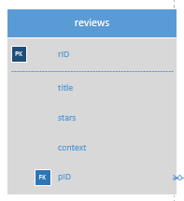
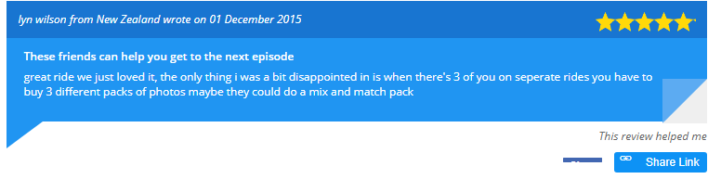
What tables Bookme Has
Reviews

Slide 12
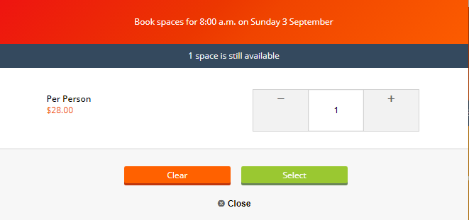
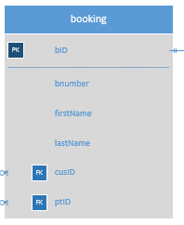
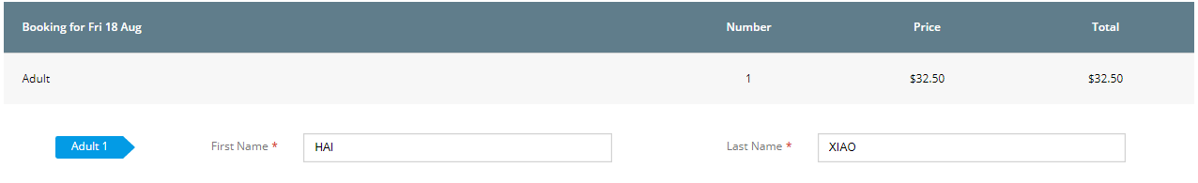
What tables Bookme Has
booking

Slide 13
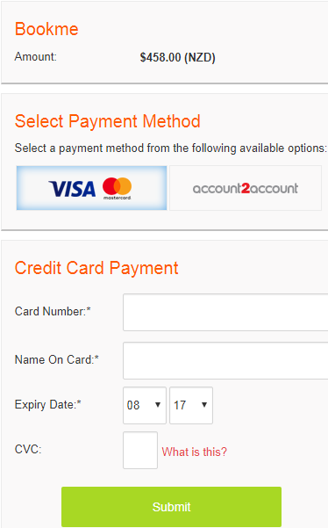
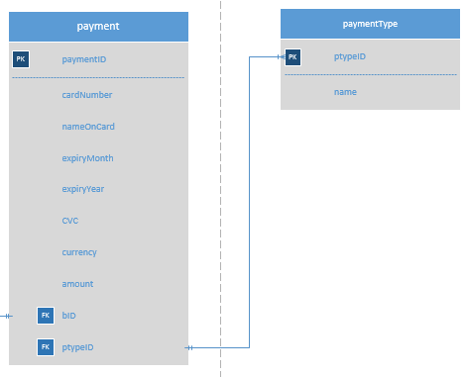
What tables Bookme Has
payment

Slide 14
The business query it uses
Customer Detail
Product Information
Product Detail
Product Reviews
Product Time
Booking Information
Payment Information

Slide 15
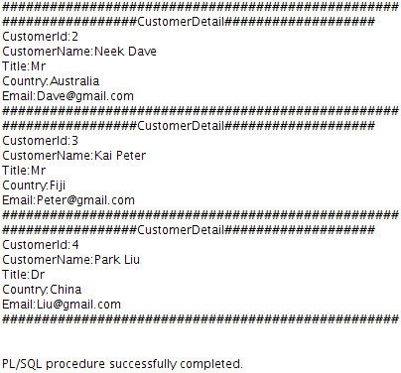
The business query it uses
Customer Detail

Slide 16
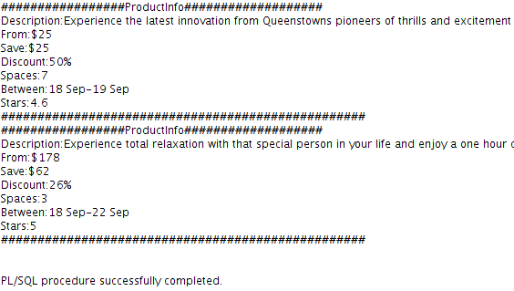
The business query it uses
Product information

Slide 17
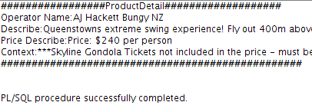
The business query it uses
Product detail

Slide 18
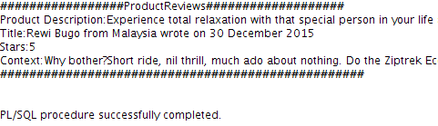
The business query it uses
Product reviews

Slide 19
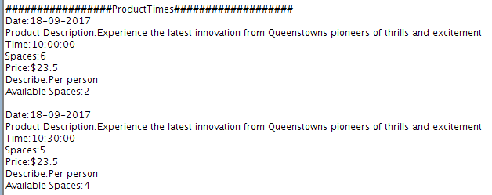
The business query it uses
Product times

Slide 20
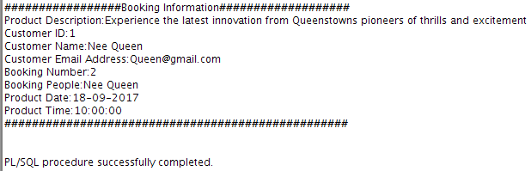
The business query it uses
Booking information

Slide 21
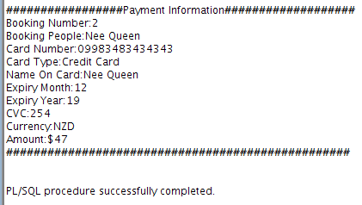
The business query it uses
Payment information

