Slide 1
COVID_19 DATASET FINAL CAPSTONE PROJECT
BY
TEAM A
TAIWO AND AYOMIDE

Slide 2
TABLE OF CONTENT
BRIEF INTRODUCTION OF PROJECT
PROBLEM STATEMENT
COVID_19 DATASET IN EXCEL...part cleaned
DATASET IN POWER BI
DATA ANALYSIS USING VISUALISATION
CONCLUSION & SUMMARY

Slide 3
BRIEF INTRODUCTION OF THE PROJECT
THE PROJECT DATASET CONSISTS OF 15 COLUMNS AND 188 ROWS.
THE FIELDS COMPRISES OF VARIOUS GEOGRAPHICAL DATA, SUCH AS COUNTRIES AND REGIONS.
DATA SUCH AS CONFIRMED NUMBERS OF COVID CASES, ACTIVE CASES, RECOVERED CASES FATALITY CASES, WEEK % INCREASE AS THE CASE MAY BE.

Slide 4
PROBLEM STATEMENT
The COVID-19 pandemic was unexpected and caught the world unprepared. The spread of various variants caused chaos and panic due to its suddenness. The World Health Organization (WHO) did not predict the extent of the spread.

Slide 5
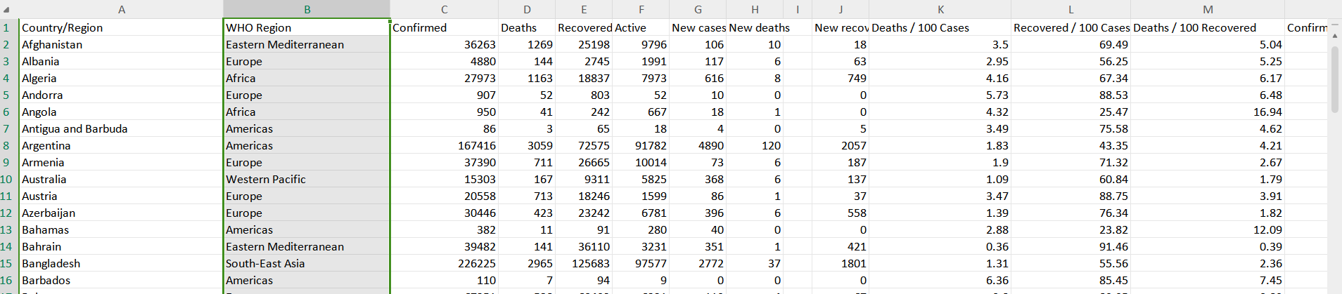
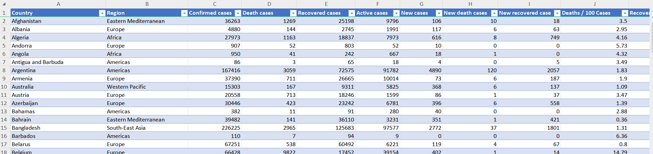
COVID_19 DATASET IN EXCEL...part cleaned

Slide 6
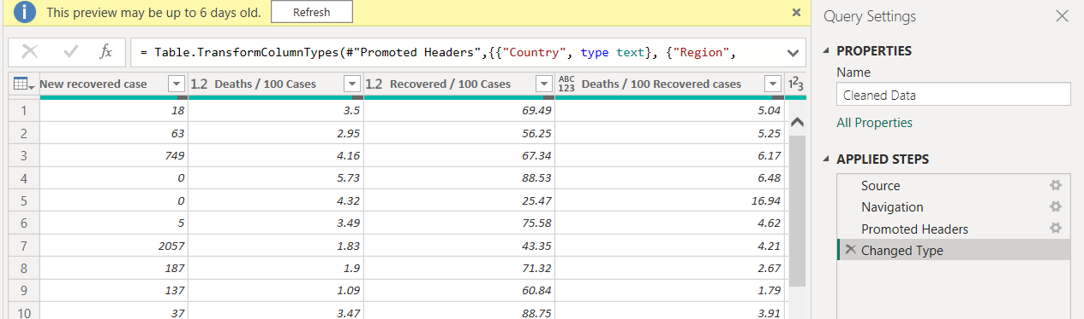
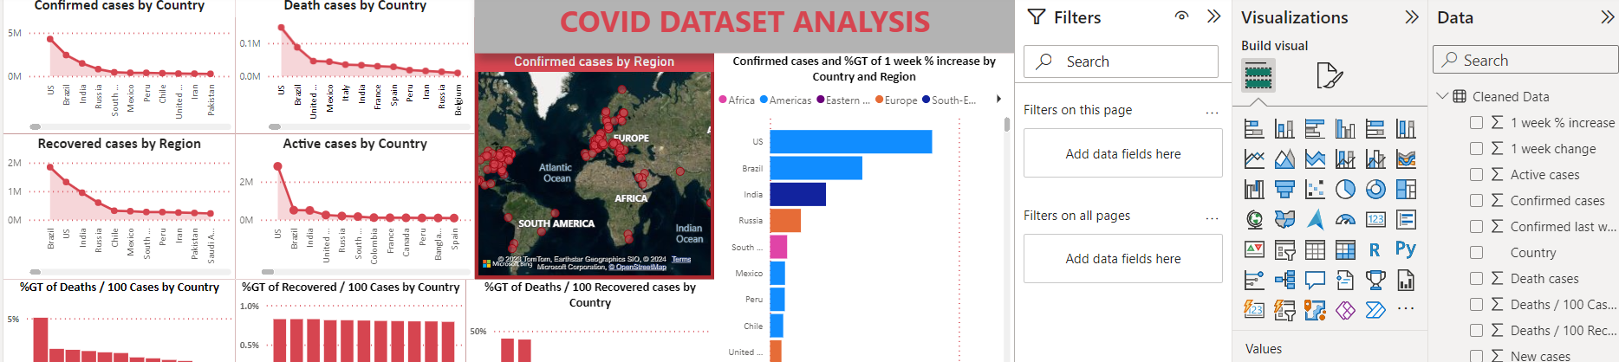
DATASET IN POWER BI

Slide 7
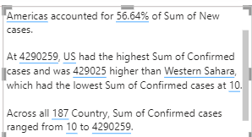
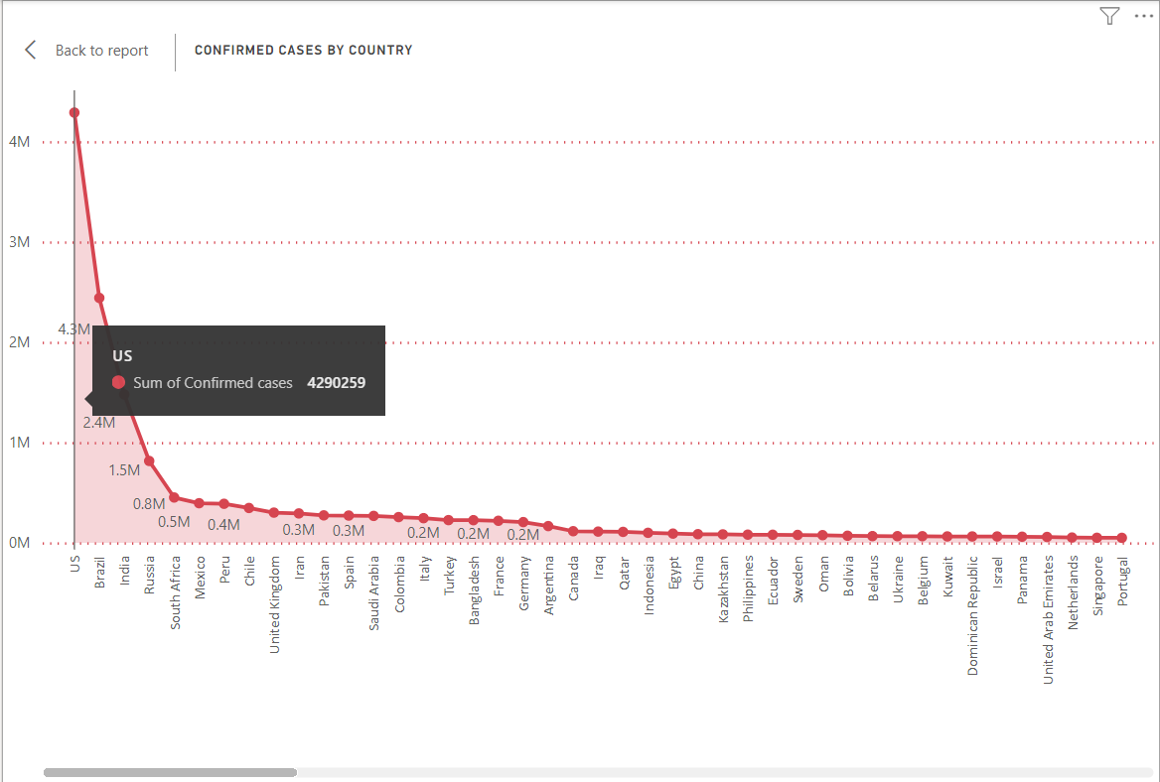
DATA ANALYSIS USING VISUALISATION

Slide 8
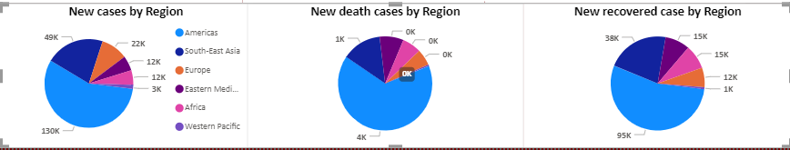
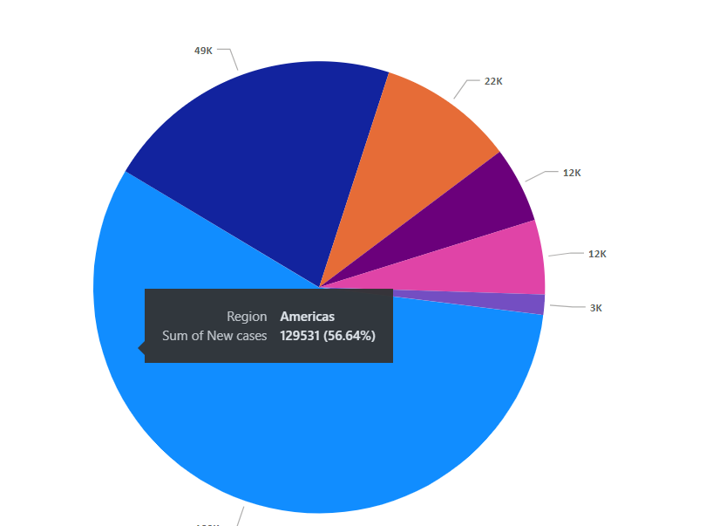

Slide 9
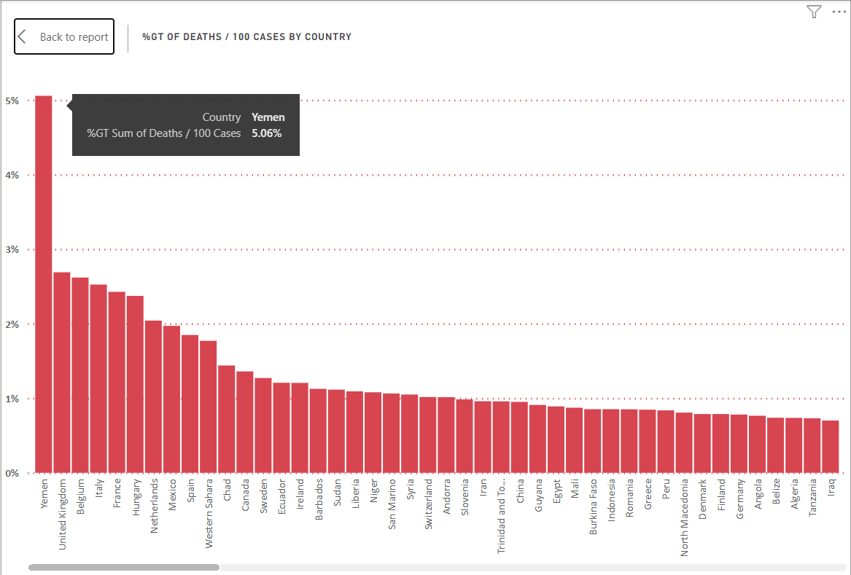

Slide 10
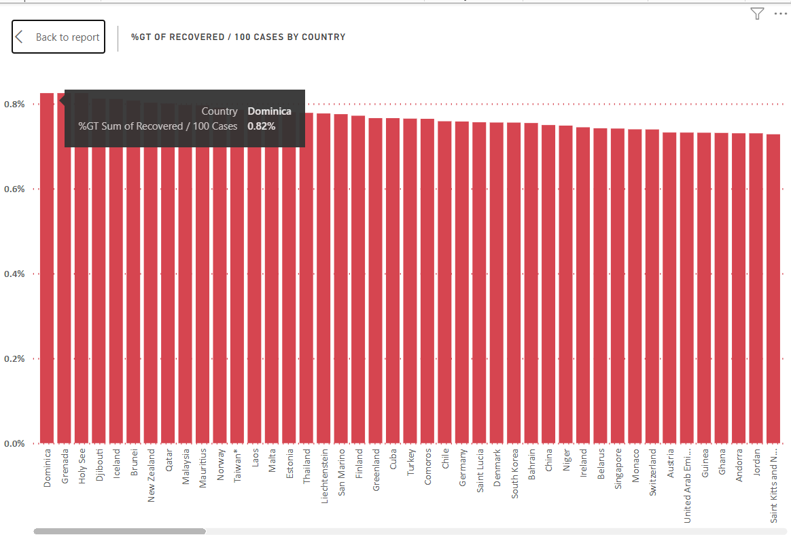

Slide 11
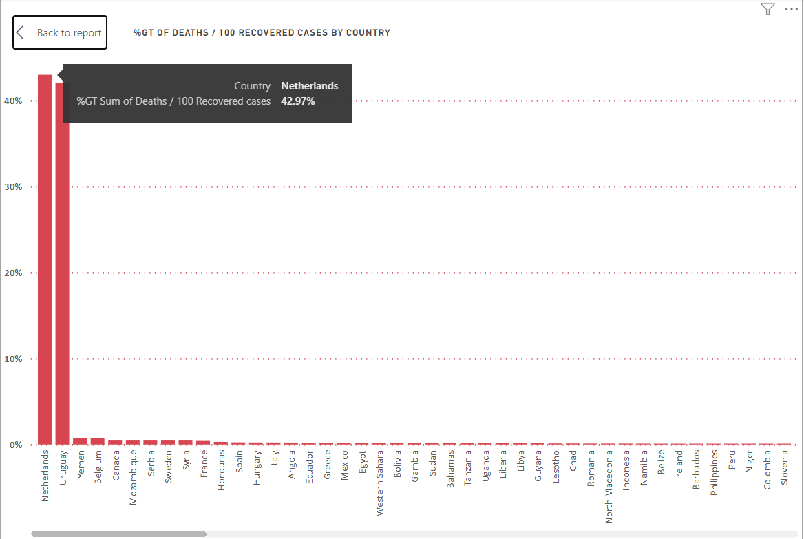

Slide 12
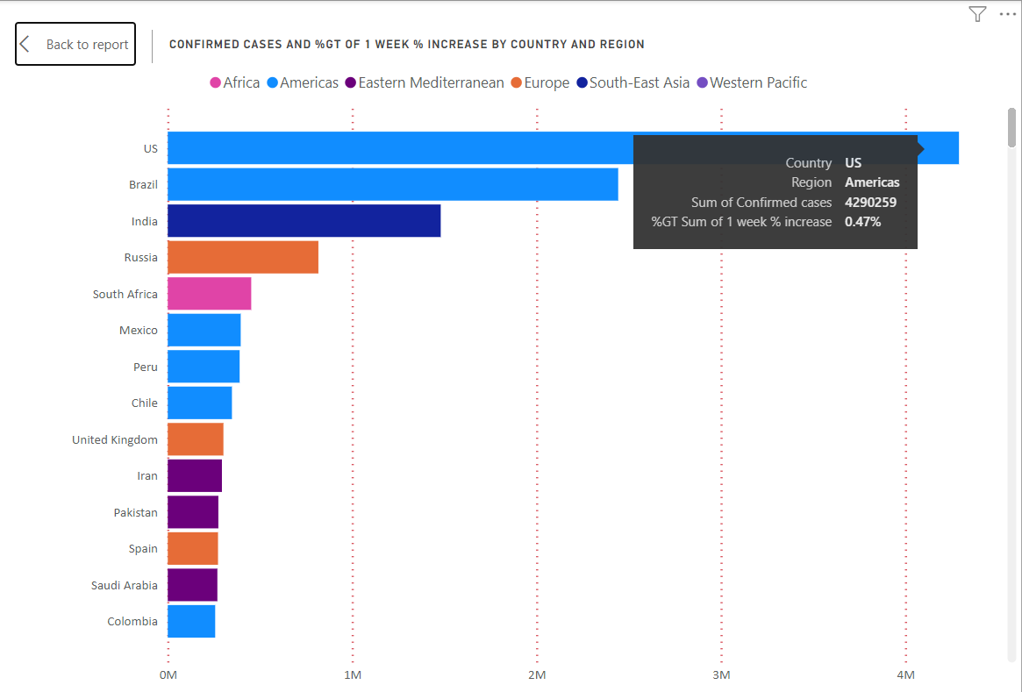

Slide 13
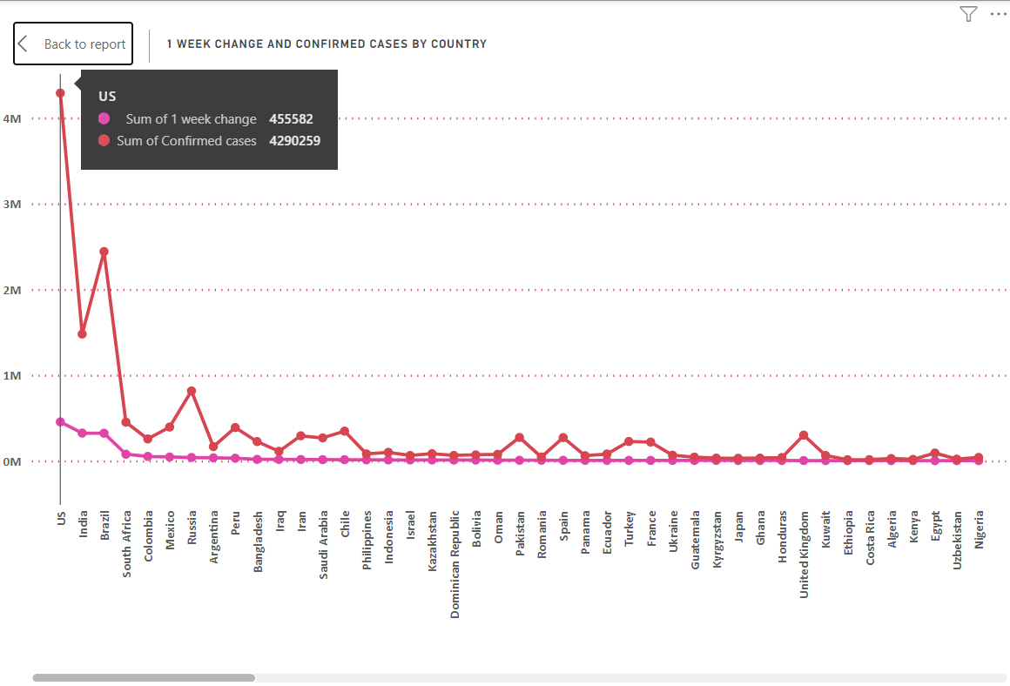

Slide 14
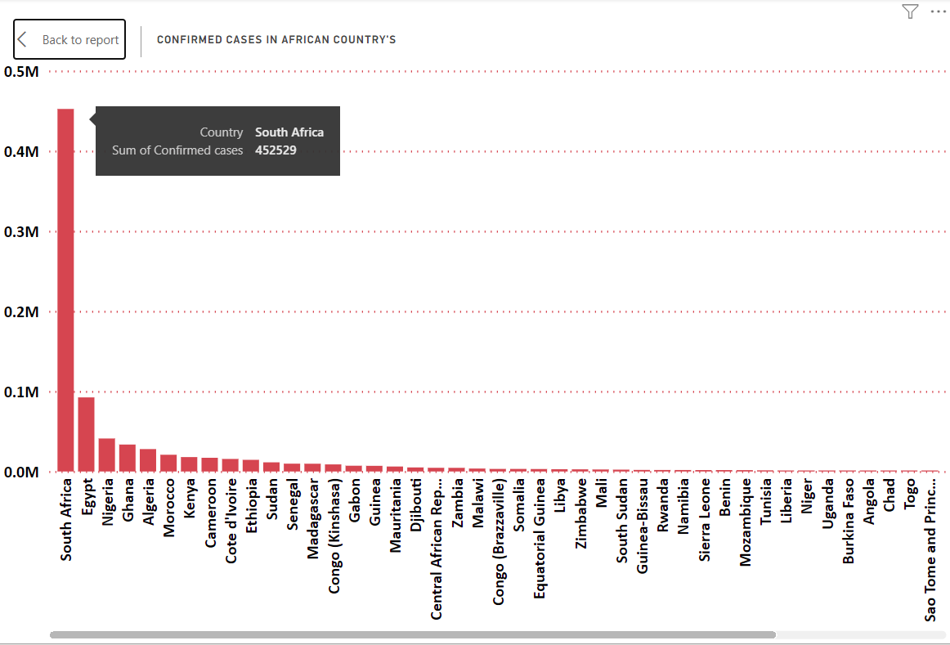

Slide 15
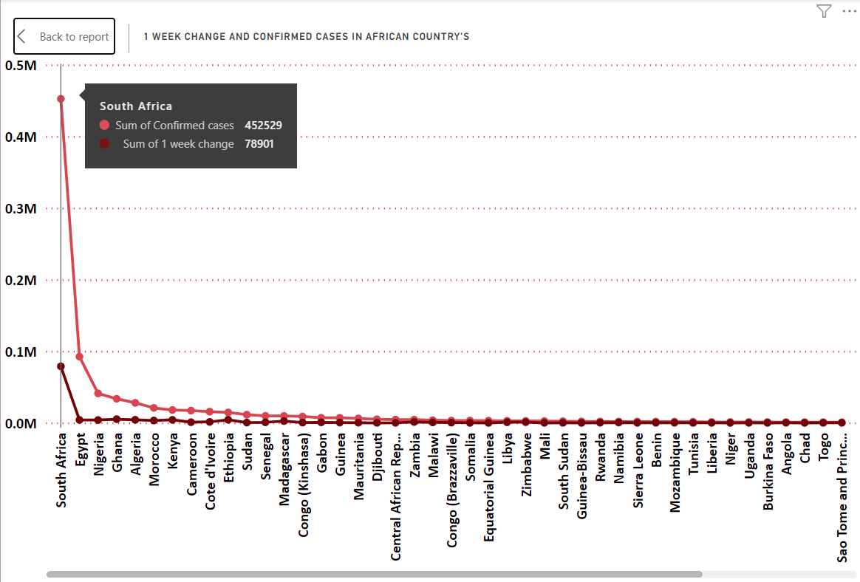

Slide 16
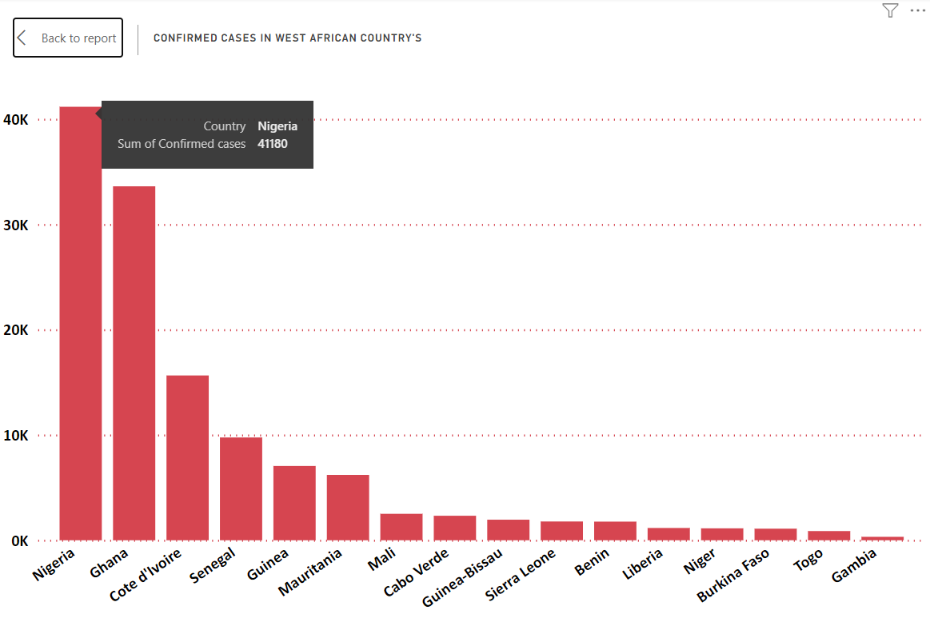

Slide 17
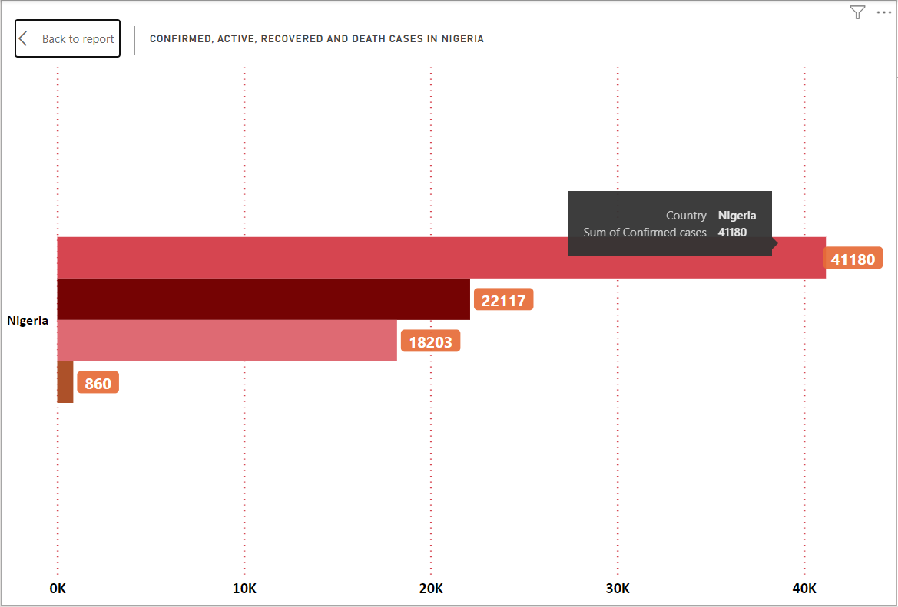

Slide 18
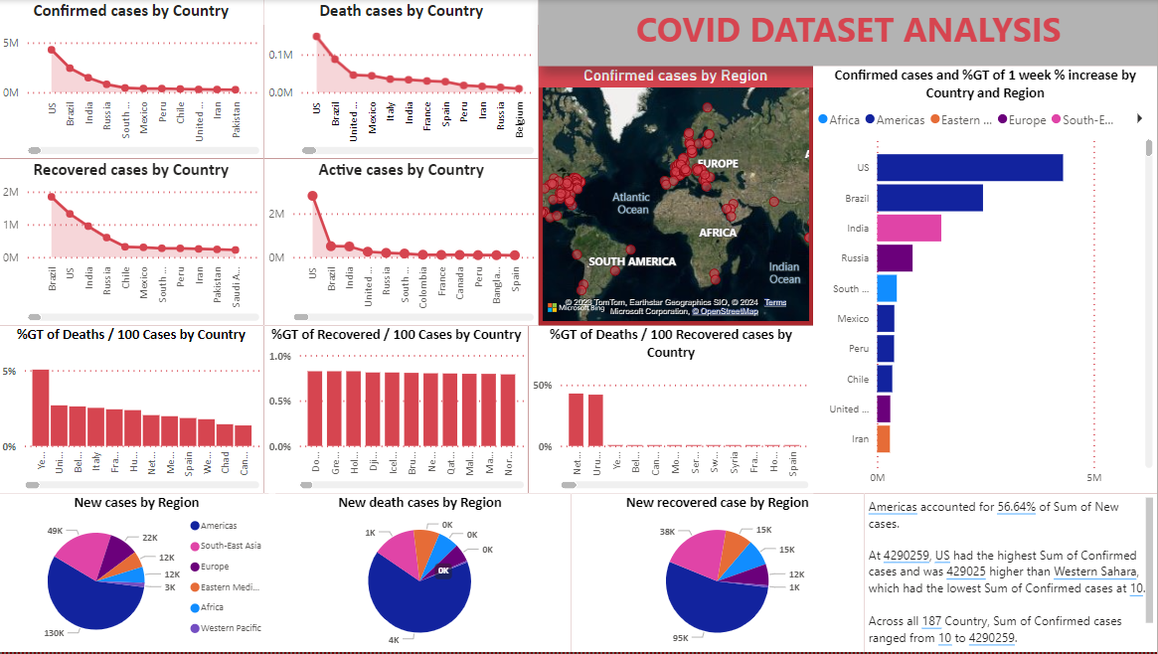

Slide 19
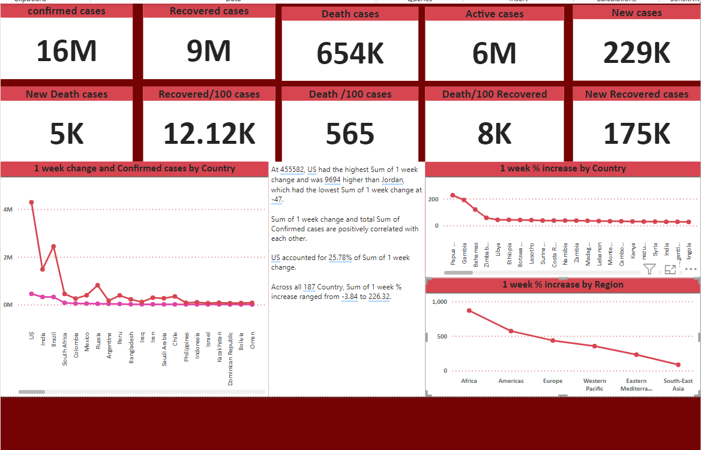

Slide 20
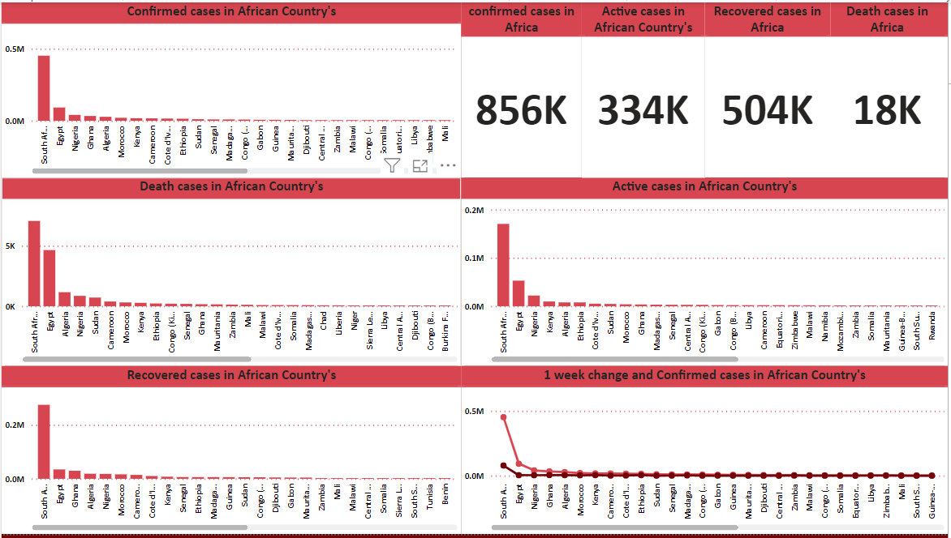

Slide 21
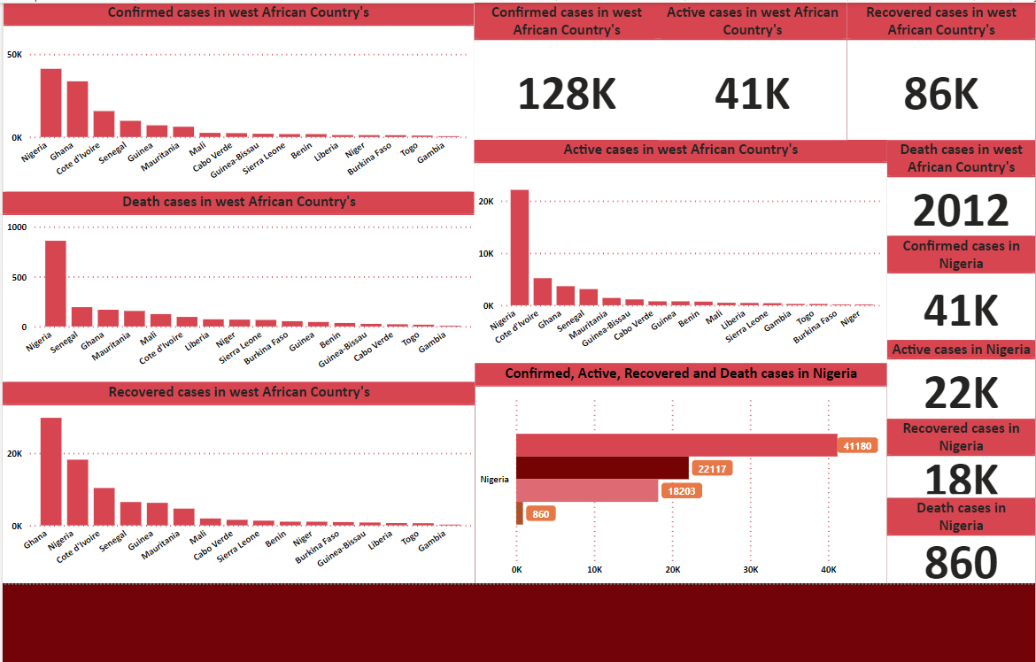

Slide 22
CONCLUSION & SUMMARY
Accurately reporting confirmed cases and ensuring accessible testing are particularly advantageous approaches in comprehending an evolving pandemic such as Covid_19. These measures enable health organizations and governments to effectively control the spread of the virus within their respective domains, while providing valuable guidance to individuals on how best to mitigate transmission risks and safeguard themselves against infection.
Throughout history, numerous pandemics have arisen and subsided, with medical and scientific comprehension, living conditions, as well as socio-political contexts all contributing to the identification, containment, and ultimate cessation of these outbreaks. Through research on Covid-19, it has been primarily established that this virus leads to severe symptoms among the elderly population and those with pre-existing health conditions.

