Slide 1
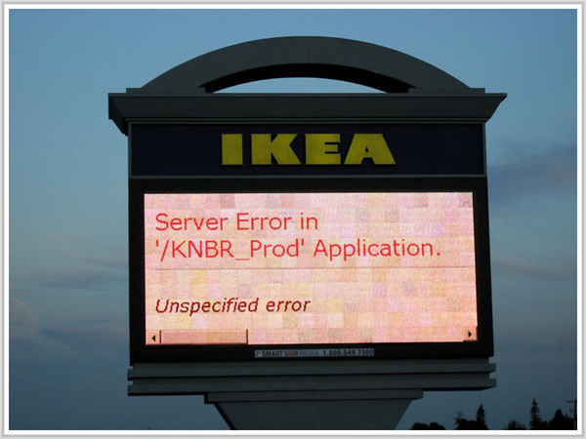

Error Handling

Slide 2
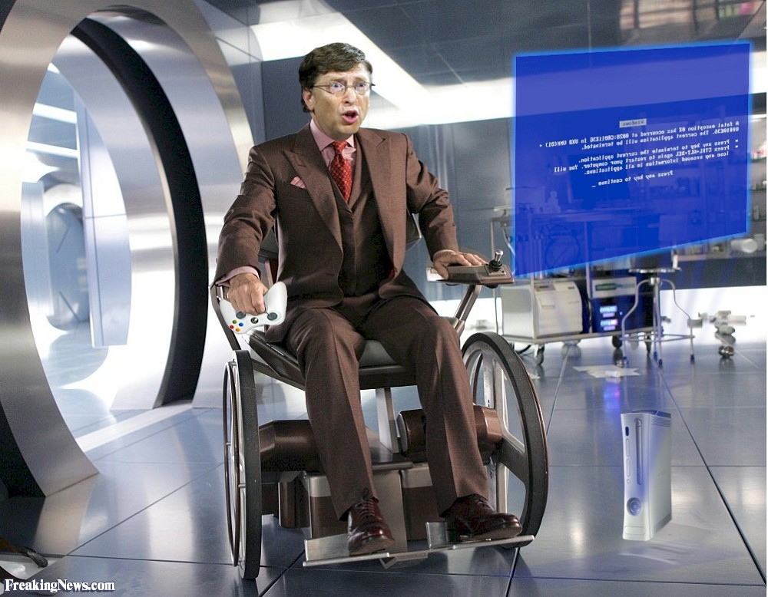
Machines, Software and Trust
Why do todays programs crash?
Car Bulb Analogy?
Must they?
How to fix it
D is one small step..

Slide 3
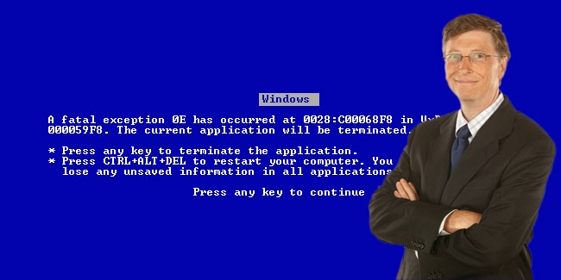
Trend: It's human to err!
Legacy: Humans don't err
Changing Tides
- Git: Mistakes Allowed
- No Programming Priesthood
Humans & Machine Redundance
Error Correction
Error Resilience

Slide 4
Software Process Goal:
Detect Errors as Early as Possible
Human
Source
Code
Program Cache
Machine
Code
(Libraries,
Programs)
Build
(Compile)
Unittest
Run
Syntax
Analysis
Semantic
Analysis
Code
Gen
Link
Static (Inferred)
Types System:
C, C++, C#, Fortran,
Pascal, Ada, Scala, Rust,
D, Haskell, ...
Dynamic
Type System:
Perl, PHP, Python
Ruby, Java, JavaScript,
Lua, MATLAB, Clojure, ...
Error
Checking
Detect Errors
before
Execution

Slide 5
Type System
Statically Inferred is the future!:
Examples: C++, D, Haskell, Julia (C#, Java)
Information Propagation
Type Inference
Don't Repeat Yourself (DRY)

Slide 6
Redundancy
Managers: Computers have no common sense!
Not just numerics but
Units, Default-Value, Range, Saturation, Ownership, Access, etc

Slide 7
Error Handling
Return Value: How checks return value error of printf.
Exceptions: Stroustrup on its performance. Almost religious wars. Polynomial Complexity.
Scope: C++, D, ...? Linear complexity. Compiler generates nested try-catch expression.

Slide 8
Interaction with
Structured Information
Limit input to very specific structure in
GUI/Webb Forms
Example: Personal Codes, Dates, etc
Lazy Programmers: Integrate pattern matching with UI component input logic!
Leaders!: Investment always pays off in the long run!

Slide 9
General Tips
Minimize Number of Configurations, especially in dynamic languages
Minimize Number of Code Paths
Learn & Use Reflection (Static & Dynamic) =>
Propagate Information Structure to
Command Line
GUIs
Protocols (showcase Boost.Serialization)
etc

Slide 10
General Tips
Make it impossible for user to enter incorrectly formatted data
Separate logic from design (CSS, LaTeX)

Slide 11
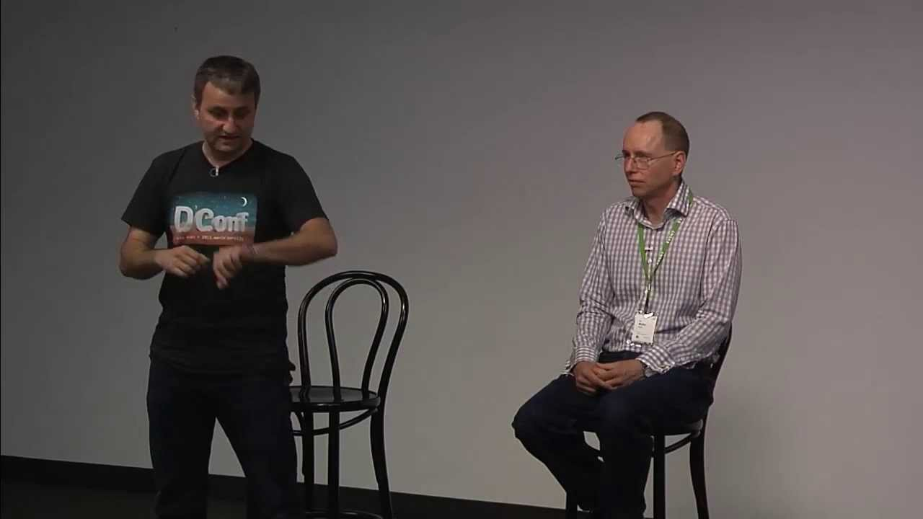
Why Just D!
Dhe Language for Quickly Building Correct and Fast Machines for the Real World

Slide 12
Leading Questions
Why do systems crash (again)?
Why so many languages?:
SAAB SimC: C/C++, Fortran, Ada, Python, Shell, Make, Java
Background for Ada: Before 100s of langs in US Defence
Why am I doing this?
  About me
  Time
  Age
Either stick with it, or try to change it:
Help/Promote D and alikes
Get to work with what I find meaningful

Slide 13
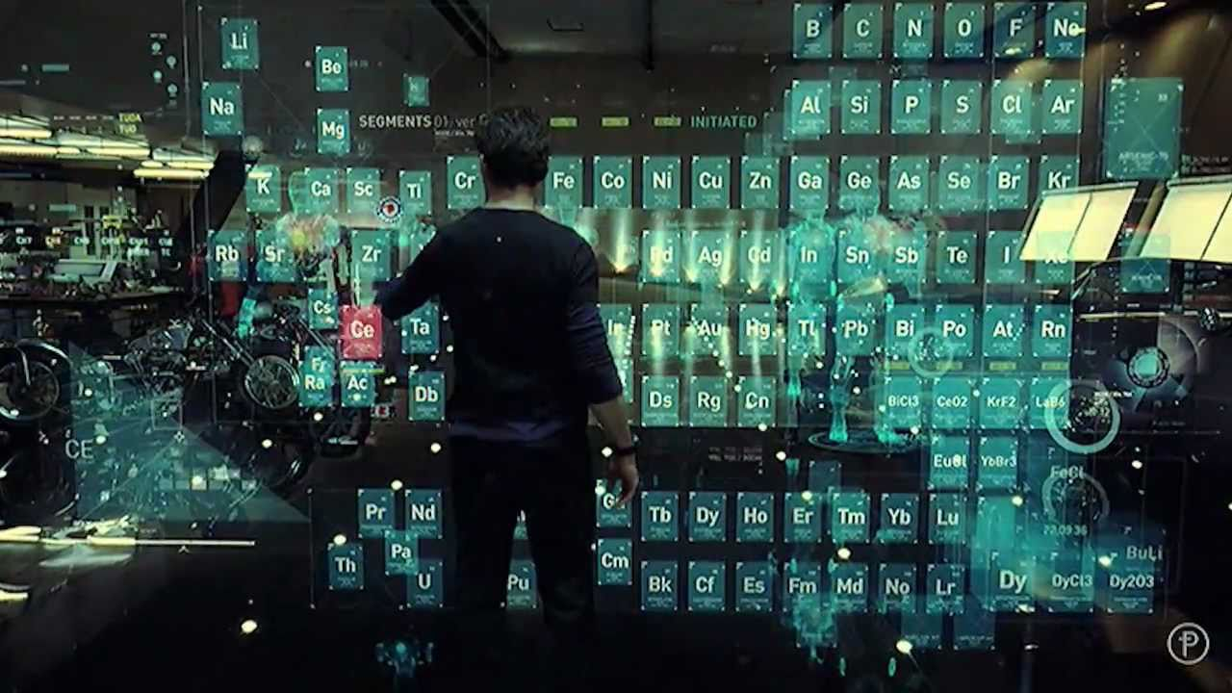
Iron Man like Systems and Interfaces?
How do we turn software engineers into Tony Starks? :)
and what language shall we bootstrap this with!?

Slide 14
Golden Triangle
Safe: Provably Correct
Performant: (Fast Build and Run)
Effective: Easy, Expressive, Creative, Joyful
Other: 2 out of 3
D: 3 out 3!

Slide 15
About This Lecture
Lots to say
Features in order of importance

Slide 16
Language Trend
Statically Inferred Languages: C++11, Haskell
Game Industry: C++ too hard => Skill is missing =>
M$ Announcement: ”We are planning new language that is”
  as fast as C++ and
  as simple as C#.
D already does this and is ready!

Slide 17
Why should I read about or learn D?
Not Just Compacter Syntax
Proving Ground for Future C++
Just like Market Consumers:
Developer have Responsibility:
  If we aren't aware
  We won't ask for it and
  We will not get it (in languages in general)

Slide 18
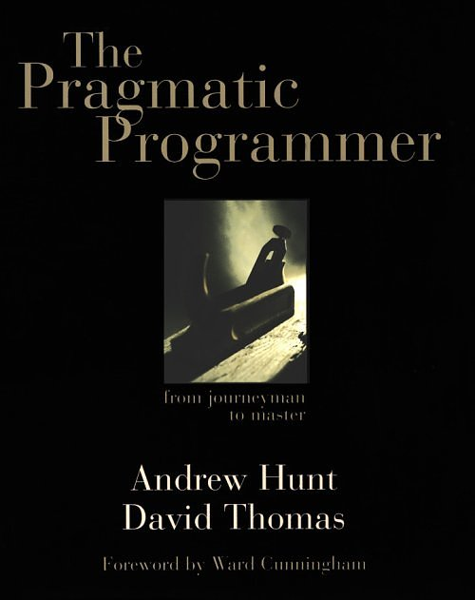
Democratic & Pragmatic Fundaments
No Priesthood,
Nor too Academic,
We have done our homework!
C/C++-like
Non-Company Controlled: no more: ”Lets reinvent everything again just because we want to be different!” (M$, Orcale, etc)
Just Software Developers who want to GTD in the most efficient way
Democratic/Dynamic: Key solutions are voted for

Slide 19

Heart of D:
Component Programming
Walter Bright:
How can write truly reusable software components?
How can we escape ”Whirlpool Programming”?

Slide 20
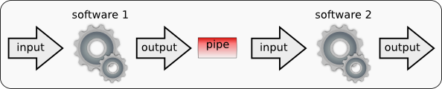
Heart of D:
Component Programming
Successful Pipeline Model
  As Western text: Left-to-right
  Proof of Concept: UNIX Commands & Pipes

Slide 21
Component Programming
Realized in D by...
Lazy Evaluated Ranges (Haskell Monads) –
Return Calculation (Delayed Evaluation) instead of Value.
Arrays and Strings Done Right
Uniform Call Syntax (UFCS)
Emptyness Propagation: no if statments to check for null etc enables. Removes Error handling problem!
Concepts: (Type Predicates)
Compile-Time Function Evaluation (CTFE)
Inlining instead of function calls

Slide 22
Heart of D:
Component Programming
Example: Read lines, sort em and print em back
import std.stdio, std.algorithm, std.range, std.array;
void main(string args[]) {
Stdin.
byLine(KeepTerminator.yes).
map!(a => a.idup).
array.
sort.
copy(stdout.lockingTextWriter());
}
as fast as handwritten C with nested loops and with manual error-checking but way simpler and more flexible

Slide 23
Uniform Call Syntax (UFCS)
to! makes API-integration transparent
needle.findIn(haystack) is more obvious than
findIn(needle, haystack) and can be
msgpack-d:
  value.pack
  value.unpack
Chained Left-to-Right: data.doThis.doThat;
Ruby-Style: "/bin/ls".isFile

Slide 24
Concepts & Ranges
Fundaments:
Algorithms First
  reverse
  editDistance
Binarysearch, quickSort
Concepts/Ranges (Minimal Data Interface Requirements) which then groups
Containers
bool isPalindrome(Range)(in Range x)
if (isBidirectionalRange!Range) {
import std.algorithm: retro, equal;
return x.retro.equal(x);
}

Slide 25
Concepts & Ranges
Minimum Set of Axioms making
Things Just Work gives
Minimal set of requirements of interfaces to types gives
Ranges and Interfaces.
Example binarySearch and quickSort works on anything that provides Random Access.
std.algorithm: return a value
std.range: return a calculation (like C++ expression templates but much simpler).
A must need in Linear Algebra Packages

Slide 26
Concepts & Ranges
More Compact/Efficient Encoding (Development) of Algorithms and their Variants (in Phobos)
Unique Feature of D: Ranges preserve powers when possible: y = x.map(”a*a”). If x is random access y also is.
std.array: array triggers computation if input is not RandomAccess
See Andrei Alexandresoucs excellent
”Forward is Not Enough”

Slide 27
Basic Needs Builtin
Strings: string
Arrays: ubyte[]
Maps (Associative Arrays): ubyte[string]

Slide 28
Fixing ”C's Biggest Mistake”:
Arrays Builtin & Done Right
“Fat” Pointers (Pointer + Length):
  Static (Stack) Compile-Time Checked:
  int[2] a;
  int[3] b;
  a[] = b[]; // mismatched array lengths, 2 and 3
  Dynamic (GC-Heap) Run-Time Checked:
  int[2] a;
  auto b = [1,2,3];
  a[] = b[]; // lengths don't match for array copy, 2 = 3
  Dynamic Scoped (Heap):
  scoped auto a = [1,2];

Slide 29
Arrays Builtin & Done Right
Easier Transition from C/C++ with: int a[2];
Compare with C/C++11/C++14’s Complexity:T[], C99 VLA, std::vector, std::array, std::valarray, std::dynarray, etc.

Slide 30
Different Empty Array Slices are Equal
This is what we want
assert([].ptr == null);
assert(”ab”[0..0] == []);
assert(”ab”[$..$] == []);
And especially notice that
auto p = ”ab”[$..$].ptr;
assert(p != null);
and
auto w = [1, 2];
assert(w[0..0]);
assert(w[$..$]);
assert(![]);

Slide 31
Associative Arrays (Maps) Builtin & Done Right
No need for separate construction of map values:
string[][int] tags;
tags[13] ~= ”Alice”;

Slide 32
Strings Builtin & Done Right
Unicode Builtin: UTF-8/16/32 = string wstring dstring are ranges and immutable. This enable for example
ASTs to refer directly to GC:ed source string (slice) instead of a heap-allocated copy =>
No heap allocation of read-only copyies =>
D XML-parsers fastest in the world

Slide 33
String Types are ”Aware” of what they ”Can & Can't Do”
Distinction Between
    Strings & Characters: (string char) and
    Array of Bytes: (ubyte[])
Literals have same powers as values
if (”/directory/somefile”.exist) {}
Letter Type | String Type | Encoding | Range Concept | Algorithms
char wchar | string wstring | Variable Length | BiDirectional | Levenshtein Distance
dchar | dstring | Fixed Length | RandomAccess | Quick Sort

Slide 34
Iteration Done Right: foreach
Like C++11 Range-Based for-loop but without need for auto:
  By Value
  foreach(element; range) {}
  By Reference
  foreach(ref element; range) {}
plus Optional Statically Inferred Index (size_t)
  foreach(index, element; range) {}
Todate – not a single for loop

Slide 35
Programming Styles Overview
Functional Style:
range.map!”a*a”
Imperative Style:
(Side-Effects): foreach
Combined Style:
foreach (elt; range.map!”a*a”) {
range.doSideEffect;
}

Slide 36
Correctness 1:
Unittests Builtin Everywhere
  Simplicity!:
  unittest { assert(something); }
  Number of tests scale a magnitude
  Can be placed everywhere they belong including generics!
  Great Leap in Stability/Correctness

Slide 37
Hey, Ada Guys!:
Value Range Propagation
Compiler follows range propagation values and assumes worst-case propagation: Add of two 1-bit results in one 2-bit.
Removes need for “dumb casts”:
auto i = 254;
ubyte ub = i+1; // no cast needed

Slide 38
Hey, Ada Guys!:
Code Correctness
Together with CTFE and D’s template power
struct/class invariant {} plus
in {} out {} body {}
makes implementing an Ada-Style Range Type a no-brainer. Example:

Slide 39
Correctness 2:
Provably not Probably Correct
No more Faith-Based Programming
How do we prove that a code newer throws NullPointerExceptions. Solutions:
  Haskell: Maybe
  Ada 2005: not null
  D:
    Library: NotNull, Maybe
    Language: @nullable
Provably Correct:
  Safety: @safe, @trusted, @system
  Data: immutable, const
  Code: pure, in, out, body, invariant, unittest + assert

Slide 40
Transactional Part 1:scope statement
Makes writing a safer cp in D a no-brainer:
import std.exception, std.file;
void main(string[] args) {
enforce(args.length == 3,
"Usage: trcopy file1 file2");
auto tmp = args[2] ~ ".messedup";
scope(failure)
if (exists(tmp))
remove(tmp);
copy(args[1], tmp);
rename(tmp, args[2]);
}

Slide 41
Transactional Part 2:
Exception-Safe Constructors
D uses Copy-And-Swap Principle
C++ does not => Not Exception-Safe!

Slide 42
Compilation Performance Facts
Carefully Designed Context-Free Non-Ambiguous Grammar makes it a
Single-Pass (vs C++ 3-7 Passes) makes builds
Fastest in the World
Compiles Phobos (like C++ STL) on 1.21 s on my laptop. That’s 6 Mbytes 175k lines of code with more advanced use of generics than C++14 will have
At least 10 times faster than C++
A number of times faster than 2:nd place which currently is Go

Slide 43
Compilation Speed Consequences
Enables use of new tools such as
  Dustmite - Code Minimizer: minimizes AST which still produces error
Instant (0.5s) Syntactic and Semantic Analys for Project ~20k lines with rich use of generics

Slide 44
Compilation Speed Consequences
“As-a-Script-Execution/Evaluation” using
  #!/usr/bin/env rdmd-unittest-module removes need for build step and tool for small applications and enables
  Module-Executable-Hybrid Behaviour á lá Python, MATLAB, etc.

Slide 45
The Big Picture
Key Conseqence in D where everything is templates => Compiler sees flow of whole program not just single function => Compiler can do better optimizations, safety checks, static analysis, etc. This has previoulsy only been available in hardware languages such as VHDL.

Slide 46
Safe Concurrency by Default
Global Variables are defaulted to Thread-Local-Storage (TLS) means
No Race-Conditions by Default (contrary to C++, Java, C#):
Fundament: Better
  Safe with 3 clockcycles than
  Incorrect with 1 clockcycle
In PIC-code difference is unnoticeble
Thread-Global must be tagged with __shared
Compare with OSes with protected memory. Nobody accepts not having it nowadays
Threads treated more like lightweight processes.

Slide 47
Floating-Point Correctness
Defaulted To NaN (Non-A-Number) making it obvious that a value is undefined (zero is not) when code switches maintainer.
NaNs propagate through system without bringing the system down

Slide 48
Strict Control of Memory/Data Access/Use
immutable, const gives way for
  More powerful Static Analysis and
  Automatic Algorithm Parallelization

Slide 49
Flexible Memory Management System
Builtint class Garbage Collection if you’re lazy or
Roll your own class Constructors/Destructors using new and delete
struct Copy Constructors more Efficient than C++ thanks to “bitblit”
Move-Semantics Built-in for struct thanks to “postblit”

Slide 50
All Aspect of Source Code Accessible to Developer
Programmer can access everything compiler ”sees”:
  Static (Compile-Time) Reflection
    Members of struct/class via tupleOf can be iterated with foreach makes reflection in for example serialization a no-brainer
    Enum-Members Names (like in Ada)
    Type Names using T.stringof
    Gives more informative error messages
  Propagate Static to Dynamic Reflection
    Auto-Generate
      Command-Line Interface and
      GUI-Look-and-Feel from

Slide 51
More Inference than in C++11
Along with type inference/propagation through auto, D also provides inference of
Accessibility (auto, const or immutable) using inout and
Value/Reference Semantics using auto ref
This is a natural extension of auto as compiler has this knowledge (more function-bodies are available by default in D) and makes life much easier for developer

Slide 52
Expressiveness: Meta-Programming
Compile-Time-Function-Evaluation (CTFE):
  Realiseras av Combon: (pure & immutable) + static if
  Safety: Detect Errors before deployment
  Pegged replaces external parsing tools
  std.regex.ctRegex fastest in the world!

Slide 53
Easy:
Concize and Uniform Syntax
ubyte someByte = 13;
string someString = ”alpha”;
auto someNumber = 42;
enum someConstant = 1;
const iPromiseToNeverChangeThisValue = 1;
immutable thisValueCanNeverBeChangedByAnyone = 1;
alias goodName = badName; // potentially many overloads

Slide 54
Easy, Flexible & Safe
Module System
As easy as the easiest languages such as Python and Matlab, but typesafe
No need for separate .h and .c to keep in sync by default...but
Compiler can auto-generate interface files based on source code complexity if needed
Consequence: Many github projects are one D file!

Slide 55
Easy, Flexible & Safe
Module System
Hijack-Safe
Imports automatically use scope (like C++’s using namespace)
Often No need to qualify symbols like Python’s os.path.join() as default
Because of D’s advanced type system overloads very seldom collide
This is not possible in dynamic languages like Python and Ruby.
When they do collide you just have to specify their scope to make their ”path”unique.

Slide 56
Module System: Imports
Scoped Imports á lá Python supported in functions, structs, etc.
Cyclic Imports (Dependencies) just works, compared to C/C++, Python. This makes it trivial to break out classes and functions into new separate files.

Slide 57
Safe Integer Literals
No need to ULL-suffix 64-bit Constants which C++ needs:0x0000_1111_2222_3333ULL
Static Type Analysis of Constants for Implicit Casts
  Ok: int x = cast(ulong)0x0000_1111;
  Error: int y = 0x0000_1111_2222_3333;
  Ok: int z = cast(int) 0x0000_1111_2222_3333;

Slide 58
Expressiveness: Type Construction
Haskell-Like Elegance in Type Construction:
alias Pair(T) = Tuple!(T, T);

Slide 59
Unique Feature: Type-Safe
Command Line Argument Parsing
Type-Aware Builtin (std.getopt)
Just define typed variable and give it as reference into a type aware overloaded register_argument(type)
Type information infers to interface generation
DRY!

Slide 60
Learning Curve
When to use x[]?
Compiler Messages are better than C++ but not yet perfect ;)
Template Instance Syntax may take a week or two: Tuple!(S,T,U)
Compile-Time Constants:
enum thisConstantCanNeverChange = 42;

Slide 61
Code Security/Safety Levels
Compiler Checked Classification of Code
@safe can call @safe and in turn
@trusted can call @trusted and in turn
@system can call @system and C code
makes bugs easier to isolate in big projects.
@safe
can unrefer pointers but not null-initialize or do arithmetic on them
cannot do any memory recast dribblings => no byteorder problems => architecture independent

Slide 62
Simple Things are Builtin & Easy
Constructors and Printing of enums, structs, etc are default-defined:
enum Color { red,green,blue };
struct X { int a; Color c; }
writeln(X(1, red));
will print
X(1, red)
Overridden by member toString() like Python’s __str__

Slide 63
Commercial Success?
A Brave Few:
Sociomantic: Profitable D-only Company with no initial funding/backing
British Game-Engine throws out their Scripting Languages!
Facebook!: Proof-of-Concept by Andrei, Bounties

Slide 64
Various: Nested Functions
Capture scope of parent

Slide 65
Other Improvements
Compacter Coding of Templates through
  static if reduces code bloat even furter and makes interface even more generic through more adaptive casts. Show example with vector struct constructors with variadic argument lists.
No darn semicolons after classes/structs!
Sök på "Foreach Restrictions" i http://dlang.org/statement.html. Bara den featuren allena är ju värt att byta språk för
Power-operatorn ^^

Slide 66
Other Improvements
GCCs -Wshadow varnar för mycket typer av shadowing. D är gjord för att hjälpa men samtidigt inte störa och är enabled/forced by default
Videos and Notes:
  http://d.puremagic.com/conference2007/speakers.html

Slide 67
Compilers
DMD: Reference (Recent Features), Super-Fast Compile
GDC: GCC, Fast Code, Fast Compile, Ubuntu-Packaged (4.8.1 in 13.10). Merged in mainline GCC-4.9?
LDC: LLVM, Fast Code, Fast Compile, Ubuntu-Packaged (0.11 in 13.10)

Slide 68
IDE
Visual D: (Visual Studio):
Eclipse DDT:
Emacs FlyCheck: Including unittests!
DCD: D Completion Daemon: Server-Client!
Allt på Github!

Slide 69
Cons
@safe pure nothrow should have been default

Slide 70
What's Next?
36: to 18:th place on TIOBE in recent 12 months
DMD & Phobos each has ~100 Pending Github Pull Requests!:
  Multi-Dim Slicing a la Matlab och Fortran 90+: x[0..m, 0..n]
  Stack Allocators and Containers: std.allocator
  No more Null Pointer Exception/Segfaults: @nullable, NotNull
  std.serialization
  Self-Reflective Tools: std.lexer
…
and prepared for the Apocalypse
...
128-bits Integers: cent and ucent are reserved words!

Slide 71
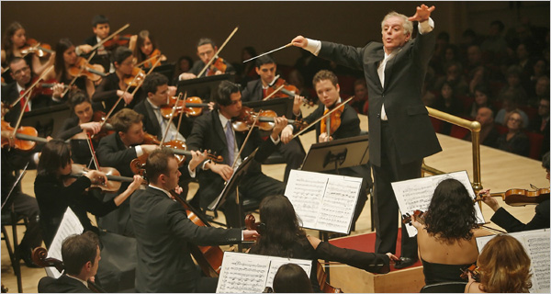
Conclusion:
Component Programming
Features come together in an elegant and concise harmony =>
Reusable Software with native performance!

Slide 72
Conclusion:
Productivity and Performance
Fastest Compilation of Fast Code
And statically Checked
A new level of productivity
Game-Changer

Slide 73
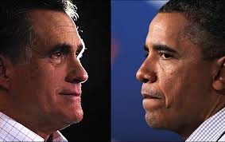
Final Words
Computing: Extension of the Intellect
It's human to err =>
Let Compilers help correct us
Ask not
What D can do for you but...
What you can do for D!
Let's make the best
candidate win!

