Slide 1
Dconf 2019 Keynote
Laeeth Isharc
Symmetry Investments
Alternative Investment Management
Adoption of an emerging language at a $4.8bn hedge fund

Slide 2
Alternative Investment Management
Symmetry Investments is an alternative investment management company.
Alternative means that if everybody does the same thing and you understand why, but you can see a better way then in the alternative domain you have a choice.

Slide 3
Symmetry Win-Win Principle
Dialectical reconciliation of seeming-opposites.
The need to compromise presumes you are already at the optimum and therefore must choose.
Refuse to accept premature compromise
Nature has many secrets yet to discover – have the courage to be open to trying

Slide 4
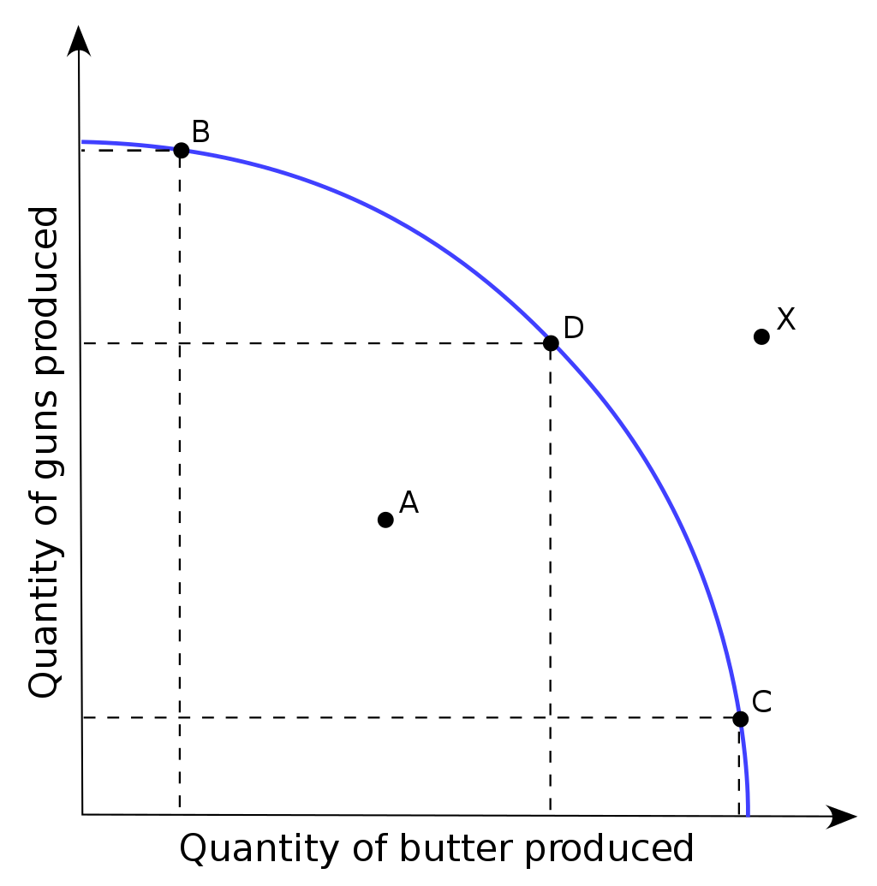
Efficient Frontier

Slide 5
Premature Compromises?
Productivity or performance (Python vs C)
Expressiveness or readability
Modeling power or plasticity
Adaptability to change alongst planned dimensions versus brittleness in the face of change you did not expect

Slide 6
Cost and Choice
Theoretical goal of the firm: maximise profits
Reality for large publicly-owned companies? Something else.
Risk aversion – but relevant dimension is social - unconventional choices seen as riskier.
Life is risk. Social risk isn’t really real.
Creates opportunities for others operating according to different principles and context

Slide 7
Selected Symmetry Ownership Principles
What would I do if I owned the business?
Now, considering I don’t, how can we address any unavoidable social factors.
It’s okay to be unconventional if you’re also serious.
Failure is okay, but consider magnitude of the downside.

Slide 8
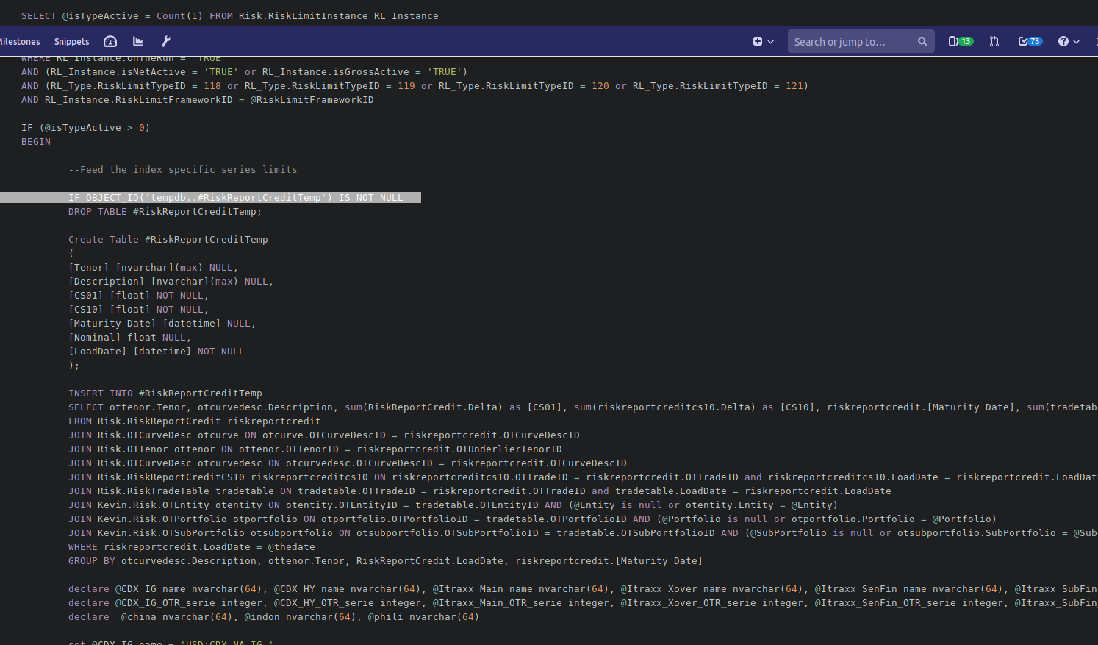
!

Slide 9
Symmetry Integration Language
Think many times before writing your own language
Are you sure you want to write a standard library too?
Purpose: domain-driven design. Shared attention from practitioners and technologists towards common representation of code and data.

Slide 10
SIL Standard Library
Good artists copy, great artists steal.
- Steve Jobs

Slide 11
SIL Standard Library
Good artists copy, great artists steal.
- Steve Jobs
=> Let’s steal Phobos

Slide 12
Stealing Phobos
void registerHandlersMath(ref Handlers handlers)
{
import std.mathspecial;
handlers.openModule("math");
scope(exit) handlers.closeModule();
static foreach(f;AliasSeq!( fabs, sqrt, sin, cos, tan, asin,
acos, atan, sinh, cosh, tanh, asinh
acosh, atanh, /*log*/ log2, log10, logb,
log1p, exp, exp2, expm1, ceil, floor,
round, lround, trunc, rint, lrint, nearbyint,
rndtol, gamma, logGamma, sgnGamma, digamma, logmdigamma,
logmdigammaInverse, erf, erfc, normalDistribution,
normalDistributionInverse, atan2, fmod, remainder, isIdentical,
fmax, fmin, gammaIncomplete, ))
handlers.registerHandler!f;
}

Slide 13
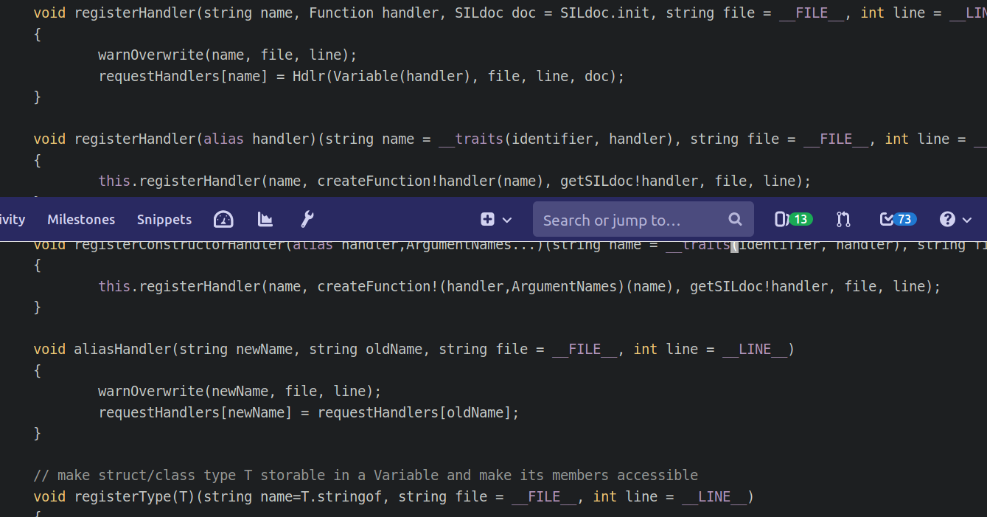
SIL: registerHandler

Slide 14
Symmetry Integration Language
4,552 SloC for language
5,998 SloC for standard library
131 uses of static if
35 static foreach
117 string mixins
112 __traits

Slide 15
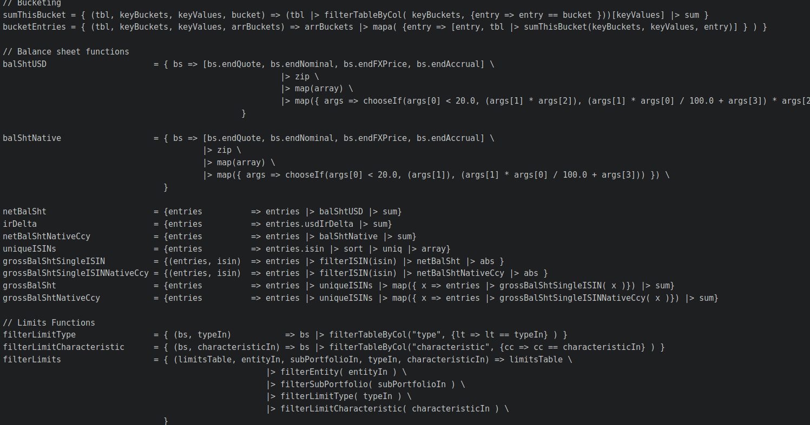
SIL code sample

Slide 16
Symmetry Integration Language
Sneaky Purpose – cultural transformation
Version control
Code review
Testing
Declarative Programming
Integration between practitioners and programmers / transformation of cultural values

Slide 17
Secrets
We've been taught that truth is conventional, but it's simply something that people agree on. What's important is to discover a new truth."
All great businesses are based on secrets.
– Peter Thiel
The best secrets are hidden in plain sight
- Tom Demark

Slide 18
Structural Hole Theory
Structural holes exist in social networks when there is a lack of a direct contact or tie between two or more entities (Burt, 1992).
How to benefit from competition in social networks and their intersecting relationships ?

Slide 19
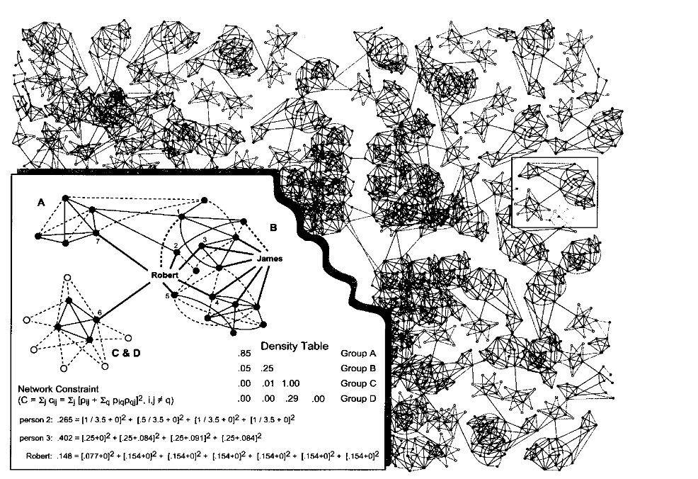
Small-world Networks

Slide 20
Structural Hole Theory and Good Ideas
Behaviour, opinion, and information are more homogeneous within than between groups.
People focus on activities inside their own group, creating holes in the information flow between groups.
Robert is better positioned than James for the social capital of brokerage.

Slide 21
Import/Export Business in Ideas
People who bridge structural holes have an advantage in detecting and developing rewarding opportunities. Information arbitrage is their advantage.
They are able to see early, see more broadly, and translate information across groups.
Brokerage across the structural holes between groups provides a vision of options otherwise unseen.

Slide 22
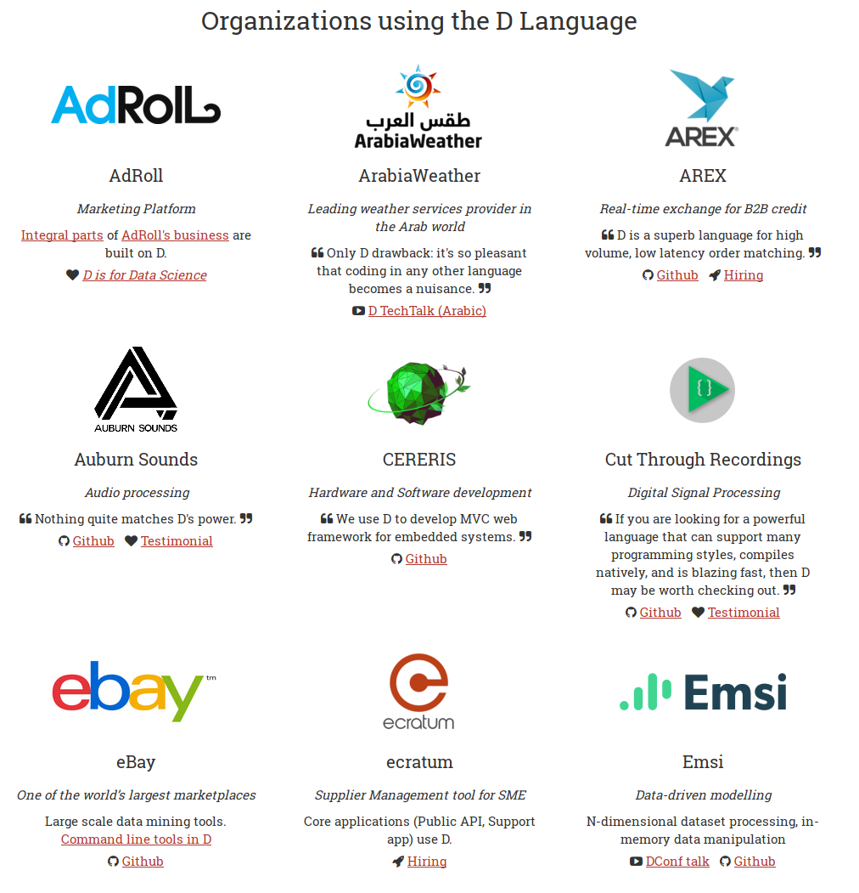
D and Structural Holes

Slide 23
It’s okay to be unreasonable
When you grow up you tend to get told the world is the way it is and you're life is just to live your life inside the world.
Life can be much broader once you discover one simple fact: Everything around you that you call life was made up by people that were no smarter than you and you can change it, you can influence it, you can build your own things that other people can use.
Once you learn that, you'll never be the same again.
– Steve Jobs

Slide 24
Imagination/Courage/Beginnings
Until one is committed, there is hesitancy, the chance to draw back, always ineffectiveness. [T]he moment one definitely commits oneself, then providence moves too.
All sorts of things occur to help one that would never otherwise have occurred. raising in one's favour all manner of unforeseen incidents, meetings and material assistance which no man could have dreamed would have come his way.
Whatever you can do or dream you can, begin it. Boldness has genius, power and magic in it. Begin it now.”
– William Hutchison Murray

Slide 25
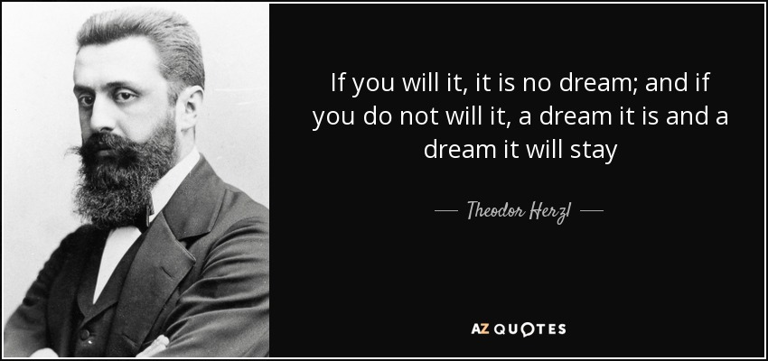
Beginnings

Slide 26
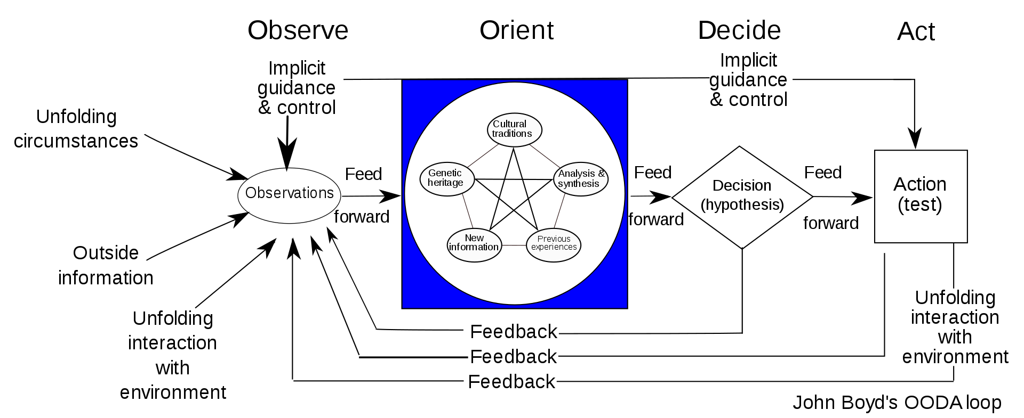
Plasticity for Suits

Slide 27
Unexpected Benefits
1. Courageousness/ Span of control/ resourcefulness
2. Information Arbitrage
3. Talent
4. Marshalling / type conversion for glue
5. Plasticity = adaptiveness and strategic optionality

Slide 28
We’re Hiring Capable People
For D / F# /Typescript in
London
Hong Kong
Singapore
Laeeth Isharc laeeth@kaleidic.io
https://symmetryinvestments.com/careers

Slide 29
References
Burt – Structural Holes and Good Ideas
Israel Kirzner on the nature of entrepreneurship
James Buchanan – Cost and Choice (mises.org)
William Boyd

