Slide 1
Microservices based Streaming and Batch Data Processing

Slide 2
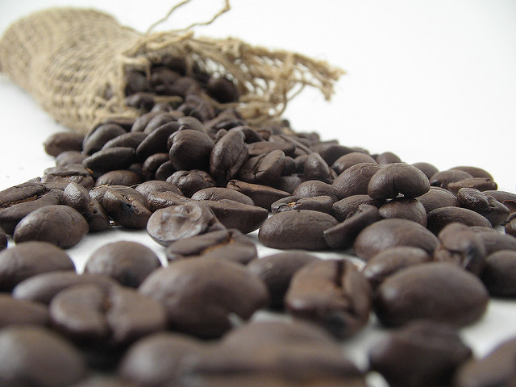
Logistics
Facilities
Coffee: 10:30
Lunch: 12:00
Coffee 2:30
Notes:
Image by Stirling Noyes:
https://flic.kr/p/4uNY9k

Slide 3



Speakers
Sabby Anandan
Twitter
Github:sabbyanandan
https://www.spring.io
Glenn Renfro
@cppwfs
Github:cppwfs
https://www.spring.io
Notes:
Image by: Matthew Keefe
https://www.flickr.com/photos/mkeefe/2349283746/

Slide 4



Slide 5

https://github.com/cppwfs/DNDataflow

Slide 6

Notes:
Ask Questions
Image by: Micky Aldridge
https://flic.kr/p/8giHbr

Slide 7
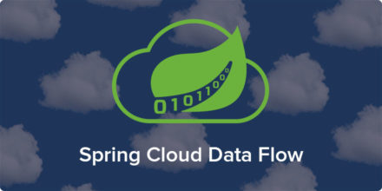
Notes:
Is a cloud-native orchestration service for composable microservice applications on modern runtimes.
Developers can create and orchestrate data pipelines for common use cases such as data ingest, real-time analytics, and data import/export.

Slide 8
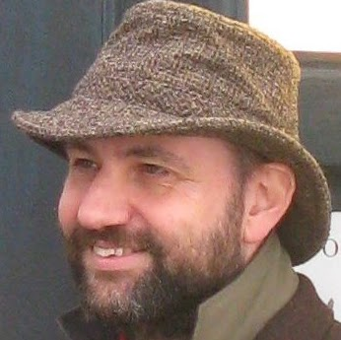
“is an approach to developing a single application as a suite of small services” --Martin Fowler
Notes:
http://www.martinfowler.com/articles/microservices.html

Slide 9


12
Factor
App
Notes:
https://12factor.net/

Slide 10
What are Streams

Slide 11
Tasks … Who needs tasks?

Slide 12
Demo

