Slide 1

Streams

Slide 2

Source | Sink
Notes:
Source is the beginning point of any stream.
A stream can only have one source
A stream can only have one sink

Slide 3

Source
Pollable
Event
Notes:
Image by: https://flic.kr/p/5xSL5

Slide 4
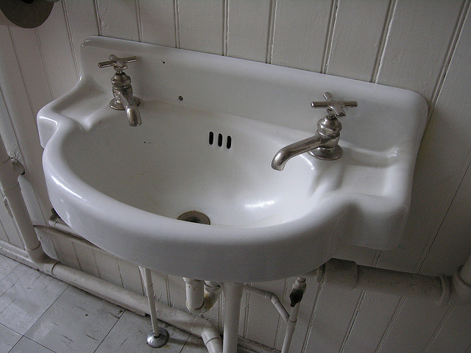
Sink
Store
Send Out
Terminate
Notes:
Image by: https://flic.kr/p/9xg9uR

Slide 5
Source | Processor | Sink

Slide 6
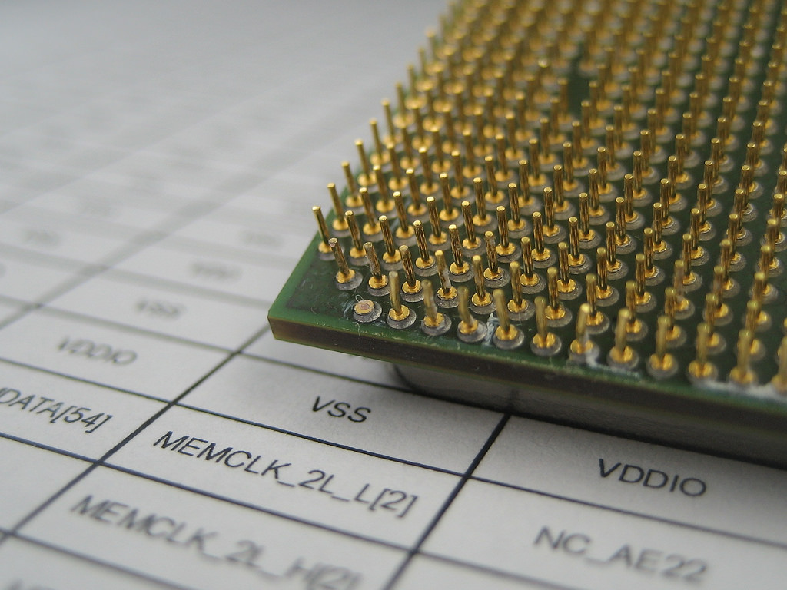
Processor
Filter
Transform
Enrich
Notes:
Image by: https://flic.kr/p/78gaTX

Slide 7
Demo basic stream

Slide 8
Spring Cloud Stream Apps
Notes:
Basic discussion on the apps
Spring boot app
Built using Spring Cloud Stream
Each app is configurable via --properties
Demo
You can use the --propertiesFile

Slide 9
Deploying

Slide 10
Deployed

Slide 11
Incomplete

Slide 12
Failed

Slide 13
Undeployed

Slide 14
The “|” Symbol
Notes:
Represents communication between 2 applications
Brokers: Kafka, Rabbit currently supported (Yes JMS versions are in the works)
Behind the scenes Creates a queue in Rabbit or a topic in Kafka
Binds the 2 apps together
Message Delivery Guarantees
Configure Binder

Slide 15
The “>” Symbol
Notes:
When you need a more complex Directed Graph than a simple linear stream
Taps
:
Labels
Demo
Destinations
Destination to sink
Source to Destination
Connect 2 destinations

Slide 16
Grouping

Slide 17
Partitioning
Notes:
Need Demo

Slide 18
Reactive

