Slide 1

Streams
Notes:
Image by: https://flic.kr/p/g7AWzU

Slide 2



+
=
Notes:
Streams are comprised of apps
Looking at the simple ticktock app you just put together. Has 2 apps time and log.
So what makes up an app
Spring boot app
So we have all the good bits that come from spring boot
Actuators for health and stats of an app
Auto-Configure
Obtaining properties for the app easily
Spring Cloud Stream
framework for building message-driven microservice applications
Uses Spring Integration to provide connectivity to message brokers.
It provides opinionated configuration of middleware from several vendors,
introducing the concepts of
persistent publish-subscribe semantics,
consumer groups
partitions.

Slide 3

Source | Sink
Notes:
A basic stream defines the ingestion of event driven data from a source to a sink that passes through any number of processors
Source is the beginning point of any stream.
Sink is the termination point of a stream
A stream can only have one source and one sink

Slide 4
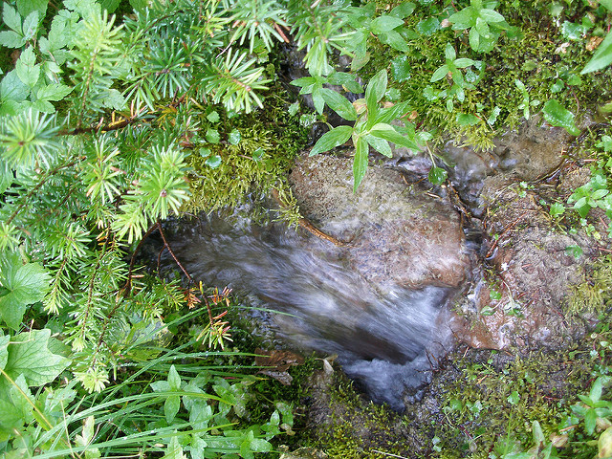
Source
Notes:
Pollable – event fired by a timer to perform some action to acquire data to send down stream
Examples:
File
Jdbc
Trigger
WebService
Event – Awaits to receive data from exterior source
JMS
HTTP
TCP
Rabbit
Image by: https://flic.kr/p/5xSL5

Slide 5

Sink
Notes:
Termination point of the stream
Performs some action on the messages it receives
Send message out to another messaging system (Kafka, Rabbit, JMS)
Store data to repository(JDBC, Mongo)
Send data to external system (FTP, S3, Mail, HTTP)
Image by: https://flic.kr/p/9xg9uR

Slide 6
Source | Processor | Sink
Notes:
Processors alter, route or filter messages in the stream
Stream may have zero or more processors

Slide 7
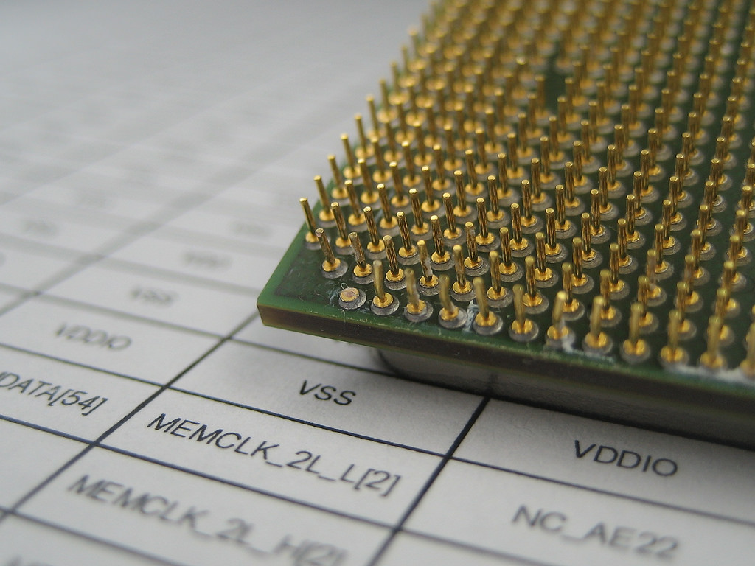
Processor
Notes:
Transform
Enrich
Filter
Split
Route
Image by: https://flic.kr/p/78gaTX

Slide 8

Demo
Notes:
Stream create xform –definition “http | transform –expression=payload.toUpperCase() | log” --deploy
Stream create xform –definition “http |filter –expression=payload.contains(‘hello’) | transform –expression=payload.toUpperCase() | log” --deploy
Image: https://flic.kr/p/q6YRM8

Slide 9
App Properties
Notes:
And a part of spring boot is the ability to retrieve properties from the environment, command-line etc.
These properties can be set at stream definition creation Each app is configurable via –properties
UI will show options
Shell has auto complete and the ability to see properties through the `app info source:<name of app>
*Demo*
You can use the --propertiesFile

Slide 10
Deploying

Slide 11
Deployed

Slide 12
Incomplete

Slide 13
Failed

Slide 14
Undeployed

Slide 15
The “|” Symbol
Notes:
Represents communication between 2 applications
Brokers: Kafka, Rabbit currently supported (Yes JMS versions are in the works)
Behind the scenes Creates a queue in Rabbit or a topic in Kafka
Binds the 2 apps together
Message Delivery Guarantees
Configure Binder

Slide 16
The “>” Symbol
Notes:
When you need a more complex Directed Graph than a simple linear stream
Taps
:
Labels
Demo
Destinations
Destination to sink
Source to Destination
Connect 2 destinations

Slide 17
Directed Graph
Notes:
stream create f --definition ":foo > transform --expression=payload+'-foo' | log" --deploy
stream create b --definition ":bar > transform --expression=payload+'-bar' | log" --deploy
stream create r --definition "http | router --expression=payload.contains('a')?':foo':':bar'" --deploy

Slide 18
Grouping

Slide 19
Partitioning
Notes:
Need Demo

Slide 20
Reactive

