Slide 1
Microservices based Streaming and Batch Data Processing

Slide 2
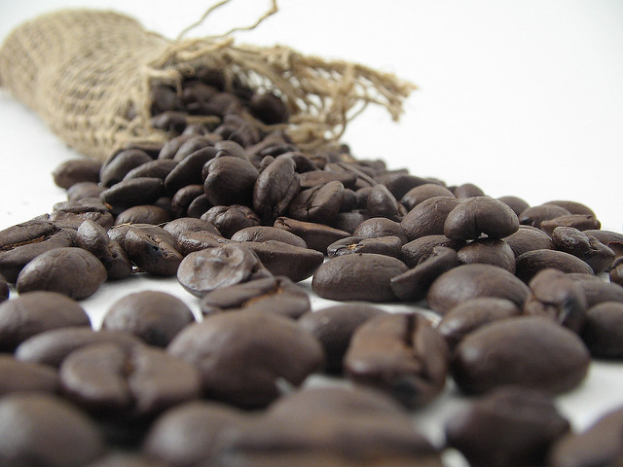
Facilities
Coffee: 10:30
Lunch: 12:00
Coffee 2:30
Notes:
Image by Stirling Noyes:
https://flic.kr/p/4uNY9k

Slide 3
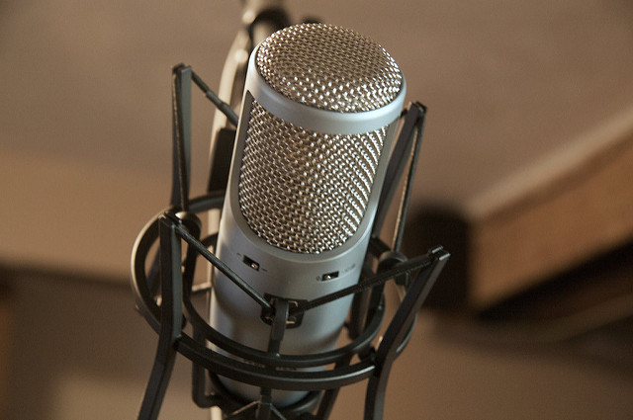


Speakers
Sabby Anandan
Twitter
Github:sabbyanandan
https://www.spring.io
Glenn Renfro
@cppwfs
Github:cppwfs
https://www.spring.io
Notes:
Image by: Matthew Keefe
https://www.flickr.com/photos/mkeefe/2349283746/

Slide 4



Slide 5
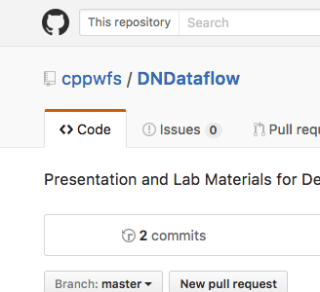
‘git’ IT ON GITHUB
https://github.com/cppwfs/DNDataflow

Slide 6

Notes:
Ask Questions
Image by: Micky Aldridge
https://flic.kr/p/8giHbr

Slide 7
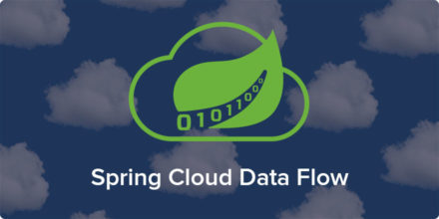
Notes:
Is a cloud-native orchestration service for composable microservice applications on modern runtimes.
Developers can create and orchestrate data pipelines for common use cases such as data ingest, real-time analytics, and data import/export.

Slide 8
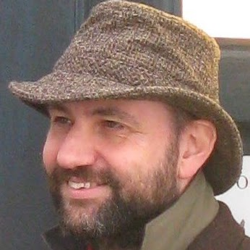
“is an approach to developing a single application as a suite of small services” --Martin Fowler
Notes:
http://www.martinfowler.com/articles/microservices.html

Slide 9


12
Factor
App
Notes:
https://12factor.net/

Slide 10

Streams
http | log
Notes:
Stream processing is basically to analyzing and acting on streaming data from real-time data sources or continuous queries.
Sensors,
Logs
Social Media
Etc
Spring Cloud Data Flow allows a user to create a message-driven microservice app that can handle streaming data via a simple DSL or Drag and Drop UI.
These streams allow you to do the following on data flowing through the pipeline:
Filter
Transform
Enrich
Run analytics
Store
Transmit to other destinations
Etc.
Spring Cloud Data Flow streams are built on Spring Cloud Stream and we will be discussing the features that Spring Cloud Stream brings later

Slide 11
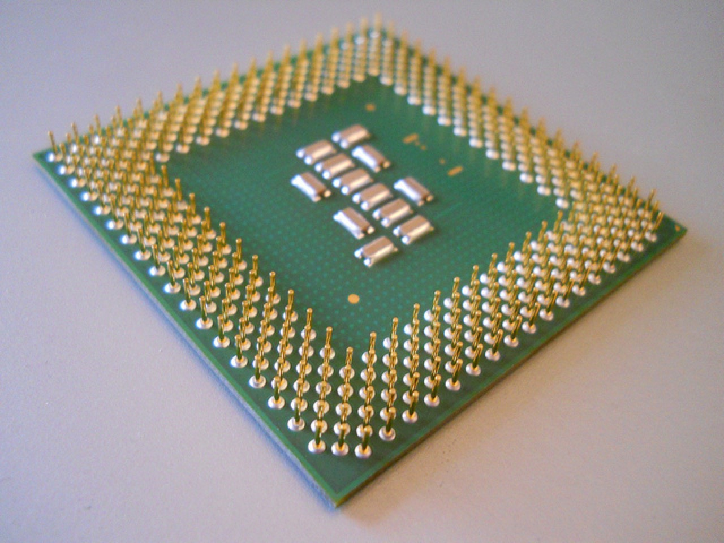
task launch jdbchdfs
Tasks
Notes:
Tasks are short lived microservices using Spring Cloud and run them locally, in the cloud, even on Spring Cloud Data Flow
Spring Boot Application
Spring Batch Application
Spring Cloud Data Flow tasks are built on Spring Cloud task and we will be discussing the features that spring cloud task brings later
Image by: https://flic.kr/p/caQnoh

Slide 12
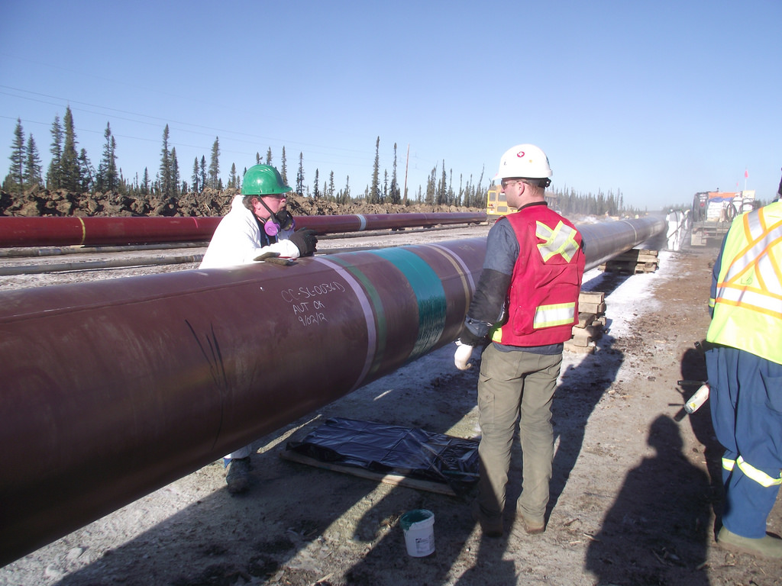
Demo Time
Notes:
https://github.com/spring-cloud/spring-cloud-dataflow-samples/tree/master/analytics/twitter-analytics

