Slide 1

TDD & BDD in action Bring it all together in the real world
Arran Bartish/hybris

Slide 2
Objective
Real world introduction to TDD and BDD
Experience with BDD and TDD on a production like application
We’re going to be pressed for time
Be autonomous
Worst case watch me

Slide 3
Getting Started
Local machine login
Localdkom15
Open internet connection
Westin-Conference
Start eclipse
C:\Program Files\Java\eclipse
Or
C:\Users\dkom\Downloads

Slide 4
Benefits of TDD/BDD
Fearless change and confident refactoring
Clear documentation of what the system actually does
Clear feedback on when you’re complete

Slide 5
Pitfalls
Testing implementation rather than behaviour
Not architecting to be testable
Tests aren’t atomic

Slide 6
Good videos and exercises
Uncle Bob
https://cleancoders.com/
Practice
https://sites.google.com/site/tddproblems/all-problems-1

Slide 7
What’s wrong with the exercises?
Usually small and self contained
They’re not usually deployed/deployable
Is TDD about technology or approach?
Single technology

Slide 8
Today’s exercise
Existing application – Online guest book
Multiple components
Multiple technologies

Slide 9
Today’s exercise
Requirements
Maven 3
IDE
Java 7 or 8
Source – clone or fork or download the zip
http://goo.gl/DbHWAV
Optional
NodeJS, npm, protractor
Git

Slide 10
Architecture
Jetty/JVM
Frontend
(AngularJS)
Server
(Java)
MYSQL
JSON
SQL

Slide 11
Deeper Architecture Server
Web tier
Service tier
DAO tier
Spring MVC
(JSON + Controllers)
Pojo’s
(Business Logic, DTO/entity transformation)
Repositories (Spring Data JPA)

Slide 12
Deeper Architecture Frontend
“Web tier”
“Service tier”
“Data tier”
AngularJS
(HTML/JavaScript)
View Logic, Model population (JavaScript)
JSON Data interaction
(JavaScript)

Slide 13
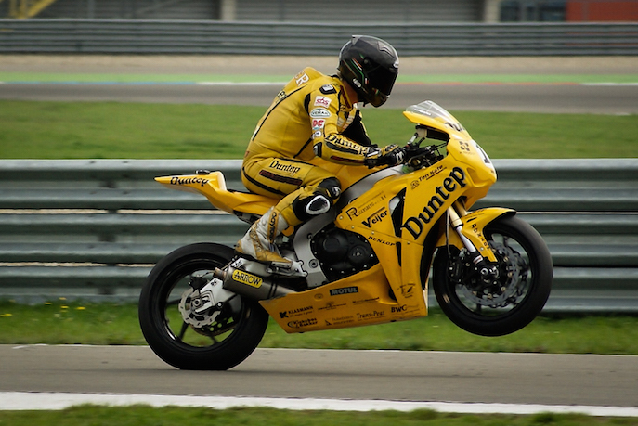
GO!
http://goo.gl/DbHWAV

Slide 14
What sort of unit test?
Integration Test
Frankenstein's monster
True Unit

Slide 15
Testing pyramid
GUI
Integration Test
Unit Test

Slide 16
Our testing pyramid
GUI
Integration Unit Test
JS Unit Test
Unit Test
Business Test

Slide 17
Thank you
Contact information:
Arran Bartish
Senior software developer
999 Boulevard de Maisonneuve Ouest, Montréal, QC H3A 3L4
Questions:
SAP Jam: http://goo.gl/tpZtth

