Slide 1

Building apps with AngularJS
Alex Marquez & Frederic Canteloup from ECP at Hybris

Slide 2
Agenda
Why rich client over server rendered pages ?
Why AngularJS as a rich client ?
Brief overview of AngularJS technical features
Hands on coding
Notes:
duration : 1mn
deadline : 1mn

Slide 3
Why rich client over server rendered pages ?
Faster response time thus better UX
presentation/behaviour decoupled from data/business so that backend can server other devices
full testability in isolation from server and its data
can run stand alone => faster development
Mature Javascript dependency management such as bower
Notes:
duration : 2mn
deadline : 3mn

Slide 4
Why AngularJS as a rich client ?
totally different paradigm : as an extension of HTML5 / scopes / 2-way binding between DOM and model
More dev friendly approach
great spring-like dependency injection => easy mocking, override mechanism
directives that allow to build reusable, self-contained, self-tested widgets
full testability (UNIT & e2e) by means of Jasmine, Karma and protractor, node JS
big community
Notes:
duration : 4mn
deadline : 7mn

Slide 5
Why AngularJS as a rich client ?
totally different paradigm : as an extension of HTML5 / scopes / 2-way binding between DOM and model
More dev friendly approach
great spring-like dependency injection => easy mocking, override mechanism
directives that allow to build reusable, self-contained, self-tested widgets
full testability (UNIT & e2e) by means of Jasmine, Karma and protractor, node JS
big community
Notes:
duration : 2mn
deadline : 9mn

Slide 6

What is AngularJS about ?
Scope & 2-way model binding
Any JavaScript object or function set into the $scope or $rootScope objects (accessible in a controller) are available on the template side
Changes from the controller reflect immediately on the template
Changes from the template reflect immediately on the controller
HTML template can be entirely conditioned by the model
Directives : reusable components
AngularJS can be instructed to modify or replace html tags with html template and/or isolated JavaScript behaviour
It will kick-in when observing a particular tag, css class or attribute
Directives are data model bound to their parent scope
Directives are UNIT and e2e testable
Notes:
duration : 2mn
deadline : 11mn

Slide 7
Hands on coding session
Notes:
duration : 49mn
deadline : 60mn

Slide 8
Installing git and npm if you don’t have them yet !
Go visit http://git-scm.com/download
Go visit http://nodejs.org/download
As a backup visit this computer to find installers of node and git :
From Mac : smb://xx.xx.xx.xx and connect as guest
From Windows: \\xx.xx.xx.xx in IE or Explorer
Notes:
Duration including next slide : 10mn
deadline : 21mn

Slide 9
Setting up your dev environment
git clone https://github.com/fcanteloup/d-kom-montreal-2015-angularjs.git
Or, if internet is too slow, on the same computer you can download and unzip
d-kom-montreal-2015-angularjs
cd d-kom-montreal-2015-angularjs
git checkout -f step-0
npm install (if downloaded tutorial from the Internet)
npm start
Visit http://localhost:7000/webapp
Notes:
Duration including previous slide : 10mn
deadline : 21mn

Slide 10
What is it ?
A single page app with front-end MVC (router) running on nodejs server
For ajax calls we leverage built in httpMock feature of Angular JS
I18n mechanism is taken care of by a cool “translate” directive and filter (by Pascal Precht) that fetches i18n map from httpMock
This app comes with UNIT and End-to-End testing setup and sample tests
All JS and CSS third parties are pulled from public repos by bower
Notes:
duration : 1mn
deadline : 22mn

Slide 11
What do we do with it ?
Starting with branch step-0, all tabs are empty except for instructions
For each tab i , one tries building content in
webapp/views/examplei.html
webapp/http/js/application/console/tabs/exampleiController.js
We then checkout the solution from next branch (git checkout -f step-1)
And so on until step-4
To finish we will have a quick look at testing.
Notes:
duration : 3mn
deadline : 25mn
show intellij and file system

Slide 12
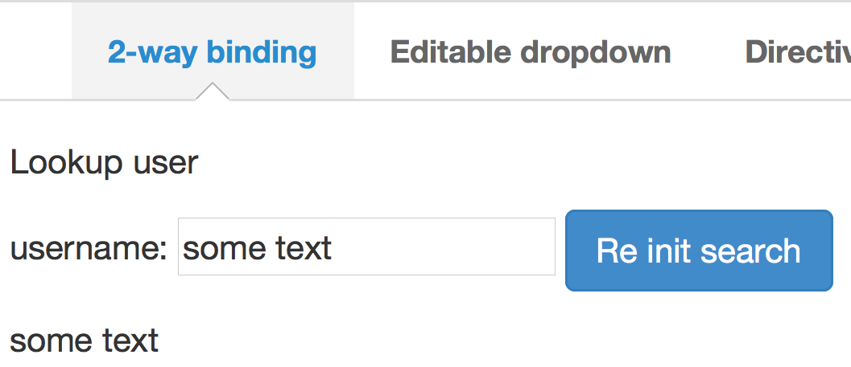
Tab 1 : Build a simple 2-way model binding
bind a test input field to a username model on the controller (ng-model attribute)
implement a 'clearSearch' function triggered by a click on a button (ng-click attribute)
have the username repeated and dynamically updated somewhere on the page (‘{{ }}’ syntax)
Notes:
duration : 8mn
deadline : 33mn
have the following ready :
intellij on the working branch
Backup intellij for cheatsheet
- terminal for 'npm start' (should already be there)
- terminal to switch branches
- browser open on localhost:7000/webapp

Slide 13
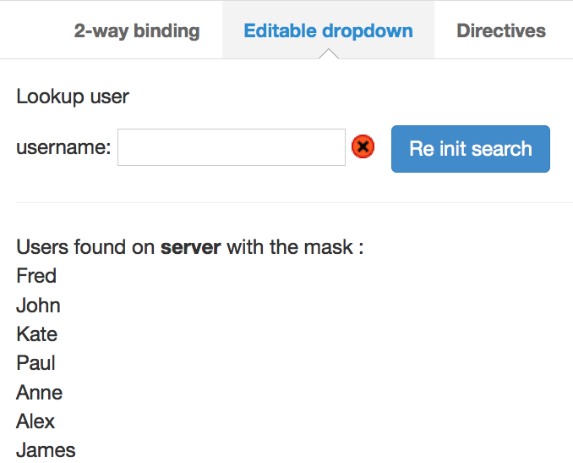
Tab 2 : watch input change and return a filtered list from server
declare a REST resource to 'users' URI ($resource("users”))
'watch' for changes on username and query the list of users with mask username
(restService.query({mask:username}).$promise.then(function(answer){…}))
retrieve the list of users and display it
(ng-repeat="user in users”)
if one and only one user found and its username equals the mask then set a 'userFound' flag and use it to toggle an icon tag css between ‘found’ and ‘notFound’
class="ng-class: {'found':userFound, 'notFound':!userFound};"
Notes:
duration : 8mn
deadline : 41mn

Slide 14
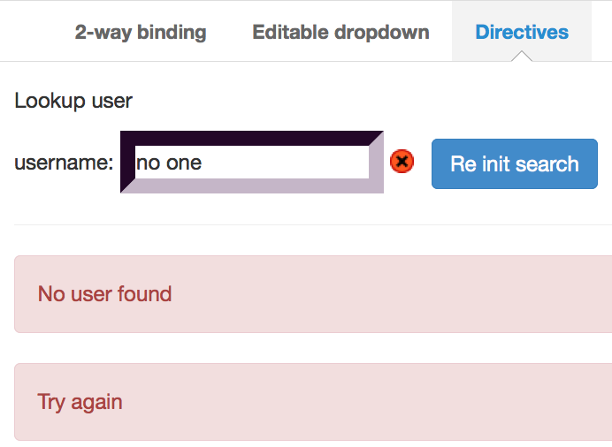
Tab 3 : using directives...
set up the alert directive by means including the following tag : <alerts-box alerts="yourAlertArrayFromScope"/>
push {successful: false, message: 'no.user.found'} and {successful: false, message: 'tryAgain'} to your alert array if no user found in the REST call
push {successful: true, message: 'users.found'} to your alert array if users found.
observe dynamic change in the alerts box and try closing alerts
Notes:
duration : 9mn
deadline : 50mn

Slide 15
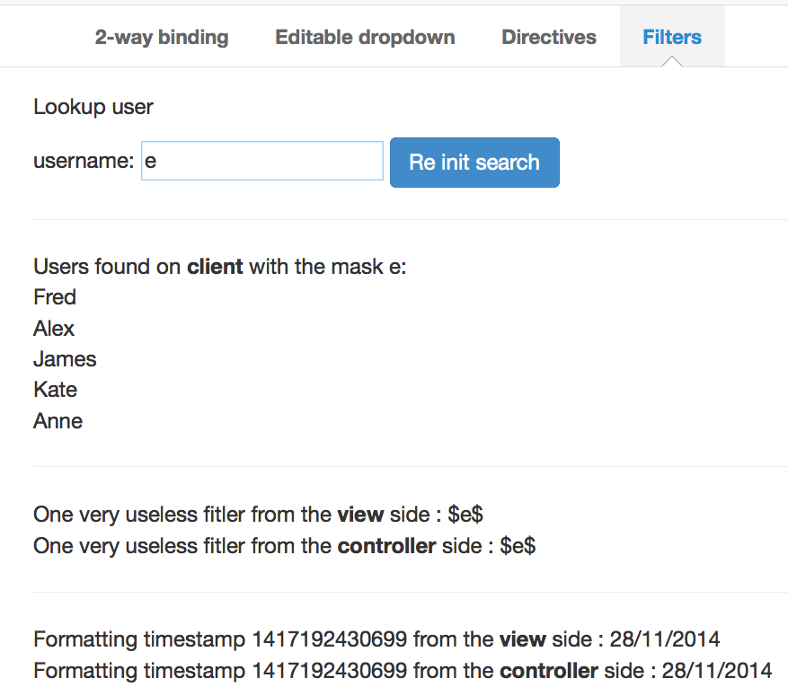
Tab 4 : using filters...
expose static users list to the template
dynamically filter it on the template side with the username value
(ng-repeat="user in users | filter:search.username”)
bootstrap 'myFilters' module and use 'fringes' filter to display somewhere the username wrapped with '$' symbol (| fringes:'$’)
expose a timestamp to the template and apply a date formatting with the pattern of your choice
(| date:'dd/MM/yyyy’)
Notes:
duration : 6mn
deadline : 56mn

Slide 16
Cool stuff for the end : Testing, Testing, Testing !!!
Have a look at the following test configurations :
For UNIT tests : test/karma.conf.js
Give it a try by running : npm test
For e2e tests : test/protractor-conf.js
Give it a try by :
Starting your server if not done yet : npm start
On another terminal run : npm run protractor
Notes:
duration : 4mn
deadline : 60mn

Slide 17
Thank you
Contact information:
Frederic canteloup & Alex Marquez
Software developers at Hybris ECP
frederic.canteloup@hybris.com
alex.marquez@sap.com

