Slide 1

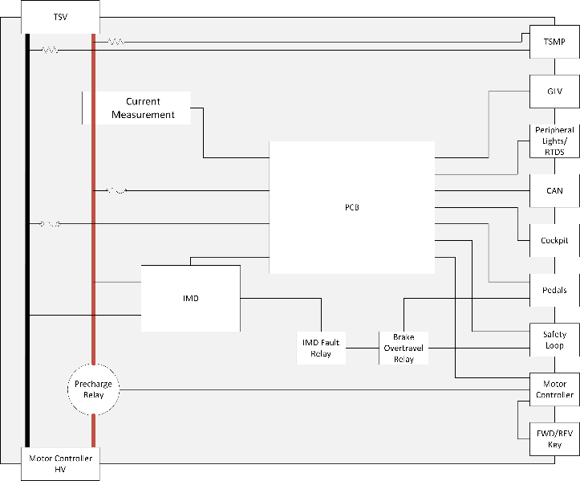
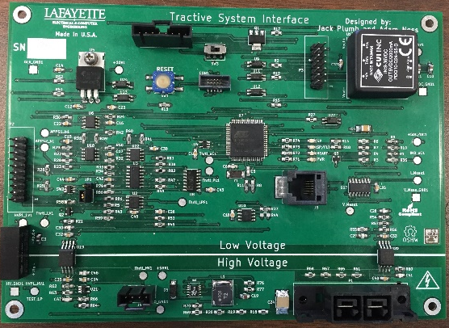
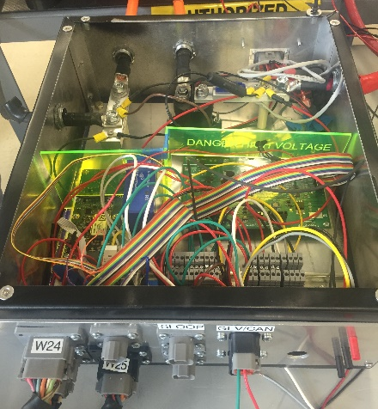
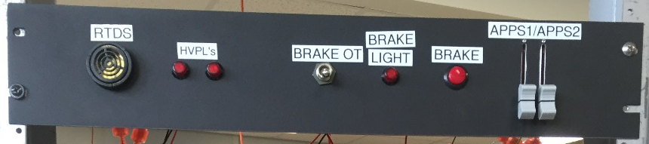
Formula Electric Vehicle
ECE 492- Spring 2017
Tractive System Interface
Project Website:
www.sites.Lafayette.edu/ece492-sp17
Engineers: Jack Plumb, Adam Ness, Christer Hoeflinger
Functionality
Throttle Plausibility
Brake Interface
Voltage/Current Measurement
Motor Controller Interface
Drive State
Insulation Monitoring Device
Overview
The Tractive System Interface is designed to safely connect the high voltage from the packs to the motor controller.
PCB
Worked at one point, now everything's fucked
Final Product
Test Panel
Acknowledgements
QR CODE

