Slide 1

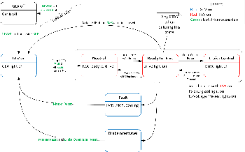
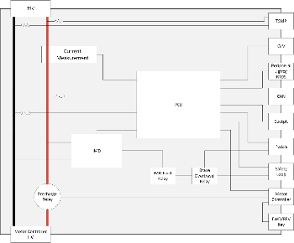
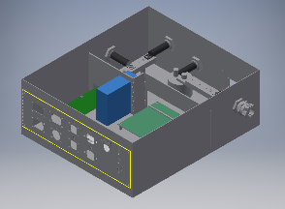
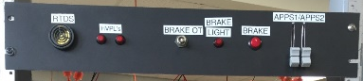
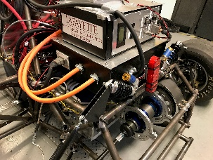
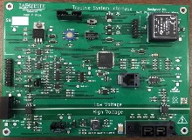

Formula Electric Vehicle
ECE 492- Spring 2017
Tractive System Interface
Project Website:
sites.lafayette.edu/ece492-sp17
Engineers:
Jack Plumb, Adam Ness, Christer Hoeflinger
Overview
The overall goal of the Tractive System Interface is to safely connect high voltage from the packs to the motor controller.
Functionality
The system was designed to facilitate a number of other functions based upon rules described by FSAE.
This included:
Throttle Plausibility
Brake Interface
Voltage Measurement
Current Measurement
Motor Controller Interface
Drive State
Insulation Monitoring Device (IMD)
Enclosure
Enclosure designed to neatly house entire subsystem
Electric insulation necessary to ensure safe operation
Panels fabricated to allow for changes to design
Fig. 2: Detailed shutdown conditions and states of the car.
Fig. 1: Simplified system block diagram
Testing
Testing focused on functionality of the board.
Test panel (Fig. 5) simulates subsystem’s driver interface
Able to simulate throttle plausibility checks, as well as brake press and over-travel.
Used to confirm drive state operability
Fig. 3: Assembled Inventor file of TSI enclosure
TSI Board
Responsible for all logical control of subsystem
Monitored throttle, brake, and driver input to determine drive state and action
Capable of interfacing with VSCADA
Send observed data
Reception and transmission of remote throttle control
Control of status lights
The Team
The Tractive System Interface consisted of somewhat working components, and hardly working team members, fueled mainly with the promise of breakfast pastries and low priced beers at the local tavern.
Fig. 5: Test panel of driver interface
Integration
The TSI subsystem was integrated into the car, successfully implementing drive-critical functionality.
Acknowledgements
A special thank you to Marv Snyder, Robert Layng, and Adam Smith for helping build our many components. Also thank you to the entire Mechanical Engineering team.
Fig. 6: TSI integrated into car
Fig. 4: Fully populated TSI board

