Slide 1

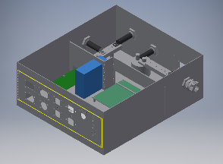
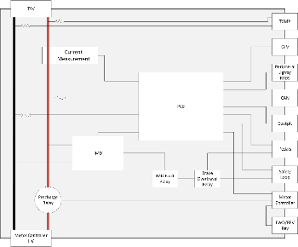
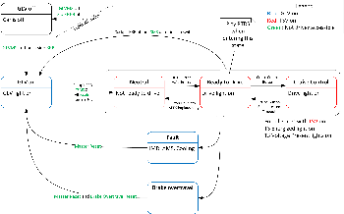
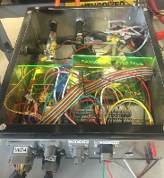
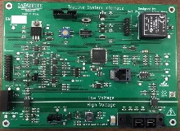
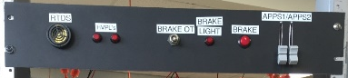
Formula Electric Vehicle
ECE 492- Spring 2017
Tractive System Interface
Project Website:
www.sites.Lafayette.edu/ece492-sp17
Engineers: Jack Plumb, Adam Ness, Christer Hoeflinger
Overview
The overall goal of the Tractive System Interface is to safely connect high voltage from the packs to the motor controller.
Functionality
The system was designed to facilitate a number of other functions based upon rules described by FSAE.
This included:
Throttle Plausibility
Brake Interface
Voltage/Current Measurement
Motor Controller Interface
Drive State
Insulation Monitoring Device (IMD)
Enclosure
The TSI Enclosure was designed to neatly house all systems needed to safely operate the vehicle. Electric insulation was needed to protect the parts from the metal walls. Panels were fabricated separately to allow for adaptability if new ports were needed.
The Team
The Tractive System Interface consisted of somewhat working components, and hardly working team members, fueled mainly with the promise of breakfast pastries and low priced beers at the local tavern.
PCB
The PCB was designed to monitor the
Testing and Integration
Acknowledgements
QR CODE

