Slide 1

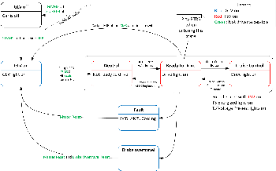
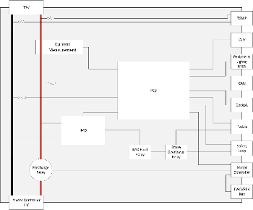
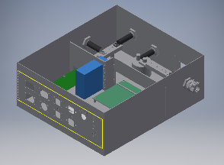
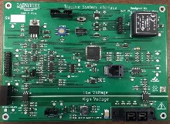
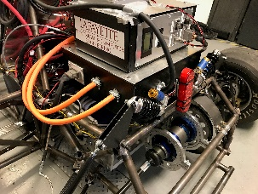
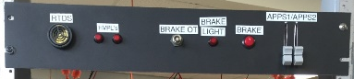

Formula Electric Vehicle
ECE 492- Spring 2017
Tractive System Interface
Project Website:
sites.lafayette.edu/ece492-sp17
Engineers: Jack Plumb, Adam Ness, Christer Hoeflinger
Overview
The overall goal of the Tractive System Interface is to safely connect high voltage from the packs to the motor controller.
Functionality
The system was designed to facilitate a number of other functions based upon rules described by FSAE.
This included:
Throttle Plausibility
Brake Interface
Voltage Measurement
Current Measurement
Motor Controller Interface
Drive State
Insulation Monitoring Device (IMD)
Enclosure
The TSI Enclosure was designed to neatly house all systems needed to safely operate the vehicle. Electric insulation was needed to protect the parts from the metal walls. Panels were fabricated separately to allow for adaptability if new ports were needed.
Fig. 2: Detailed shutdown conditions and states of the car.
Fig. 1: Simplified system block diagram
Testing and Integration
Testing of the TSI subsystem largely revolved around functionality of the board. At the completion of this semester, many of the designed abilities of the board remain unimplemented. As the semester progressed, efforts were directed towards drive-critical components of the subsystem, so that a functional car could be realized.
Figure 5 (left) shows the test panel that was built to test the subsystem’s driver interface prior to integration. This was able to simulate the two throttle potentiometers, allowing for throttle plausibility checks, as well as brake press and over-travel. These signals were used to confirm drive state operability.
Fig. 3: Assembled Inventor file of TSI enclosure
TSI Board
All logical control of the TSI subsystem was processed by the PCB. This included monitoring of throttle, brake, and driver input, to determine appropriate drive state and action. The board is capable of interfacing with VSCADA to send observed data, as well as the reception and transmission of remote throttle control to the motor controller. Additionally, various status lights and signals are controlled by the board.
The Team
The Tractive System Interface consisted of somewhat working components, and hardly working team members, fueled mainly with the promise of breakfast pastries and low priced beers at the local tavern.
Figure 6 (right) is the fully integrated subsystem mounted on the car. Here you can see the high voltage connections entering and leaving the enclosure, as well as the motor controller connections.
Acknowledgements
A special thank you to Marv Snyder, Robert Layng, and Adam Smith for helping with the build of our many components. Also thank you to the entire Mechanical Engineering team.
Fig. 6: TSI integrated into car
Fig. 4: Fully populated TSI board
Fig. 5: Test panel of driver interface

