Slide 1
HOSPITALITY SECTOR
Analyzing Customer Satisfaction and Service Quality in Selected Hotels in Abuja
11th June, 2026

Slide 2
PROJECT TOPIC
Analyzing Customer Satisfaction and Service Quality in Selected Hotels in Abuja

Slide 3
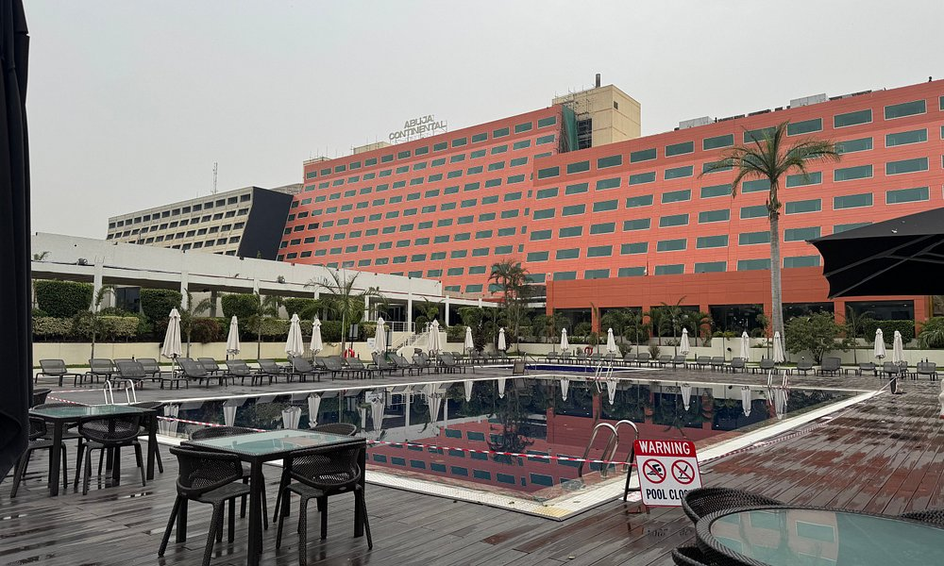
INTRODUCTION
Customer satisfaction is important in the hotel industry because it affects customer loyalty, hotel reputation, and business success. Hotels must provide quality services to meet customer expectations and remain competitive.
Abuja, Nigeria's capital city, has many hotels serving business and leisure travelers. Factors such as service quality, food, cleanliness, room comfort, and facilities influence how satisfied guests are with their hotel experience.
This study analyzes customer reviews and ratings from selected hotels in Abuja using Microsoft Excel tools such as pivot tables, charts, and dashboards. The aim is to identify the key factors affecting customer satisfaction, compare hotel performance, and provide insights that can help hotels improve their services and customer experience.

Slide 4
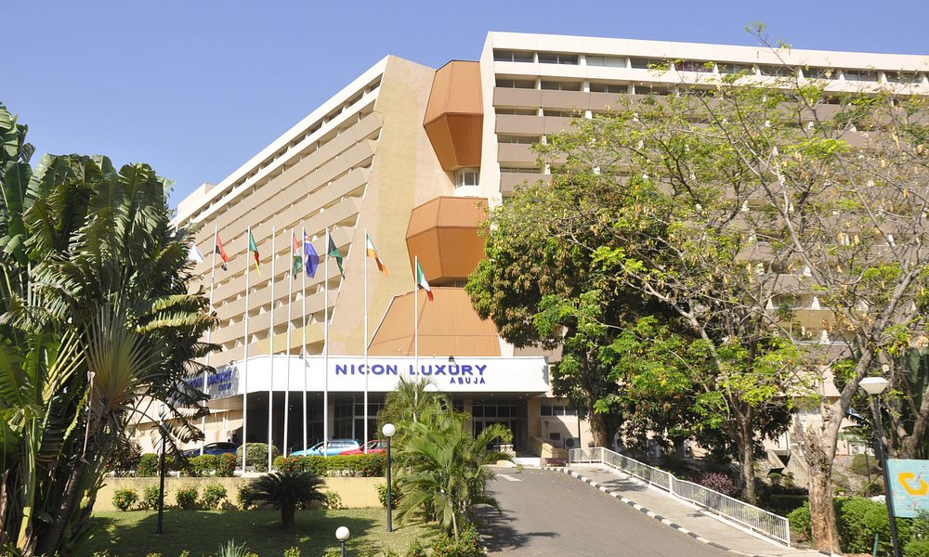
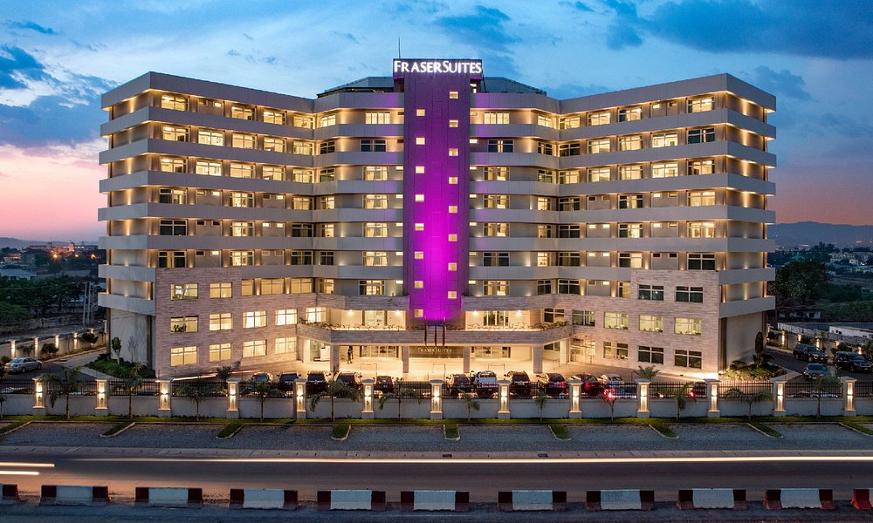
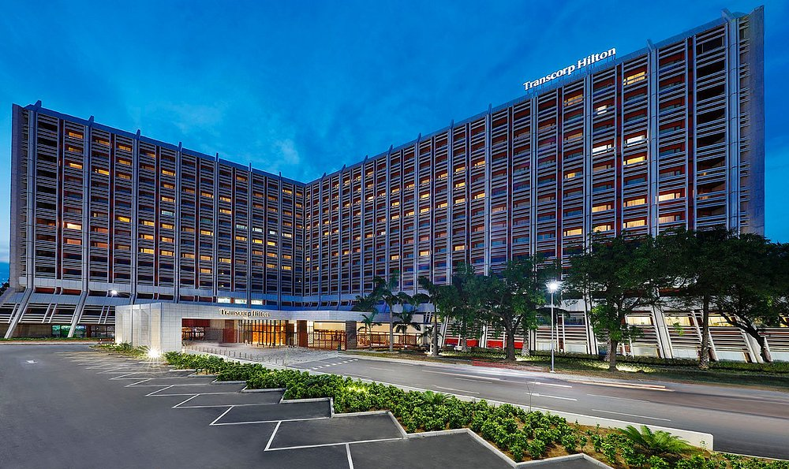
STATEMENT OF PROBLEMS
Many hotels in Abuja struggle to maintain consistent service quality, leading to varying levels of customer satisfaction. Complaints relating to staff responsiveness, cleanliness, booking efficiency, and overall guest experience continue to affect the competitiveness of hotels in the hospitality sector. This problem is worth investigating because customer satisfaction directly influences hotel reputation, repeat patronage, and profitability in an increasingly competitive market. The study fills a knowledge gap by providing evidence on how specific service quality affects customer satisfaction in selected hotels in Abuja.

Slide 5
OBJECTIVES
To examine the level of customer satisfaction in selected hotels in Abuja.
To identify the major factors that influence customer satisfaction in hotels.
To compare the quality of services provided by different hotels.
To evaluate the relationship between service quality and hotel ratings.

Slide 6
RESEARCH QUESTIONS
What is the general level of customer satisfaction in the selected hotels in Abuja?
Which service quality factors have the strongest effect on customer satisfaction?
How do the selected hotels perform when compared in terms of service quality?
How does service quality affect hotel ratings?

Slide 7
SCOPE OF STUDY
The study focused on customer reviews and ratings from selected hotels in Abuja, Nigeria.
Analysis was limited to customer satisfaction and service quality factors.
The study covered eight selected hotels and over 2,000 customer reviews.
Findings may not represent all hotels in Nigeria or other countries.
Summerset Continental, Fraser Suites Abuja, Transcorp Hilton Abuja, Abuja Continental, Best Premier Maitama Residence,
Nicon Luxury, The Wells Carlton, and Bolton White Residence Hotel.
Selected Hotels in Abuja

Slide 8
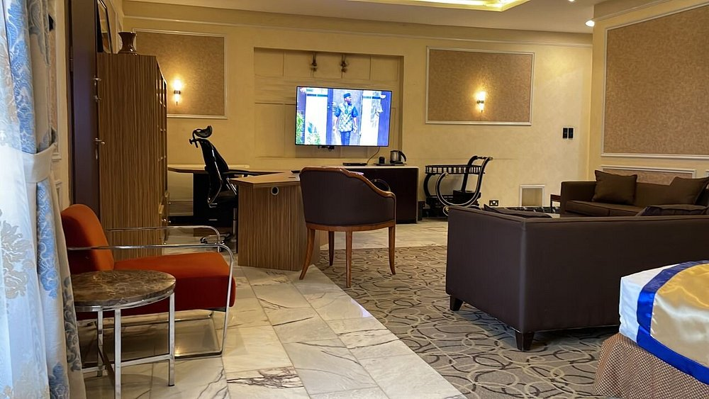
DATA CLEANING PROCESS
The dataset initially contained six (6) columns. To ensure the data was relevant to the research objectives and analysis, several data cleaning procedures were carried out:
We removed irrelevant columns (URL and Review URL) as they were not required for the analysis.
We removed duplicate records based on hotel name, rating, and review content.
We retained records with ratings but no reviews, and reviews but no ratings, as both variables were important for the analysis.
Missing values were labeled as "No Rating" and "No Review" instead of being replaced with estimated values.
We created three new columns: Rate Category | Review Category | Guest Perception
We sorted Guest Perception column manually to ensure accurate opinion categorization.
Renamed column headers for clarity: Title → Hotel Name, Star → Rating, Text → Review

Slide 9
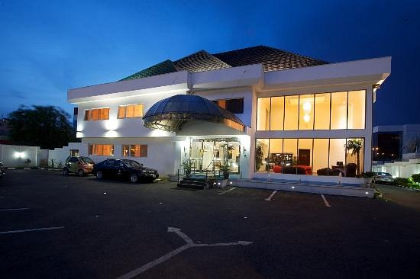
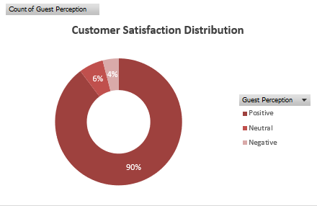
FINDINGS AND INSIGHTS
Insight 1: Customer Satisfaction Level
What is the general level of customer satisfaction in the selected hotels in Abuja?
Positive customer perceptions accounted for 90% of all customer feedback, representing the largest proportion of reviews received across the selected hotels. Neutral perceptions accounted for 6%, while only 4% of reviews were classified as Negative. Additionally, these findings indicate a generally high level of customer satisfaction and suggest that most guests had favorable experiences with the services provided by the selected hotels in Abuja.

Slide 10
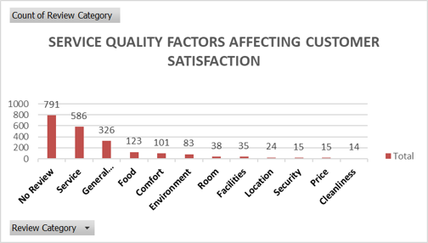
FINDINGS AND INSIGHTS
Insight 2: Major Factors Influencing Customer Satisfaction
Service received the highest number of customer mentions (586 reviews), making it the most influential factor affecting customer satisfaction. General Feedback (326 reviews) and Food (123 reviews) were also frequently discussed, highlighting their importance in shaping guest experiences. Room, Facilities, Location, Security, Price, and Cleanliness received fewer reviews, suggesting that customers were less likely to comment on these areas. Overall, the findings indicate that delivering excellent service and maintaining high-quality food offerings are key drivers of customer satisfaction and positive hotel reviews.

Slide 11
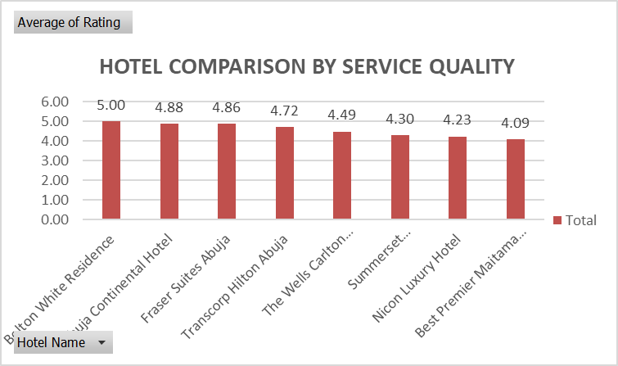
FINDINGS AND INSIGHTS
Insight 3: Hotel Performance Comparison
How do the selected hotels perform when compared in terms of service quality?
The comparison shows that all selected hotels received a high number of Excellent ratings, indicating generally strong service quality and customer satisfaction across the hotels. Good ratings were the second most common category, while Poor and Fair ratings were relatively low, suggesting limited negative customer experiences. Overall, the results indicate that the selected hotels maintain positive service standards, with only minor variations in performance among them.

Slide 12
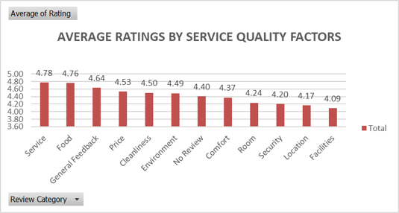
FINDINGS AND INSIGHTS
Insight 4: Relationship Between Service Quality and Hotel Ratings
How does service quality affect hotel ratings?
Service and Food emerged as the highest-rated service quality factors, with average ratings of 4.78 and 4.76 respectively. Facilities (4.09), Location (4.15), Security (4.18), and Room Quality (4.24) recorded comparatively lower average ratings highlighting areas for improvement. This suggests that customers generally perceive hotel service quality positively, although improvements in these lower-rated areas may further enhance overall customer satisfaction hotel ratings, and competitiveness.

Slide 13
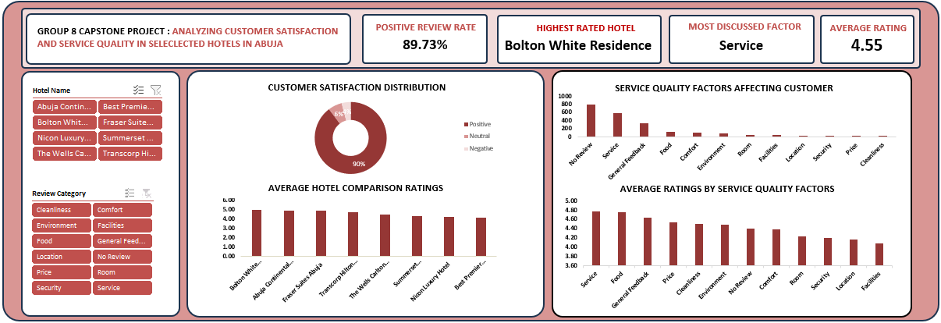
OVERVIEW OF THE DASHBOARD

Slide 14
RECOMMENDATIONS
Hotels should invest in continuous staff training to improve service delivery.
Customer feedback should be monitored regularly to identify service gaps.
Greater attention should be given to food quality, comfort, and environmental conditions.
Hotels should leverage customer reviews to improve guest experience and increase customer loyalty.
Management should adopt data-driven strategies for continuous service improvement.

Slide 15
VALUE OF ANALYSIS
Who is this analysis useful for?
Hotel Owners and Management
Hospitality Industry Stakeholders
Customer Experience Managers
Potential Investors
Researchers and Academics
Tourism Development Agencies

Slide 16
CONCLUSION
The analysis revealed that customer satisfaction across the selected hotels was remarkably high, highlighting the strong performance of Abuja's hospitality sector. Among all factors evaluated, service quality stood out as the key driver of guest satisfaction, proving that exceptional service has the greatest impact on customer perceptions and experiences. While some hotels outperformed others, the findings clearly demonstrate that investments in service excellence can significantly boost customer ratings, strengthen brand reputation, encourage repeat patronage, and create a lasting competitive advantage in the hospitality industry.

Slide 17
Thank you
for
Listening!

