Slide 1

Stochastic Duty Cycling for Heterogenous Energy Harvesting Networks
Jianhui Zhang, Mengmeng Wang, and Zhi Li
Reporter: Zhi Li
Email: zhili.pro@gmail.com
College of Computer Science and Technology Hangzhou Dianzi University, Hangzhou 310018 China

Slide 2
Outline
Background & Motivation
Related work
Problem formulation
Algorithm design
Evaluation
Conclusion

Slide 3
Outline
Background & Motivation
Related work
Problem formulation
Algorithm design
Evaluation
Conclusion

Slide 4
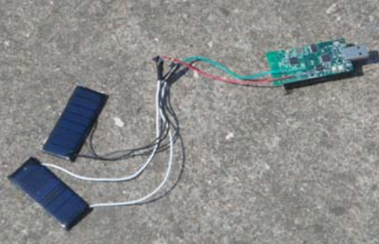
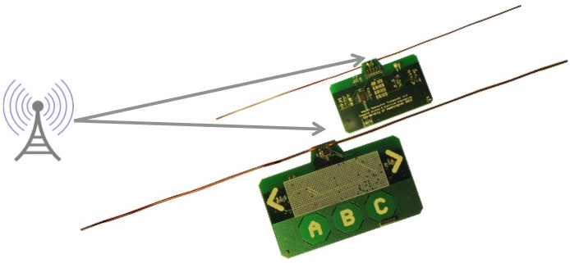
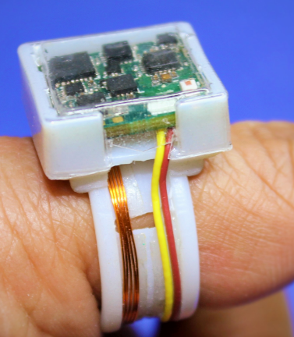
Background
Energy harvesting systems
Ambient backscatter (SIGCOMM 2013)
Ring
(MobiSys 2014)
Renewable sensor networks (ICDCS 2011)
Factors affecting system performance
Energy heterogeneity
Low charge efficiency
other

Slide 5
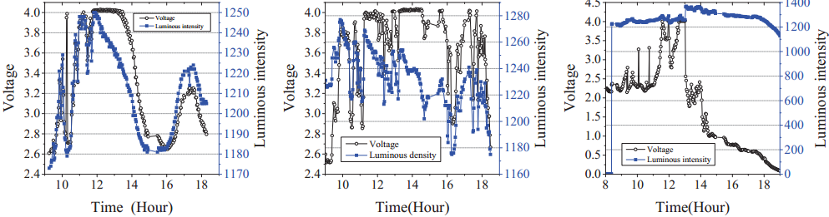
Motivation
Random profile of harvested energy
One device harvests energy in three days with changing weather
Observations
Weather variations
（a）First day
（b）Second day
（c）Third day

Slide 6
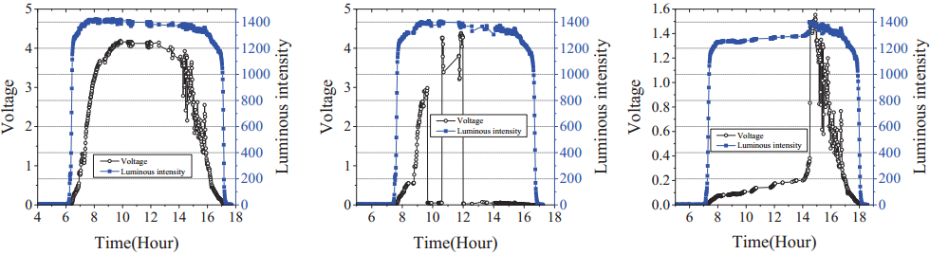
Motivation
Random profile of harvested energy
Three devices harvest energy in a single day with the similar weather
Observations
Unpredictable environmental factors
（a）First device
（b）Second device
（c）Third device

Slide 7
Motivation
Randomness of energy harvesting
Weather variations and environmental factors
The devices may not use the harvested energy synchronously
Low charge efficiency
Less than 75% for a solar powered node
It is better to use the harvested energy directly
How to improve the utilization of the harvested energy?
New stochastic duty cycling algorithms

Slide 8
Outline
Background & Motivation
Related work
Problem formulation
Algorithm design
Evaluation
Conclusion

Slide 9
Related Work
Duty cycling
Deterministic duty cycling
Consider amount of active time
Stochastic duty cycling
Consider active moments
Consider amount of active time
Our work
Consider imperfect charge efficiency
Consider randomness of harvested energy
Consider active moments and amount of active time together

Slide 10


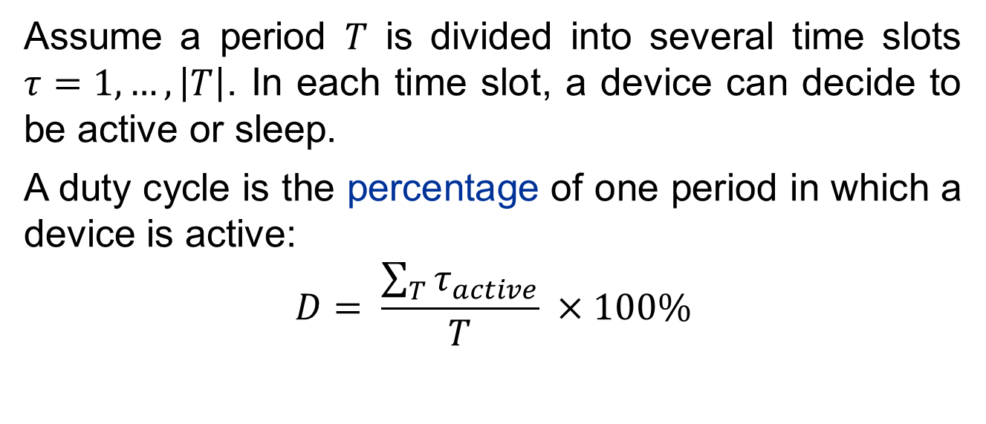









Stochastic Duty Cycling
Assume a period $T$ is divided into several time slots $τ=1, …, \left|T\right|$. In each time slot, a device can decide to be active or sleep.
A duty cycle is the percentage of one period in which a device is active:
$$D= \frac{\sum_{T}{τ_{active}}}{T} ×100\%$$
Active
Time
$$τ_{1}$$
$$τ_{2}$$
$$τ_{3}$$
$$τ_{4}$$
$$τ_{5}$$
$$τ_{6}$$
$$τ_{7}$$
$$τ_{8}$$
$$τ_{9}$$
$$τ_{T}$$
$$T$$

Slide 11
Outline
Background & Motivation
Related work
Problem formulation
Algorithm design
Evaluation
Conclusion

Slide 12

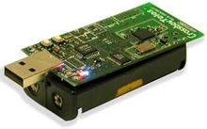

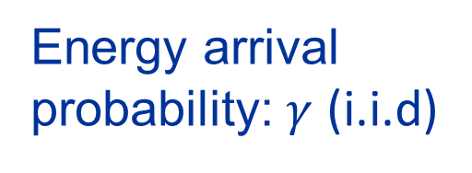
Problem Formulation
Energy arrival probability: $γ$ (i.i.d)
To maximize the CAT over the period $T$
P2P
Common Active Time
（CAT）

Slide 13
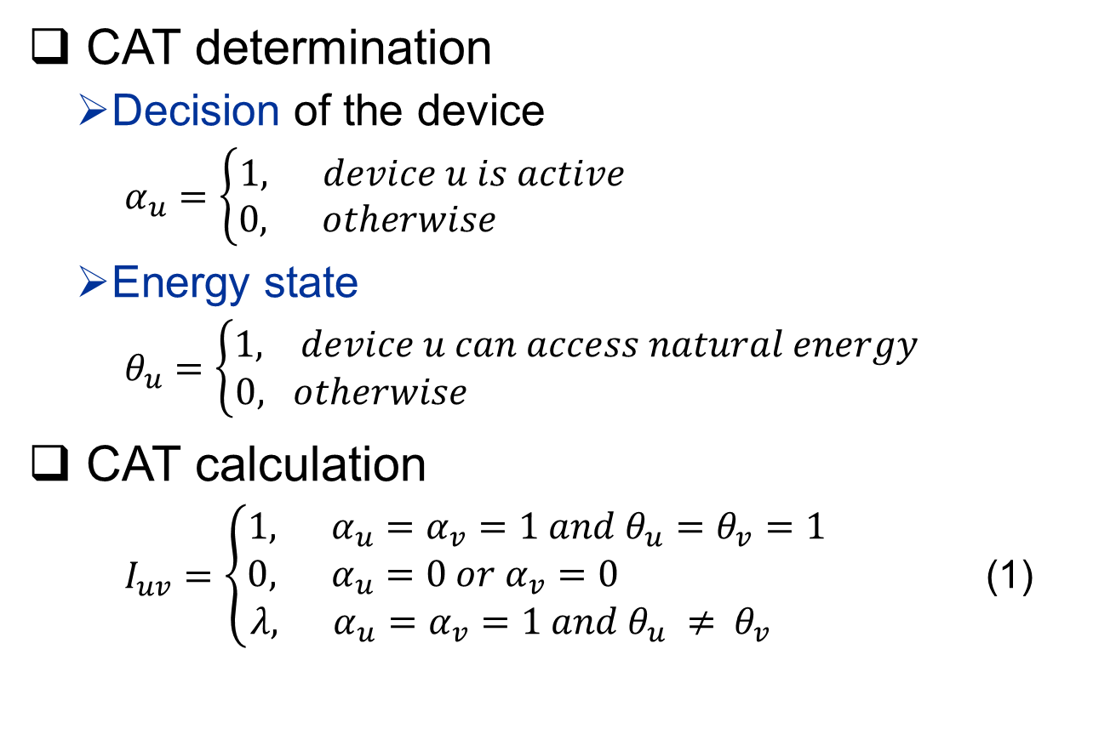
Problem Formulation
CAT determination
Decision of the device
$α_{u}=\left\{\begin{aligned}1, device u is active \\ 0, otherwise \end{aligned}\right.$
Energy state
$θ_{u}=\left\{\begin{aligned}1, device u can access natural energy \\ 0, otherwise \end{aligned}\right.$
CAT calculation
$I_{uv}=\left\{\begin{aligned}1, α_{u}=α_{v}=1 and θ_{u}=θ_{v}=1 && \\ 0, α_{u}=0 or α_{v}=0 \\ λ, α_{u}=α_{v}=1 and θ_{u} ≠{ θ}_{v} \end{aligned}\right.$ (1)

Slide 14
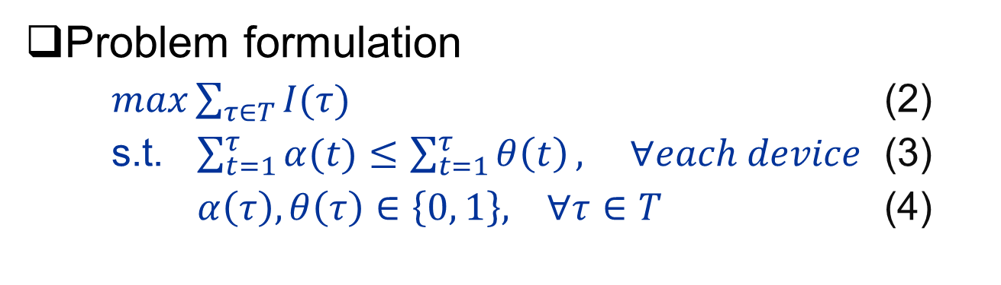
Problem Formulation
Problem formulation
$\max{\sum_{τ∈T}{I(τ)}}$ (2)
s.t. $\sum_{t=1}^{τ}{α(t)}≤\sum_{t=1}^{τ}{θ\left(t\right)}, ∀each device$ (3)
$α\left(τ\right),θ\left(τ\right)∈\left\{0, 1\right\}, ∀τ∈T$ (4)

Slide 15
Outline
Background & Motivation
Related work
Problem formulation
Algorithm design
Evaluation
Conclusion

Slide 16
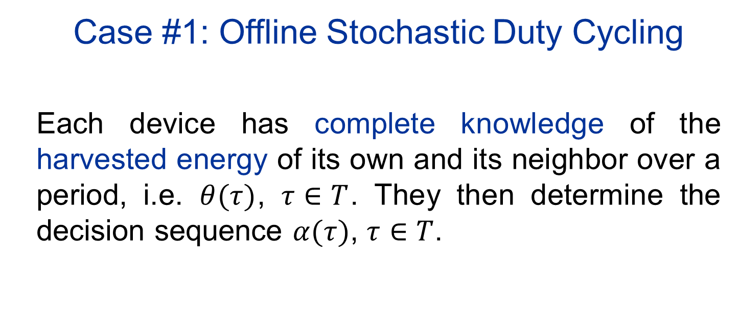
Case #1: Offline Stochastic Duty Cycling
Each device has complete knowledge of the harvested energy of its own and its neighbor over a period, i.e. $θ(τ)$, $τ∈T$. They then determine the decision sequence $α(τ)$, $τ∈T$.

Slide 17



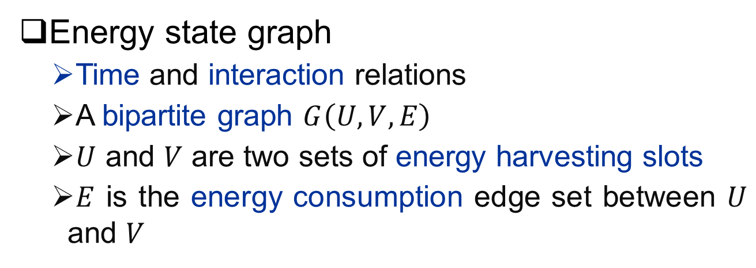





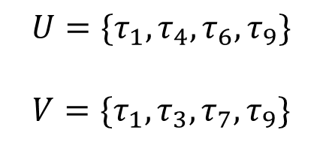






Offline Stochastic Duty Cycling
Energy state graph
Time and interaction relations
A bipartite graph $G\left(U,V,E\right)$
$U$ and $V$ are two sets of energy harvesting slots
$E$ is the energy consumption edge set between $U$ and $V$
Time
Device $u$
$$τ_{1}$$
$$τ_{2}$$
$$τ_{3}$$
$$τ_{4}$$
$$τ_{5}$$
$$τ_{6}$$
$$τ_{7}$$
$$τ_{8}$$
$$τ_{9}$$
$$U=\{τ_{1},τ_{4},τ_{6},τ_{9}\}$$
$$V=\{τ_{1},τ_{3},τ_{7},τ_{9}\}$$
1
$$λ$$
$$λ$$
1
$$λ$$
Time
Device $v$
$$τ_{1}$$
$$τ_{2}$$
$$τ_{3}$$
$$τ_{4}$$
$$τ_{5}$$
$$τ_{6}$$
$$τ_{7}$$
$$τ_{8}$$
$$τ_{9}$$

Slide 18

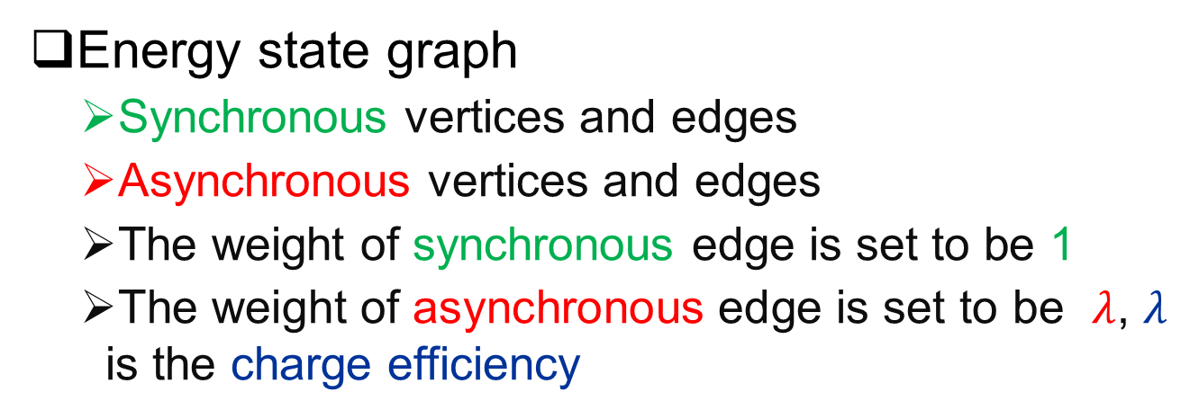


Offline Stochastic Duty Cycling
Energy state graph
Synchronous vertices and edges
Asynchronous vertices and edges
The weight of synchronous edge is set to be 1
The weight of asynchronous edge is set to be $λ$, $λ$ is the charge efficiency
Time
Device $u$
$$τ_{1}$$
$$τ_{2}$$
$$τ_{3}$$
$$τ_{4}$$
$$τ_{5}$$
$$τ_{6}$$
$$τ_{7}$$
$$τ_{8}$$
$$τ_{9}$$
$$U=\{τ_{1},τ_{4},τ_{6},τ_{9}\}$$
$$V=\{τ_{1},τ_{3},τ_{7},τ_{9}\}$$
1
$$λ$$
$$λ$$
1
$$λ$$
Time
Device $v$
$$τ_{1}$$
$$τ_{2}$$
$$τ_{3}$$
$$τ_{4}$$
$$τ_{5}$$
$$τ_{6}$$
$$τ_{7}$$
$$τ_{8}$$
$$τ_{9}$$

Slide 19



Offline Stochastic Duty Cycling
Offline duty cycling graph
A bipartite graph $G\left(U,V,E\right)$
The energy consumption decision
Time
Device $u$
$$τ_{1}$$
$$τ_{2}$$
$$τ_{3}$$
$$τ_{4}$$
$$τ_{5}$$
$$τ_{6}$$
$$τ_{7}$$
$$τ_{8}$$
$$τ_{9}$$
$$U=\{τ_{1},τ_{4},τ_{6},τ_{9}\}$$
$$V=\{τ_{1},τ_{3},τ_{7},τ_{9}\}$$
1
$$λ$$
$$λ$$
1
Time
Device $v$
$$τ_{1}$$
$$τ_{2}$$
$$τ_{3}$$
$$τ_{4}$$
$$τ_{5}$$
$$τ_{6}$$
$$τ_{7}$$
$$τ_{8}$$
$$τ_{9}$$
Maximum weighted matching problem
Offline duty cycling problem
Generate offline duty cycling graph from energy state graph

Slide 20


Offline Stochastic Duty Cycling
Offline duty cycling algorithm
Connect each pair of the synchronous vertices
Each remaining vertex searches backward and connects to the nearest unconnected vertex of its neighbor device
Time
Device $u$
$$τ_{1}$$
$$τ_{2}$$
$$τ_{3}$$
$$τ_{4}$$
$$τ_{5}$$
$$τ_{6}$$
$$τ_{7}$$
$$τ_{8}$$
$$τ_{9}$$
$$U=\{τ_{1},τ_{4},τ_{6},τ_{9}\}$$
$$V=\{τ_{1},τ_{3},τ_{7},τ_{9}\}$$
1
$$λ$$
$$λ$$
1
Time
Device $v$
$$τ_{1}$$
$$τ_{2}$$
$$τ_{3}$$
$$τ_{4}$$
$$τ_{5}$$
$$τ_{6}$$
$$τ_{7}$$
$$τ_{8}$$
$$τ_{9}$$

Slide 21
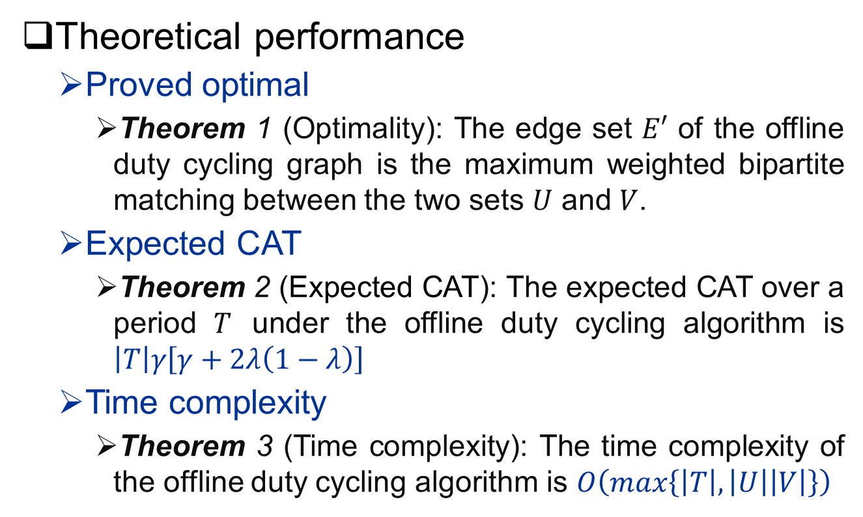
Offline Stochastic Duty Cycling
Theoretical performance
Proved optimal
Theorem 1 (Optimality): The edge set $E′$ of the offline duty cycling graph is the maximum weighted bipartite matching between the two sets $U$ and $V$.
Expected CAT
Theorem 2 (Expected CAT): The expected CAT over a period $T$ under the offline duty cycling algorithm is $\left|T\right|γ\left[γ+2λ\left(1−λ\right)\right]$
Time complexity
Theorem 3 (Time complexity): The time complexity of the offline duty cycling algorithm is $O\left(max\left\{\left|T\right|,\left|U\right|\left|V\right|\right\}\right)$

Slide 22
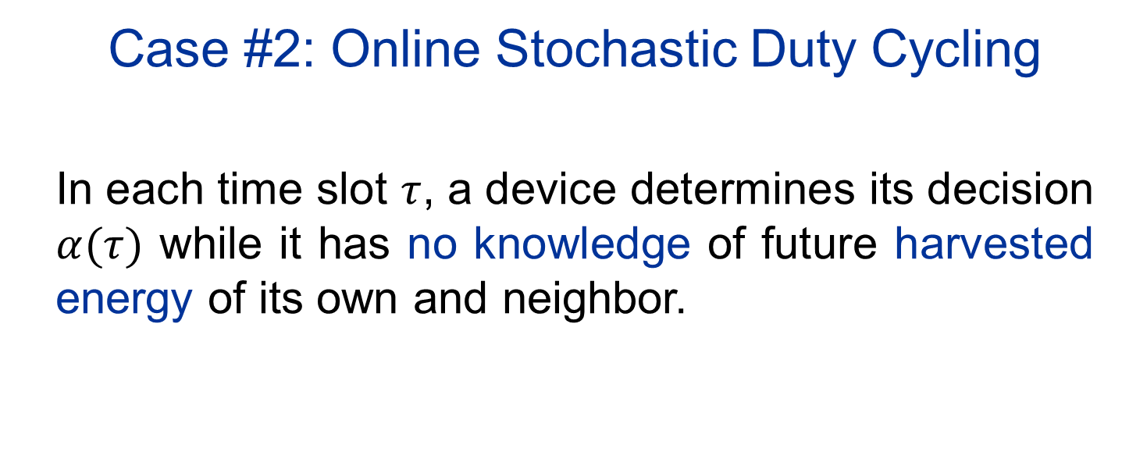
Case #2: Online Stochastic Duty Cycling
In each time slot $τ$, a device determines its decision $α(τ)$ while it has no knowledge of future harvested energy of its own and neighbor.

Slide 23
Online Stochastic Duty Cycling
Online duty cycling problem
Generate an online duty cycling graph
Online maximal weighted matching problem
Challenge
No future energy profile information
Basic idea
To capture synchronous edge as many as possible

Slide 24
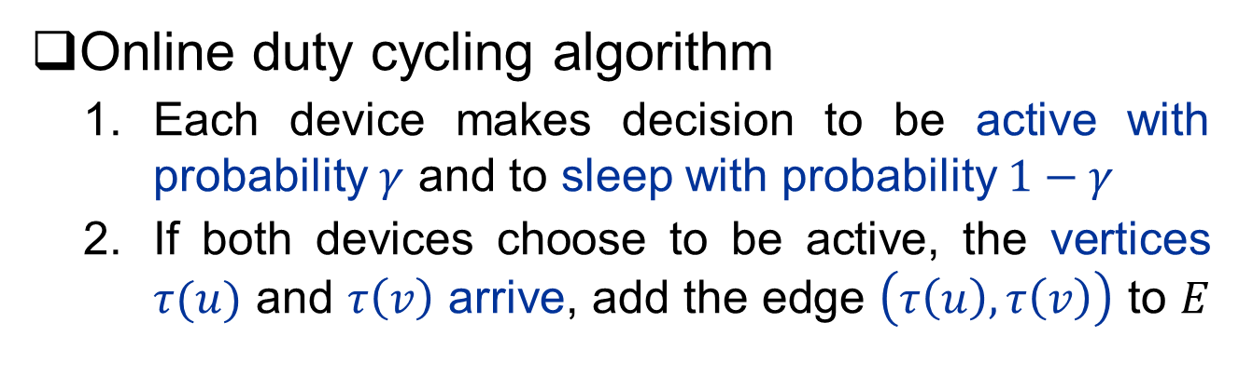
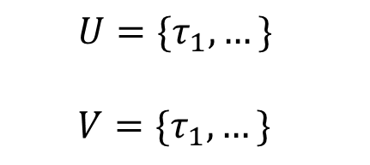
Online Stochastic Duty Cycling
Online duty cycling algorithm
Each device makes decision to be active with probability $γ$ and to sleep with probability $1−γ$
If both devices choose to be active, the vertices $τ(u)$ and $τ\left(v\right)$ arrive, add the edge $\left(τ\left(u\right),τ\left(v\right)\right)$ to $E$
Active
Time
Device $u$
$$τ_{1}$$
$$τ_{2}$$
$$τ_{3}$$
$$τ_{4}$$
$$τ_{5}$$
$$τ_{6}$$
$$τ_{7}$$
$$τ_{8}$$
$$τ_{9}$$
$$U=\{τ_{1},…\}$$
$$V=\{τ_{1},…\}$$
1
Active
Time
Device $v$
$$τ_{1}$$
$$τ_{2}$$
$$τ_{3}$$
$$τ_{4}$$
$$τ_{5}$$
$$τ_{6}$$
$$τ_{7}$$
$$τ_{8}$$
$$τ_{9}$$

Slide 25

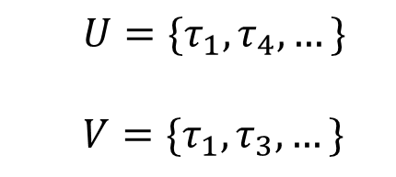
Online Stochastic Duty Cycling
Online duty cycling algorithm
If both devices choose to be active, and the vertex $τ(u)$ arrives at current slot, and $τ′(v)$ arrives earlier, add the edge $\left(τ\left(u\right),τ′\left(v\right)\right)$ to $E$
Active
Time
Device $u$
$$τ_{1}$$
$$τ_{2}$$
$$τ_{3}$$
$$τ_{4}$$
$$τ_{5}$$
$$τ_{6}$$
$$τ_{7}$$
$$τ_{8}$$
$$τ_{9}$$
$$U=\{τ_{1},τ_{4},…\}$$
$$V=\{τ_{1},τ_{3},…\}$$
1
$$λ$$
Active
Time
Device $v$
$$τ_{1}$$
$$τ_{2}$$
$$τ_{3}$$
$$τ_{4}$$
$$τ_{5}$$
$$τ_{6}$$
$$τ_{7}$$
$$τ_{8}$$
$$τ_{9}$$

Slide 26
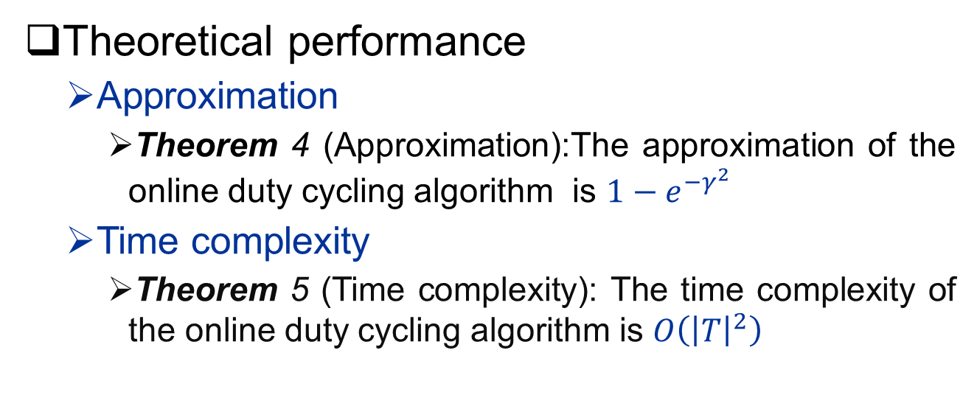
Online Stochastic Duty Cycling
Theoretical performance
Approximation
Theorem 4 (Approximation):The approximation of the online duty cycling algorithm is $1−e^{−γ^{2}}$
Time complexity
Theorem 5 (Time complexity): The time complexity of the online duty cycling algorithm is $O\left({\left|T\right|}^{2}\right)$

Slide 27
Outline
Background & Motivation
Related work
Problem formulation
Algorithm design
Evaluation
Conclusion

Slide 28
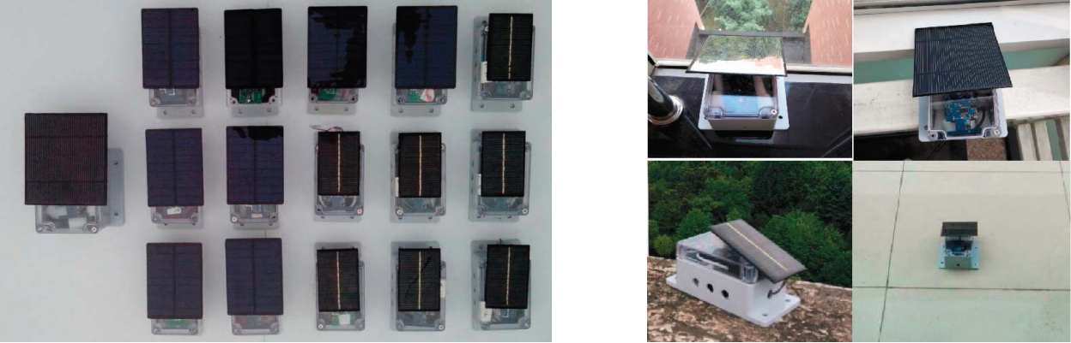
Experiment Evaluation
Experiment setting
15 nodes and one sink deployed around our lab building
The period is set to be 10 hours, the time slot is set to be 1 minute
15 nodes
Sensor deployment

Slide 29
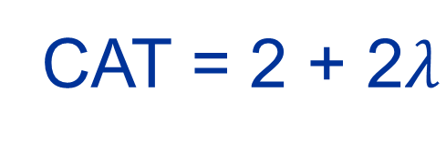
Experiment Evaluation
Metrics
Common Active Time(CAT): the sum of all edges’ weight
Synchronous Active Time (SAT): the sum of synchronous edges’ weight
Time
Device $u$
$$τ_{1}$$
$$τ_{2}$$
$$τ_{3}$$
$$τ_{4}$$
$$τ_{5}$$
$$τ_{6}$$
$$τ_{7}$$
$$τ_{8}$$
$$τ_{9}$$
$$U=\{τ_{1},τ_{4},τ_{6},τ_{9}\}$$
$$V=\{τ_{1},τ_{3},τ_{7},τ_{9}\}$$
1
$$λ$$
$$λ$$
1
Time
Device $v$
$$τ_{1}$$
$$τ_{2}$$
$$τ_{3}$$
$$τ_{4}$$
$$τ_{5}$$
$$τ_{6}$$
$$τ_{7}$$
$$τ_{8}$$
$$τ_{9}$$
CAT = 2 + 2$λ$
SAT = 2

Slide 30
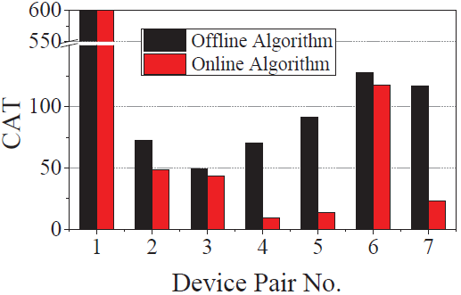
Experiment Evaluation
CAT
The online algorithm can achieve 52.68% on average of the CAT under the offline algorithm.
 | CAT Percentage
 | Min | Max
Offline | 8.24% | 100%
Online | 2.30% | 100%
CAT over two algorithms
CAT percentage

Slide 31
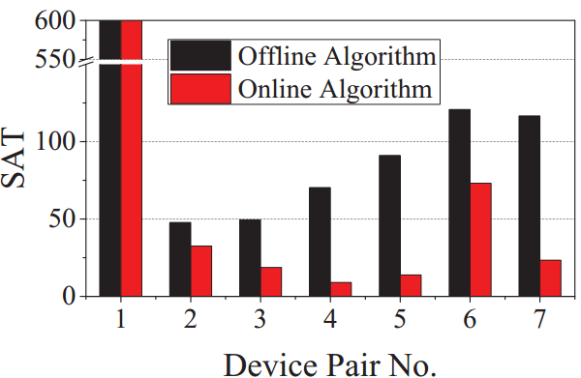
Experiment Evaluation
SAT
The online algorithm can achieve 27.45% on average of the CAT under the offline algorithm.
 | SAT Percentage
 | Min | Max
Offline | 7.96% | 100%
Online | 1.51% | 100%
SAT over two algorithms
SAT percentage

Slide 32
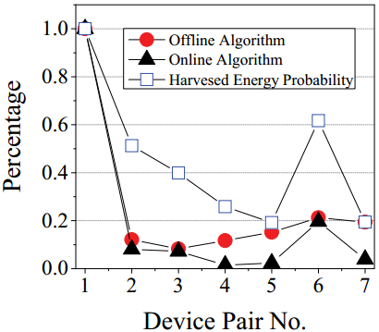
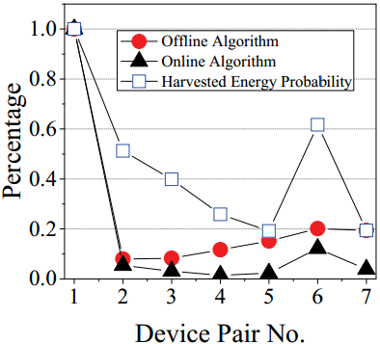
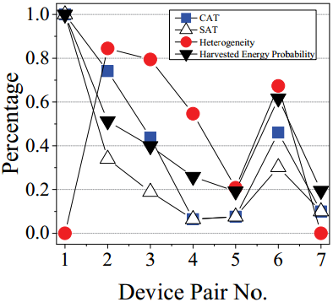
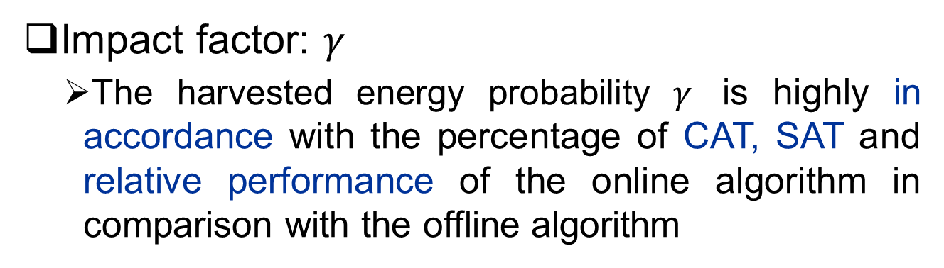
Experiment Evaluation
Impact factor: $γ$
The harvested energy probability $γ$ is highly in accordance with the percentage of CAT, SAT and relative performance of the online algorithm in comparison with the offline algorithm
(a) CAT percentage
(b) SAT percentage
(c) Comparison over
two algorithms

Slide 33
Outline
Background & Motivation
Related work
Problem formulation
Algorithm design
Evaluation
Conclusion

Slide 34
Conclusion
This is the first work that investigates the stochastic duty cycling problem under the random harvested energy and low charge efficiency
We address the offline and online stochastic duty cycling problem and design the offline and online stochastic duty cycling algorithms
We perform both theoretical analysis and experimental evaluation of the offline and online duty cycling algorithms

Slide 35
References
[1] Vincent Liu, Aaron Parks, Vamsi Talla, Shyamnath Gollakota, David Wetherall, and Joshua R Smith. Ambient backscatter: wireless communication out of thin air. In ACM SIGCOMM Computer Communication Review, volume 43, pages 39–50, 2013.
[2] Jeremy Gummeson, Bodhi Priyantha, and Jie Liu. An energy harvesting wearable ring platform for gestureinput on surfaces. In Proceedings of the 12th annual international conference on Mobile systems, applications, and services (MobiSys), pages 162–175, Bretton Woods, NH, USA, June 16-19 2014. ACM.
[3] S.J. Tang, X.Y. Li, X. Shen, Jianhui Zhang, G. Dai, and S.K. Das. Cool: On coverage with solar-powered sensors. In Proceedings of the 31st International Conference on Distributed Computing Systems (ICDCS), pages 488–496, Minneapolis, Minnesota, USA, June 20-24 2011. IEEE.

Slide 36
Questions?
Thank you
Reporter: Zhi Li
Email: zhili.pro@gmail.com
College of Computer Science and Technology Hangzhou Dianzi University, Hangzhou 310018 China

