Slide 1

M-TECH DISSERTATION PHASE – 1
External Review Presentation
Name:- Nakul Lagad
Enrollment:- 2503032340022
Department:- Artificial Intelligence and Data Science
Faculty:- PIET

Slide 2
DISSERTATION TITLE
Self-Reflection and Failure Recovery in Agentic AI Coding Systems: A Systematic Review
(Empirical extension: An Evaluation of Blind Retry, Reflection, and Diagnosis-Based Recovery Strategies for LLM Coding Agents)

Slide 3
INTRODUCTION
Large Language Model (LLM) based autonomous coding agents can now navigate repositories, generate and modify code, execute development tools, and complete multi-step software engineering tasks with minimal human intervention.
Real systems such as SWE-agent, AutoCodeRover, RepairAgent, and OpenHands demonstrate this capability on realistic, repository-level tasks.
A key limitation persists: agents can often detect that an execution failure occurred, but rarely diagnose why it occurred, leading to repeated, ineffective repair attempts.
Central research question: Does providing an autonomous coding agent with real, ground-truth diagnostic evidence about a prior failure measurably improve its ability to recover, compared to blind retry or unguided self-reflection?

Slide 4
OBJECTIVES
To conduct a systematic literature review of self-reflection, memory, planning, and failure-recovery mechanisms in agentic AI coding systems and identify a validated research gap.
To design and implement a reproducible empirical pipeline capable of generating, applying, and evaluating LLM-proposed bug fixes on real repository-level tasks.
To design a fair, controlled comparison of three recovery strategies: Blind Retry, Reflection-only, and Diagnose+Revise.
To identify and correct confounding factors (e.g., patch-formatting reliability) that could compromise the validity of the comparison.
To verify the robustness of findings through an independent second round of testing.
To analyze, document, and honestly report the results, including the methodological contributions arising from the study.

Slide 5
LITERATURE REVIEW
Author | Focus | Contribution | Limitation
Xia et al. (2024) | SWE-agent | Introduced repository-aware autonomous software engineering using real repositories and developer tools. | Limited adaptive recovery after repeated execution failures.
Wang et al. (2024) | AutoCodeRover | Combined code search, localization, patch generation, and testing for automated bug fixing. | Performance decreases on complex multi-step debugging tasks.
Muennighoff et al. (2024) | OpenHands | Enabled interactive software engineering through terminal and tool-based agent execution. | Lacks long-term memory and robust failure recovery.

Slide 6
LITERATURE REVIEW
Author | Focus | Contribution | Limitation
Wang et al. (2024) | LLM-Based Autonomous Agents Survey | Proposed unified agent architecture with Profiling, Memory, Planning, and Action modules. | Reflection discussed conceptually without implementation.
Abou Ali et al. (2025/2026) | Agentic AI Survey | Introduced dual-paradigm taxonomy and future directions for Agentic AI.. | No experimental evaluation of coding-specific recovery mechanisms.
Suri et al. (2024) | Self-improving Coding Agents | Introduced iterative self-improvement through execution feedback and repeated refinement. | Limited root-cause analysis and long-term adaptive recovery.
Huang et al. (2024) | Reflexion | Enabled agents to learn from execution failures using verbal self-reflection. | Reflection remains local and does not support persistent learning across tasks.

Slide 7
RESEARCH GAPS
While 2023–2026 literature extensively diagnoses why coding agents fail (failure taxonomies, root-cause localization, process-level trajectory analysis), comparatively little work tests whether ACTING on that diagnosis improves recovery on repository-level tasks.
The closest prior work, AgentDebug (AgentErrorTaxonomy / AgentErrorBench), provides diagnosis and iterative recovery — but was validated only on general agent environments (ALFWorld, GAIA, WebShop), never on repository-level coding.
It remains unclear whether patch-formatting reliability and code-reasoning correctness — two conceptually distinct failure modes — are adequately separated in existing evaluation methodologies.

Slide 8
PROBLEM STATEMENT
It is not empirically established whether a structured detect → diagnose → revise → re-execute loop, grounded in real diagnostic evidence, actually improves recovery success on repository-level coding tasks, compared to simpler baselines such as blind retry or unguided self-reflection.
It further remains unclear whether patch-formatting reliability and code-reasoning correctness are adequately separated in existing coding-agent evaluations, or whether they are conflated into a single pass/fail outcome.

Slide 9
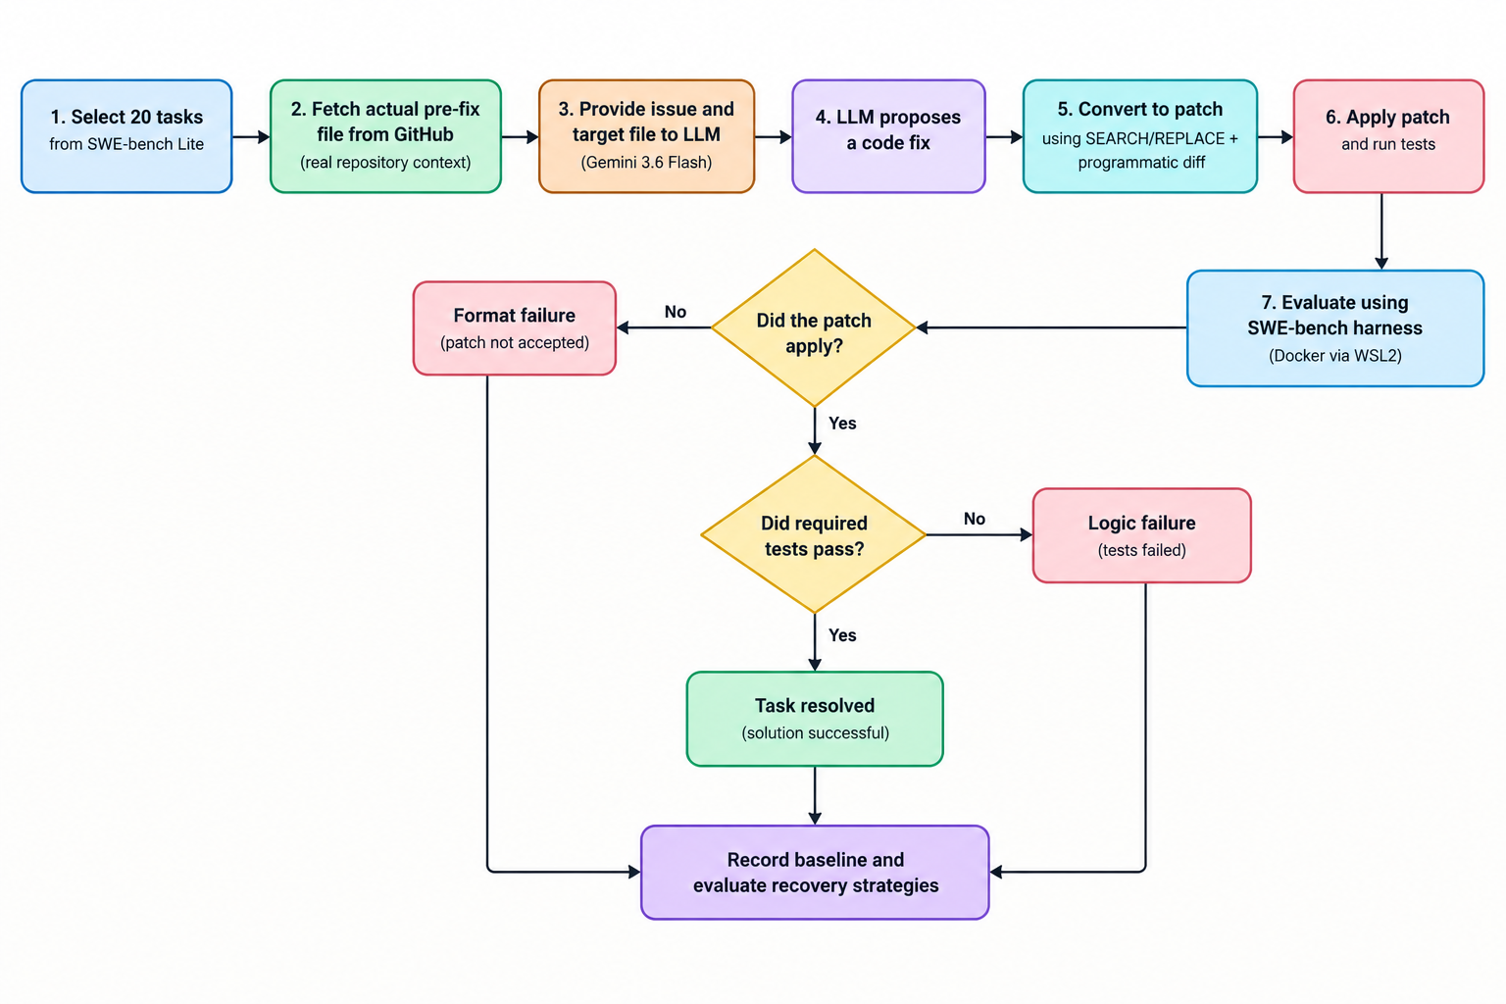
PROPOSED RESEARCH WORK
Empirical Pipeline
Step 1: Use SWE-bench Lite — real, resolved GitHub issues from open-source Python projects.
Step 2: Fetch the actual pre-fix file content directly from GitHub (real repository context, not memory-based guessing).
Step 3: LLM agent (Gemini 3.6 Flash) proposes a fix based on the real code.
Step 4: Convert the fix into a reliable patch using an engineered SEARCH/REPLACE + programmatic-diff mechanism.
Step 5: Evaluate using the official SWE-bench harness inside Docker containers, executed via WSL2.

Slide 10
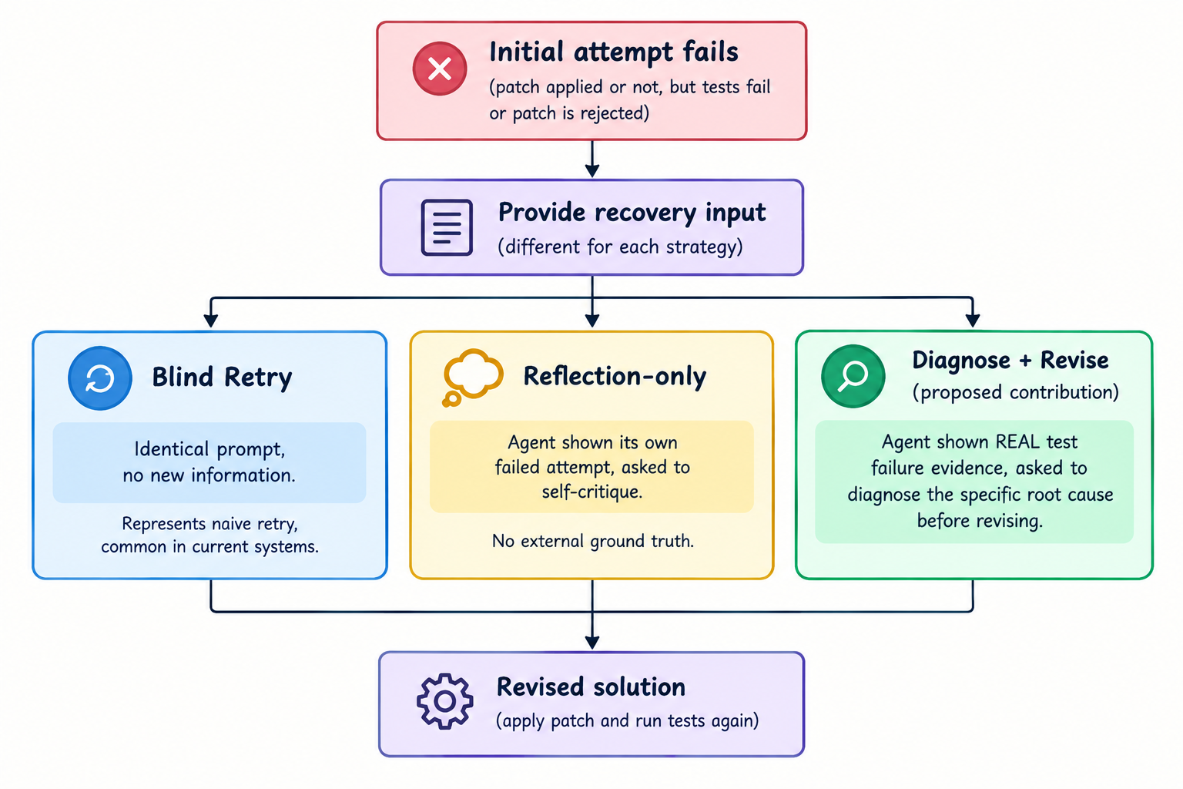
PROPOSED RESEARCH WORK
Three Recovery Strategies Compared
Blind Retry: identical prompt, no new information — represents naive retry, common in current systems.
Reflection-only: agent shown its own failed attempt, asked to self-critique — no external ground truth.
Diagnose + Revise (proposed contribution): agent shown REAL test failure evidence, asked to diagnose the specific root cause before revising.

Slide 11
PROPOSED RESEARCH WORK
Methodological Discovery: Separating Formatting from Reasoning
BEFORE — Unified Diff Format
AFTER — SEARCH/REPLACE + difflib
100%
0%
of Diagnose+Revise attempts produced malformed, unusable patches — regardless of reasoning correctness.
malformed-patch errors — the formatting failure mode was structurally eliminated, isolating reasoning quality for fair evaluation.

Slide 12
PROPOSED RESEARCH WORK
Results Obtained (20-task pilot)
Result: 0/4 genuine logic failures recovered by any strategy — confirmed across two independent rounds.

Slide 13
CONCLUSION AND FUTURE WORK
CONCLUSION
Across two independent rounds of testing, Blind Retry, Reflection-only, and Diagnose+Revise produced identical results on genuine logic failures (0/4 recovered by any strategy) — a robust, honestly reported null finding.
Patch-formatting reliability and code-reasoning correctness were demonstrated to be separable failure modes: the SEARCH/REPLACE mechanism eliminated formatting failures entirely, isolating reasoning quality for fair comparison.
The bottleneck for genuinely hard bugs appears to be single-shot reasoning depth, not diagnostic information quality — Diagnose+Revise received the richest information and still showed no advantage.
A platform-level validity threat was discovered and documented: native Windows execution of the evaluation harness silently corrupted results via CRLF line-ending encoding.

Slide 14
CONCLUSION AND FUTURE WORK
FUTURE WORK
Scale the empirical study to the full SWE-bench dataset (300+ tasks) to test generalizability of the null finding.
Test recovery across more than two iterative rounds, since Diagnose+Revise may benefit from repeated evidence-grounded revision.
Remove the oracle file-localization simplification by incorporating a real repository-search component.
Compare results across multiple LLMs and context-window sizes.
Develop standardized, recovery-oriented evaluation metrics (diagnosis accuracy, recovery latency, repeated-failure reduction) beyond final task success.

Slide 15
REFERENCES
[1] Jimenez, C. E. et al. “SWE-Bench: Can Language Models Resolve Real-World GitHub Issues?” ICLR, 2024.
[2] Yang, J. et al. “SWE-agent: Agent-Computer Interfaces Enable Automated Software Engineering.” NeurIPS, 2024.
[3] Shinn, N. et al. “Reflexion: Language Agents with Verbal Reinforcement Learning.” NeurIPS, 2023.
[4] Madaan, A. et al. “Self-Refine: Iterative Refinement with Self-Feedback.” NeurIPS, 2023.
[5] Zhu, K. et al. “Where LLM Agents Fail and How They Can Learn from Failures.” arXiv:2509.25370, 2025.
[6] Bouzenia, I. et al. “RepairAgent: An Autonomous, LLM-Based Agent for Program Repair.” ICSE, 2025.
[7] Wang, X. et al. “OpenHands: An Open Platform for AI Software Developers as Generalist Agents.” ICLR, 2025.
[8] Full 35-reference list available in the submitted systematic review, Manuscript No. INFSOF-D-26-01742.

Slide 16
RESEARCH PAPER STATUS REPORT
[1] “Self-Reflection and Failure Recovery in Agentic AI Coding Systems: A Systematic Review” — Manuscript No. INFSOF-D-26-01742. Status: Submitted.
[2] Empirical study — “An Evaluation of Blind Retry, Reflection, and Diagnosis-Based Recovery Strategies for LLM Coding Agents”, based on original research carried out during Dissertation Phase-I. Status: Under preparation; to be submitted during Semester 4 as per program requirements.

Slide 17
Thank You

