Slide 1

TEAM3
DES project

Slide 2
Index
1. PiRacer assembly
2. Connect CAN communication
3. Connect other sensors
4. Construct D-bus
5. Future plans

Slide 3
PiRacer assembly
Assemble a PiRacer
Install Raspbian

Slide 4
Connecting CAN
Install CAN library, CAN utils
Set CAN bitrates
Set up a frequency depending on the CAN shield
Connect the pins correctly

Slide 5
Connecting Sensor
RPM Sensor
Distance Sensor(ultra sonic sensor)
LCD Pannel (To monitor CAN)

Slide 6
Connecting Sensor
Uno
LCD Pannel
RPM
Nano
DIstance
Raspberry Pi
Piracer

Slide 7
Construct D-bus
Sensor
Cluster(QT)
DBUS
Arduino Nano
CAN
Raspberry pi

Slide 8
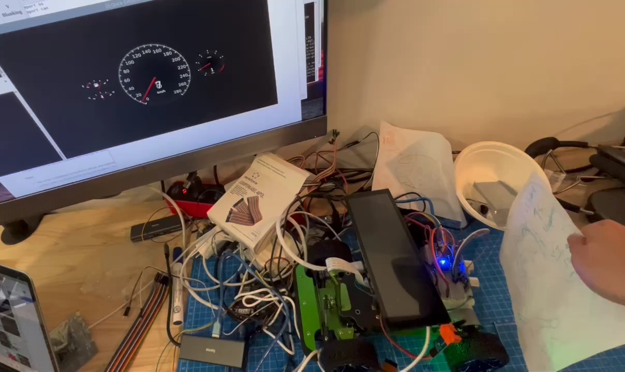
Construct D-bus

Slide 9
Future plans
Cross compile
External Display ( 7.9” LCD touch screen)

