Slide 1
Get Started With Quarto
In R programming language

Slide 2
About me
Hello! I'm Ayomide, a business intelligence analyst based in Lagos, Nigeria. Specializing in data analysis and visualization, I use of tools like R and Python to gather insights and drive business growth. My expertise lies in crafting interactive and dynamic reports and web applications using frameworks like Quarto, Shiny, and Plotly Dash.
You can follow me on GitHub: https://github.com/akins11

Slide 3
What is Quarto:
Quarto is an open-source scientific and technical publishing system that enables the creation of dynamic, interactive, and visually appealing documents, reports, dashboards, presentations, books, and more. Its supports various output formats, including HTML, PDF, Word, PowerPoint, and others, making it an ideal choice for many applications.
Quarto's core strength lies in its easy integration of code that produces analysis, and visualization within a document. This allows for reproducible research and data-driven storytelling using various programming languages, including R, Python, Julia, and SQL.
Building upon the foundations of Rmarkdown, Quarto extends its capabilities by offering more enhanced features for document layout, interactivity, and customization. Also, Quarto documents can be easily shared and deployed across different platforms, making it an excellent choice for collaborative projects and knowledge sharing. With Quarto, users can efficiently create, share, and present their work in a compelling and professional manner.
https://quarto.org

Slide 4
Topics of discussion
YAML global options.
Code cell.
Code execution options.
Code fold option.
Callout block.
Code annotation.
Tabset panel.
Tables.
Charts.
Article Layout.
https://github.com/akins11/get-started-with-quarto

Slide 5
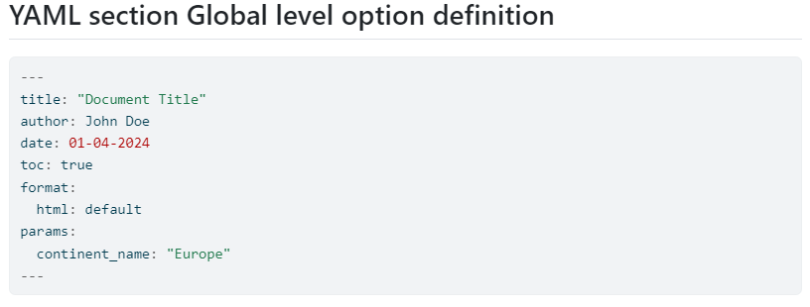
1. YAML global options.
When working with Quarto, the YAML section at the top of your .qmd file or in a separate _quarto.yml file is crucial. This section sets essential options that govern the entire document's behavior, rendering, and output. It's vital to carefully consider the options you specify here, as they will have a direct impact on your document's appearance, functionality, and overall quality.

Slide 6
2. Code cell
In Quarto, most of your work will involve writing and executing code in code cells. These cells are versatile and can run various programming languages, including R, as well as markup languages like HTML, CSS, and JavaScript. Code cells are where you'll write and execute code to perform data analysis, create visualizations, and generate output for your documents.
2.1 Code Blocks:
To create a code block in Quarto, follow these steps:
Start a code block by typing three backticks ```` on a new line, followed by the language identifier (e.g., {r} for R.)
Write your code in the block.
End the code block by typing three backticks ```` on a new line.
This syntax tells Quarto to execute the code within the block using the specified language.
2.2 Inline code:
In Quarto, there are times when you need to insert dynamic values or results directly into your text summary. In such cases, a code block isn't suitable, and that's where inline code comes in. Inline code allows you to execute code and insert the output directly into your text, making it ideal for dynamic values. The syntax for inline code is similar to code blocks, but instead of using three backticks ```` , you use a single backtick ` For example: The current date is `r Sys.Date()`. You can learn more about inline code and its capabilities in the Quarto documentation: https://quarto.org/docs/computations/inline-code.html

Slide 7
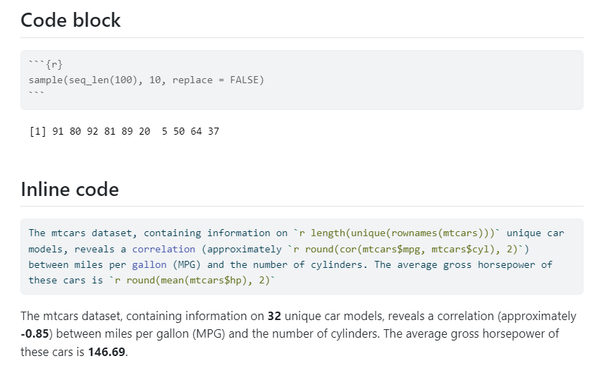

Slide 8
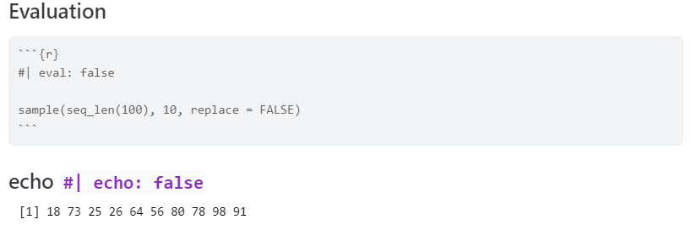
3. Code execution options
Quarto provides various code execution options to control how your code is evaluated and displayed. These options allow you to customize the output and behavior of your code chunks.
3.1 Evaluation: If set to false, the code chunk will not be evaluated (run).
3.2 Echo: If set to false, the source code will not be included in the output.

Slide 9
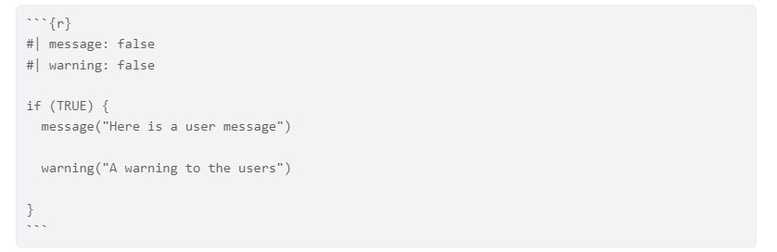
3.3 Message and Warning:
If set to true (e.g., #| message: true, #| warning: true), messages and warnings generated by the code will be displayed along with the output.
If set to false, messages and warnings will be hidden.
3.4 Error handling:
If set to true (e.g., #| error: true), errors will be displayed as part of the output, and the rendering process will continue.
If set to false, errors will halt the rendering process entirely.
For more information, please refer to the Quarto documentation: https://quarto.org/docs/computations/execution-options.html

Slide 10
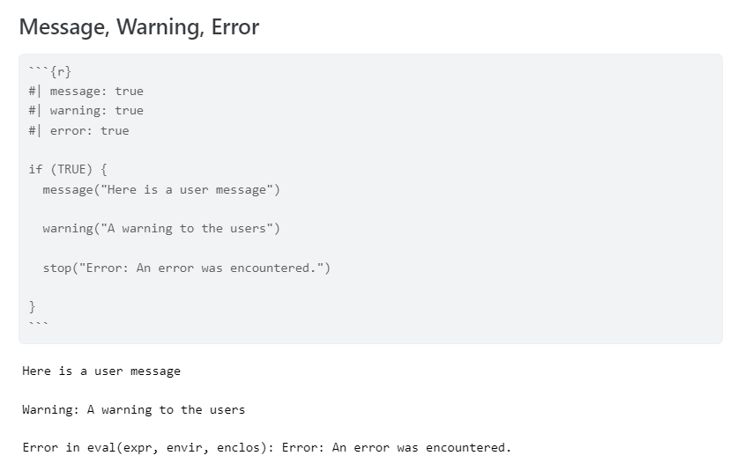

Slide 11

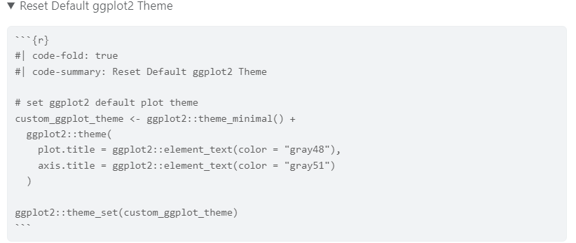
4. Code folding option
When you want to keep your code in the document but temporarily hide it from view, Quarto's code folding feature comes in handy. By setting the code-fold option to true, you can collapse the code block, making it easier to focus on the output or other parts of the document.
Additionally, you can customize the label displayed on the folded code block using the code-summary option. This allows you to provide a brief description of the code inside. Learn more about code folding and its options in the Quarto documentation: https://quarto.org/docs/output-formats/html-code.html#folding-code

Slide 12
5. Callout blocks:
Callout blocks are a powerful tool for drawing attention to important information, highlighting key points, and making your content more engaging. With callout blocks, you can:
Emphasize crucial information to ensure your viewers' attention.
Collapse or expand the output to control the level of detail.
Customize the appearance to fit your style.
Include icons to add visual interest.
Learn more about the possibilities and how to use them in your documents: https://quarto.org/docs/authoring/callouts.html

Slide 13
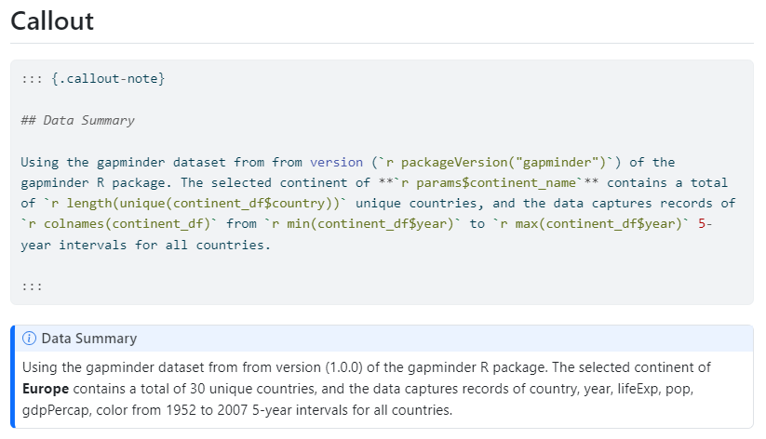

Slide 14
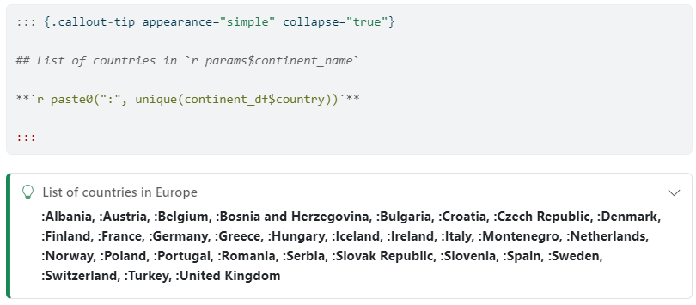
Callout with collapse output:

Slide 15
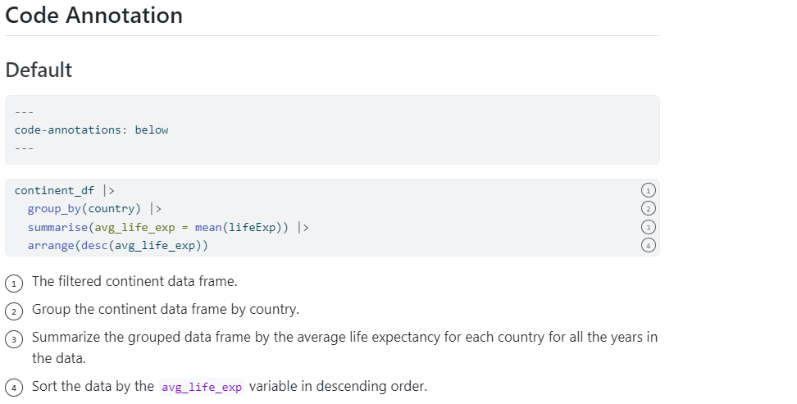
6. Code annotation
Code annotation in Quarto allows you to add line-by-line explanations to your code cells, making it easier for readers to understand the purpose and functionality of each line of code. Learn more about how to use code annotation effectively in your Quarto documents: https://quarto.org/docs/authoring/code-annotation.html

Slide 16
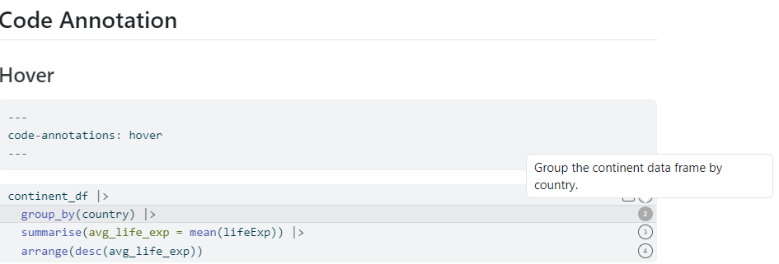
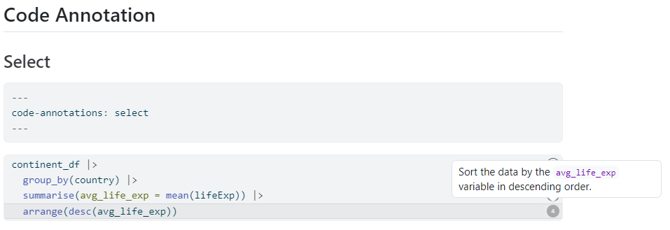

Slide 17
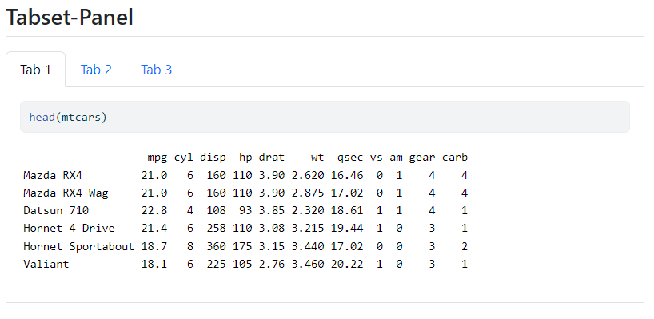
7. Tabset panel
The Tabset Panel is a powerful feature in Quarto that allows you to display multiple outputs side by side, making it easy to compare and contrast different results or views. To create a Tabset Panel, simply:
Assign the .panel-tabset class to a Quarto div container ( ::: ) e.g. ::: {.panel-tabset }
Add headings (e.g., ##) for each tab in the tabset
This will create a tabbed interface where readers can easily switch between different outputs, enhancing the overall readability and user experience of your document.

Slide 18
8. Tables
Tables are a crucial element for displaying data or summaries in a clear and organized manner, and Quarto supports them perfectly. You can include tables in your Quarto project in various ways, including:
Direct Markdown usage.
Using the knitr kable() function.
Utilizing third-party libraries like gt, reactable, DT, and more.
Quarto provides flexible options for creating and customizing tables to suit your needs. Learn more about the different methods and how to use them effectively in your documents: https://quarto.org/docs/authoring/tables.html

Slide 19
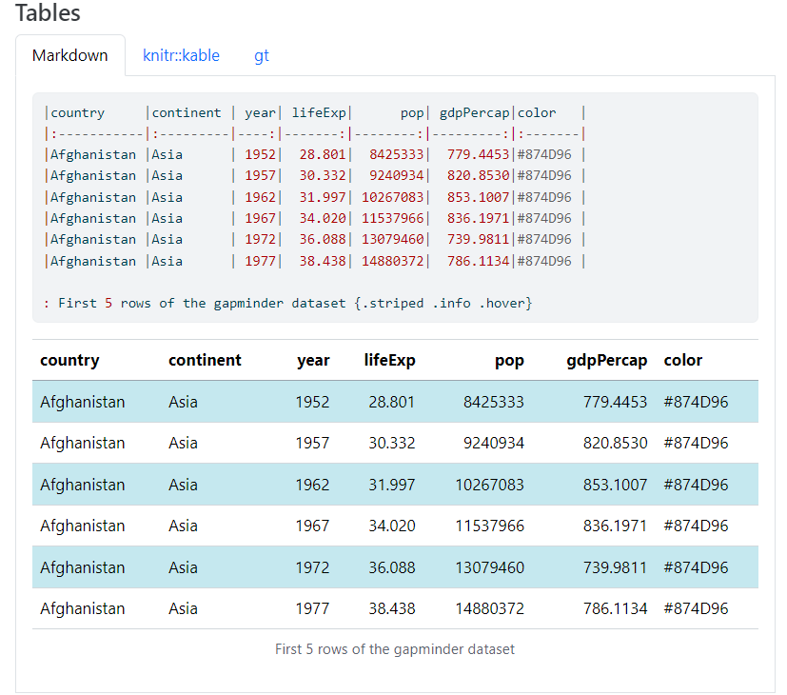

Slide 20
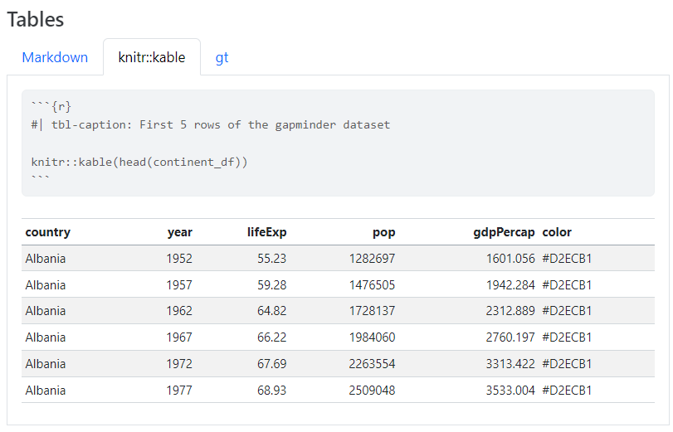

Slide 21
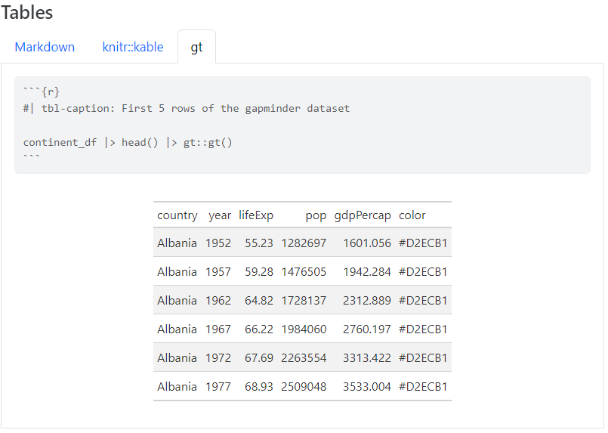

Slide 22
9. Charts
You can add really nice informative and engaging charts to your quarto project. Quarto supports various plotting libraries in R, offering a wide range of options to visualize your data. Some popular choices include:
ggplot2
plotly
echarts4r
And many more.
Most of the plotting libraries in R work seamlessly with Quarto, allowing you to create high-quality, interactive charts that enhance your document's narrative. Learn more about how to incorporate figures and charts into your Quarto project: https://quarto.org/docs/authoring/figures.html

Slide 23
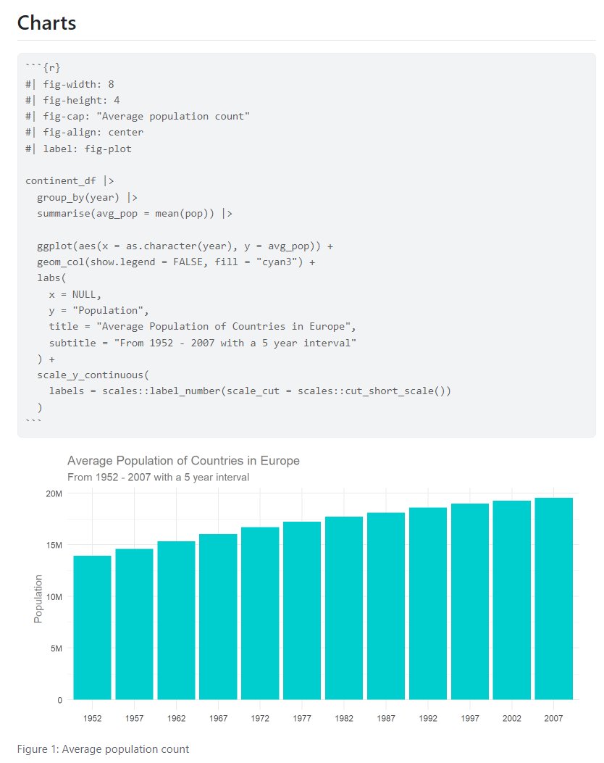

Slide 24
10. Customizing article layout
Quarto's default page layout is versatile, but sometimes you need more control over the layout to achieve your desired output. Quarto offers numerous layout options to help you tailor your article's appearance. With these options, you can:
Adjust body and screen widths,
Change column layouts
Work with margins
Visit the Quarto documentation to explore the various layout options and examples, and take your article's design to the next level: https://quarto.org/docs/authoring/article-layout.html for more information and examples.

Slide 25
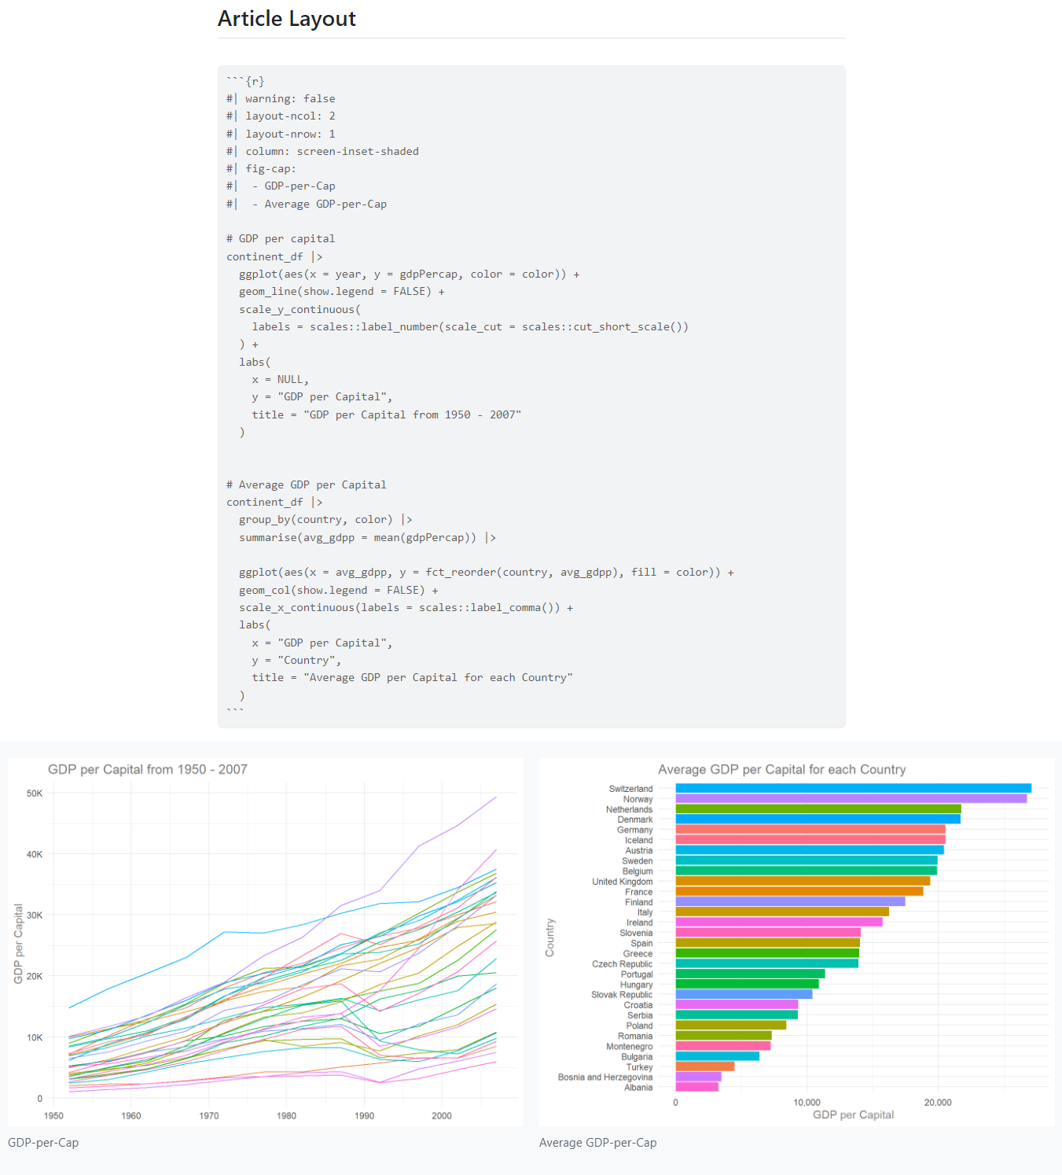

Slide 26
In conclusion, Quarto opens up new possibilities for effective communication, collaboration, and knowledge sharing. With Quarto, you can:
Unlock powerful interactive storytelling.
Amplify your research impact by making it accessible to all.
Create better workflow for maximum efficiency
Enhance analytics productivity and presentation.
Automate reporting processes.

