Slide 1





Hacking via Direct Memory Allocation A Feasibility Report
Research by: Yannis Lagrosa
Advisor: Dr. Tracy Bilsing
Tracking Bad Actors: Human & Machine
Notes:
Good morning, Undergraduate Research Symposium!
My name is Yannis Lagrosa, I am a Senior in the Department of Computing Science. My interests are Cybersecurity, Programming, and Reverse Engineering.
I love to hack and play video-games, and I’m mildly interested in developing and analyzing malware.
My project is titled Hacking via Direct Memory Allocation – A Feasibility Report.
It classifies as unfinished research. And all work was done entirely by me.
This presentation mainly speaks about security from the perspective of the Windows Operating System.
I hope you enjoy.

Slide 2


Outline
Introduction
Motivation
Related Work
Methodology
Result and Discussion
Conclusion
References

Slide 3

Introduction
Definition from Oxford Languages
hacking
noun
/ˈhakiNG/
the gaining of unauthorized access to data in a system or computer.
"outlawing hacking has not stopped it"
Malware
Phishing
Social Engineering..?
Notes:
What is hacking? Oxford defines “hacking” as the gaining of unauthorized access to data in a system or computer. This definition is suitable for our use-case.
When you think of hacking, you might associate it with computer viruses.
Malware such as Trojans, Worms, Keyloggers, etc.
But ‘hacking’ can also be done without the usage of software. Things like social engineering, which rely on manipulating other humans to hack into systems are executed via word of mouth. With the main goal being hacking human behavior as opposed to running code on a machine.
And actually, Phishing, which is a more common phrase. Is a type of social engineering, though it relies more on software.

Slide 4
Hacking is bad.
Getting hacked is bad.
So how do we prevent it?
Identify Vulnerabilities
Technical Literacy
Anti-Virus Software
Anti-Viruses aren’t all-powerful..
How do they work?
Notes:
So, obviously no one wants to get hacked.. But with any system containing information, there will always be an entity seeking to extract said information.
Basically.. Getting hacked is bad.. So how do we prevent it?
Well.. A computer specialist at a company might identify vulnerabilities in their machines. In what ways can information be extracted from their system..? Does the interface reveal too much information?
But that’s not too important for us.
People should have a general Technical Literacy and understanding of what hacking is. As a user of a computer, it is your responsibility to sniff out sketchy emails.. And avoid them!
As a general rule of thumb.. most computers should have an Anti-Virus software, which will scan the device for viruses and block potential downloads.
For the purposes of a layman, technical literacy and anti-viruses are the most accessible and mandatory prevention methods. The convenience of an Anti-Virus makes it the easiest. People simply install them and they’ll occasionally stop you from downloading a malicious program. But Anti-Viruses aren’t all-powerful.

Slide 5
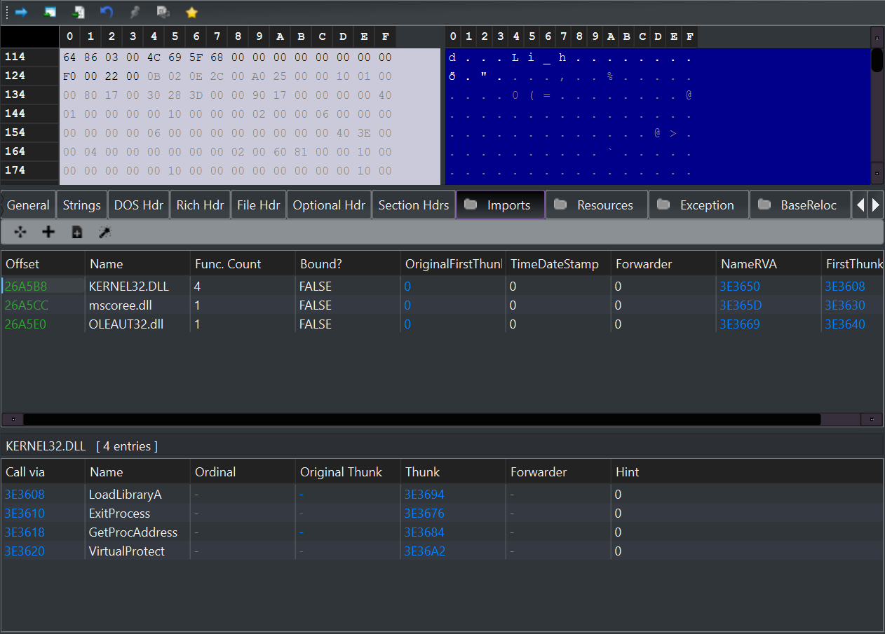
Anti-Virus Software
Detection
Anti-Viruses can work either statically (passive) or dynamically (active).
A static approach to detecting viruses may be to analyze the binary of a file.
Viruses will typically have tell tale signs.
Functions from Kernel32.DLL such as LoadLibraryA.
MALICIOUS?
Notes:
Antiviruses serve to complete the goals of: Detection, Prevention, and Removal of viruses. We will only be speaking about the detection and prevention aspects.
So.. Anti-Viruses want to detect malicious software on your computer.
Very broadly speaking, they can either work statically or dynamically.
A static approach to detecting viruses may be to analyze the binary of a file.
-> (A binary is simply the original file with the executable assembly instructions)
Viruses will typically have tell tale signs; these might be calls to WinAPI functions such as LoadLibraryA, which is a function to inject a DLL into a process. This might signify that this program is attempting to modify the memory of another process and call its own functions using said process as an alias of sorts.

Slide 6
What is the Kernel..?
The administrator of the computer.
It has control over the everything in the device.
Provides an interface for software to interact
with the machine via functions in various DLL files.
This means that ALL information goes through
the kernel without exception.
Applications
Kernel
CPU
Memory
Devices
Diagram inspired from Wikipedia.
Notes:
So.. What am I even talking about? What is a kernel?
It’s basically the administrator of the computer. The kernel holds all of the control in the machine and is the middle-man that allows applications to interface with the machine.
Most importantly, it provides an interface for software to interact with the machine via functions in various DLL files, essentially imparting its powers unto the lower-level, user-space applications.
This means that, without exception, all information goes through the kernel.

Slide 7
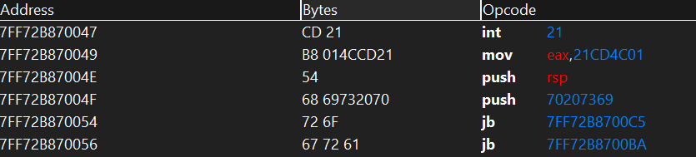
Anti-Virus Software
Detection (Dynamic)
A dynamic approach may involve the Anti-Virus scanning active memory on the system, RAM.
CD 21 B8 ?? ?? ?? ?? 54.
Array of Bytes (AOB) or “Pattern”
(Addresses are replaced with ‘wild-cards’)
AOB are compared to a database, and suspicious behavior of files is blocked from executing on the machine.
Notes:
I hope you remembered we were still talking about Anti-Viruses. Our next topic is Dynamic Detection of Viruses.
A dynamic approach may involve the Anti-Virus scanning active memory on the system, colloquially, RAM. Suspicious patterns of bytes can be clumped together into an Array of Bytes (AOB).
Addresses are replaced with wild-cards, which are the question marks you see in the AOB that we collected.
These bytes are then analyzed against known signatures.

Slide 8

Anti-Virus Software
Prevention
Upon downloading a file, a hash can be calculated for it through an algorithm that iterates over all the bytes.
01001000 01100001 01110000 01110000 01111001 00100000 01000010 01101001 01110010 01110100 01101000 01100100 01100001 01111001 00100000 01001011 01100001 01110011 01100001 01101110 01100101 00100000 01010100 01100101 01110100 01101111 00100001 00100001
#Mod#
13c1a8857790c95eac58309120f01319
Ingest File
Hashing Algorithm
Hash Value
Notes:
Next is how anti-viruses Prevent the downloading of malicious files.
Upon downloading a file, a hash value can be calculated for it through an algorithm that iterates over all the bytes. No matter how large the file is, it will always consolidate itself to a, in the case of MD5, 32 hexadecimal-character hash.
Hash values are stored by the anti-virus and compared to a database of known malicious files.

Slide 9



Enter: DMA Devices
A DMA or Direct Memory Access Device is a piece of hardware that bypasses the kernel and directly interfaces with DRAM.
Completely ignores current standards for AV Software
Capable of Reading/Writing Memory through a separate DMA channel
Notes:
A DMA or Direct Memory Access Device is a piece of hardware that bypasses the kernel and directly interfaces with DRAM.
If you’ve ever played a game on the Atari, the implications of this definition is very reminiscent to something you would see as the result of the Konami Code.
( Which was a cheat code you could input into most Atari games that allowed the player to receive various cheat effects )
That is to say, DMA devices currently completely ignore the systems and standards that we have place for Anti-Virus software.
To add more fuel to the fire, they are capable of reading and writing memory as well, meaning malware can be directly installed to machines, bypassing the prevention phase of the Anti-Virus software.

Slide 10
Outline
Introduction
Motivation
Related Work
Methodology
Result and Discussion
Conclusion
References

Slide 11
Motivation
Goal: Use DMA to mimic a computer virus, gaining information on the machine without leaving any traces of the device.
Is DMA a Threat Today?
Notes:
The goal of this project is to leverage DMA to mimic a computer virus, gaining information on the machine without leaving any traces of the device. Specifically, we’ll be building a key-logger that directly reads from the gafAsyncKeyState array. Using this as a basis, we explore means of DMA malware and its feasibility in real-life scenarios today.

Slide 12
Outline
Introduction
Motivation
Related Work
Methodology
Result and Discussion
Conclusion
References

Slide 13
Related Work
Authors(Year) | Focus of Study | Key Findings​ | Limitations
Patrick Stewin, Iurii Bystrov (2012) | Cybersecurity | Explained and tested the feasibility of DMA-based Malware attacks. | Recent DMA landscape was not discussed. VT-D?
Anna Trikalinou, Dan Lake (2017) | Cybersecurity | Hardware design and protocol limitations. | Acknowledged DMA attacks; how does it compare to malware?
Lu, Chao, et al (2022) | Cybersecurity | Proposes design method of DMA Controller | What applications does this board have?
Notes:
Before we continue, I wanted to use a slide to acknowledge my motivation for this research.

Slide 14
Outline
Introduction
Motivation
Related Work
Methodology
Result and Discussion
Conclusion
References

Slide 15
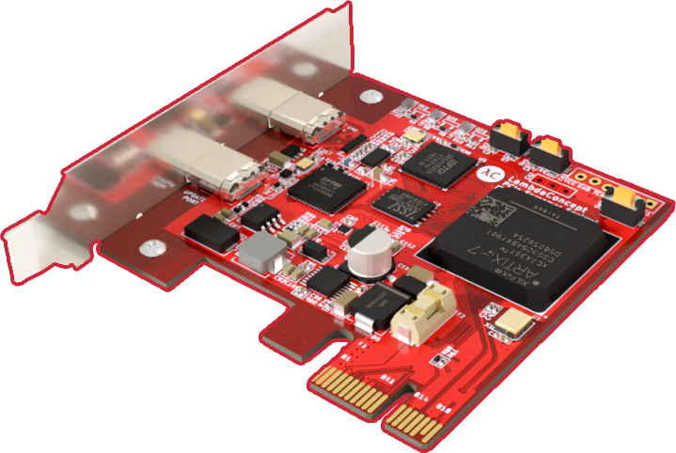
Methodology
Screamer PCIe Squirrel, a circuit board designed to issue DMA attacks using the PCI Express port.
Specifically designed for DMA Attacks
Supported by various software to interface with target device
Notes:
This project leverages the Screamer PCIe Squirrel, a circuit board designed to issue DMA attacks using the PCI Express port.
Other boards are compatible for DMA attacks, so threat actors may have ways to potentially obscure their attacks by disguising their board as USB drives, keyboards, etcetera.
I chose this device specifically because of its inherent support for DMA Attacks, and the support it has received from various open-source projects.
Basically, its ease-of-use.

Slide 16
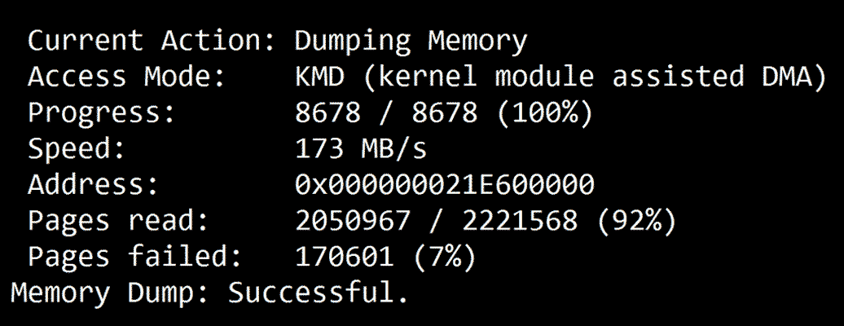
PCILeech
Our attack uses PCILeech, a software by Ulf Frisk on Github.
Notes:
Our attack uses PCILeech, a software by Ulf Frisk on Github, to carry out the attack.
The board is flashed from the Host PC with the PCILeech FPGA gateware, which begins execution when the target PC is booted.

Slide 17
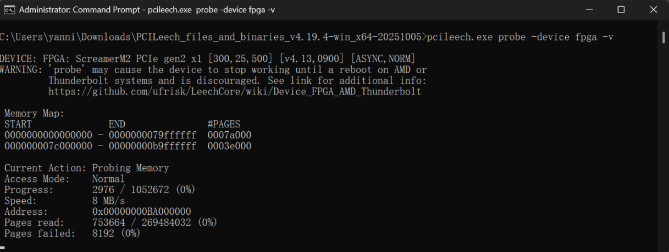
Probing Memory
This program allows us to probe memory on the target device.
Notes:
This program allows us to probe memory on the target device. Basically, we can scan the entire DRAM of the system.

Slide 18
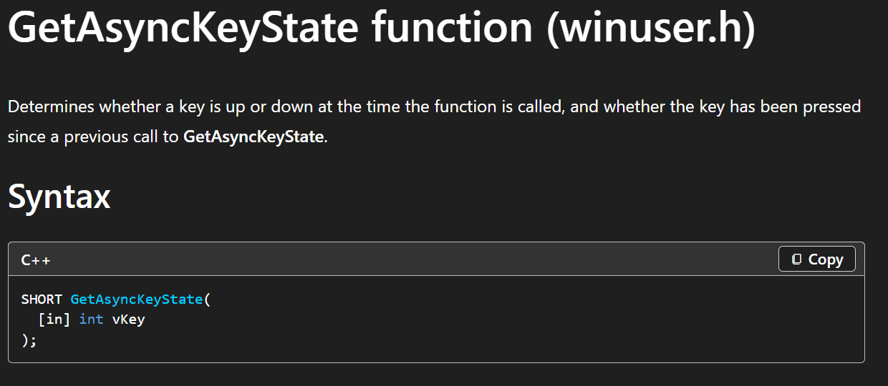
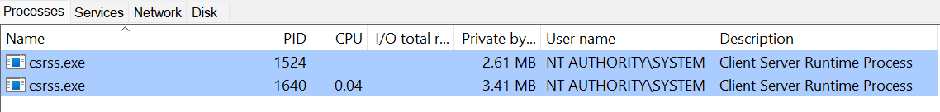
Building a Key-Logger
Now that we can properly read the memory on the target device, we can begin to construct a key-logger.
Function is called by Client/Server Runtime Subsystem (CSRSS)
Notes:
Now that we can properly read the memory on the target device, we can begin to construct a key-logger.
Here’s how we’ll go about that:
First, we want to identify a function that stores key-presses in a buffer, which we can directly read. GetAsyncKeyState is a WinAPI function that does exactly this.
The GetAsyncKeyState is called by the Client/Server RunTime Subsystem (CSRSS).

Slide 19




Building a Key-Logger
This means that we can get the process ID of that program and use our own AOB/Pattern scan to dereference the value at that location!
Process ID
Find in Process Buffer Map
Get Base Address of Process 1524
Base Addr.
Scan from Base to Base + Size for
48 8D 90 ? ? ? ? E8 ? ? ? ? 0F 57 C0
Access Value at memory address
?? 48 8D 90
?? ?? ?? ??
E8 ?? ?? ??
Base Addr + Size
?? 0F 57 C0
Memory of Process
Notes:
This means that we can get the process ID of that program, which we then look up in the map of our process buffer. From there we can get the base address of that process and the size of the process.
The memory of this process can then be scanned using the AOB or Pattern of the GetAsyncKeyState, which yields another address. We can simply access or dereference this address this address in the context of the process to acquire the key being pressed
48 8D 90 ? ? ? ? E8 ? ? ? ? 0F 57 C0

Slide 20
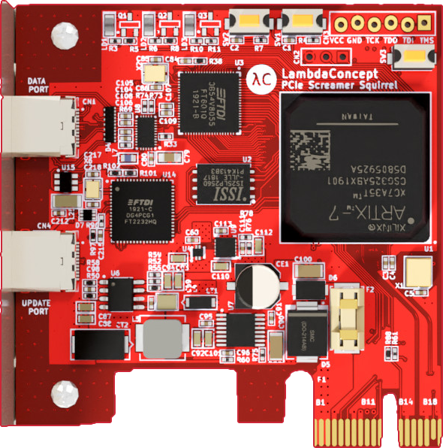
Phase 1 Diagram
LED1/2
LED3
Target Device
Reset
USB-C
To control
computer
PCIe Slot
Host
Device
DMA
USB-C
JTAG for
Programming
Running: Keylogger
PCIe
To target Computer
Notes:
Building a successful keylogger marks the completion of the first phase. Here is how our current set-up looks.
The DMA Device is connected via PCIe slot to the target computer. There is a USB-C that is run from the DMA device to the host device. The purpose of this USB-C is two-fold. The host tells the DMA device where to access GetAsyncKeyState. The accessed memory is read on the DMA card and then sent back to the Host Device.
There is an issue with this set-up though. Namely, the DMA device must have physical connection to the Host Device, which the attacker is operating.

Slide 21
Phase 2 Diagram
Target Device
PCIe Slot
Host
Device
DMA
USB-C
Running: Keylogger
Notes:
By modifying this set-up a bit, we can resolve this. We start by moving the keylogger script to the DMA device, flashing it onto the board.

Slide 22
Phase 2 Diagram
Target Device
PCIe Slot
Host
Device
DMA
USB-C
Running: Keylogger
Notes:
Next, we host a webserver from the host-device, allowing data to be received. The keylogger script now uses the curl command to send POST requests to the web server so that it may be accessed remotely.

Slide 23
Phase 2 Diagram
Target Device
PCIe Slot
DMA
Host
Device
Running: Keylogger
curl IP:999
Running: Webserver
Port 999

Slide 24
Outline
Introduction
Motivation
Related Work
Methodology
Result and Discussion
Conclusion
References

Slide 25
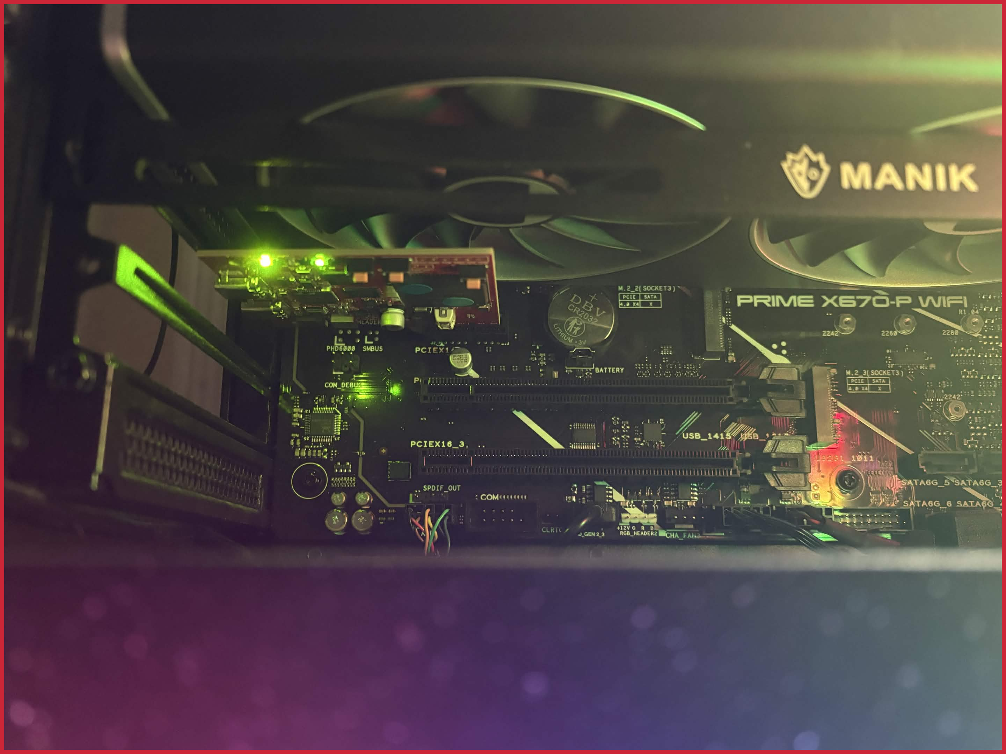
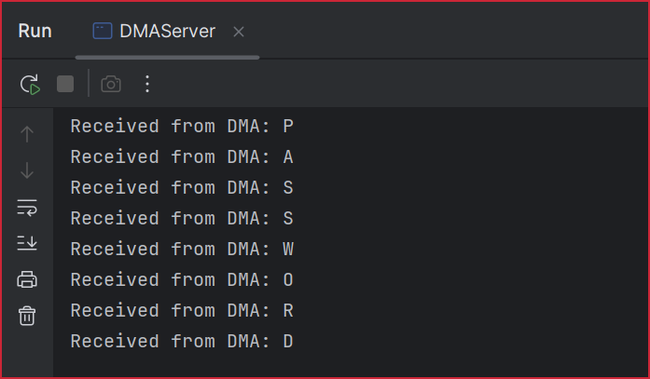
Result and Discussion
DMA Card
Notes:
As a result of this set-up, we now have a DMA device plugged into the computer that monitors all key-presses and sends data back to the host’s webserver.

Slide 26

Result and Discussion
Advantage
No programs are necessary; very hard to detect.
Disadvantage
Requires physical attachment; can simply be unplugged.. Right?
Remember, DMA Devices can be disguised!
Notes:
This is very similar to how the typical software-based keylogger works, with the advantage that no program needs to be run on the target device, meaning it is undetectable by anti-virus programs.
However, there does need to be a physical attachment to the device.. So It can just be unplugged, right?
Theoretically, yes, but boards similar to this can be exploited and disguised. What if the DMA attack is disguised as a keyboard or mouse someone hands you to plug in? What if it’s a USB stick? Were you aware that this kind of attack was possible?

Slide 27
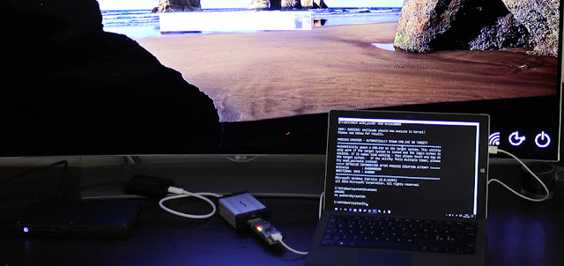
Result and Discussion
Only Thunderbolt 3 ports carry PCI Express.
Windows has implemented Kernel DMA Protection in Windows 10 1803.
Picture from Ulf Frisk
Notes:
Thankfully, only Thunderbolt 3 ports are vulnerable to DMA attacks since they can carry PCI Express.
Additionally, According to Stigviewer, Windows 10 version 1803 devices and above now come configured to have a higher security level for Thunderbolt ports, thus limiting DMA Attacks.
But, this means that computers that were released before Windows 10 Version 1803 became the standard- even if they are upgraded to said version, are inherently vulnerable to DMA attacks due to insufficient hardware requirements.
https://www.stigviewer.com/stigs/microsoft_windows_10/2025-02-25/finding/V-220902

Slide 28
Result and Discussion
Data from statcounter
Notes:
The statcounter website states that in March 2026, about 2% of all Windows devices are still running Windows 7 or below. This statistic doesn’t even factor in devices that simply upgraded to Windows 10, but were purchased before the Windows 10 Version 1803 update.
How many of these devices are owned by large companies or even the U.S. government?

Slide 29
Outline
Introduction
Motivation
Related Work
Methodology
Result and Discussion
Conclusion
References

Slide 30
Conclusion
If you weren’t already– I hope this presentation made you aware of the dangers of DMA Attacks.
Key Take-aways
Don’t leave your computer unattended.
PLEASE update your devices.
Be aware of the devices plugging into your computer.
Notes:
If you weren’t already– I hope this presentation made you aware of the dangers of DMA Attacks.
Now for our key take-aways…
I’ve seen a lot of college students leave their computers unattended in public spaces to go get a snack or to go to the bathroom. Although I demonstrated a keylogger, other forms of malware such as a File-Dropper, which essentially downloads files from the internet can be replicated using this attack, potentially allowing threat actors to gain persistence over the device. Even if the device is password protected, DMA attacks can work even from the lock-screen.
In the case of DMA Attacks, vulnerable information such as passwords stored in Google Chrome can just be read directly and sent to the attacker.
Second.. PLEASE update your devices. Many companies use legacy hardware and software because it cuts down on costs to neglect updates, especially if that means already well-established code has to be changed. They justify this philosophy by saying stuff like: “If it ain’t broke, don’t fix it”; but sometimes it takes a bit of time for us to realize how broken something truly is.
And finally, circling back to technical literacy. Please be aware of what you are plugging in to your computer. Variations of DMA cards or other hard-ware based attacks may be possible in the future.

Slide 31
Outline
Introduction
Motivation
Related Work
Methodology
Result and Discussion
Conclusion
References

Slide 32
References
“Client/Server Runtime Subsystem.” Computingexplained.org, 2026, www.computingexplained.org/processes-and-jobs/csrss.
GrantMeStrength. “Windows API Index - Win32 Apps.” Learn.microsoft.com, 15 Mar. 2023, learn.microsoft.com/en-us/windows/win32/apiindex/windows-api-list.
Lu, Chao, et al. “Design and Implementation of a Direct Memory Access ControllerBased on Microcontroller Unit.” Journal of Physics Conference Series, vol. 2221, no. 1, 1 May 2022, pp. 012016–012016, https://doi.org/10.1088/1742-6596/2221/1/012016.
“Most Laptops Vulnerable to Attack via Peripheral Devices, Say Researchers.” University of Cambridge, 26 Feb. 2019, www.cam.ac.uk/research/news/most-laptops-vulnerable-to-attack-via-peripheral-devices-say-researchers.
Pavel Yosifovich, et al. Windows Internals, Part 1. Microsoft Press, 5 May 2017.
Trikalinou, Anna, and Dan Lake. Taking DMA Attacks to the next Level: How to Do Arbitrary Reads/Writes in a Live and Unmodified System Using a Rogue Memory Controller. 22 July 2017.
ufrisk. “GitHub - Ufrisk/Pcileech: Direct Memory Access (DMA) Attack Software.” GitHub, 16 Jan. 2025, github.com/ufrisk/pcileech.

Slide 33



