Slide 1



CPU
Scheduling
ALAGU PRAKALYA P - 19PD05
DHIKSHITHA A - 19PD09
HARIPRIYA R - 19PT09
HARIHARAN S- 19PD27

Slide 2
TABLE OF CONTENT:
PROBLEM STATEMENT
MODEL PIPELINE
DATA PREPROCESSING
MODEL BUILDING
MODEL EVALUATION
QUEUE SCHEDULING
API DEVELOPMENT

Slide 3

In the context of CPU job scheduling, we are faced with the task of efficiently allocating a set of 'n' CPU jobs to a limited number of 'm' available CPUs. The objective is to optimize the allocation of jobs to CPUs in a manner that maximizes the overall system throughput while considering the priority of each job within the system.
PROBLEM STATEMENT:

Slide 4
1. Job Allocation: The allocation must be done in a way that optimizes the utilization of CPU
resources.
2. Classification Algorithm: To determine the optimal allocation of jobs to CPUs, a
classification algorithm needs to be developed.
3. Job Priority: Each CPU job has an associated priority. The priority property of jobs is
crucial in determining the order in which jobs are executed on the CPUs.
4. Queue Management: After allocating jobs to CPUs, there is a need to manage the job
queues on each CPU.
TASKS:

Slide 5

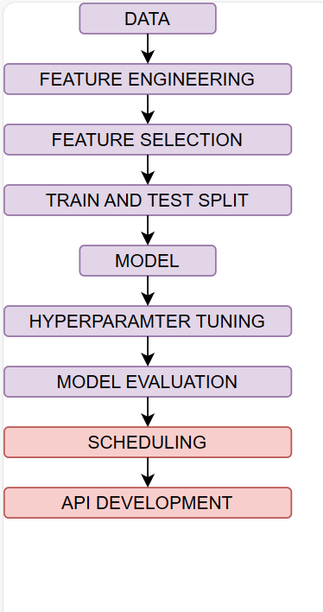

MODEL PIPELINE:

Slide 6
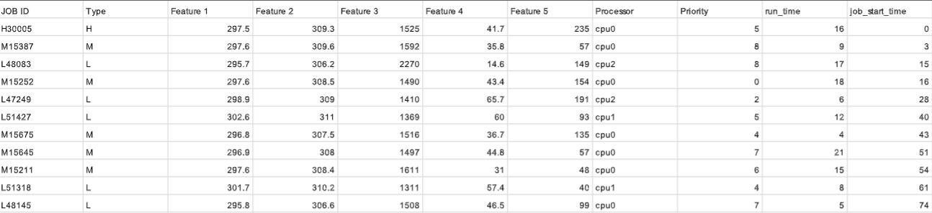
DATA:
https://drive.google.com/file/d/1Uxk85q74rDygUcQUajafLhC8K-TFZmiT/view?usp=sharing
DATA

Slide 7
DATA PREPROCESSING:
Feature Engineering :
Normalization of all the 5 feature values into certain range.
Label encoding is done for the categorical data to convert them to a numerical value based on its categories.
SMOTE analysis which is an oversampling technique is used to synthesis the values corresponding to classes which had lower occurrences.
Feature Selection :
Outlier analysis is performed on the each feature in order to decrease the modelling error.
Multicollinearity is being checked for all the feature since they don’t add any extra information and rather decrease the model performance.

Slide 8
MODEL BUILDING:
Train-Test Split :
The train-test split procedure is used to estimate the performance of machine learning algorithms when they are used to make predictions on data not used to train the model.
The train-test split procedure is appropriate when you have a very large dataset, a costly model to train, or require a good estimate of model performance quickly.
The train-test split we used is 80:20.
Models used :
Gradient Boosting
Random Forest
KNN
Logistic Regression

Slide 9
MODEL EVALUATION:
Model evaluation is the process of using different evaluation metrics to understand a machine learning model's performance, as well as its strengths and weaknesses.
Precision :
Precision helps us to visualize the reliability of the machine learning model in classifying the model as positive
( TP/TP+FP )
Recall :
The recall measures the model's ability to detect positive samples.
( TP/TP+FN )
Accuracy :
Accuracy is a proportional measure of the number of correct predictions over all predictions.
(TP + TN/TP+FP+TN+FN)

Slide 10
HYPERPARAMETER TUNING:
GridSearchCV :
In GridSearchCV approach, the machine learning model is evaluated for a range of hyperparameter values. This approach is called GridSearchCV, because it searches for the best set of hyperparameters from a grid of hyperparameters values.
For example, if we want to set two hyperparameters C and Alpha of the Logistic Regression Classifier model, with different sets of values. The grid search technique will construct many versions of the model with all possible combinations of hyperparameters and will return the best one.

Slide 11
SCHEDULING:
Initially there are n CPUs and m jobs and for scheduling, we used the data structure of max heap because of logarithmic time complexity for both insertion and heapify operation.
The job after getting classified to a CPU looks like (priority, arrival_time) : Job_Id.
This optimized approach ensures that jobs are processed based on their priority and arrival time, contributing to efficient resource allocation and task execution.

Slide 12
API:
FastAPI-based endpoint for scheduling jobs with job features as input.
Endpoint:
@app.post("/schedule_job")
async def schedule_job_endpoint(job_info: List[str] = Query(None)):
Accepts a list of job features in the request.
Outputs the status of jobs in N-CPU queues, showing the order of finished and processing jobs.

Slide 13
THANK YOU!!
Github Link:
https://github.com/Lagstill/ASAPP_Hackathon

