Slide 1




Data Reveals - Final Assignment
Project Group # 11
Dhanya P, Monish O , Tarun L
9th January 2021

Slide 2
Topic for hypothesis testing
Is India’s urbanisation is slower when compared to other emerging nations ?
Based on the analysis : We are able to confirm that India’s urbanisation is slower than other emerging nations.
The analysis was done comparing BRICS nations - Brazil, Russia, India, China and South Africa.

Slide 3

What are we testing?
Urbanisation
Rate
Degree
of Urbanisation
Categories
1. Average Annual Rate of Change of the Percentage Urban
2. Urban population (% of total population) - Brazil, China, India, Russian Federation, South Africa
Urban population Density People (per sq km of land area ) - Brazil, China, India, Russian Federation, South Africa
Population in largest city (% of urban Population) - Brazil, China, India, Russian Federation, South Africa
Urbanisation (Population Density) vs Prosperity (Per capita Income)
Hypothesis
Urbanisation in India
Dhanya P, Monish O and Tarun L
January 9, 2021

Slide 4
What are we testing?
Urbanisation
Agglomeration
Change in
Percentage
Share of
Urban
Population
Categories
1. Population in urban agglomeration more than 1 million(% of total population) - Brazil, China, India, Russian Federation, South Africa
1.Change in Percentage Share of Urban Population
2. Average Annual Rate of Change of the Urban Population (%)
Hypothesis
Unknown Knowns: Empirically testing the media narrative on India
Dhanya P, Monish O and Tarun L
9 January 2021

Slide 5
What are we testing?
Basic Urban
Sanitation
Services
Access
to Basic
Necessities
(Electricity)
Categories
1.People in Urban areas using atleast basic sanitation services - Brazil, China, India, Russian Federation, South Africa
Urban Population with access to electricity (% of urban population) - Brazil, China, India, Russian Federation, South Africa
Hypothesis
Unknown Knowns: Empirically testing the media narrative on India
Dhanya P, Monish O and Tarun L
9 January 2021

Slide 6
What are we testing?
Urbanisation
Value
Urban Built
Up Area
Categories
Urbanization Value - Brazil, Russia,India,China, South Africa
Average night time light emission - Brazil, Russia,India,China, South Africa
Mean area of urban green - Brazil, Russia,India,China, South Africa
Surface of the built-up area per person - Brazil, Russia,India,China, South Africa
2.Total built-up area - Brazil, Russia,India,China, South Africa
Hypothesis
Unknown Knowns: Empirically testing the media narrative on India
Dhanya P, Monish O and Tarun L
9 January 2021

Slide 7
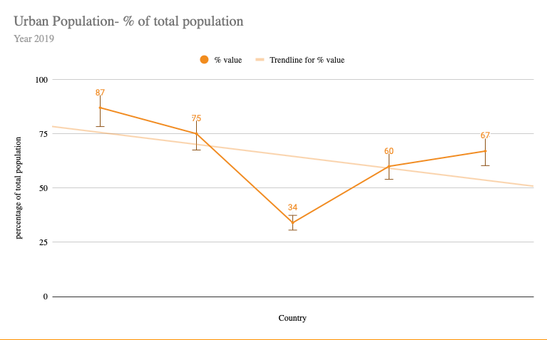
Urbanisation Rate in India - Urban Population % of total population
Observation:
1. India has scored the least in terms of total population in Urban areas at 34% of the total population when compared to the average 64.5% in other areas. In this measure India falls far behind the other emerging nations
Brazil
Russia
China
South Africa
India
Dhanya P, Monish O and Tarun L
9 January 2021
Notes:
When conducting research, it is easy to go to one source: Wikipedia. However, you need to include a variety of sources in your research. Consider the following sources:
Who can I interview to get more information on the topic?
Is the topic current and will it be relevant to my audience?
What articles, blogs, and magazines may have something related to my topic?
Is there a YouTube video on the topic? If so, what is it about?
What images can I find related to the topic?

Slide 8
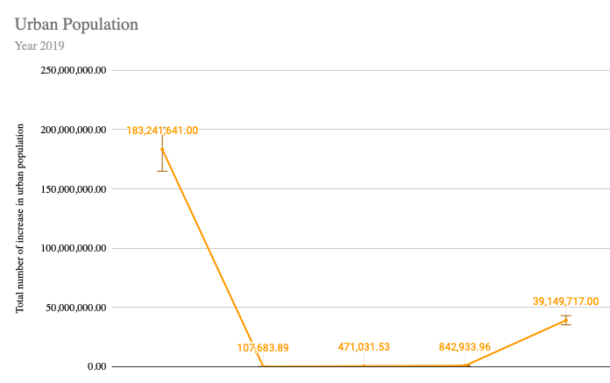
Urbanisation Rate in India - Urban Population in 2019
Observation:
1. The increase in the number of urban population in the year 2019. India is yet again in the bottom two of the BRICS nations. It can be stated that the flow although urbanisation in India is increasing but its much slower when compared to the the other BRICS nations.
Brazil
South Africa
South Africa
India
China
Russia
Dhanya P, Monish O and Tarun L
9 January 2021
Notes:
When conducting research, it is easy to go to one source: Wikipedia. However, you need to include a variety of sources in your research. Consider the following sources:
Who can I interview to get more information on the topic?
Is the topic current and will it be relevant to my audience?
What articles, blogs, and magazines may have something related to my topic?
Is there a YouTube video on the topic? If so, what is it about?
What images can I find related to the topic?

Slide 9
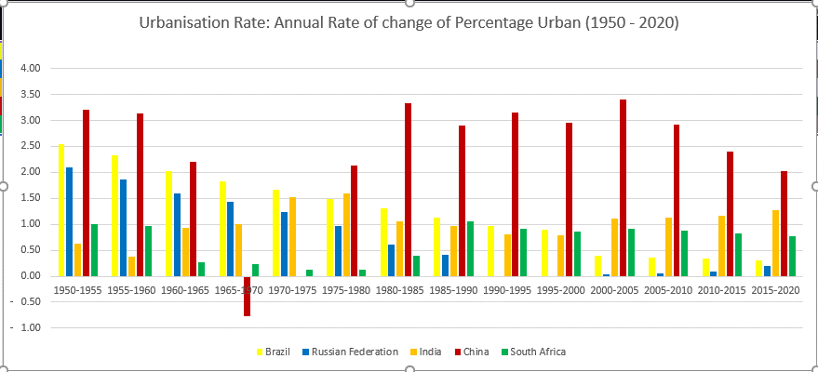








China has the highest but declining urbanization rate
Urbanization Rate
Observations
India had a declining urbanization rate from 80 - 95 along with Brazil and Russia
China has the missing decade between 1965 - 1975 bust has highest urbanization rate since 1980's
Unknown Knowns: Empirically testing the media narrative on India
Dhanya P, Monish O and Tarun L
9 January 2021

Slide 10
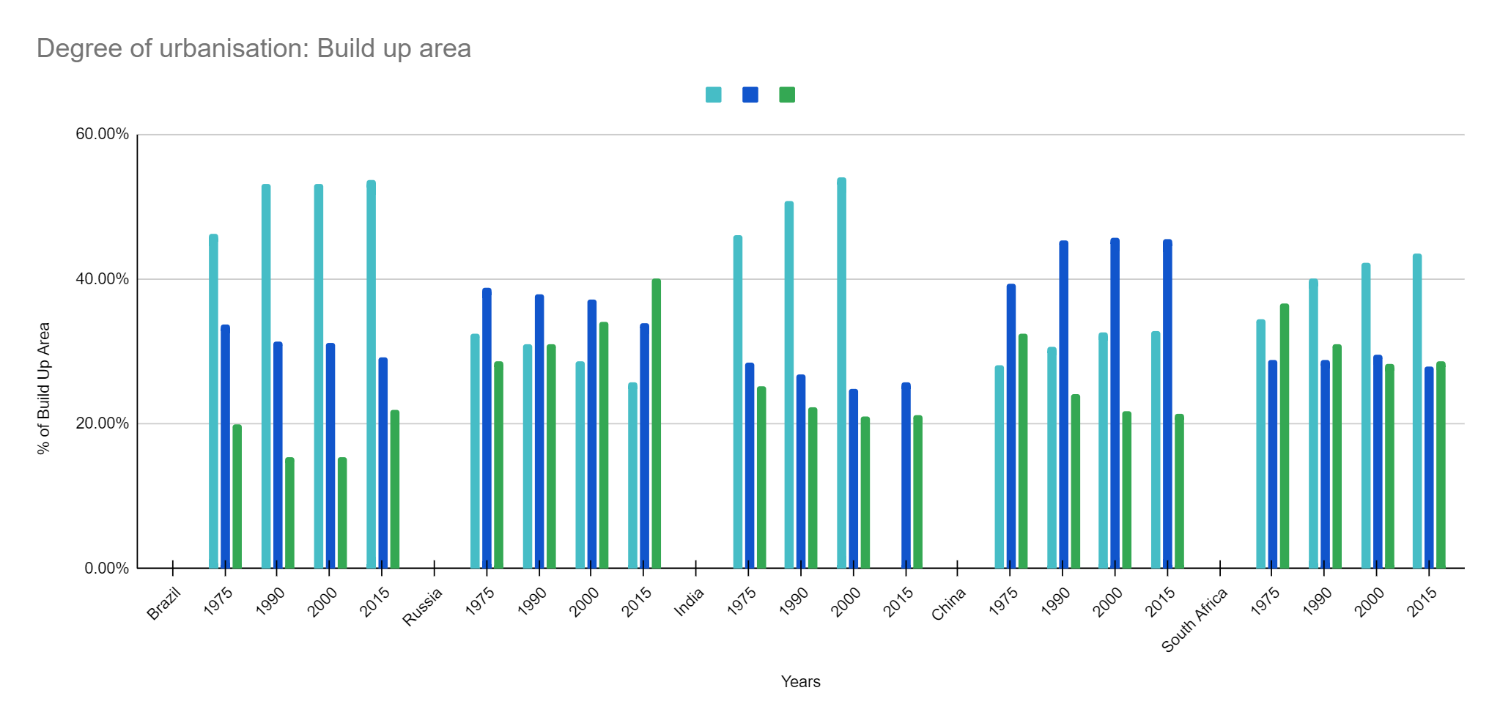



India's Urban Centers dropped by 1%, urban clusters (0.90) and rural grid cell (0.10) grew incrementally over 1975
Degree of Urbanization: Built-up Area
Observations
India had a declining urbanization rate from 80 - 95 along with Brazil and Russia
China has the missing decade between 1965 - 1975 bust has highest urbanization rate since 1980’s
Urban Centres
Urban Cluster
Rural
Grid Cell
Unknown Knowns: Empirically testing the media narrative on India
Dhanya P, Monish O and Tarun L
9 January 2021

Slide 11
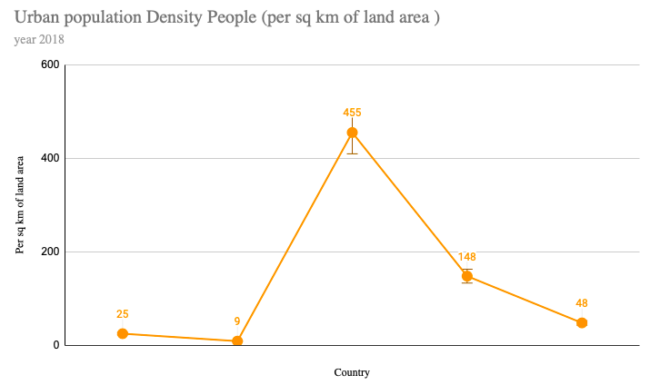
Degree of Urbanisation - Urban population Density People (per sq km of land area )
Observations:
India has scored the highest on urban population density when compared to the other BRICS nations.
Nonetheless, the increase in density can be attributed to the total population as India is the second highest populated nation in the world. Therefore it cannot be construed that India's urban density is higher.
India
China
South Africa
Brazil
Russia
Dhanya P, Monish O and Tarun L
9 January 2021
Notes:
When conducting research, it is easy to go to one source: Wikipedia. However, you need to include a variety of sources in your research. Consider the following sources:
Who can I interview to get more information on the topic?
Is the topic current and will it be relevant to my audience?
What articles, blogs, and magazines may have something related to my topic?
Is there a YouTube video on the topic? If so, what is it about?
What images can I find related to the topic?

Slide 12
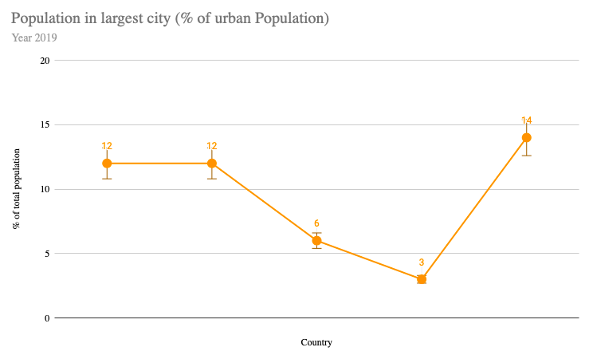
Degree of Urbanisation - Population in largest city (% of urban Population)
Observations:
India's scoring is just above China at 6% of the total population in the largest city. Nonetheless, it is still the lower compared to the other nations
South Africa
Brazil
Russia
India
China
Dhanya P, Monish O and Tarun L
9 January 2021
Notes:
When conducting research, it is easy to go to one source: Wikipedia. However, you need to include a variety of sources in your research. Consider the following sources:
Who can I interview to get more information on the topic?
Is the topic current and will it be relevant to my audience?
What articles, blogs, and magazines may have something related to my topic?
Is there a YouTube video on the topic? If so, what is it about?
What images can I find related to the topic?

Slide 13
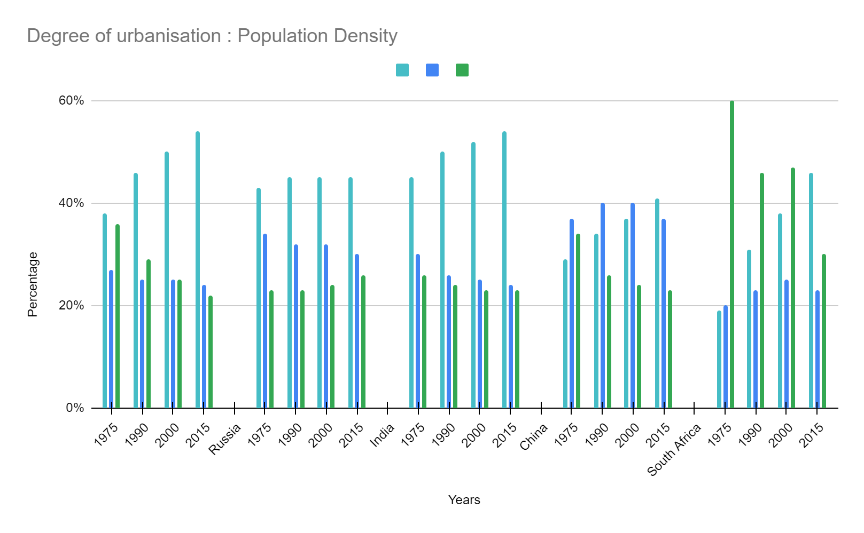
Population density in India has increased in urban centres but decreased in the urban clusters
Degree of Urbanization: Population Density
Observations
India and Brazil follow similar population density across urban centres and urban clusters
India has drop in population density across urban clusters over 1975 - 2015
Urban Centres
Urban Cluster
Rural
Grid Cell
Unknown Knowns: Empirically testing the media narrative on India
Dhanya P, Monish O and Tarun L
9 January 2021

Slide 14
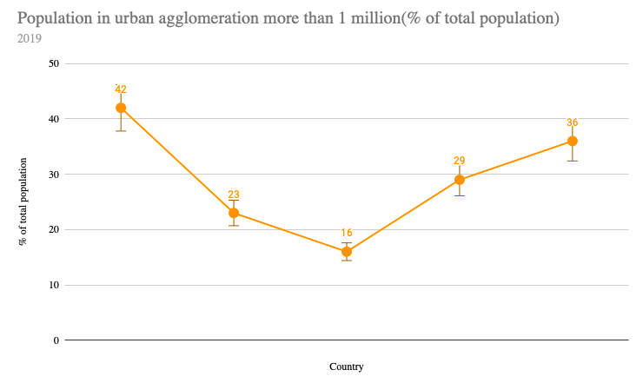
Urban Agglomeration- Population in urban agglomeration more than 1 million(% of total population)
Observations:
India has scored 16% of urban agglomeration of more than 1 million in total % of population. Again falling at the last place.
Brazil
South Africa
China
Russia
India
Dhanya P, Monish O and Tarun L
9 January 2021
Notes:
When conducting research, it is easy to go to one source: Wikipedia. However, you need to include a variety of sources in your research. Consider the following sources:
Who can I interview to get more information on the topic?
Is the topic current and will it be relevant to my audience?
What articles, blogs, and magazines may have something related to my topic?
Is there a YouTube video on the topic? If so, what is it about?
What images can I find related to the topic?

Slide 15
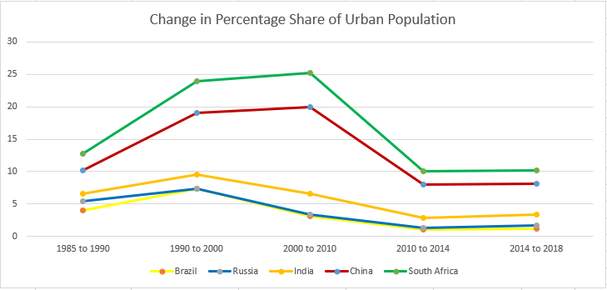
India’s change in urban population (% share) has never crossed 10%
Change in Percentage Share of Urban Population
Observations
BRICS nation had a fall in percentage share since 2000 but consistent since 2010 to 2018
Unknown Knowns: Empirically testing the media narrative on India
Dhanya P, Monish O and Tarun L
9 January 2021

Slide 16
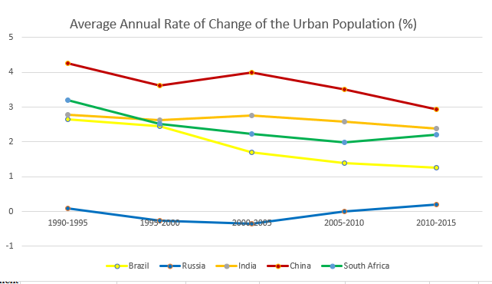
India’s AAR of the change the Urban Population dropped from 2.8% to 2.5% in 2015
Average Annual Rate of Change of the Urban Population (%)
Observations
India’s average annual rate of urban population is consistent with a downward trend post 2000
Brazil & China has downward trend, while Russia and South Africa have upward change of urban population
Unknown Knowns: Empirically testing the media narrative on India
Dhanya P, Monish O and Tarun L
9 January 2021

Slide 17
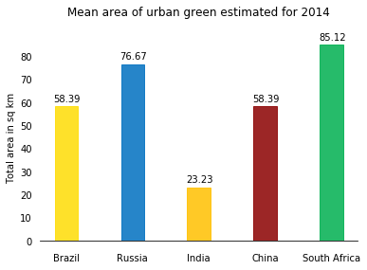
Mean area of urban green estimated for 2014
Observations:
On an average South Africa has large green spaces in urban areas and India is at the bottom of the list.
Dhanya P, Monish O and Tarun L
9 January 2021
Notes:
When conducting research, it is easy to go to one source: Wikipedia. However, you need to include a variety of sources in your research. Consider the following sources:
Who can I interview to get more information on the topic?
Is the topic current and will it be relevant to my audience?
What articles, blogs, and magazines may have something related to my topic?
Is there a YouTube video on the topic? If so, what is it about?
What images can I find related to the topic?

Slide 18
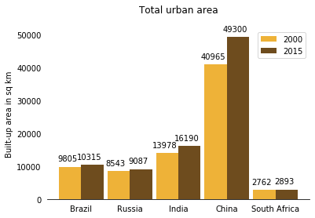
Total Urban built-up area in sq km
Observations:
China has the largest urban area compared to other BRICS nations. India is at 2nd place but the difference is too high. China’s urban area is increasing at a higher rate compared to others.
Dhanya P, Monish O and Tarun L
9 January 2021
Notes:
When conducting research, it is easy to go to one source: Wikipedia. However, you need to include a variety of sources in your research. Consider the following sources:
Who can I interview to get more information on the topic?
Is the topic current and will it be relevant to my audience?
What articles, blogs, and magazines may have something related to my topic?
Is there a YouTube video on the topic? If so, what is it about?
What images can I find related to the topic?

Slide 19
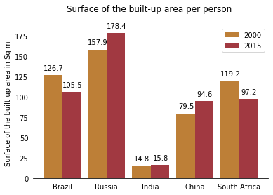
Surface of the built-up area per person
Observations:
Among BRICS nations Russia has large built-up area per person and India has the least.
Dhanya P, Monish O and Tarun L
9 January 2021
Notes:
When conducting research, it is easy to go to one source: Wikipedia. However, you need to include a variety of sources in your research. Consider the following sources:
Who can I interview to get more information on the topic?
Is the topic current and will it be relevant to my audience?
What articles, blogs, and magazines may have something related to my topic?
Is there a YouTube video on the topic? If so, what is it about?
What images can I find related to the topic?

Slide 20
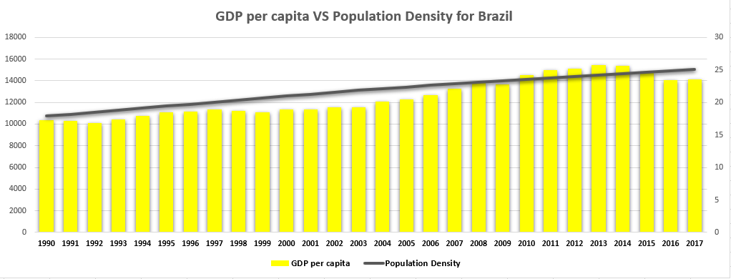
Russia leads with China and India on a steady growth, Brazil and South Africa stable or degrown
Urbanization (Population Density) vs Prosperity (Per capita Income)
Observations
Brazil’s GDP per capita got steady growth but degrown since 2015
GDP per capita
GDP per capita
people per sq. km of land area
people per sq. km of land area
Unknown Knowns: Empirically testing the media narrative on India
Dhanya P, Monish O and Tarun L
9 January 2021

Slide 21
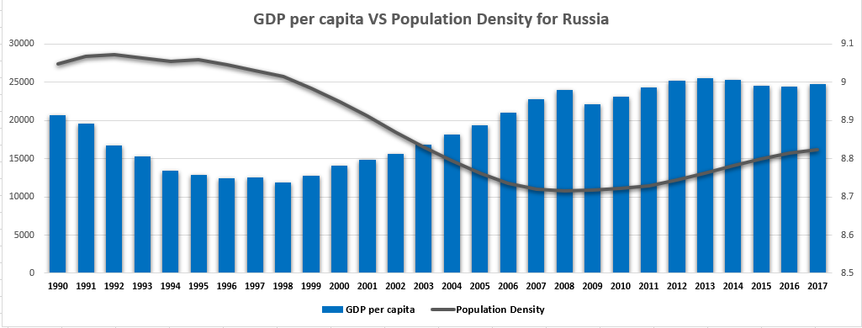
Russia leads with China and India on a steady growth, Brazil and South Africa stable or degrown
Urbanization (Population Density) vs Prosperity (Per capita Income)
Observations
Russia’s population density had a fall since 1997, and stabilized at 8.8
While growth in GDP per capita has become stable at 25000$
GDP per capita
people per sq. km of land area
Unknown Knowns: Empirically testing the media narrative on India
Dhanya P, Monish O and Tarun L
9 January 2021

Slide 22
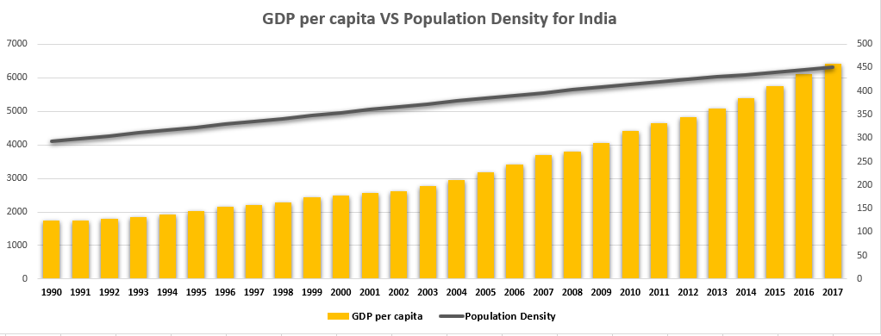
Urbanization (Population Density) vs Prosperity (Per capita Income)
Russia leads with China and India on a steady growth, Brazil and South Africa stable or degrown
Observations
India is population density is highest and lowest GDP per capita which is steadily rising
GDP per capita
people per sq. km of land area
Unknown Knowns: Empirically testing the media narrative on India
Dhanya P, Monish O and Tarun L
9 January 2021

Slide 23
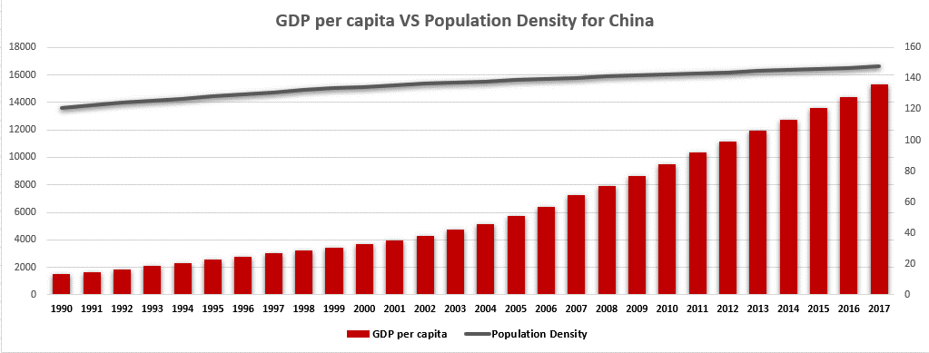
Urbanization (Population Density) vs Prosperity (Per capita Income)
Russia leads with China and India on a steady growth, Brazil and South Africa stable or degrown
Observations
China’s GDP per capita had the highest growth
GDP per capita
people per sq. km of land area
Unknown Knowns: Empirically testing the media narrative on India
Dhanya P, Monish O and Tarun L
9 January 2021

Slide 24
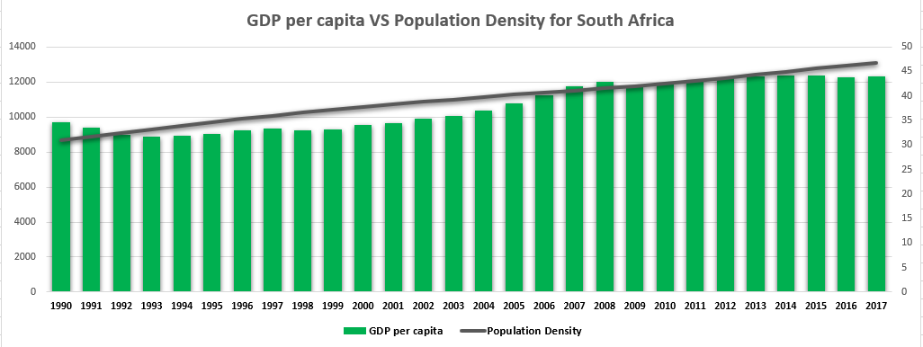
Urbanization (Population Density) vs Prosperity (Per capita Income)
Russia leads with China and India on a steady growth, Brazil and South Africa stable or degrown
Observations
South Africa populations density follows the similar growth pattern to Brazil.
GDP per capita growth are incremental at crossed 12k$ In 2008
GDP per capita
people per sq. km of land area
Unknown Knowns: Empirically testing the media narrative on India
Dhanya P, Monish O and Tarun L
9 January 2021

Slide 25
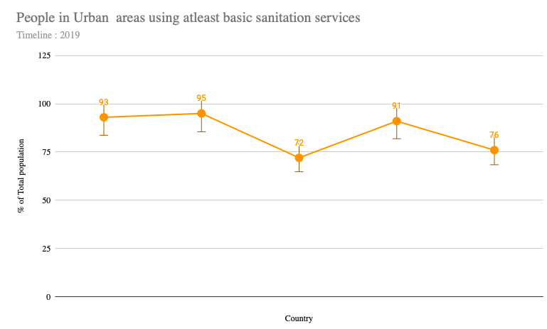
Urban Sanitation Services -People in Urban areas using at least basic sanitation services
Observations:
In terms of basic sanitation services, India is at the end of the line among BRICS nations. The basic sanitation in urban cities are relatively higher in Brazil, Russia and China above 90% whereas India is at 72%. This shows that the level of sanitation services in the urban areas in India is relatively lower.
Brazil
Russia
China
India
South Africa
Dhanya P, Monish O and Tarun L
9 January 2021
Notes:
When conducting research, it is easy to go to one source: Wikipedia. However, you need to include a variety of sources in your research. Consider the following sources:
Who can I interview to get more information on the topic?
Is the topic current and will it be relevant to my audience?
What articles, blogs, and magazines may have something related to my topic?
Is there a YouTube video on the topic? If so, what is it about?
What images can I find related to the topic?

Slide 26
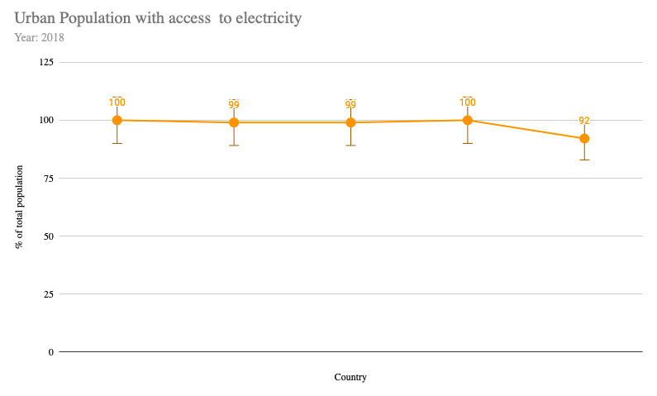
Urban Sanitation Services -Urban Population with access to electricity
Observations:
In terms of access to electricity in urban areas. India scored well at 99%. Although every nation scores above 90% access to electricity in urban areas.
Brazil
Russia
India
China
South Africa
Dhanya P, Monish O and Tarun L
9 January 2021
Notes:
When conducting research, it is easy to go to one source: Wikipedia. However, you need to include a variety of sources in your research. Consider the following sources:
Who can I interview to get more information on the topic?
Is the topic current and will it be relevant to my audience?
What articles, blogs, and magazines may have something related to my topic?
Is there a YouTube video on the topic? If so, what is it about?
What images can I find related to the topic?

Slide 27
Urban Sanitation Services -Urban Population with access to electricity
Observations:
In terms of access to electricity in urban areas. India scored well at 99%. Although every nation scores above 90% access to electricity in urban areas.
Brazil
Russia
India
China
South Africa
Dhanya P, Monish O and Tarun L
9 January 2021
Notes:
When conducting research, it is easy to go to one source: Wikipedia. However, you need to include a variety of sources in your research. Consider the following sources:
Who can I interview to get more information on the topic?
Is the topic current and will it be relevant to my audience?
What articles, blogs, and magazines may have something related to my topic?
Is there a YouTube video on the topic? If so, what is it about?
What images can I find related to the topic?

Slide 28
Urban Sanitation Services -Urban Population with access to electricity
Observations:
In terms of access to electricity in urban areas. India scored well at 99%. Although every nation scores above 90% access to electricity in urban areas.
Brazil
Russia
India
China
South Africa
Dhanya P, Monish O and Tarun L
9 January 2021
Notes:
When conducting research, it is easy to go to one source: Wikipedia. However, you need to include a variety of sources in your research. Consider the following sources:
Who can I interview to get more information on the topic?
Is the topic current and will it be relevant to my audience?
What articles, blogs, and magazines may have something related to my topic?
Is there a YouTube video on the topic? If so, what is it about?
What images can I find related to the topic?

Slide 29
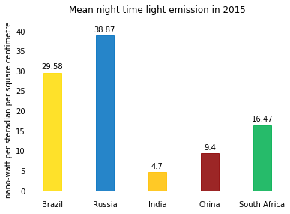
Mean night light emission in 2015
Observations:
India scores the least in the average night light emissions.
Dhanya P, Monish O and Tarun L
9 January 2021
Notes:
When conducting research, it is easy to go to one source: Wikipedia. However, you need to include a variety of sources in your research. Consider the following sources:
Who can I interview to get more information on the topic?
Is the topic current and will it be relevant to my audience?
What articles, blogs, and magazines may have something related to my topic?
Is there a YouTube video on the topic? If so, what is it about?
What images can I find related to the topic?

Slide 30








Summary – Urbanisation Metrics
Urbanisation Rate
India is the lowest among peers in Urbanisation rate
Degree of Urbanisation
India scores highest in the population density of urban population.
Urban Agglomeration
India has scored 16% of urban agglomeration of more than 1 million in total % of population. Again falling at the last place.
Change in Percentage Share of Urban Population
India relatively high, second only to China.
Dhanya P, Monish O and Tarun L
9 January 2021

Slide 31



Summary – Urbanisation Metrics
Sanitation Services
India is the lowest among peers in Urbanisation rate
Access to basic necessities
India scores highest in the population density of urban population.
Urbanisation Value
India has scored 16% of urban agglomeration of more than 1 million in total % of population. Again falling at the last place.
Urbanisation Built up area
India’s built up area is relatively high.
Dhanya P, Monish O and Tarun L
January 9 2021

Slide 32
Conclusion
We accept the hypothesis that ‘Urbanisation in India is slower when compared to other emerging nations’.
To measure the urbanisation level we chose those to compare the metrics with the BRICS nations. The analysis proves that India scores lower than the BRICS nations in several parameters.
India did fairly well in terms of population density in urban cities, access to electricity, urban and built up area, however, India did poorly in several metrics such as urbanisation rate, urban agglomeration and basic sanitation. In certain cases India scored the least among the BRICS nations.

Slide 33
Thank you
Group 11

