Slide 1
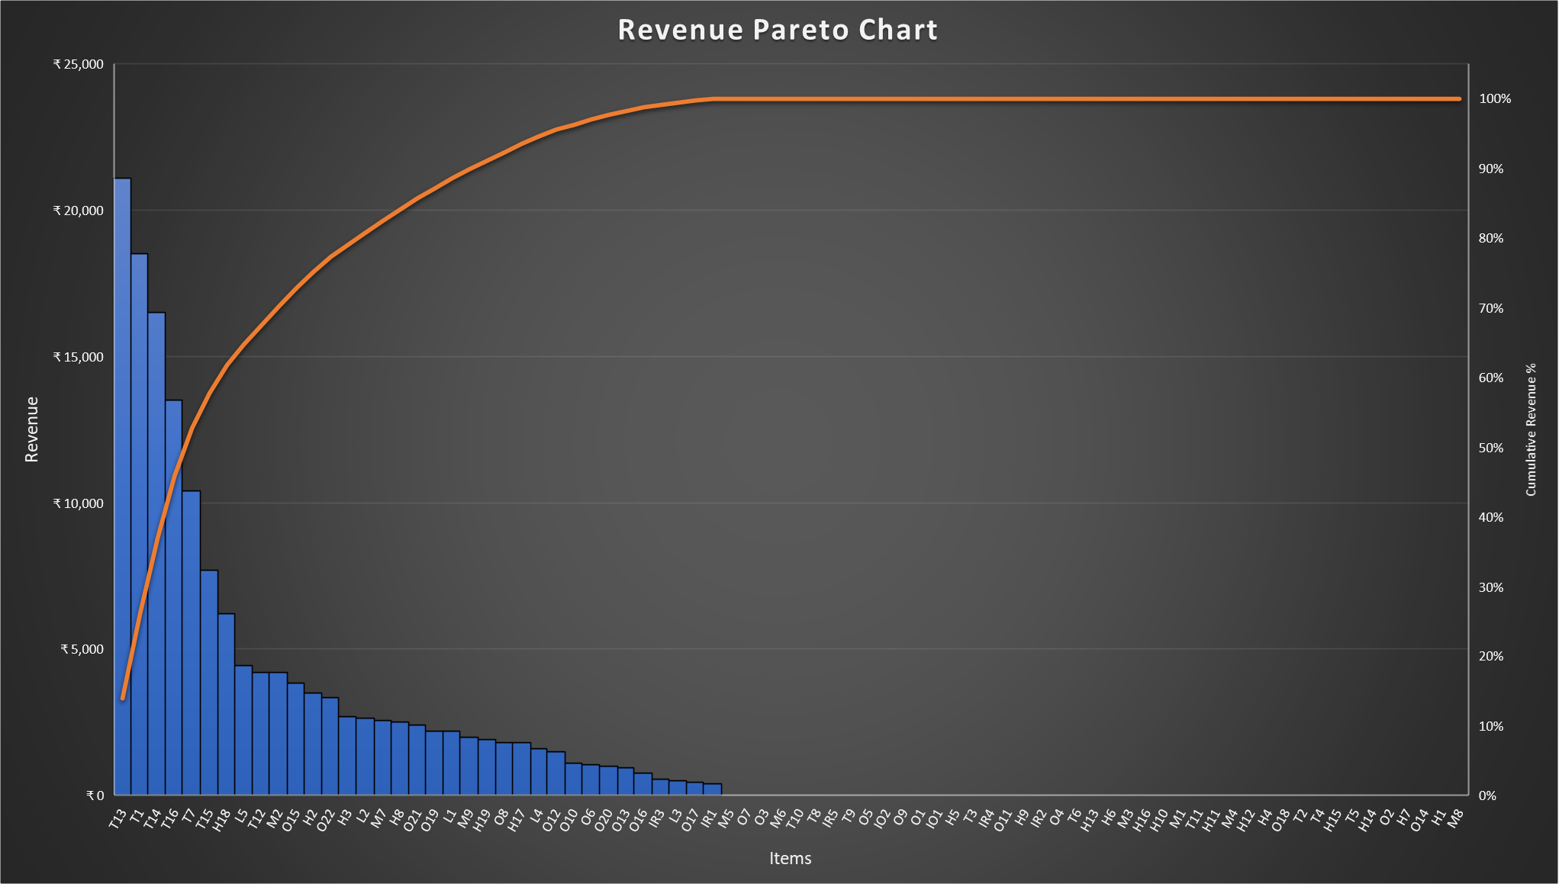
In the charts T stands for Tvs, H stands for hometheatre, M for mixer grinder, IO for Induction oven, IR for iron, L for Lights and O for Other items.

Slide 2
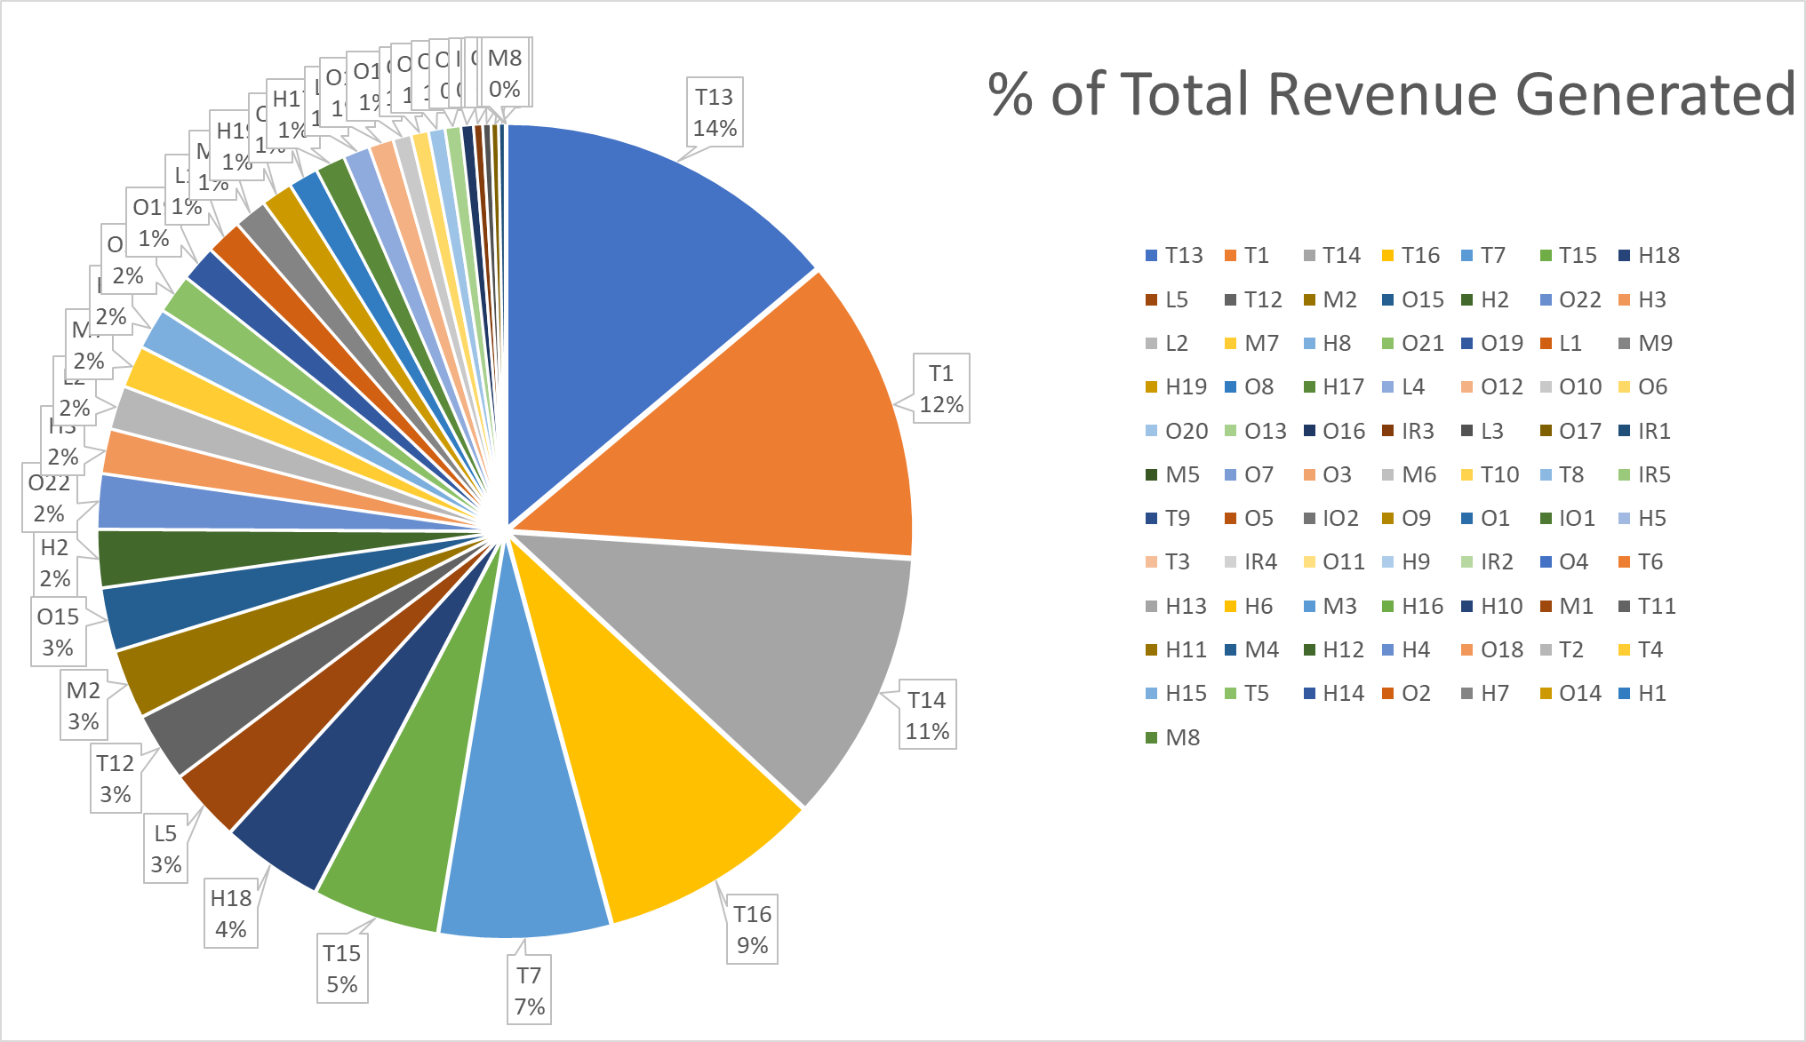
From the previous slide and this slide you can observe that the sales data is maintaining the pareto rule.
Here there are in total 78 items out of which 15 items generate 80% of the total revenue.
The main items which causes this revenue are tvs, home theatres and mixers as they are priced higher than other items.
“ The Pareto principle states that for many outcomes, roughly 80% of consequences come from 20% of causes ”

Slide 3
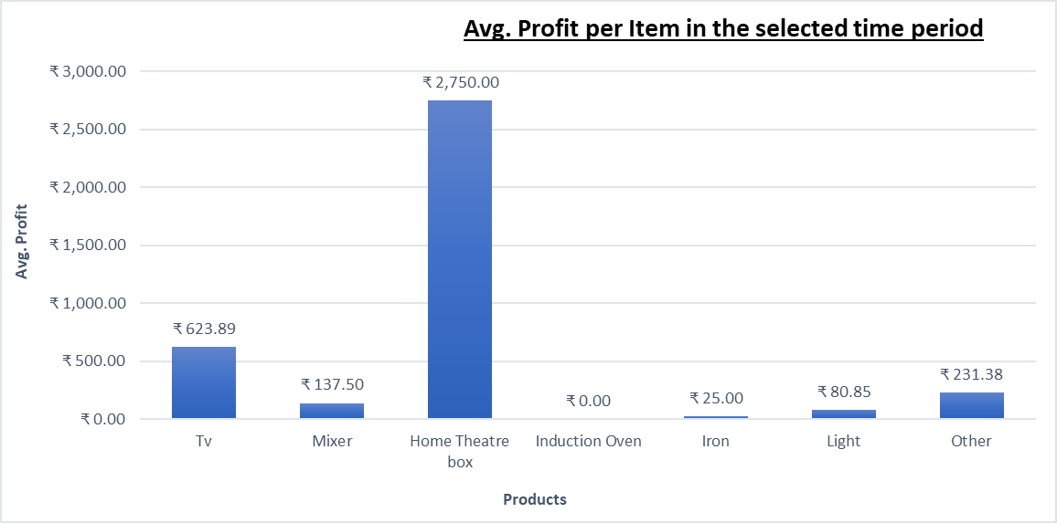
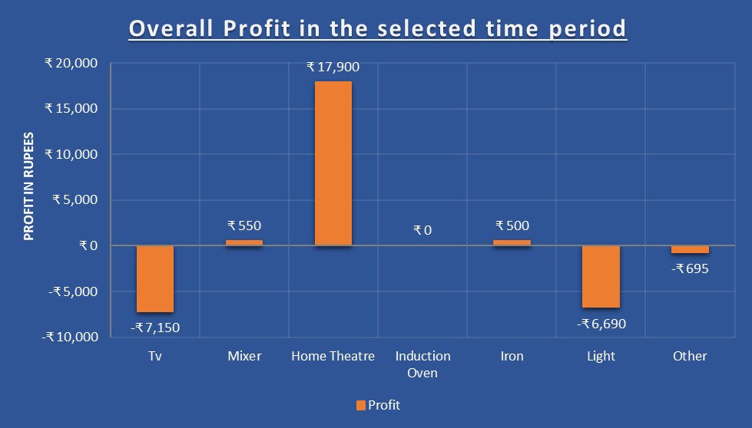
In the right chart we can see that in the selected time period home theatre and tvs caused the most profit for the shop as on that time it was festival season going on so people tend to spend more on those items.
Though in the above chart tv stands for the 2nd highest profitable item but in the left side chart we can observe that tvs actually caused biggest loss in total as the shop owner may have purchased more tvs in between the time period.
Also lights are causing the loss as the number of lights which were bought to sell in Diwali did not meet the owner’s expected sale.

Slide 4
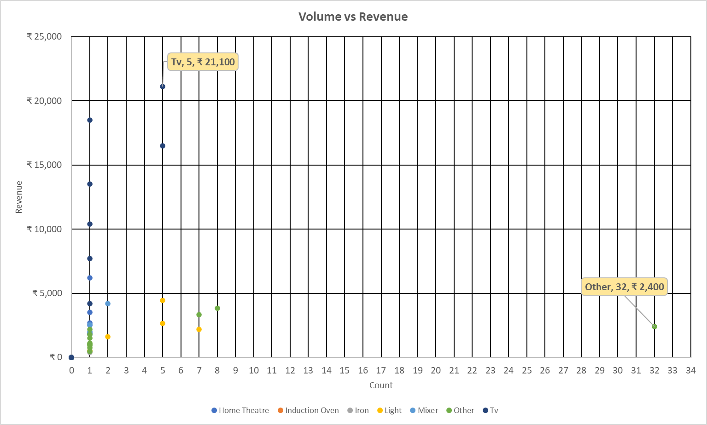
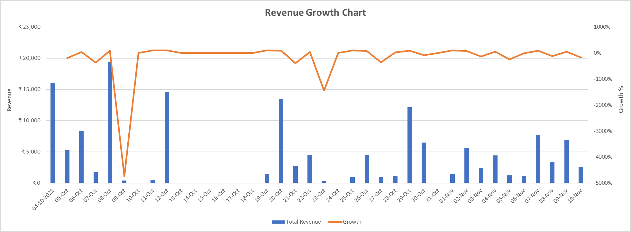
Here we can see that the ‘Other’ item which is small lights is sold 32 units which is the most as it was the time of Diwali.
From below we can derive that the shop’s daily revenue growth is very low.
Maybe, the online giants like Amazon , Flipkart and other big shops like ‘Great Eastern’ are causing this tough time for small businesses like this.

Slide 5
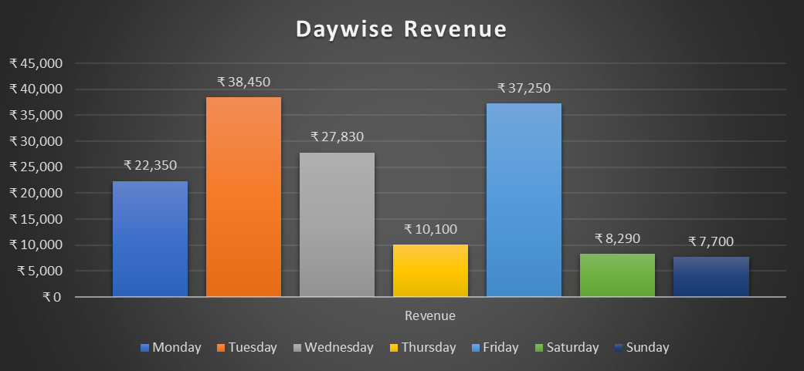
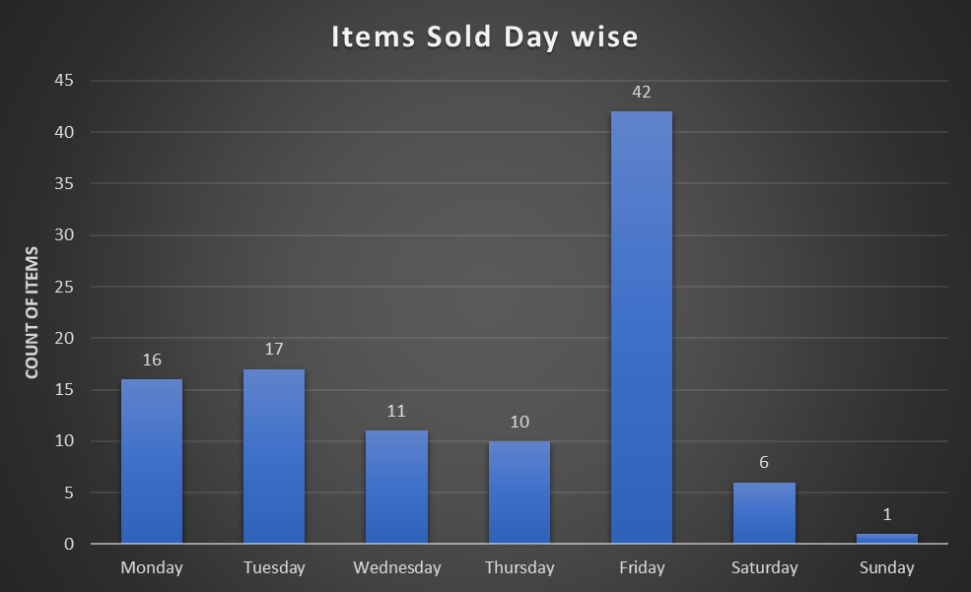
From the right side chart we can decide that Fridays are the days where people tend to buy electronics more.
And after Fridays Monday and Tuesday are the days when people spend on electronics more.
Final Verdict :
At last we can conclude that the shop needs to pay more attention on its revenue growth.
And it has to stock more profitable items rather than selling less profitable items to make its presence more strong in the retail market.

