Slide 1
Research Update 12/01/14
Leah Dickstein

Slide 2
“X” Delay
“Y” Delay
X
Y
X
D
Y
U
U
Y(n) = CX(n-k) + V(n)
“U” Delay
X
Y
D
X
Y
U
D
U
U(n) = E[X(n) | Y(n-k)]
X(n) = AX(n-1) + W(n) + U(n-k)

Slide 3
“Buffering” Delay
“Streaming” Delay
X
Y
X
D
Y
U
U
Y(n) = CX(n-k) + V(n)
X
Y
D
X
Y
U
D
U
U(n) = E[X(n) | Y(n-k)]
X(n) = AX(n-1) + W(n) + U(n-k)

Slide 4
Drop Location
Link doesn’t matter
Only effect is at X
Assumes each system component memoryless
If Y = 0 controller should do nothing
Not necessarily always the case
We’re afraid of bringing something back from the dead
X
X
Y
U
X
Y
X
Y
X
X
U
U

Slide 5
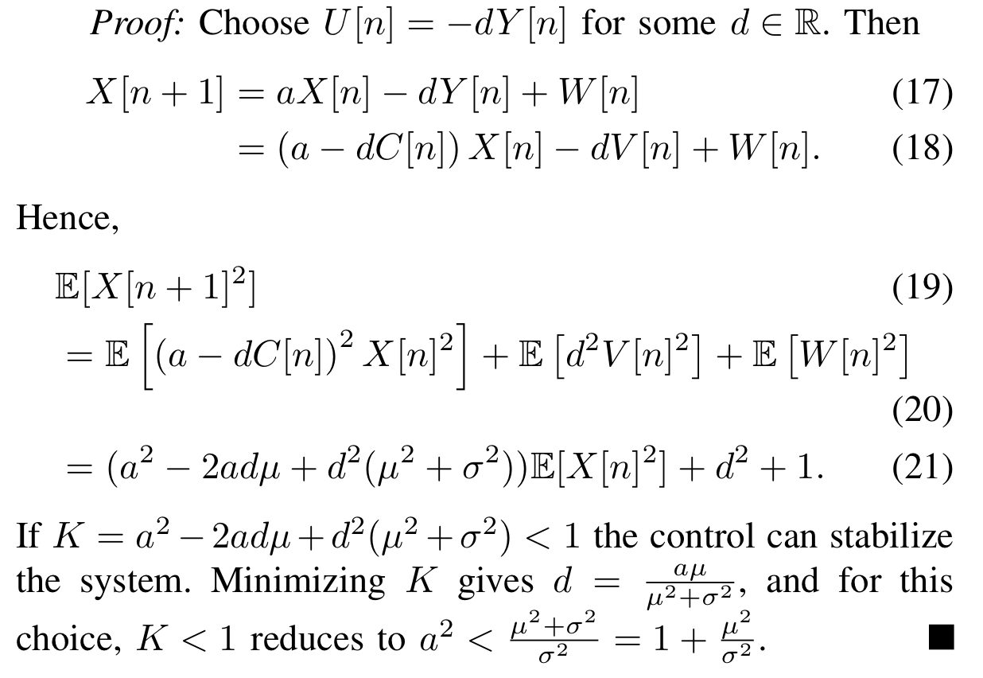
Gireeja’s NonCoherence
Notes:
This works because at the beginning of each round the old x(n) becomes x(0), so as long as (a-dC) < 1 then overall the system will stabilize

Slide 6
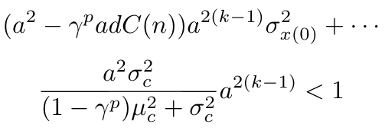
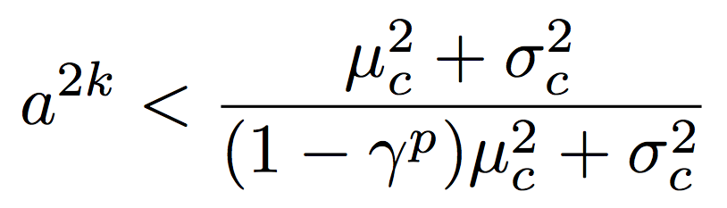
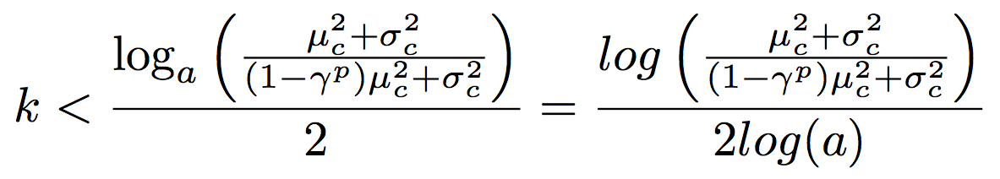
Buffering Delay
X
V(n)
P
Y
C(n)
Sys
Enc
Dec
U(n)
k…
Change in stability because multiplicative noise
Delay → X larger → noise larger

Slide 7
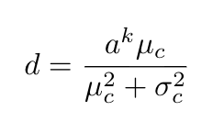

Streaming Delay
X
D
Y
U
Y(n) = CX(n-k) + V(n)
Note: This is based on my current strategy…I talk about suboptimality later

Slide 8
Theoretical Curves

Slide 9
Suboptimality
Optimal for Buffering Delay but NOT for Streaming Delay
Waiting to act probably suboptimal
The more observations, the less impact from additive noise
At the same time, acting “between” mod k timesteps brings back stuff that was just killed
We need memory! Control with memory is hard
Problem = additive noise → can’t completely kill x(0), so the calculations get out of hand
By bounding growth I can bound error…but it’s similar to ignoring the additive noise

Slide 10

Polyanskiy
Before finding more optimal controls for Streaming Delay, need to connect what we have to Blocklength vs. Drop Probability
Shannon = Channel Capacity = fastest rate, but this doesn’t bound the blocklength
Capacity = max entropy
If you limit the length of your codes you lose entropy
Polyanskiy gives 3 bounds on maximum rate possible for a given blocklength / drop probability
Notes:
Entropy = number of bits = number of binary questions needed to find X
H(X) = E[ log 1/p(X) | p(X) ] or neg sum p(x) log p(x)
Mutual information I(X; Y) = H(X) – H(X|Y)

Slide 11
Finishing Notes
Control noise would be interesting to explore—the cost of acting!

