Slide 1


AR Frameworks
VRA705
By Kessel Okinga Koumou and Mfundo Andrew

Slide 2
Outlines
Vuforia
Vuforia setup
Image target
Image target activity
Multi target activity
Ground plane activity

Slide 3
Vuforia
Vuforia engine overview
Vuforia Engine offers a variety of AR tracking capabilities. These capabilities range from image tracking, object tracking, environment tracking and cloud recognition services to mention a few.
Mobile AR framework support
Vuforia provides cross platform AR development support ranging from your ARCore running devices to your ARKit devices.
ARCore and ARKit devices
Google provides ARCore for Android running devices.
Apple provides ARKit for iOS running devices.

Slide 4
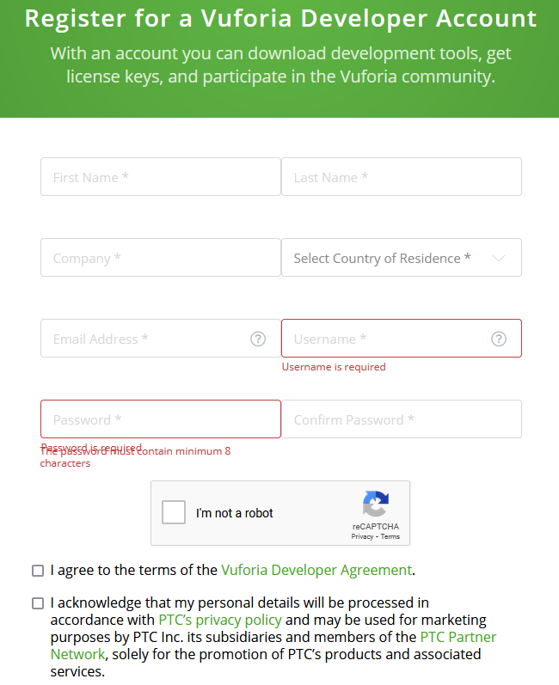
Vuforia setup
Account setup
Search for “Vuforia” on Google and head to the main page
Select register and follow the prompts
Use your varsity email and password
Under Company set “UWC” as the value
Download Vuforia package
Unity download should have .unitypackage extension
Installation
On the top right search bar type in “AR Foundation”
Select “Install”
Do the same for “ARCore”

Slide 5
Image target
Vuforia developer tab
Head to Vuforia and login
Under License Manager select “Basic plan”
Create a Title for your basic plan and a license key should be generated
Navigate till you find the “Target Manager” tab under the “Develop” tab
Add a Database and call it “Image target”
Within the Image target select Add Target and upload any 5 images that are 24 bit RGB with the file extension of either JPG or PNG
Set the Width scale to 0,3
Naming conventions are up to you
Download Database
Import Database into Unity project
Setup project
Right click in hierarchy -> Vuforia Engine -> ImageTarget
Within ImageTarget set Type to -> From Database
Select a specific image to track
Import a 3D prefab into your Unity project and place it under the ImageTaget
Scale the prefab until it’s the same size as the image target
Ensure the prefab is on top of the image target
Delete main camera, right click in hierarchy -> Vuforia Engine -> AR Camera
Copy the license key in the camera configuration
AR player settings
Apply the same skills learnt yesterday when it comes to building an AR .apk
Build and run .apk

Slide 6
Image target activity
Build a functional AR .apk
Download an image locally into your Unity project
Set the ImageTarget Type to -> From Image
Drag and drop the downloaded image into the “From Image” section
Please use the previous slides as a guide
AR player settings
Build and run .apk

Slide 7
Multi target activity
Setup project
Right click in hierarchy -> Vuforia Engine -> ImageTarget
Within ImageTarget set Type to -> From Database
Select a specific image to track
Import a 3D prefab into your Unity project and place it under the ImageTaget
Scale the prefab until it’s the same size as the image target
Ensure the prefab is on top of the image target
Delete main camera, right click in hierarchy -> Vuforia Engine -> AR Camera
Copy the license key in the camera configuration
Duplicate the above steps with a secondary ImageTarget
AR player settings
Apply the same skills learnt yesterday when it comes to building an AR .apk
Build and run .apk

Slide 8
Ground plane activity
Ground plane setup
Setup essential Vuforia, ARCore and player build settings
Right click in hierarchy -> Vuforia Engine -> Ground Plane -> Ground Plane Stage
Use the preinstalled Vuforia Astronaut prefab
Drag and drop the Astronaut prefab into the Ground Plane Stage
Ensure Plane Stage type is set to “Plane”
Plane finder setup
Right click in hierarchy -> Vuforia Engine -> Ground Plane -> Plane Finder
Drag and drop Ground Plane Stage into the Plane Finder Anchor Stage component
Setup project
Delete main camera, right click in hierarchy -> Vuforia Engine -> AR Camera
AR player settings
Apply the same skills learnt yesterday when it comes to building an AR .apk
Build and run .apk
Ground not detecting
Navigate to Assets\Vuforia\Databases\Emulator\ open the .pdf
Point your device to the open .pdf file

