Slide 1


SIMATS ENGINEERING Saveetha Institute of Medical and Technical Sciences Chennai-602105.
“AI-Powered Smart Stick for Enhanced Mobility of the Visually Impaired”
MLA0103-Aritifical Intelligence and Expert Systems
Guided By:
Dr Jaithunbi
Dr Kalaivani
Presentation By:
M Jayasree (192325140)
T S Sai Lahari (192325137)

Slide 2

ABSTRACT
This project presents a software-based AI Smart Assistant for Visually Impaired individuals, designed to enhance navigation, awareness, and accessibility in daily life. The system integrates advanced Artificial Intelligence capabilities including object detection, text-to-speech (TTS), speech recognition, and optical character recognition (OCR) to assist users in understanding their surroundings. It provides real-time audio feedback, enabling users to detect objects, read printed text, and interact through voice commands. Unlike expensive hardware-based smart stick solutions, this assistant offers a cost-effective, portable, and highly accessible digital aid. The solution enhances independence, safety, and confidence by delivering continuous environmental awareness and reliable voice-based assistance.

Slide 3
OBJECTIVES
To develop an AI-based assistant that helps visually impaired users navigate and interact with their surroundings.
To integrate real-time object detection and text-to-speech to identify obstacles, objects, and text in the environment.
To provide voice-based interaction and emergency assistance features to enhance user safety and independence.
To build a free, user-friendly, and accessible AI system that promotes digital inclusivity for visually impaired individuals.

Slide 4
INTRODUCTION
The AI Smart Assistant for Visually Impaired is an AI-driven assistive system designed to support visually challenged individuals.
It uses advanced AI capabilities such as object detection, text recognition, and voice interaction to assist with daily navigation and awareness.
Acts as a free, software-based alternative to costly electronic smart sticks and wearable assistive devices.
Enhances user independence and safety by providing real-time voice feedback for object alerts, text reading, and environmental understanding.

Slide 5
PROBLEM STATEMENT
Visually impaired individuals face difficulty navigating independently and safely in unfamiliar environments.
Traditional white canes cannot detect upper-body-level obstacles (e.g., branches, signboards) or fast-moving objects.
Lack of real-time voice guidance limits spatial awareness and decision-making for visually impaired users.
Need for a low-cost, AI-based solution that provides obstacle detection, voice feedback, and safe mobility and independence

Slide 6
LITERATURE REVIEW
Traditional white cane aids mobility but cannot detect distant or elevated obstacles.
Early smart sticks used ultrasonic sensors for obstacle detection but lacked AI-based object recognition and voice guidance.
Smartphone-based vision apps (e.g., Seeing AI) demonstrated the potential of camera-based assistance but require constant connectivity and high device performance.
Recent studies highlight the need for low-cost, portable AI assistance systems for visually impaired users with real-time voice alerts and user-friendly interfaces.

Slide 7
TECHNIQUES TO BE USED
Computer Vision: OpenCV + YOLO for object detection.
Machine Learning: Pre-trained COCO dataset for accurate classification.
Speech Synthesis: pyttsx3 for voice feedback.
Deep Learning (CNN): For accurate feature extraction from camera input.
Multi-threading: Enables simultaneous vision processing and voice alerts.

Slide 8
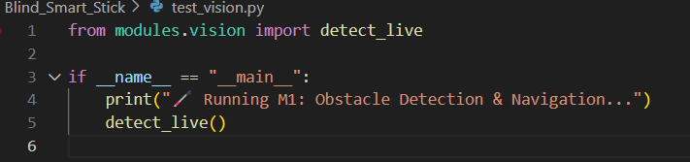
Module-1:Obstacle Detection & Navigation
Uses ultrasonic sensors or YOLO object detection (camera-based) to detect obstacles.
Calculates distance between the stick and the obstacle.
Gives vibration or voice alerts to guide the user safely.
Helps in path navigation, detecting speed breakers, veicles, walls, etc.

Slide 9
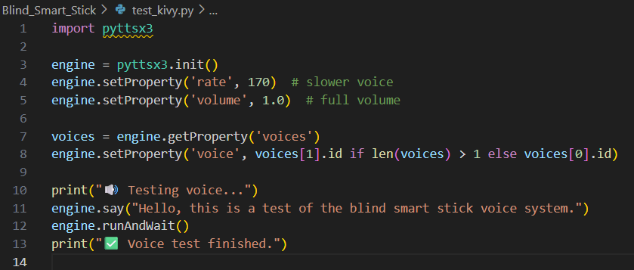

Module-2: Voice Interaction & Assistance Module
Uses Text-to-Speech (TTS) engine (e.g., pyttsx3) for audio guidance.
Provides real-time voice feedback like “Person ahead”, “Turn right”, “Traffic signal red”.
Allows voice-based commands for mode switching or stopping.
Enhances user experience for the visually impaired with hands-free communication.

Slide 10
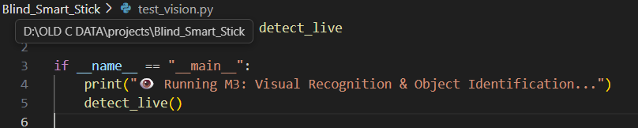
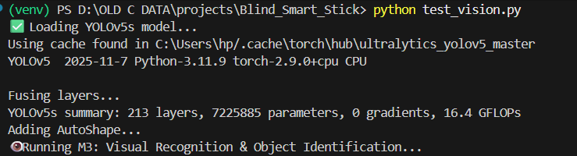
Module-3: Visual Recognition & Object Identification
Employs YOLOv5 / YOLOv8 deep learning models for detecting objects.
Recognizes people, vehicles, signals, poles, etc.
Works with live camera feed for real-time detection.
Data processed through ONNX or OpenCV DNN for performance optimization.

Slide 11
Challenges
Accurate detection in low light or foggy environments.
Real-time processing on low-power hardware.
Background noise affecting voice clarity.
Model size and memory limitations.
Balancing speed vs accuracy for mobile use.

Slide 12
Future Scope
Integration with GPS and Google Maps for route guidance.
Use of Edge AI chips (like Jetson Nano) for faster detection.
Addition of voice recognition commands (e.g., “Where am I?”).
Cloud-based data updates for smarter learning and personalization.
Integration with wearable devices (like smart glasses).

Slide 13
Conclusion
The Blind Smart Stick successfully detects obstacles and assists visually impaired users.
Combines AI, Computer Vision, and Voice Assistance for real-time safety.
Helps users navigate roads confidently with minimal dependency.
Demonstrates how AI-powered devices can improve accessibility and inclusiveness.

Slide 14
REFERENCES
Bousbia-Salah, M., Ahmed-Nacer, M., Bouktir, T., & Achour, C. (2009). Smart cane for the blind: Obstacle detection and mobility assistance.
Dakwale, S., Patil, S., & Bhongade, S. (2016). Smart walking stick using sensors for visually impaired people.
Kumar, A., Sharma, P., & Singh, R. (2018). AI-based navigation aid for visually impaired individuals.
Raj, K., & Reddy, P. (2020). GPS-enabled smart cane for outdoor navigation.
Saini, S., Gupta, R., & Kaur, H. (2021). Vision-assisted smart stick using computer vision for obstacle detection.

Slide 15

THANK YOU

