Slide 1
IMPLEMENTATION OF FINGERPRINT RECOGNITION USING GABOR FILTER
REVIEW-2 BY:
2310040036-D.LAHARI
2310040033-A.KAVYANJALI

Slide 2
OBJECTIVES:
To enhance fingerprint image quality using Gabor filters.
To reduce noise and improve ridge and valley clarity.
To extract fingerprint features more accurately.
To improve the overall accuracy of fingerprint recognition.
To implement an efficient Gabor filter–based fingerprint recognition system.

Slide 3
LITERATURE SURVEY
Fingerprint recognition accuracy depends on image quality.
Noise and low contrast reduce recognition performance.
Image enhancement is a key preprocessing step.
Gabor filters are effective for enhancing ridge patterns.
Local ridge orientation and frequency are estimated.
Enhanced images improve minutiae extraction and matching accuracy.

Slide 4
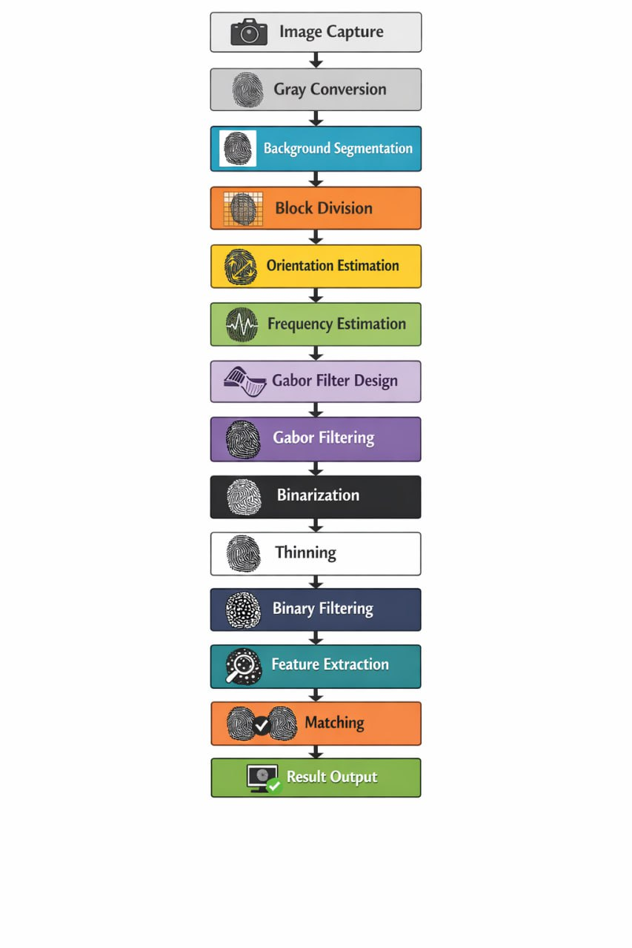
METHODOLOGY

Slide 5
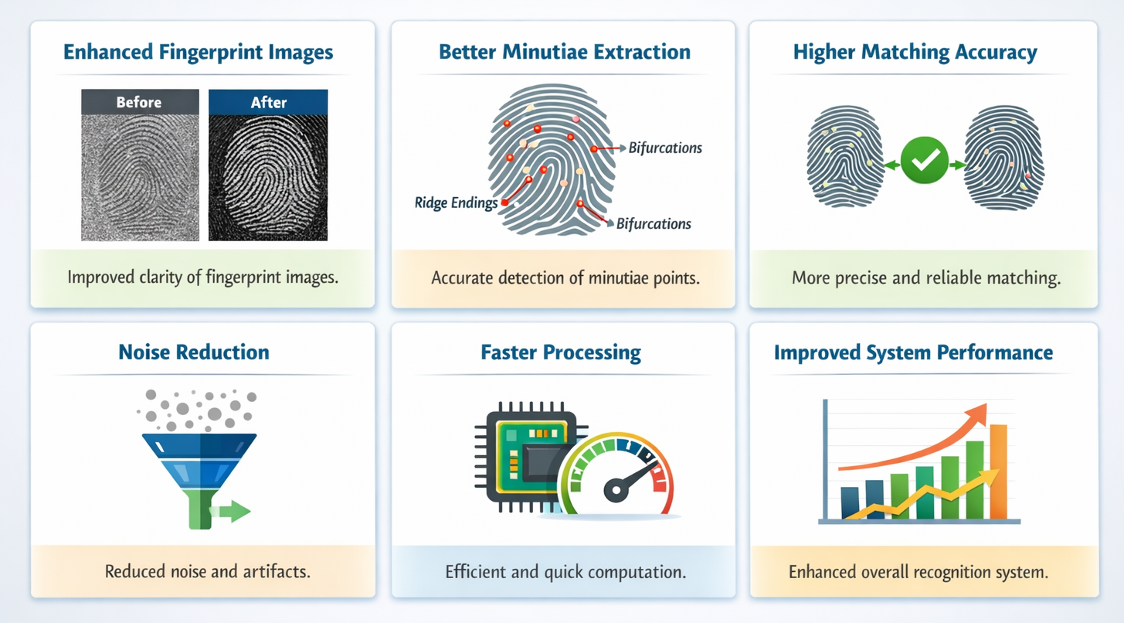
EXPECTED OUTCOMES

Slide 6
CONCLUSION
• Enhances fingerprint image clarity
• Reduces noise and artifacts
• Improves minutiae extraction accuracy
• Increases matching accuracy
• Enables faster processing
• Enhances overall system performance

Slide 7
• Gabor Filter Design in Verilog HDL (Fingerprint Enhancement – Student Version) https://ir.uitm.edu.my/98427/1/98427.PDF
• Design and Simulation of Gabor Filter Using Verilog HDL (Research Article) https://www.ijltet.org/wp-content/uploads/2013/04/12.pdf
• Gabor Filter Design Using Verilog HDL with MAC Implementation (2024) https://journals.stmjournals.com/ijvcdt/article=2024/view=132745
• Gabor Filter for Fingerprint Recognition – Review Survey Paper https://ijrsm.com/index.php/journal-ijrsm/article/view/656
• Fingerprint Recognition Based on Gabor Features Extraction https://jceps.utq.edu.iq/index.php/main/article/view/68
• Gabor Filter Design for Fingerprint Application Using MATLAB + Verilog HDL https://www.scribd.com/document/312476729/01-3-1
• Design and Implementation of Fingerprint Recognition Process on FPGA (Verilog HDL) https://www.scribd.com/document/354803533/61-231-239-pdf
REFERENCES

