Slide 1
EDA Project – Analysis of AMCAT Data
- Lahari Nelluri
- Ai-elite- 14

Slide 2
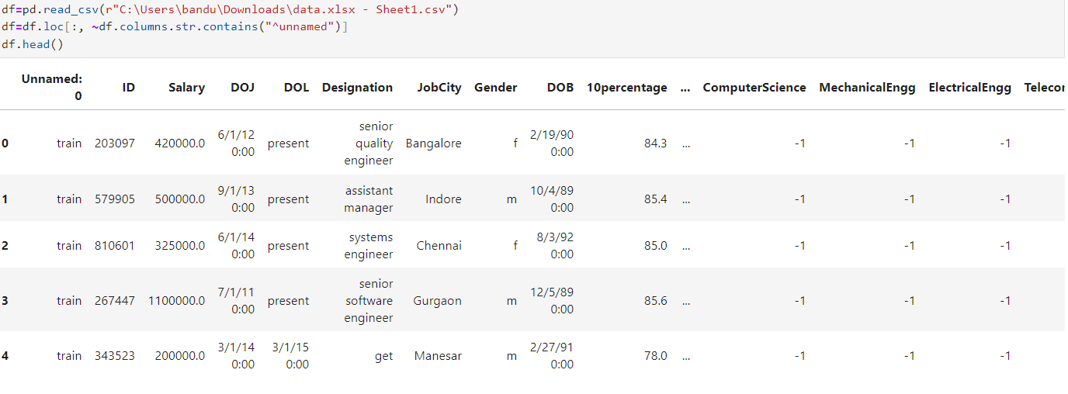
DATA EXTRACTION
Project on AMCAT Data
Here’s the Raw data in the form of CSV(Comma-separated values) format

Slide 3
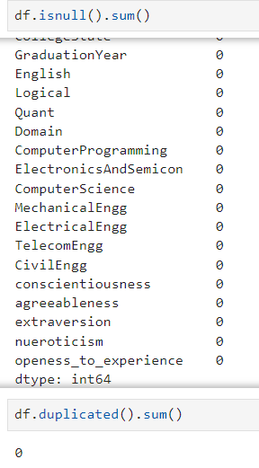
Identifying Null Values

Slide 4
DATA VISUALIZATION

Slide 5
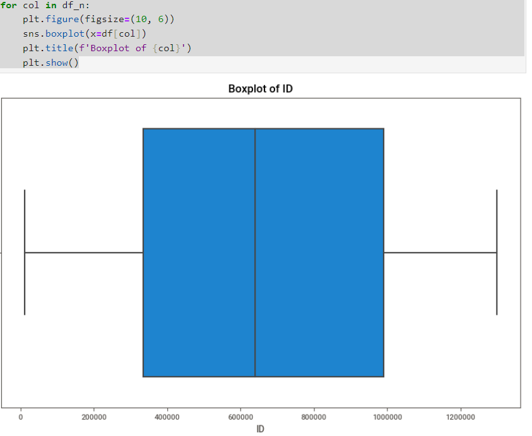
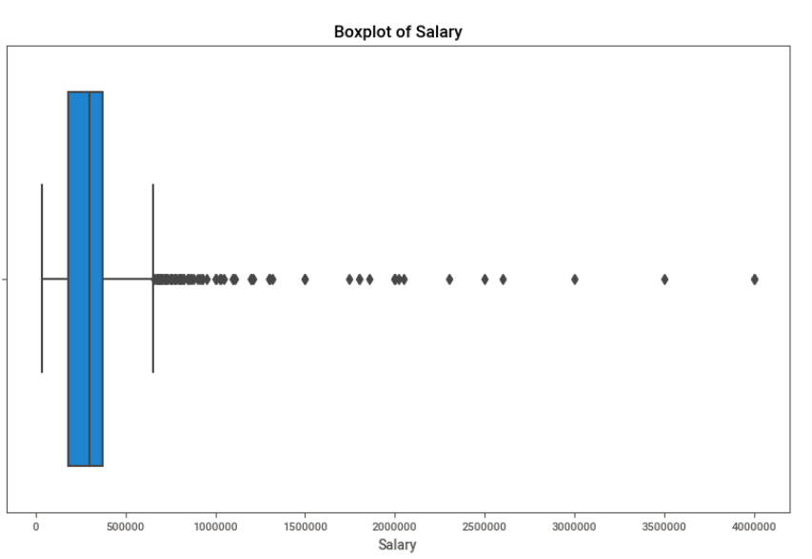
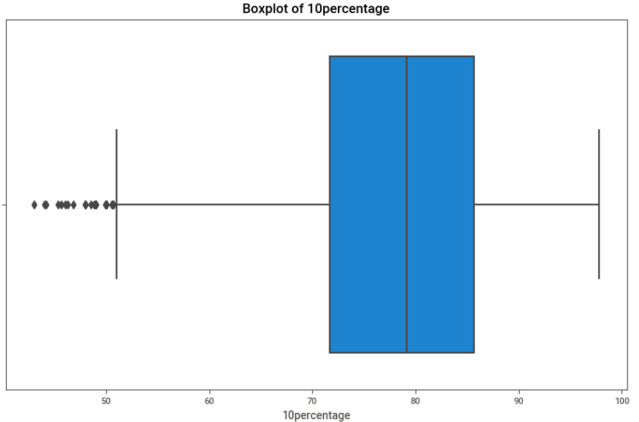
Uivariate analysis
These are some Boxplot on the AMCAT Data

Slide 6
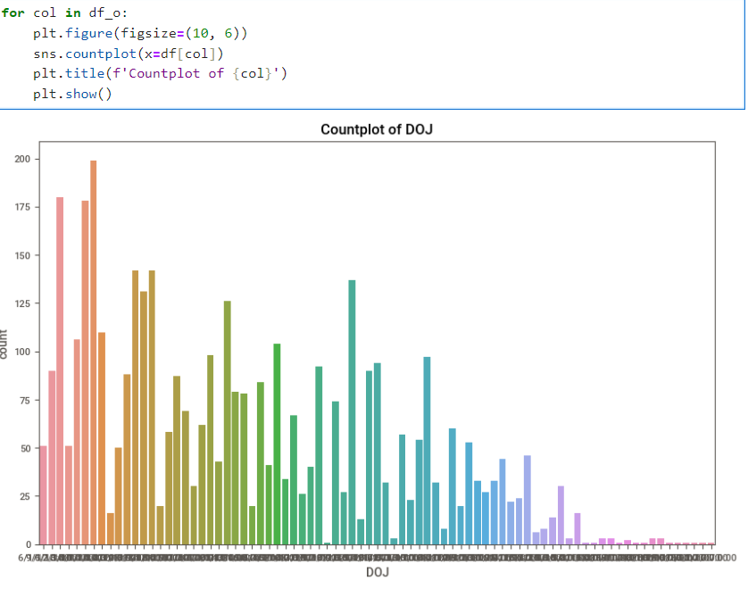
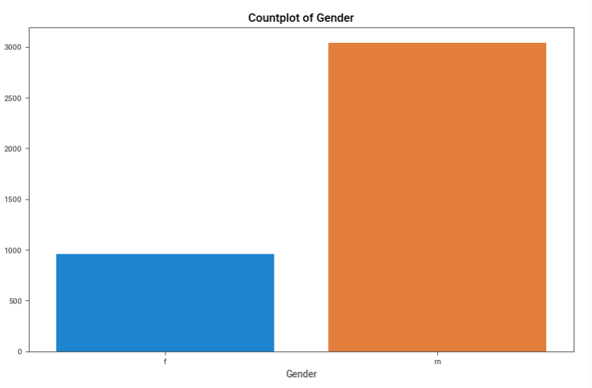
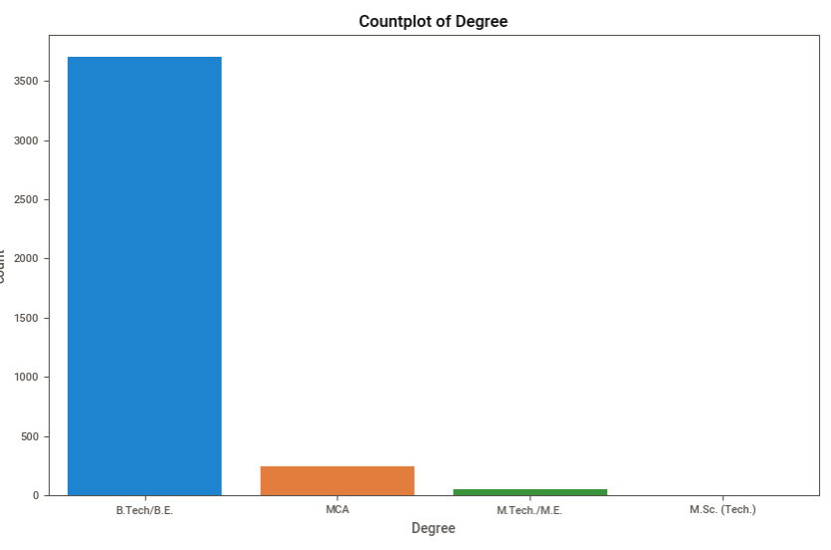
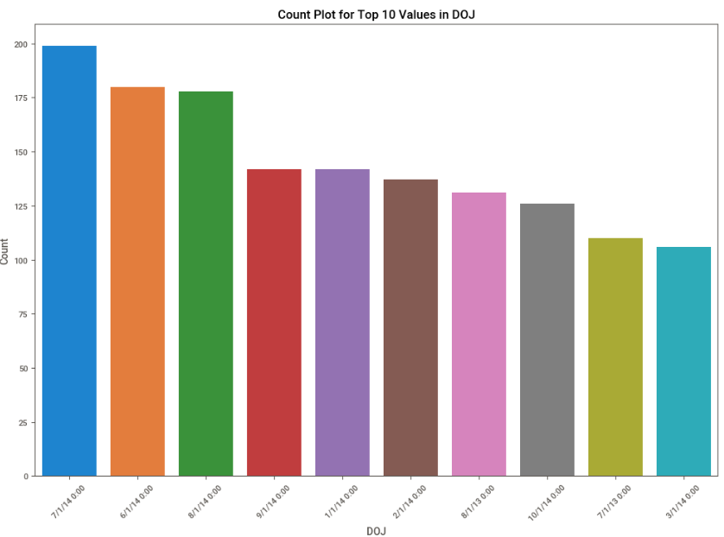
These are the some Count plots on numerical data.

Slide 7
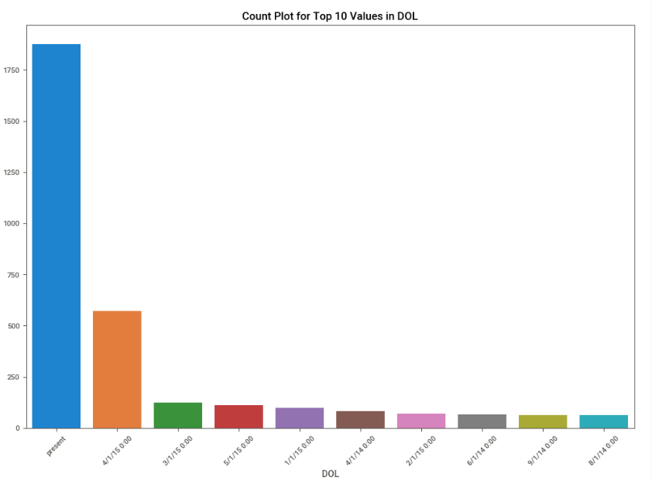
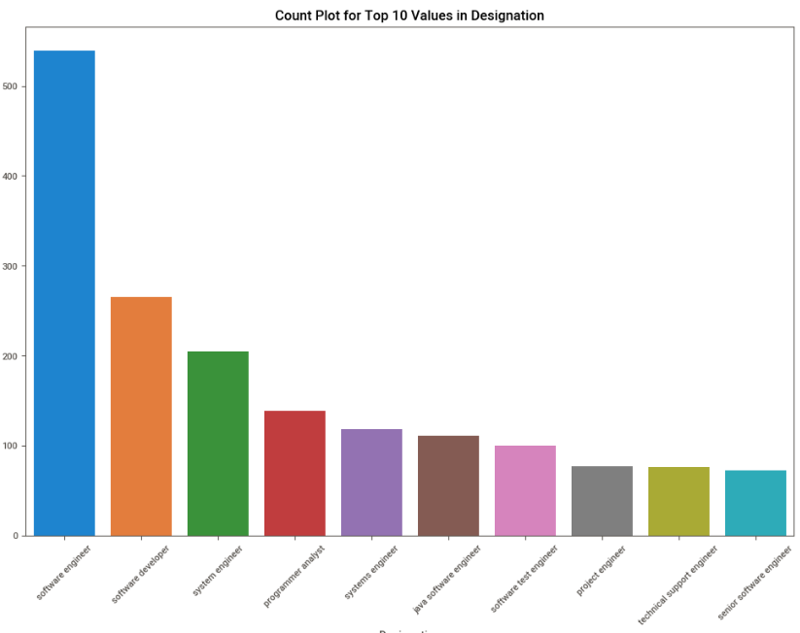

Slide 8
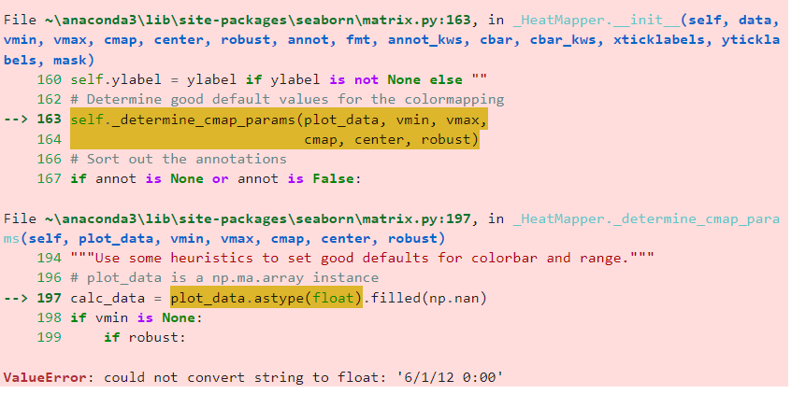
Conclusion
Faced some difficulties while working on this dataset one of the major difficulty was converting date time(string) into float and I came up with some data cleaning techniques and sorted it out.

Slide 9
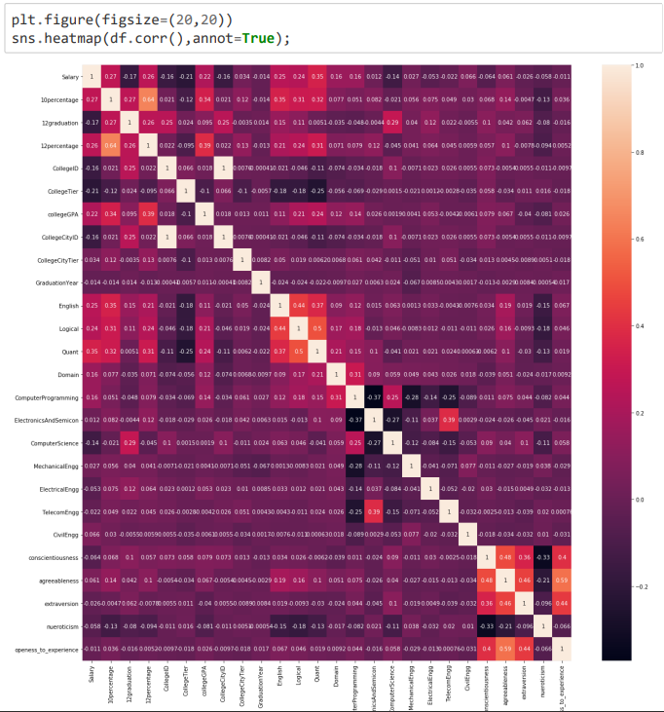
After using some data cleaning techniques finnaly able to sort Bi-variant

Slide 10
From the above test it rejects null hypothesis and hence we can say both are dependent
From the EDA we observe that , the specialization is dependent on the gender
The fresher who has done CSE and have got into analyst,engineer etc position have an maximum salary of 5.6lakh and minimum of 50k
With experience the there is a hike in the salary

