Slide 1

CloudBites: Serverless Food Ordering with AWS Amplify
CloudBites is a modern food ordering web application. It's built on serverless architecture. It leverages AWS Amplify, Cognito, Lambda, API Gateway, DynamoDB, and GitHub. CloudBites is scalable, cost-effective, and easy to maintain.
by K LAHARI
2200031043

Slide 2
AWS Amplify: The Foundation
Frontend Deployment
Framework Support
Amplify handles frontend deployment and hosting. It offers automated CI/CD pipeline with GitHub integration. This simplifies backend resource provisioning.
Amplify supports multiple frameworks: React.The Amplify CLI drastically reduces deployment time for web applications.

Slide 3



Cognito: Secure User Authentication
Secure Sign-in
Enhanced Security
Cognito provides user sign-up, sign-in, and access control. It also integrates seamlessly with Amplify for authentication flows.
Cognito supports multi-factor authentication (MFA) for enhanced security. It stores user credentials and profiles securely.
Cognito manages over 50 million identities globally as of 2023.

Slide 4



IAM: Identity and Access Management
Resource Access
Least Privilege
IAM provides fine-grained control over AWS resource access. This defines permissions for Lambda functions and API Gateway.
The principle of least privilege is key. Only grant necessary permissions. IAM restricts Lambda function access to specific DynamoDB tables.
AWS manages over 722 million IAM roles as of 2024.

Slide 5



Lambda: Serverless Compute
Scalability
1
Auto-scaling
Cost
2
Pay-per-execution
Versatility
3
Multi-language support
Lambda executes backend logic for handling orders and payments. It supports multiple languages: Node.js, Python, Java. Lambda processes trillions of requests per month.

Slide 6
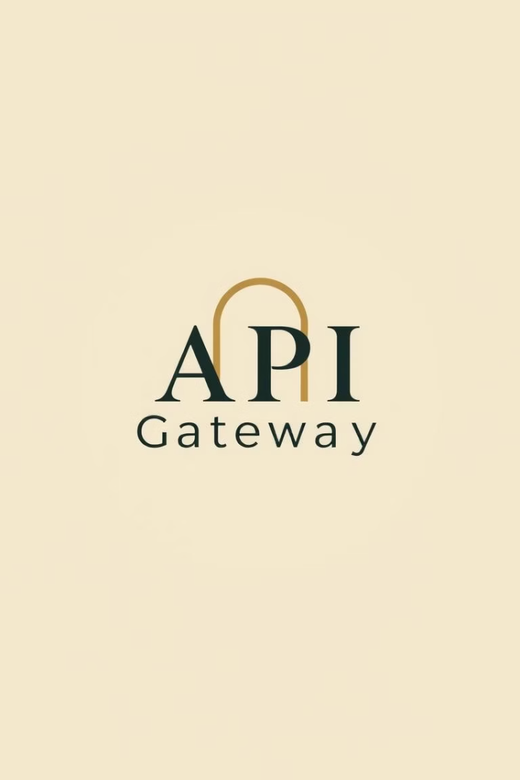
API Gateway: The Front Door
RESTful APIs
Creates APIs for the web application.
Request Routing
Routes requests to Lambda functions.
Management
Manages authentication and authorization.
API Gateway exposes endpoints for placing orders and retrieving menus. It handles billions of API calls daily for AWS customers.

Slide 7



DynamoDB: NoSQL Database
Orders
Menu Items
User Data
2
1
3
DynamoDB stores menu items, orders, and user data. It is highly scalable and performant. This serverless database requires no infrastructure management.

Slide 8






CloudBites Architecture: End-to-End Flow
User Interaction
User interacts with the web app (Amplify).
Authentication
Cognito handles authentication.
Request Routing
API Gateway routes requests to Lambda.
Data Processing
Lambda interacts with DynamoDB.
Security
IAM ensures secure access.
Code Management
GitHub manages code and deployment.

Slide 9


