Slide 1
JOURNAL CLUB
Lakshmi Lahari Kollipara
#700755463
Video link : https://drive.google.com/file/d/1lGdoWi2gAGKyNTn_vDIPcwt0lZPg91_P/view?usp=drive_link

Slide 2
Paper that I referred is:
Convolutional Neural Network Based Image Classification And New Class Detection-IEEE
Paper link: https://ieeexplore.ieee.org/document/9362375
Authors:
Akshaya B : akshayabalaram@gmail.com
Prof. Kala M T : kalakrishnakumar22@gmail.com

Slide 3
Contents
Motivation
Problem statement
Objectives
Contributions
Results
References

Slide 4
Motivation
Image classification is the process of categorizing and labelling groups of pixels or vectors within an image based on specific rules.
Classification problems are primarily concerned with achieving maximum accuracy.
Often, classification models only consider existing instances and misclassify new instances when they arrive.
In this way, the proposed method improves the accuracy of image classification and introduces a new class detection model. Additionally, a new class can be added to the model if needed to classify correctly in the future.
Hence by using the Convolution Neural Network(CNN) algorithm, we can provide better accurate results.
By analyzing the trend of the softmax prediction score of class labels, a new class is detected.
In this work, the model is built for CIFAR10 image dataset.

Slide 5
Problem Statement
In certain situations, based on object’s characteristics, it is necessary to place it into a particular group or class. Most of the problems in today’s world are classification problems.
. Production of numerous images in a single day, resulting in large datasets makes the need for classification of images.
By classifying those images, a proper arrangement of images can be created that facilitates fast and easy access whenever required.
If the image faces problems due to noise and poor quality, in such case identification of the object in that image becomes very hard. Also if the image contains more objects then complexity increases.
Hence researchers are constantly creating new classification models to improve the results. It is crucial to select the appropriate method for a given classification problem.
The main objective in image classification is the identification of accurate features existing in the image. Because of the vast usage of image classification in different applications, there is always a need for finding a better accurate method to provide higher accurate classification results.
A second major problem is that many previous works only consider the existing class images.The arrival of new class images can also occur as time evolves.
To solve all the above mentioned problems, we propose a new approach.

Slide 6
Objectives
A number of methods have been used in the past to categorize images from the CIFAR10 dataset. But most of them doesn’t have a good classification accuracy(below 90%).
The goal here is to create a CNN-based classification model that is approximately 90% accurate for CIFAR10 image classification.
We can detect and update the new classes with the classification models, to correctly classify them in the future.
To create a better accurate classification and new class detection model for CIFAR10 dataset as an example.
When compared with other works that classify CIFAR10 dataset, this model should provide higher accurate results.

Slide 7
Contributions
Downloaded a dataset from an official website, which 60000 images in total, from which 50000 images are used for training and 10000 images are used for testing. The images are divided into 10 classes, with each class containing 6000 images.
The more we understand the dataset, better the results. We have increased the diversity of the training dataset without collecting the new images.
Used a deep CNN with 6 convolutional layers, 3 maxpool layers, 1 flatten layer, and 1 output or fully connected layer.
Each convolutional layer provided with 3 functions here, that are convolution, activation, and batch normalization and used the ELU as activation function.
By using python, tensorflow and keras, we train the CNN model with our training data set and later we perform the data augmentation.
While testing, CNN makes prediction of labels for test images and predict the results.
Now to test the new class images, we pass both the existing and new class images. Based on the softmax prediction, we classify the images.
To classify the new images correctly, we add the new class names into the input label list and new nodes obtained into the output layer.
Hence we can classify the new images and predict the highest accuracy for the model.

Slide 8
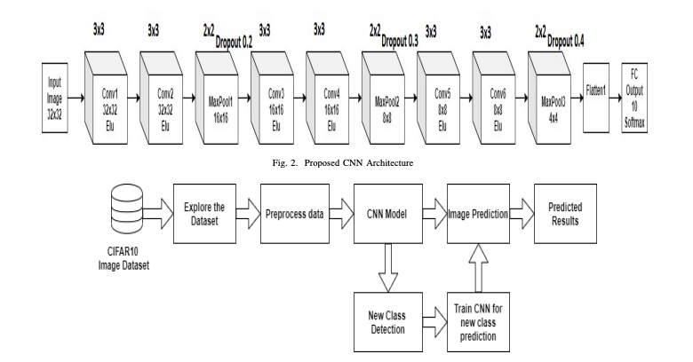
Contributions continued..
Proposed architecture

Slide 9
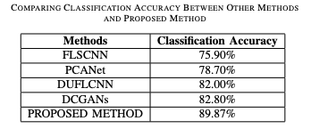
Results
After the CNN is trained for 125 epochs the model reaches a classification accuracy of 89.87%.
In the case of new images, by observing the softmax we predict the new classes and add them to the training dataset.
We continue the same process for the new images and hence keep on training the data.
After successfully training the data, we are able to predict the output images with high accuracy.
Comparison of our work to other referred works:

Slide 10
References
[1] Wang, Zhuoyi, Zelun Kong, Swarup Changra, Hemeng Tao, and Latifur Khan. ”Robust high dimensional stream classification with novel class detection.” In 2019 IEEE 35th International Conference on Data Engineering (ICDE), pp. 1418-1429. IEEE, 2019.
[2] Jmour, Nadia, Sehla Zayen, and Afef Abdelkrim. ”Convolutional neural networks for image classification.” In 2018 International Conference on Advanced Systems and Electric Technologies (ICASET), pp. 397-402. IEEE, 2018.
[3] Islam, Md Tohidul, BM Nafiz Karim Siddique, Sagidur Rahman, and Taskeed Jabid. ”Image recognition with deep learning.” In 2018 International Conference on Intelligent Informatics and Biomedical Sciences (ICIIBMS), vol. 3, pp. 106-110. IEEE, 2018.
[4] McDonnell, Mark D., and Tony Vladusich. ”Enhanced image classification with a fast-learning shallow convolutional neural network.” In 2015 International Joint Conference on Neural Networks (IJCNN), pp. 1-7. IEEE, 2015.
[5] Chan, Tsung-Han, Kui Jia, Shenghua Gao, Jiwen Lu, Zinan Zeng, and Yi Ma. ”PCANet: A simple deep learning baseline for image classification?.” IEEE transactions on image processing 24, no. 12 (2015): 5017-5032.
[6] Dosovitskiy, Alexey, Jost Tobias Springenberg, Martin Riedmiller, and Thomas Brox. ”Discriminative unsupervised feature learning with convolutional neural networks.” In Advances in neural information processing systems, pp. 766-774. 2014.
[7] Radford, Alec, Luke Metz, and Soumith Chintala. ”Unsupervised representation learning with deep convolutional generative adversarial networks.” arXiv preprint arXiv:1511.06434 (2015).
[8] Shorten, Connor, and Taghi M. Khoshgoftaar. ”A survey on image data augmentation for deep learning.” Journal of Big Data 6, no. 1 (2019): 60

Slide 11
Thank You

